Slide 1










TRILHA ARQUITETURA DE DADOS
AZURE SYNAPSE ANALYTICS – v2
(Experiência Unificada)
Introdução ao Azure Synapse Analytics
Sidney Oliveira Cirqueira
/sidneycirqueira
/sidneyoliveiracirqueira/
Microsoft Learn Student Ambassador
Data Analyst - LANLINK
https: github.com/sidneyocirqueira/azure-synapse-analytics

Slide 2
O que é Azure Synapse Analytics?
Synapse Analytics v1 (GA) & v2 (Preview)
Principais features
Demonstração
Referências

Slide 3
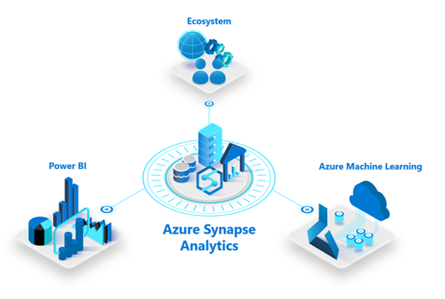
O que é o Azure Synapse Analytics?
SERVIÇO ILIMITADO DE ANALYTICS QUE COLOCA JUNTO DATA WAREWOUSE EMPRESÁRIAL E ANALISE DE BIG DATA COM UMA INTERFACE ÚNICA DE INGESTÃO, PREPARAÇÃO, GERENCIAMENTO E DISPONIBILIZAÇÃO DOS DADOS PARA NECESSIDADES DE BUSINESS INTELLIGENCE E MACHINE LEARNING.

Slide 4
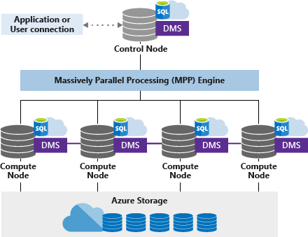
AZURE SYNAPSE ANALYTICS – v1
(Evolução do SQL Data Warehouse)
Arquitetura MPP (Massively Parallel Processing)

Slide 5





ARQUITETURA DE DATA WAREHOUSE MODERNO
Ingest & Prep
Model & Serve
Visualize
Logs (unstructured)
Azure Data Factory
Azure SQL Data Warehouse
Code-free data ingestion from 85+ data integration connectors
Power BI
Media (unstructured)
Up to 14x faster and costs 94% less than other cloud providers
Leader in the Magic Quadrant for Business Intelligence and Analytics Platforms*
Azure Databricks
(Prep-only)
Files (unstructured)
Business/ custom apps (structured)
Store
Azure Data Lake Storage
High performance data lake available in all 54 Azure regions
https://gigaom.com/report/data-warehouse-cloud-benchmark/
Notes:
5

Slide 6

AZURE SYNAPSE ANALYTICS – DATA LAKEHOUSE
Visualize
Logs (unstructured)
Azure
Synapse
Analytics
Power BI
Media (unstructured)
Leader in the Magic Quadrant for Business Intelligence and Analytics Platforms*
Brings together enterprise data warehousing and Big Data analytics
Files (unstructured)
Business/ custom apps (structured)
Store
Azure Data Lake Storage
High performance data lake available in all 54 Azure regions
Notes:
6

Slide 7
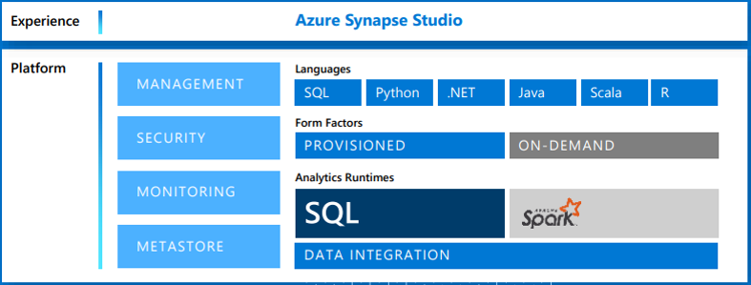

AZURE SYNAPSE ANALYTICS – v2
(Experiência Unificada)
Logs (unstructured)
Azure
Synapse
Analytics
Media (unstructured)
Azure Machine Learning
Brings together enterprise data warehousing and Big Data analytics
Files (unstructured)
Business/ custom apps (structured)
Store
Power BI
Azure Data Lake Storage
High performance data lake available in all 54 Azure regions
Notes:
unified experience to ingest, prepare, manage, and serve data for immediate BI and machine learning needs.
7

Slide 8
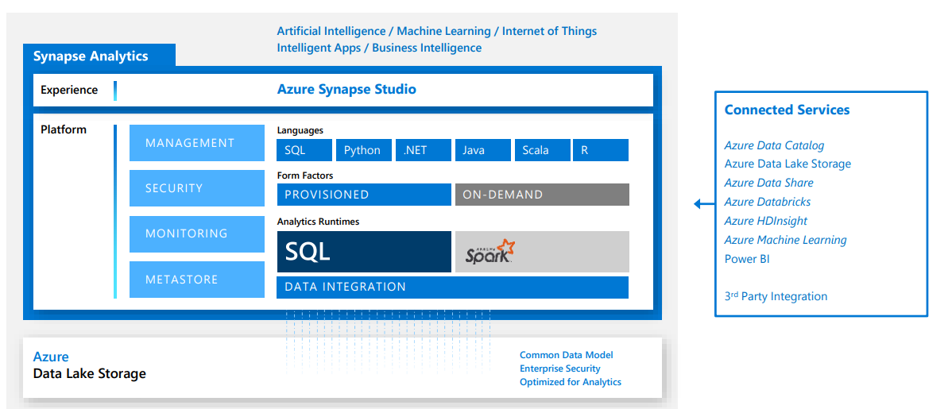
AZURE SYNAPSE ANALYTICS
(Plataforma de dados integrada)
Notes:
8

Slide 9
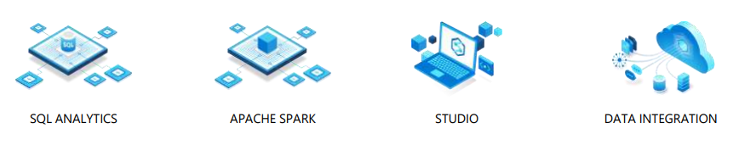
AZURE SYNAPSE ANALYTICS - Features
Limitless Scale
GA
Provisioned Compute
Materialized views
Result-set cache
Workload importance
Workload isolation
Powerful insights
Preview
Power BI integration
Azure Machine Learning integration
Stream analytics (data warehouse)
Apache Spark integration
Instant Clarity
Preview
Azure Synapse Link
Unmatched security
GA
Column and row-level security
Dynamic data masking
Private endpoints
Unified experience
Preview
Hybrid data ingestion
Azure Synapse Studio
Preview
Serverless data lake Exploration
Notes:
9

Slide 10
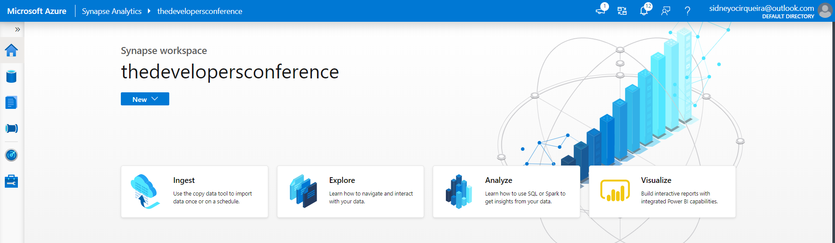
DEMOSTRAÇÃO

Slide 11
REFERÊNCIAS
Synapse Analytics(workspaces): https://docs.microsoft.com/en-us/azure/synapse-analytics/overview-what-is
Synapse Analytics(SQL DW): https://docs.microsoft.com/en-us/azure/synapse-analytics/sql-data-warehouse/
Modern Data Warehouse: https://azure.microsoft.com/en-in/solutions/architecture/modern-data-warehouse/
MPP Architecture: https://docs.microsoft.com/en-us/azure/synapse-analytics/sql-data-warehouse/massively-parallel-processing-mpp-architecture
Product: https://azure.microsoft.com/en-us/services/synapse-analytics/
Synapse Link: https://docs.microsoft.com/en-us/azure/cosmos-db/synapse-link
Benchmark Cloud DW: https://azure.microsoft.com/en-us/services/synapse-analytics/compare/
Synapse Analytics Toolkit: https://azure.microsoft.com/en-us/resources/azure-synapse-analytics-toolkit/
Introdução ao Azure Synapse Analytics: https://www.youtube.com/watch?v=cBsc09a9VNk
https: github.com/sidneyocirqueira/azure-synapse-analytics

