Slide 1
Applied Data Science Capstone by IBM/Coursera
Luciano Pinheiro jun 2021

Slide 2
Business problem
The idea here is to explore the city trying to find the distribution of a particular business over the city, trying to find some gaps, which may help entrepreneurs to find places to start new business.
We will demonstrate the solution with pharmacies. But you may notice that with just small changes, it will work with any sort of business.

Slide 3
Data
Based on definition of our problem, factors that will influence our decision are:
  number of existing pharmacies in the neighborhood
  the size of district/neighborhood
We will get the names of districts on an Wikipedia page. Then, the geolocation will be returned by geocoder python library.
Another source of data is the list of pharmacies from Foursquare API.

Slide 4
Methodology
Having the main data, we can see the distribution, the density and the gaps on the map;
We may now intersect the amount of pharmacies on each district and their population to find the best places where an entrepreneur may use the data.

Slide 5
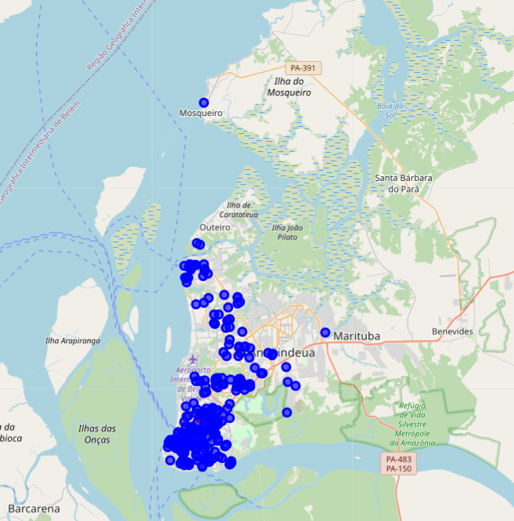
Analysis
Pharmacies in Belém
The city is a peninsula, including the Ilha de Mosqueiro and Ilha de Caratateua

Slide 6
Analysis
Some districts have 0 pharmacies,
Some have high density os pharmacies,
Some of them have high density of people, others have low density
These have the highest pharmacy density
Disctrict | Population | Pharmacies | Pharmacies per 1000
Val-de-Cans | 7032 | 7.0 | 0.995449
Reduto | 6336 | 9.0 | 1.420455
Guanabara | 1919 | 3.0 | 1.563314
Campina | 6156 | 12.0 | 1.949318
Universitário | 2557 | 7.0 | 2.737583

Slide 7
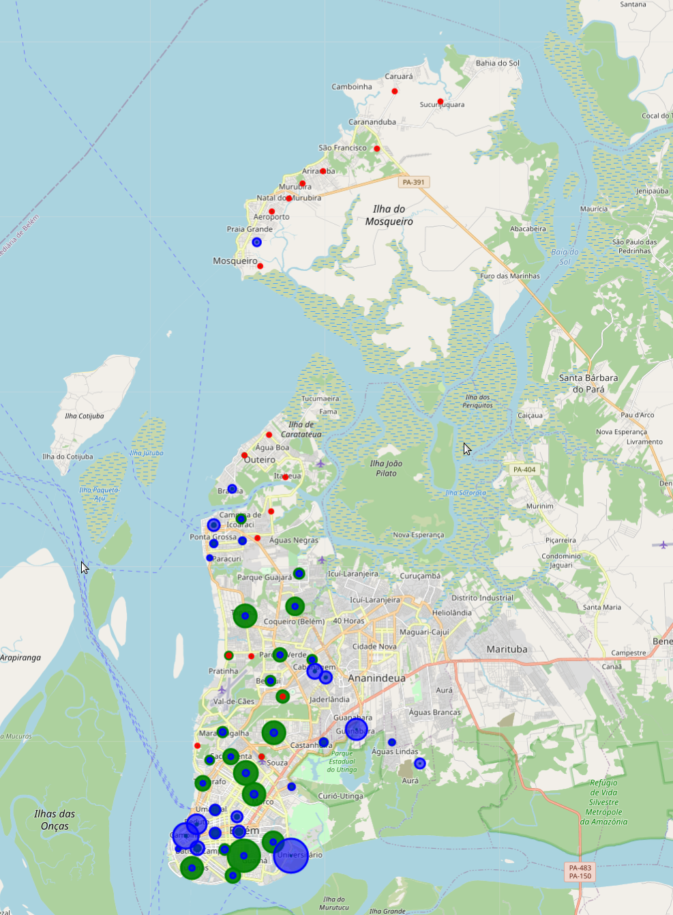
Analysis
On the following map, we combined the size of neighborhood (green) with the number of pharmacies per 1000 inhabitants (blue). The red circles are districts with no pharmacies.

Slide 8
Analysis
district | inhabitants | pharmacies | Pharmacies per 1000 | Opportunity index
Guamá | 94610 | 12.0 | 0.126836 | 19.637808
Pedreira | 69608 | 14.0 | 0.201126 | 12.792990
Tapanã | 66669 | 8.0 | 0.119996 | 12.707284
Jurunas | 64478 | 8.0 | 0.124073 | 12.126913
Marambaia | 66708 | 15.0 | 0.224861 | 11.878115
Montese | 61439 | 7.0 | 0.113934 | 11.448277
Marco | 65844 | 17.0 | 0.258186 | 11.395512
Coqueiro | 51776 | 5.0 | 0.096570 | 9.171441
Sacramenta | 44413 | 3.0 | 0.067548 | 7.562868
Telégrafo | 42953 | 2.0 | 0.046563 | 7.365750
We assume the greener the dot, the better the opportunity;
Numerically, we created the Opportunity index
These are the best disctricts based on opportunity index

Slide 9
Conclusion
The best district to place a new business is Guamá because it has a big population and almost no competitors;
Some places have no pharmacies at all: they should be in mind too:
  the Island of Mosqueiro, the Island of Caratateua, Mangueirão district and around Pratinha neighborhood.
This project analysis only 2 aspects: density of pharmacies and population;
  For real interest, other aspects should be evaluated, as safety;

