Slide 1
Personal Health Analytics Dashboard – Glucose and Lifestyle (2024)
Data-driven insights from one year of personal glucose tracking.
Luciano Martín Vernazza

Slide 2
What Drives Blood Sugar Changes?
I hypothesize that blood glucose levels are significantly affected by four factors:
Exercise
Food Intake
Stressful Events
Insulin Use
The following analysis explores how these variables correlate with daily and monthly glucose patterns.

Slide 3
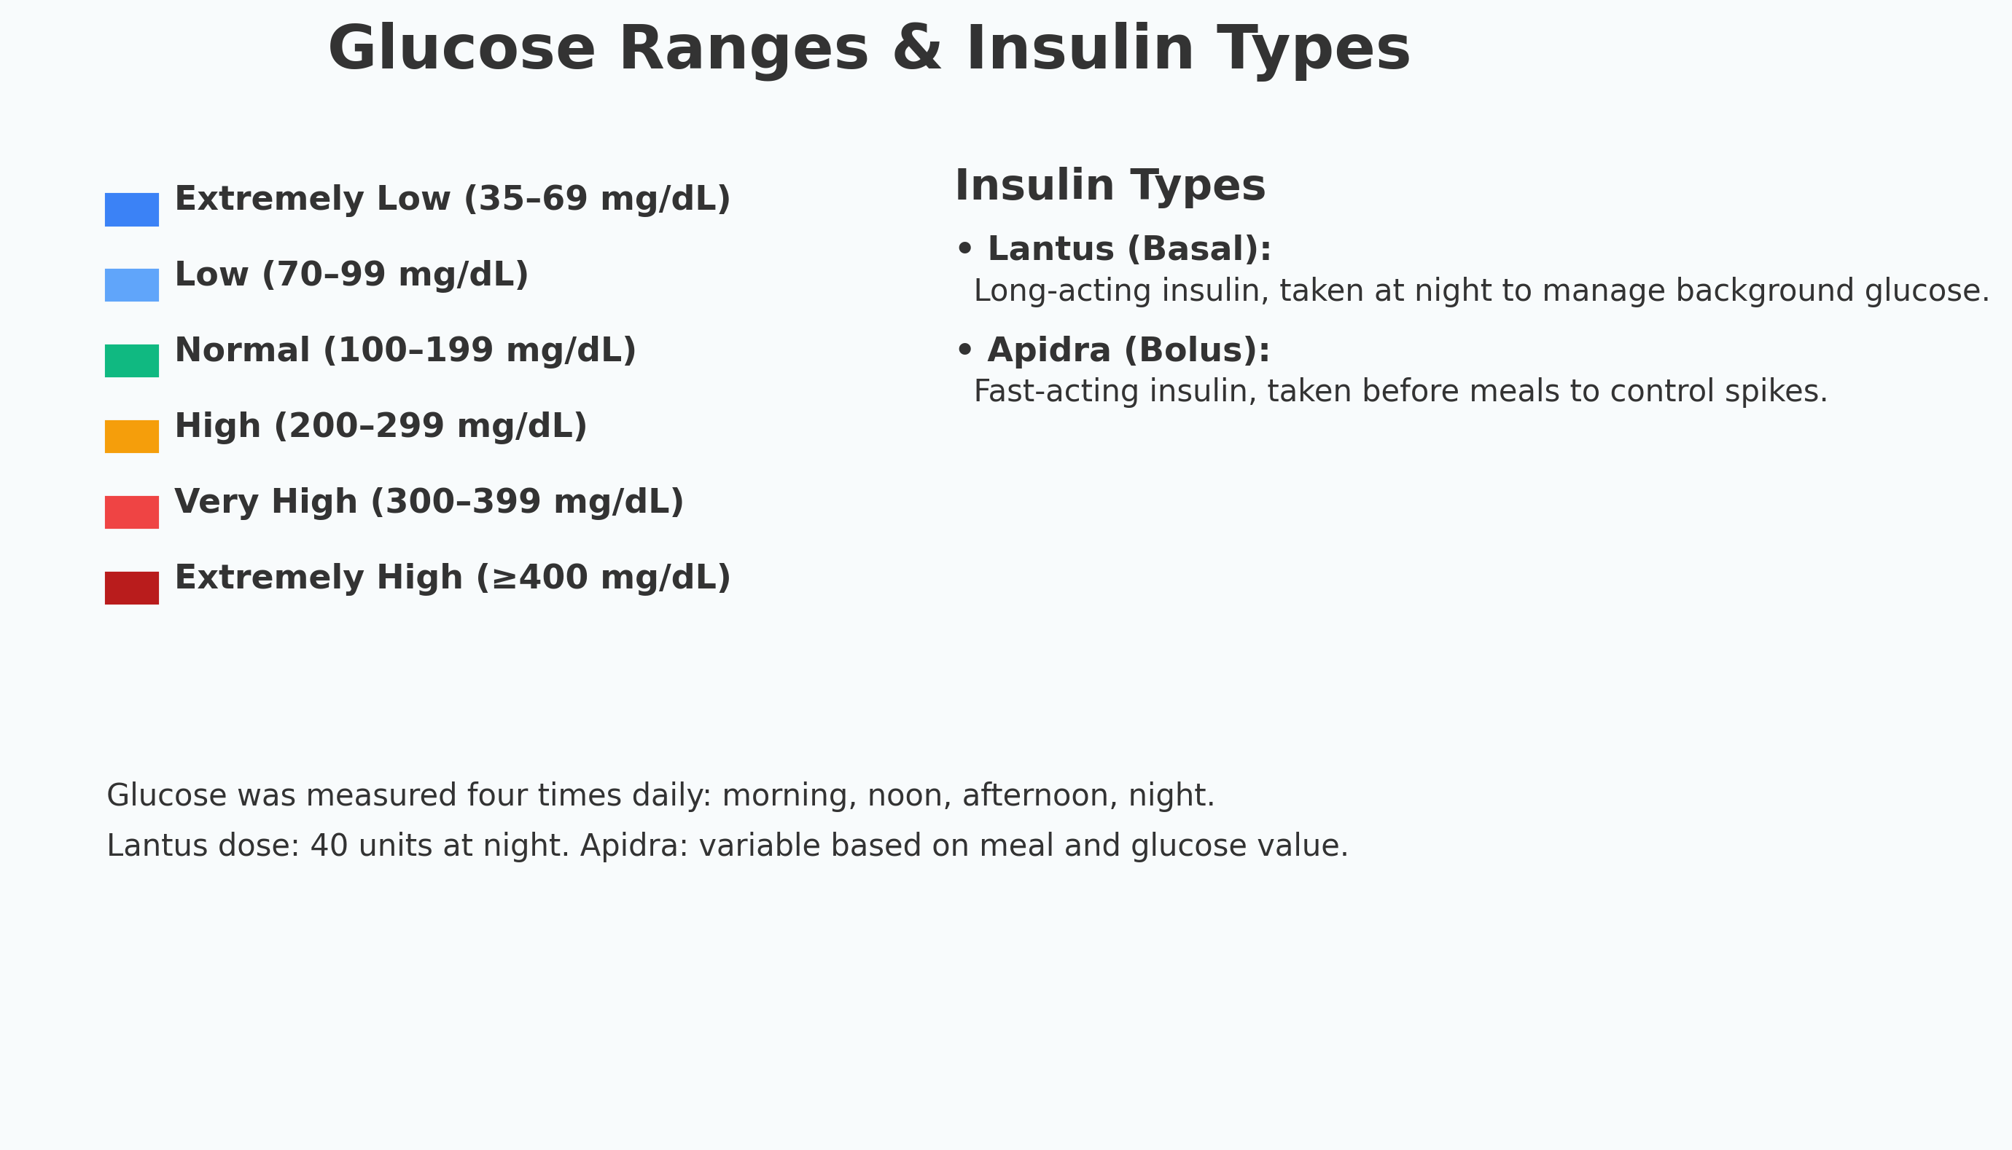
Understanding Glucose Ranges and Insulin

Slide 4
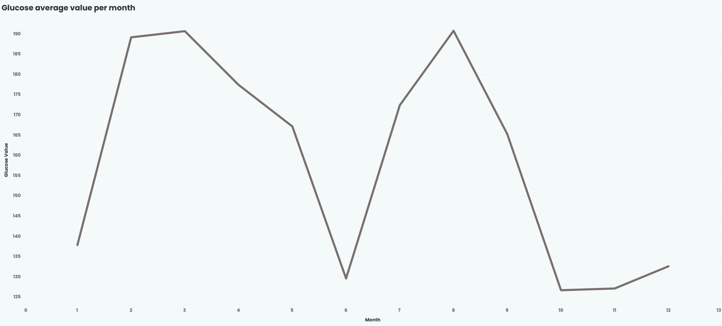
How Did My Glucose Evolve During 2024
The year started with frequent highs and instability. From May onwards, values improved and stabilized, thanks to progressive lifestyle changes.

Slide 5
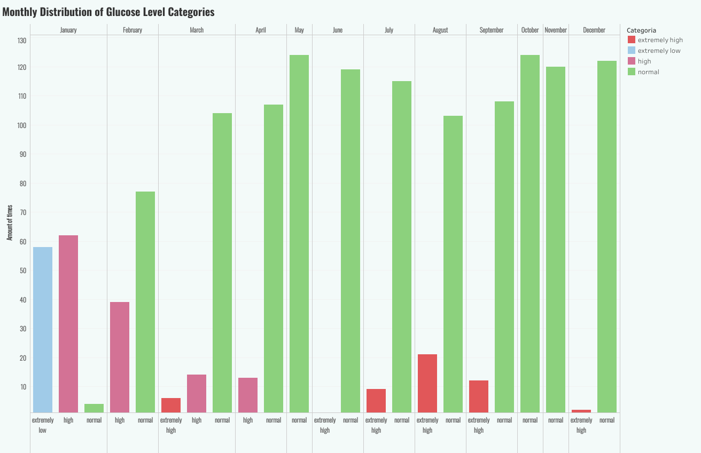
Monthly Distribution of Glucose Categories
January and February were dominated by 'high' and 'extremely high' readings. By mid-year, 'normal' became the dominant category.

Slide 6
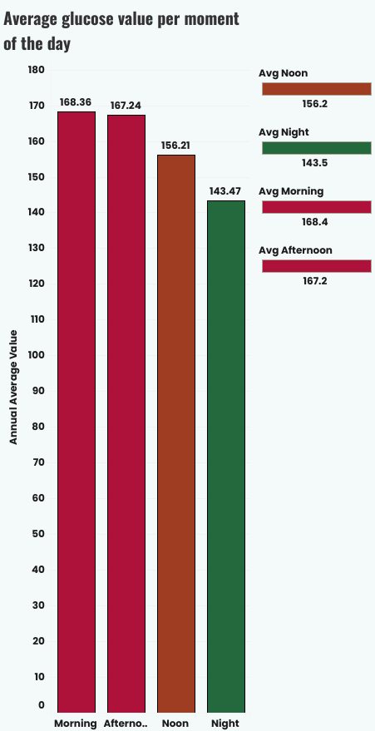
Glucose by Time of Day
Afternoon and morning values were the most volatile. Nighttime levels remained more stable, possibly due to basal insulin and routine.

Slide 7
Glucose Trends – What Have We Seen So Far?
Over the first five slides, we've explored how glucose values evolved independently of external factors. Here's what we've seen:
• Annual Evolution: Glucose levels were unstable and elevated during the first quarter. From May onward, they progressively normalized, suggesting a response to behavioral changes.
• Category Distribution: The prevalence of “high” and “extremely high” values was dominant early in the year, while “normal” readings increased steadily in the second half.
• Daily Rhythm: When broken down by time of day, glucose levels were most volatile in the morning and afternoon, possibly due to post-meal responses or correction errors. Nighttime values were generally more stable.

Slide 8
Glucose Trends – What Have We Seen So Far?
These trends confirm that glucose values are not random: they respond to rhythms and patterns.However, this raises the next question:
What actually caused the improvements or spikes across the year?
To answer that, we now turn to the four lifestyle factors tracked in parallel: exercise, food, stress, and insulin.

Slide 9
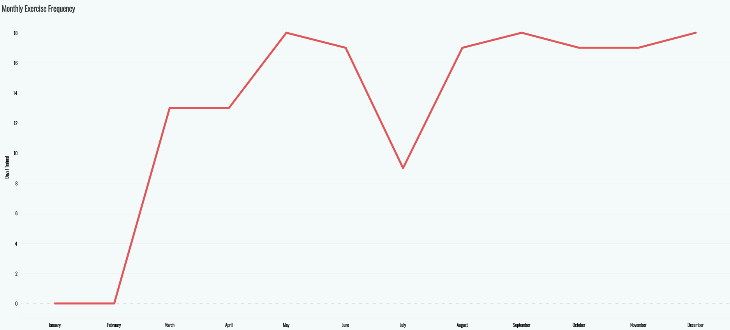
The Impact of Exercise: How Often Did I Exercise?
Exercise became progressively more frequent starting in March, reaching a peak around mid-year.

Slide 10
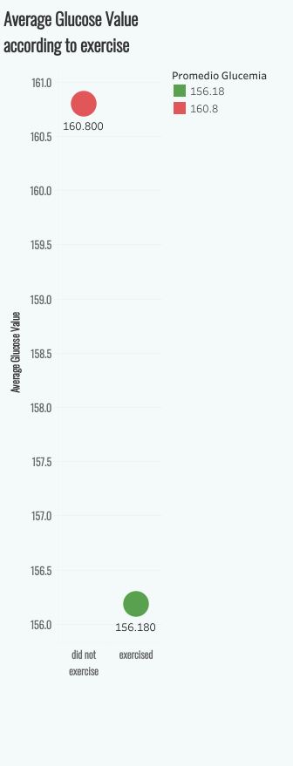
Summary: Exercise and Glucose
A clear inverse correlation between exercise frequency and average glucose levels begins to emerge here.
Average glucose is consistently lower on days with exercise. Even a few sessions per week made a noticeable difference.

Slide 11
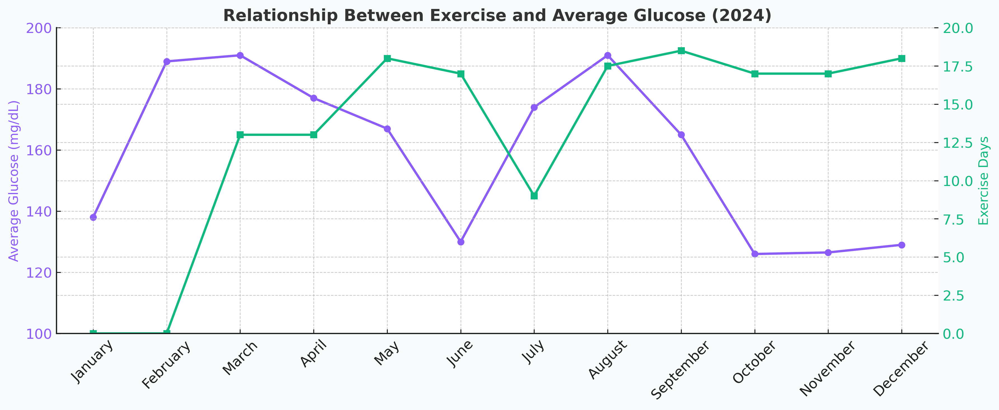
How Did Exercise Frequency Impact My Glucose Levels?
More exercise = lower glucose.
Glucose dropped steadily as physical activity increased — especially from March to June.
In July, reduced exercise led to a spike in glucose.
Regular activity in late 2024 helped maintain better control.

Slide 12
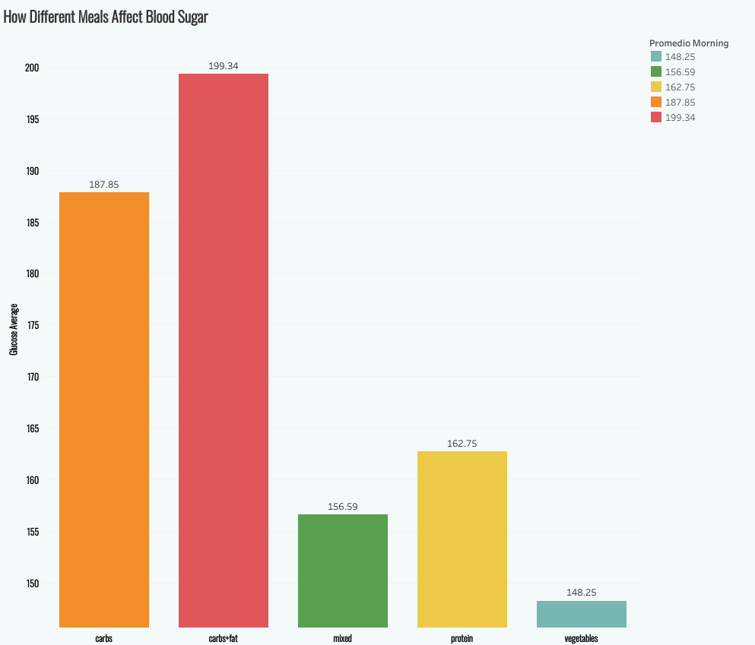
Meal Composition and Glycemic Response: How Meals Affect Glucose
Food quality—particularly the type of macronutrients consumed—was another key factor in glucose control.
Meals rich in carbs and fat were associated with the highest readings. Protein and mixed meals showed lower averages.

Slide 13
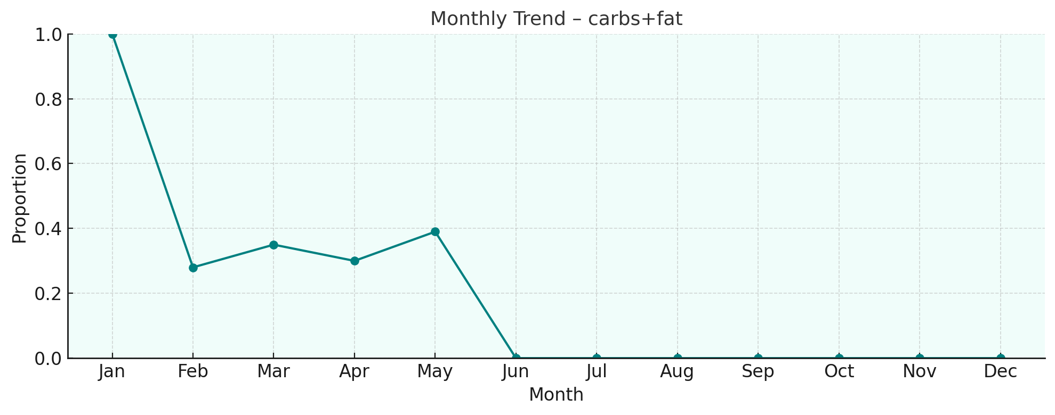
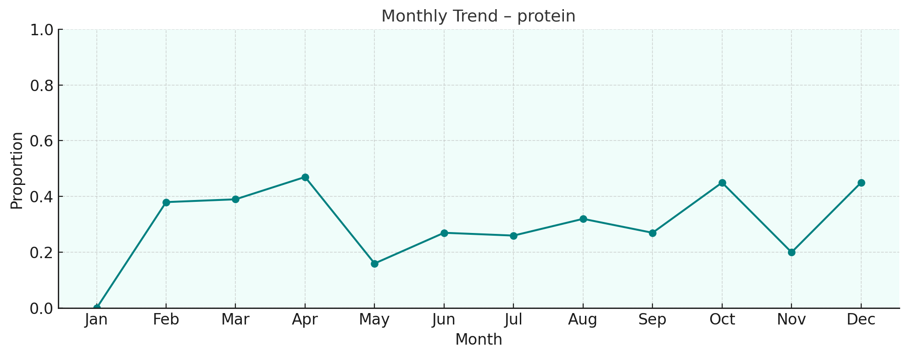
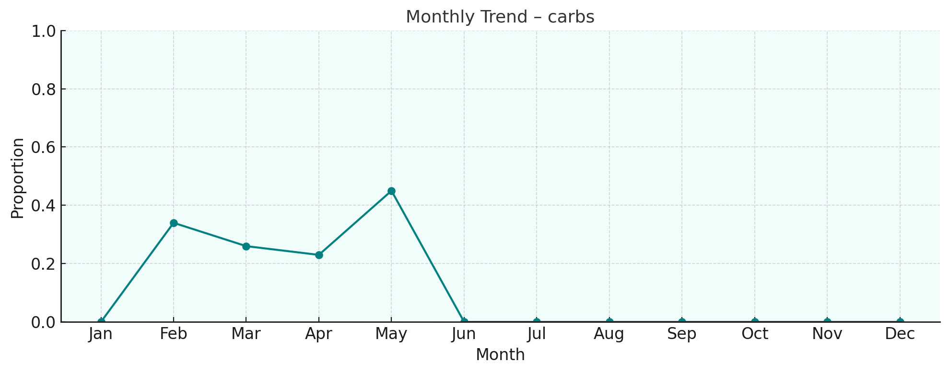
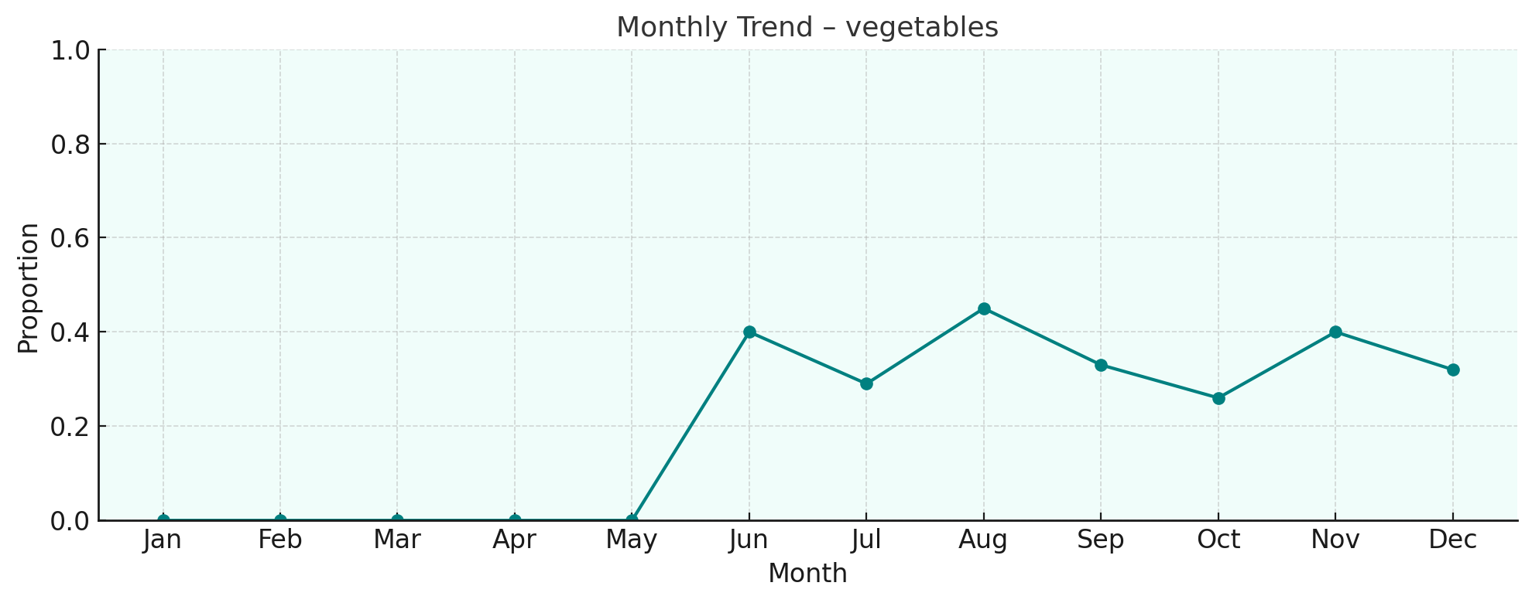
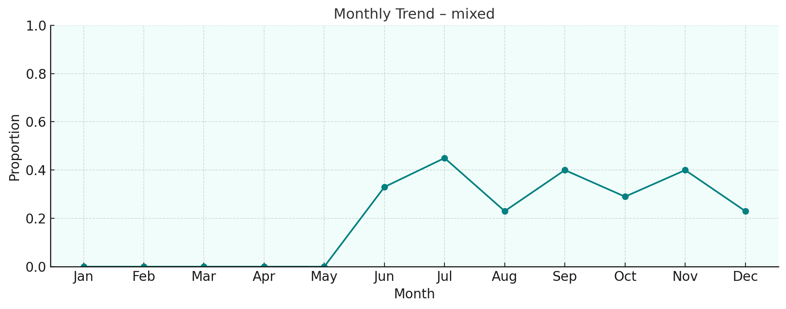
Meals rich in carbs and fat were associated with the highest readings. Protein and mixed meals showed lower averages.
Carb+fat meals declined mid-year, aligning with better glucose outcomes.
Protein-based meals increased gradually, especially in later months.

Slide 14
Stress and Glucose Spikes
Despite good habits, stress and unexpected events caused sharp and dangerous spikes.
Exams and illness were the most common triggers of extreme values, followed by holidays like Christmas and New Year’s.

Slide 15
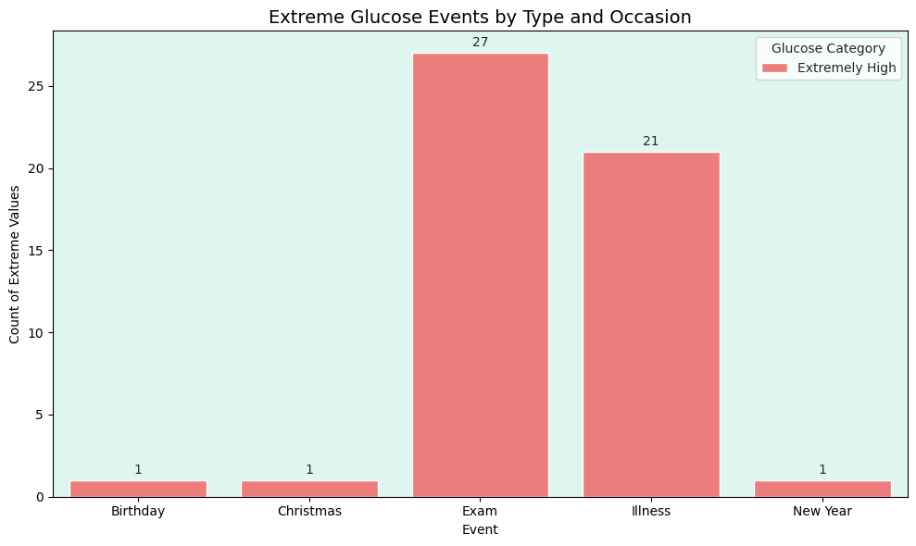
The most frequent spikes occurred during exams and periods of illness, confirming that both mental and physical stress have a strong impact on glycemic stability.
Events like Christmas, New Year, and birthday celebrations also triggered critical glucose levels — especially at night — likely due to large meals, irregular schedules, and insulin miscalculations.
While diet and exercise improved throughout the year, this chart highlights that stressful or disruptive events remained the most unpredictable factor in glucose management.

Slide 16
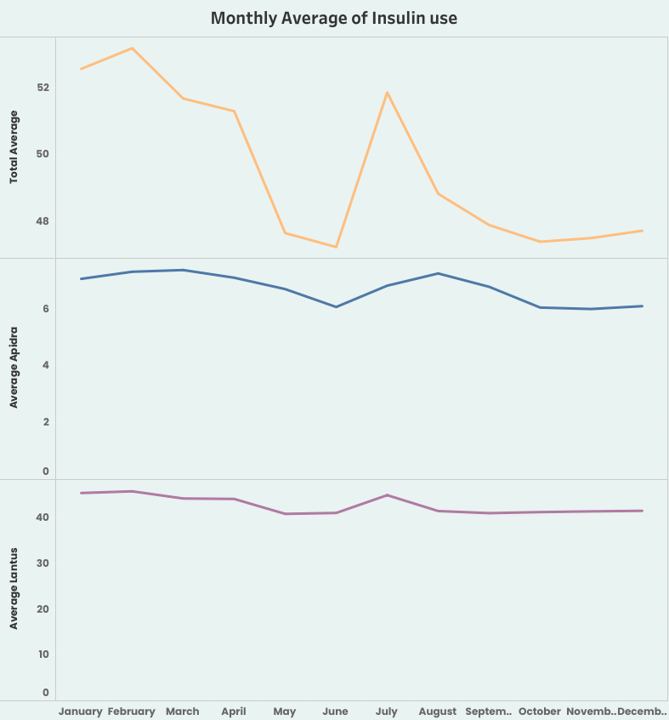
Total Insulin Units Used Over the Year
Insulin use was highest in early months when glucose was more unstable. Usage declined as control improved.
Apidra varied with meal intake, while Lantus remained more stable but slightly declined over time.
Insulin dosage decreased as lifestyle improved. Apidra remained variable, while Lantus stabilized over time.

Slide 17
Conclusions
Exercise showed the strongest correlation with improved glucose control.
Diet composition—especially avoiding carbs+fat—helped stabilize levels.
Stress events disrupted regulation more than expected.
Insulin became more efficient as habits improved.
Data-driven reflection helped initiate real behavioral change.

Slide 18
This project reflects the integration of data skills with real-world impact. It’s both a personal journey and a technical demonstration.

Slide 19
Tools Used & What I Did
Data collected manually daily
Cleaned and reshaped with Python (Pandas)
Queried and aggregated using SQL in BigQuery
Visualized using Tableau & Python (Matplotlib/Seaborn)
Storytelling in PowerPoint

