Slide 1

CONTROLLING LEDS USING AN IR REMOTE AND ARDUINO UNO R3
ANAMARIA CIOCAN
POPESCU LUCIAN
A PRESENTATION FOR
COURSE: ELECTRONIC DEVICES AND ANALOG ELECTRONICS

Slide 2
OBJECTIVES OF THE PROJECT
Main goal
Create a system to control LEDs dynamically using an IR remote
Specific Objectives
Turn individual LEDs on and off;
Activate multiple LEDs simultaneously;
Implement special effects: Blink Mode, Fade Mode, Christmas mode

Slide 3
COMPONENTS OF THE CIRCUIT
ARDUINO UNO R3 – the microcontroller used to control and interact with the components on a breadboad
IR RECEIVER – allows the Arduino to receive signals from the IR remote control
IR REMOTE CONTROL– used to send commands for controlling the LEDs
BREADBOARD – for assembling the circuit
LEDs (Red, White, Green) – used to display different lighting effects
RESISTORS(220Ω) – used to limit the current flow throughout the circuit
JUMPER WIRES – used for connecting the circuit

Slide 4
WIRING CONNECTIONS
LED Wiring
IR Receiver wiring
The Red LED is connected to pin D6 of Arduino through a 220Ω resistor
The White LED is connected to pin D10 of Arduino through a 220Ω resistor
The Green LED is connected to pin D9 of Arduino through a 220Ω resistor
The VCC pin of the IR receiver is connected to Arduino’s 5V source
The Ground pin of the IR receiver is connected to Arduino’s Ground
The Signal pin of the IR receiver is connected to pin D7 of Arduino

Slide 5
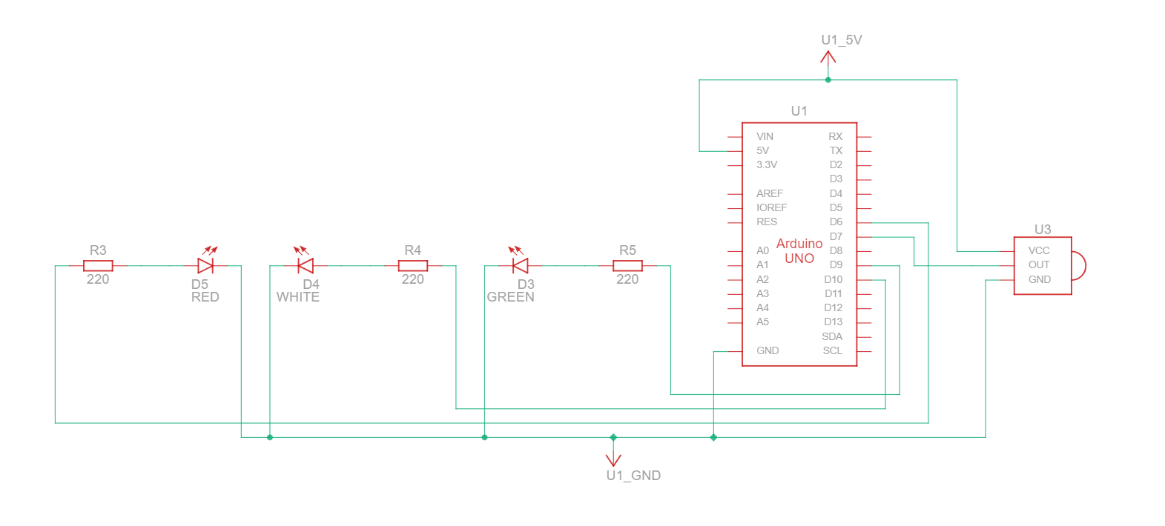
SCHEME OF THE CIRCUIT

Slide 6
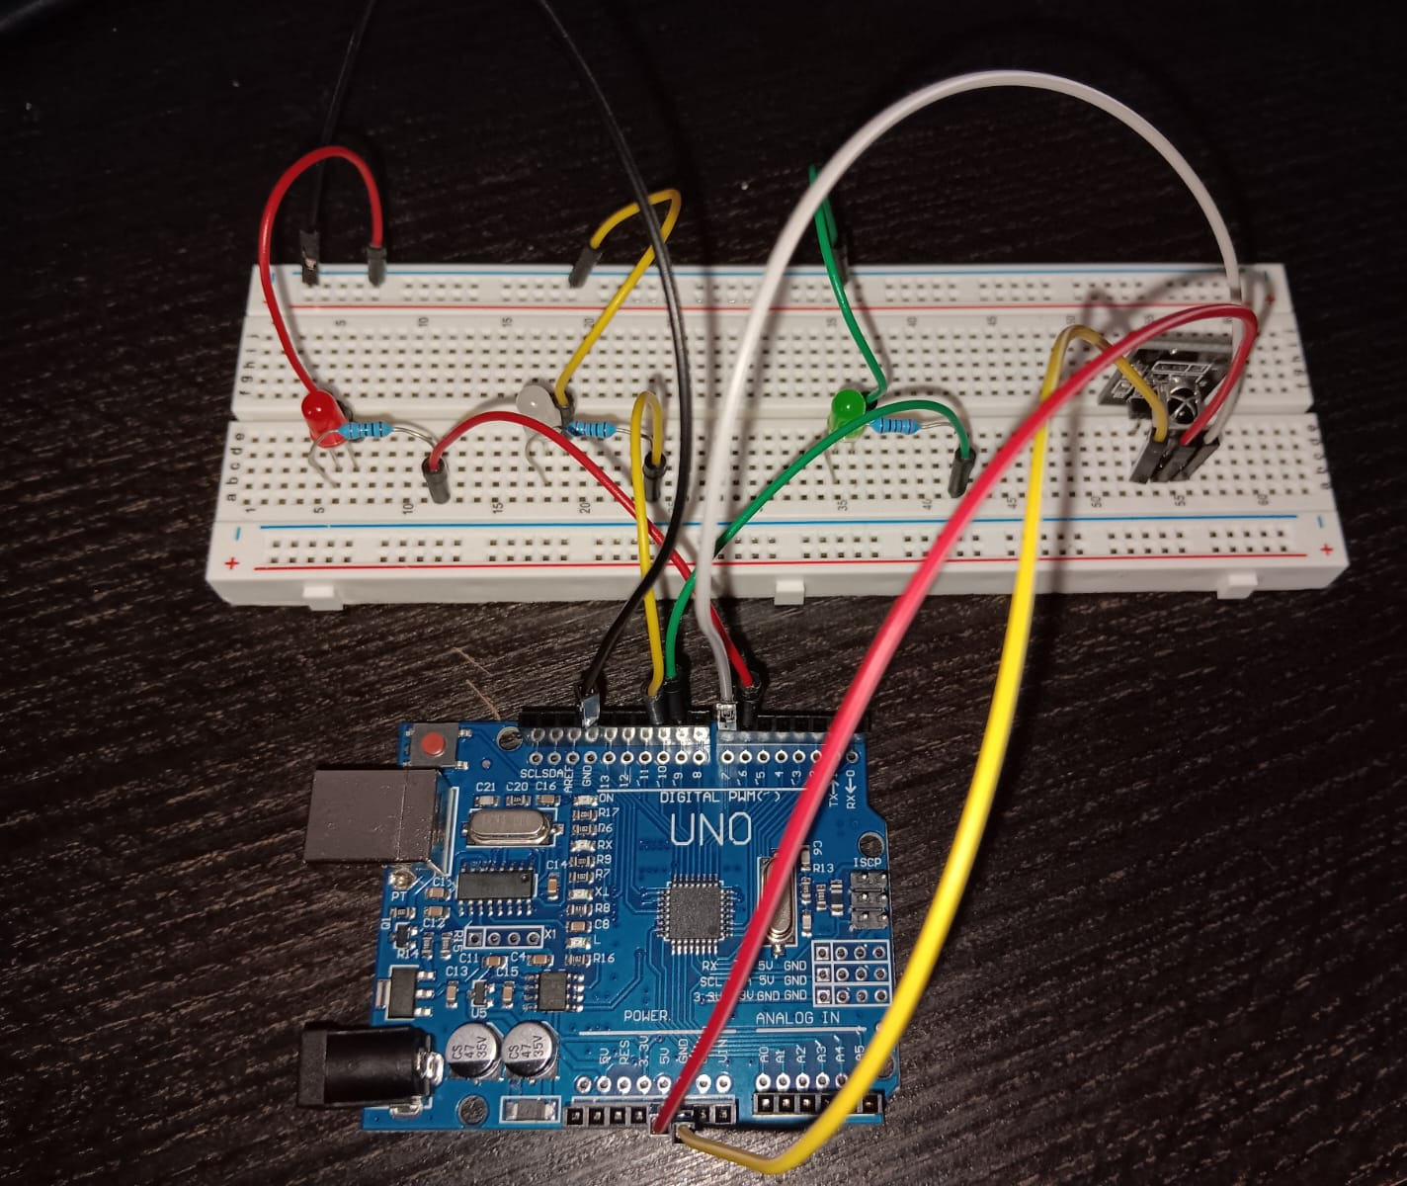
SCHEME OF THE CIRCUIT

Slide 7
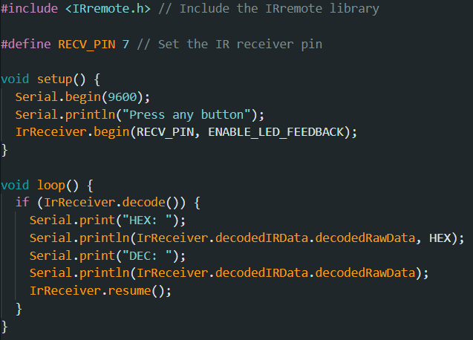
IR Remote Control Decoder Code
This Arduino code uses the IRremote library to receive and decode IR signals.
Pin Setup: The IR receiver is connected to pin 7.
Setup: Initializes serial communication and starts the IR receiver with LED feedback.
Loop: When an IR signal is received, the code decodes and prints the signal in both HEX and DEC formats, then prepares for the next signal.

Slide 8

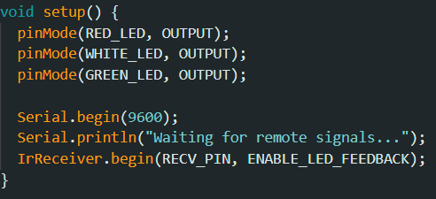
IR Remote Control with LED Modes
PIN Setup
Initialization in Setup
RECV_PIN – defines where the IR receiver is connected
RED/WHITE/GREEN_LED – assign pins for the LEDs, all suporting PWM
Configures the LED pins as outputs
Initializes:
the serial communication to output messages to the Serial Monitor
The IR receiver to listen for signal from remote control

Slide 9
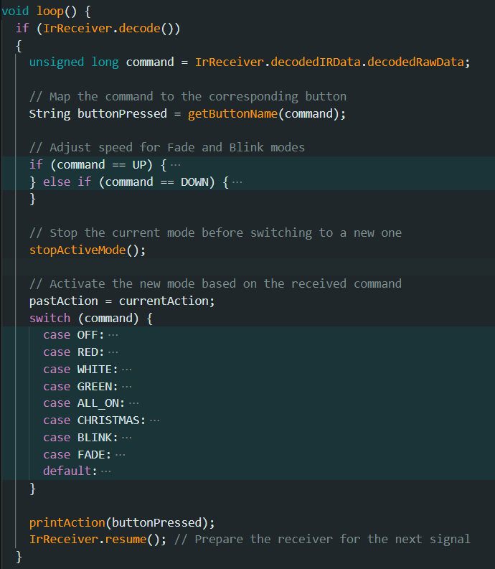
Main Loop - IR Signal Handling
The loop() function continously checks for IR signals
When a signal is received, the command is decoded and mapped to specific actions
The corresponding LED control functions are executed based on the command received from the remote

Slide 10
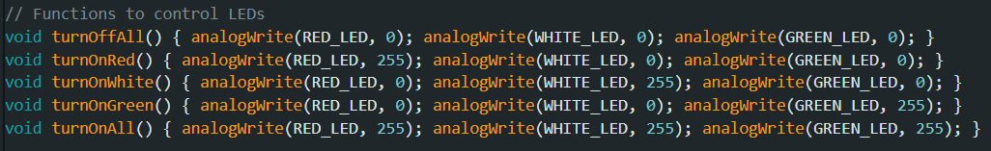
LED Control Functions
The turnOffAll() function turns off all LEDs
The turnOnRed(), turnOnWhite(), turnOnGreen() function turns on the respective LEDs using PWM to control brightness
The turnOnAll() function turns on all LEDs

Slide 11
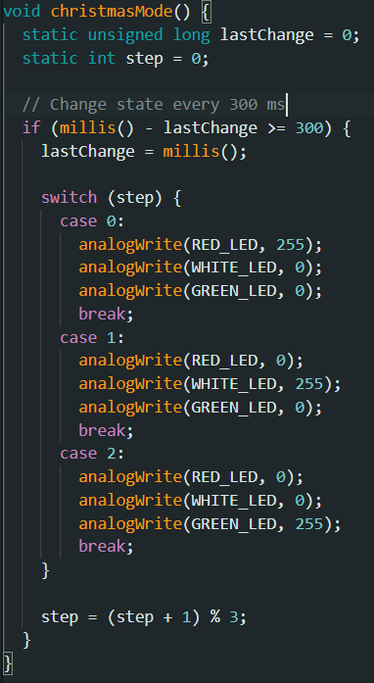
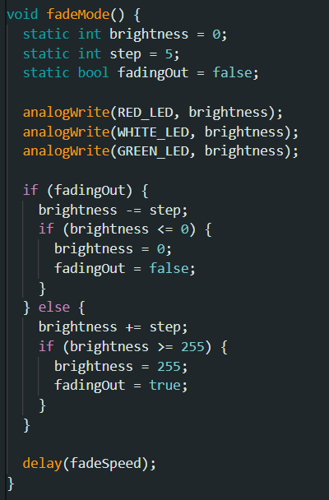

LED Modes
Fade Mode gradually changes the brightness of LEDs by adjusting the PWM value
Christmas Mode cycles through Red, White, and Green LEDs every 300 ms
Blink Mode toggles all LEDs on and off based on the blink speed

Slide 12
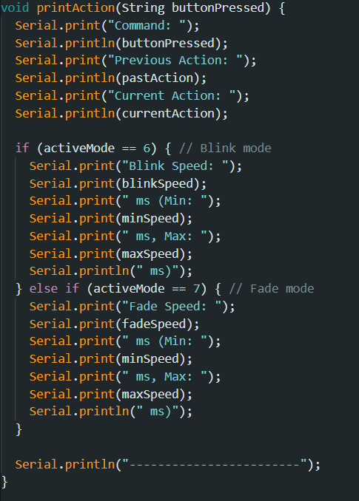
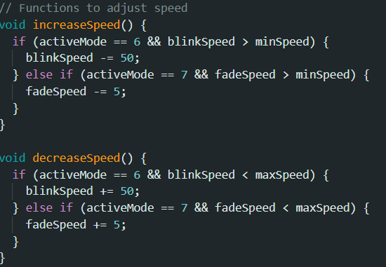
Output to Serial Monitor
Speed Control Functions
The printAction() displays the current command, action, and the speed for Blink or Fade modes on the Serial Monitor
The increaseSpeed() and decreaseSpeed() adjust the speed of Blink and Fade modes by changing the delay times

Slide 13
Thank you for your attention!!!

