Slide 1
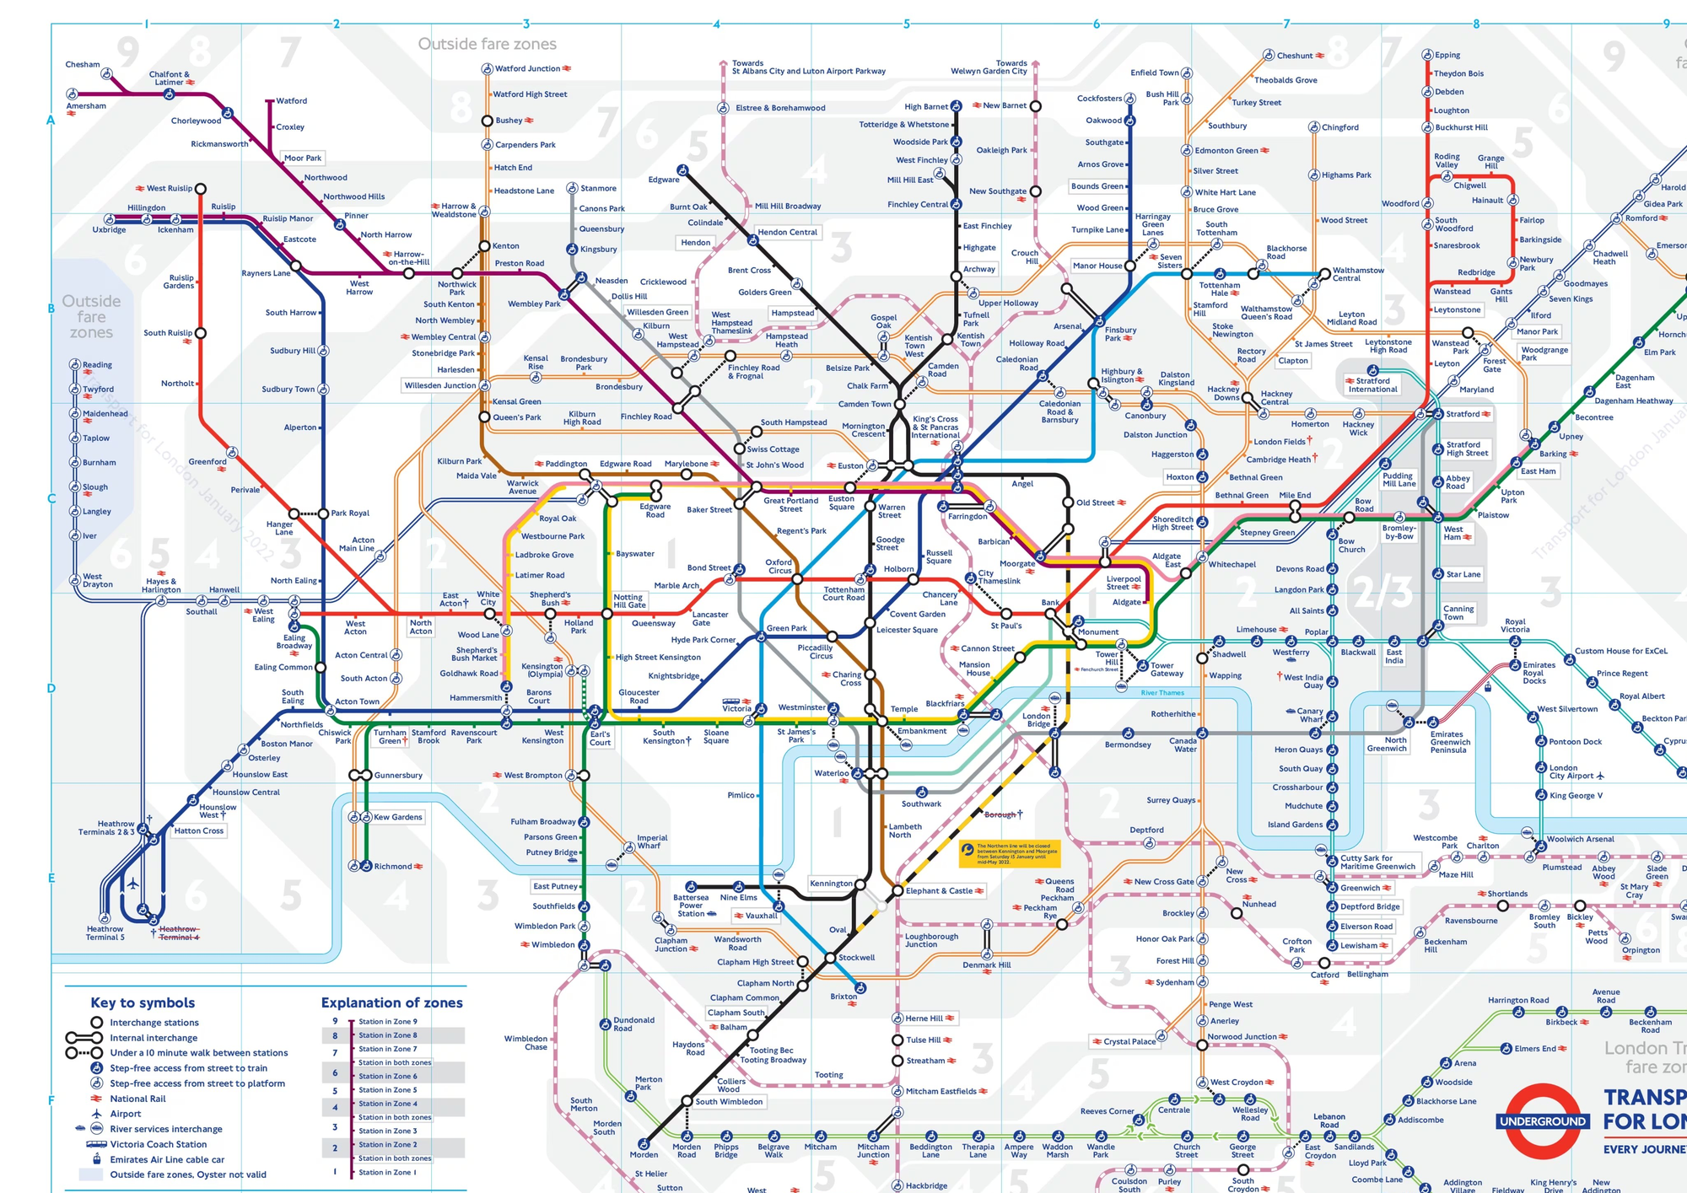
TRANSPORT FOR LONDON · CAPSTONE · 2026
Transit Network
Intelligence
5M
daily passengers
London Underground
Graph-Based Pathfinding, Bottleneck Detection
& Resilience Analysis of the London Underground
80
stations analysed
Graph model
Presented by Alwyn, Lucia and Lance
Neo4j Graph Data Science · 80-Station Nicola Greco Dataset
5
research objectives
covered today
1

Slide 2
OVERVIEW
At a Glance
01
04
Background & Context
Key Findings
The London Underground, global metro comparison, dataset
Pathfinding, bottlenecks, clusters, resilience
02
05
Problem & Objectives
Recommendations
Why conventional tools fall short, 5 research questions
Actionable steps for TfL — by priority
03
06
Methodology
Conclusion & Future Work
How we built the graph model — in plain terms
What we proved, what comes next
2

Slide 3
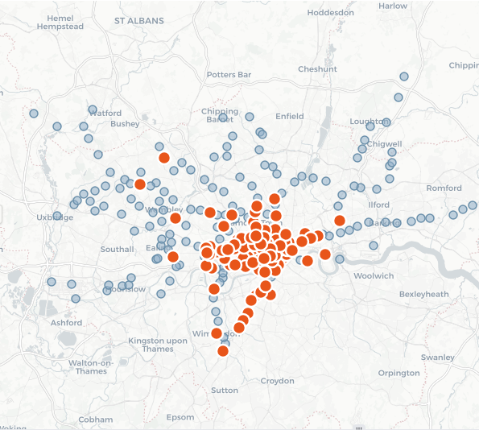
01 / BACKGROUND
The London Underground in Global Context
London Underground
Est. 1863
272 stations · 11 lines
~5M/day
80-station study subset
Full TfL network (192 more)
New York Subway
Est. 1904
472 stations · 36 lines
~3.4M/day
Paris Métro
Est. 1900
302 stations · 16 lines
~4.2M/day
Why the London Underground?
Oldest metro network in the world — 163 years of layered infrastructure Most dense zone 1 interchange in any European capital Ideal complexity for graph analytics stress-testing
3

Slide 4
01 / BACKGROUND
About the Dataset — What It Covers and What It Doesn't
The Dataset
LIMITATIONS & THEIR IMPACT ON RESULTS
Source: Nicola Greco open-source tube dataset
Format: 3 CSV files (stations, connections, lines)
Size: 80 stations · 11 lines · 338 connections
Type: Static snapshot — no real-time data
What's missing | Dataset says | Reality | Effect on findings
Station count | 80 | 272 | Route times distorted — paths route around missing hubs
Victoria & W&C lines | Nodes only | Fully operational | 2 lines invisible to every algorithm
Transfer time | Zero seconds | 2–8 minutes | Journeys appear 5–15 min faster than reality
Outer zones | Z1–4, Z9 only | Z1–9 | Suburban resilience gaps invisible
Wait time | Train always ready | 1–10 min avg | Multi-change routes understated
DATASET COVERS
29% of the full TfL network — Zones 1–4 and Zone 9 only
What this means for today's findings
All patterns and rankings in this study are structurally valid — the relative ordering of bottleneck stations, cluster boundaries, and resilience gaps are real and reproducible. Absolute journey times should not be used for production journey planning without the full 272-station TfL OpenData graph.
4

Slide 5
02 / PROBLEM & SIGNIFICANCE
Why This Matters to Transport for London
Traditional data tools — spreadsheets, SQL databases — can count passengers and record delays. But they cannot answer the questions TfL faces every day:
"Which single station, if closed today, would cause the greatest network disruption?"
"Where do passengers have no alternative route if a line fails?"
"Which communities of stations share the same operational risk?"
1
2
3
4
Operational Safety
Investment Priority
Service Equity
Resilience Planning
Know where disruptions cascade before they happen
Rank stations by true criticality — not intuition
Expose communities with zero route alternatives
Simulate closures and quantify the real cost
5

Slide 6
02 / OBJECTIVES
Five Research Questions, Five Actionable Answers
O1
Build the Graph
→ Results on slides 9–13
Model the Tube as a connected property graph — stations as nodes, travel time as edges
O2
Find Optimal Routes
→ Results on slides 9–13
Compute the fastest route between any two stations accounting for real travel time
O3
Identify Bottlenecks
→ Results on slides 9–13
Rank every station by how critical it is to the flow of the whole network
O4
Discover Natural Clusters
→ Results on slides 9–13
Find which stations naturally group together — without looking at line or zone data
O5
Stress-Test Resilience
→ Results on slides 9–13
Simulate station closures and measure how badly the network is disrupted
6

Slide 7
03 / METHODOLOGY
How We Analysed the Network
Think of the Tube as a road map where every station is a town and every rail connection is a road with a travel time. We loaded this into a graph database — software specifically built to answer questions about connections — then ran four types of analysis.
Step 1
Step 2
Step 3
Step 4
Load the Data
Build the Model
Run the Algorithms
Simulate Disruptions
Three data files — stations, lines, connections — loaded into Neo4j, a specialised connections database. Validation checks confirm 80 stations and 338 route segments are correctly linked.
Every station becomes a point on a graph. Every rail connection becomes a link labelled with its travel time in minutes. The result: a digital twin of the Tube network.
Four algorithms are applied — shortest path (GPS-style routing), betweenness (who is the busiest junction?), PageRank (which stations are connected to the most important other stations?), and community detection (which stations form natural operational clusters?).
We virtually close the top-5 most critical stations one at a time and measure how much the network degrades — how many stations become unreachable, how much longer journeys become.
7

Slide 8
04 / FINDINGS
What the Data Revealed — Five Headline Findings
Before we walk through each result, here are the five things you should take away from this study:
F1
Green Park is the network's single most critical station — by a wide margin
F2
Zone 1 houses all top-5 bottlenecks — outer-zone passengers have no fallback routes
F3
Central London has hidden resilience built in — 32 routes with 4+ line alternatives
F4
Network clusters match real TfL corridors — the data found them with zero prior knowledge
F5
Closing Kings Cross disrupts 100,000+ daily journeys with no single bus bridge solution
8

Slide 9
04 / FINDINGS — O1 & O2
Building the Model + Finding Optimal Routes
O1 — What the graph looks like
O2 — Fastest route between stations
80
338
25
10
Euston → Hammersmith
Stations
(nodes)
Connections
(edges)
Multi-line
hubs
Isolated
nodes
Algorithm: 17 min · Real world: ~9 min
Why the gap? Missing western stations force the algorithm north via Kings Cross — it takes the only mathematical path available in the data.
Key structural facts
Canary Wharf → Paddington
Kings Cross St. Pancras connects to 8 different lines — more than any other station
Algorithm: 16 min · Real world: ~18 min
Green Park connects to 13 neighbouring stations — highest local connectivity
Putney Bridge → Finsbury Pk
Algorithm: 20 min · Real world: ~22 min
62% of all stations are in Zone 1 — meaning most journeys must pass through the centre
Bottom line
10 stations have no connections at all in this dataset — they are invisible to every algorithm
These routes are valid for comparing options within the dataset. For production journey planning, the full network with real interchange times is essential.
9

Slide 10
04 / FINDINGS — O3
Which Stations Are the Real Bottlenecks?
We measured two things: how many shortest paths pass through each station (Betweenness), and how well-connected each station's neighbours are (PageRank). Stations ranking high on both are the true irreplaceable nodes.
TOP 5 MOST CRITICAL STATIONS
Green Park
# | Station | Betweeness Centrality | Page Rank | Composite criticality
1 | Green Park | 1.000 | 1.000 | 1.000 ★
2 | Waterloo | 0.591 | 0.863 | 0.510
3 | Kings Cross | 0.480 | 0.903 | 0.433
4 | Embankment | 0.464 | 0.799 | 0.371
5 | High St Ken. | 0.498 | 0.605 | 0.302
BC Score: 763.5
That is 8 times higher than the network average of 90.5.
Jubilee, Victoria & Piccadilly lines converge here. Close Green Park and three major corridors fracture simultaneously — there is no single alternative interchange that absorbs all three.
What does a Centrality Coefficient of 1.0 mean
Imagine a station where all of its neighbours also connect directly to each other. If you removed that station, every neighbour could still reach every other neighbour without it. A score of 1.0 means the station is surrounded by a tight local network — it seems safe to close. Counterintuitively, the most critical stations score LOW here, because their neighbours belong to completely different corridors and cannot reach each other without passing through the hub.
10

Slide 11
04 / FINDINGS — O4
Natural Network Clusters — Found Without Prior Knowledge
We ran Louvain, an algorithm that grouped stations purely based on travel-time connections — with no knowledge of which line or zone each station belongs to. The result: 16 natural clusters that map almost perfectly to TfL's own operational corridors.
16
0.57
5/6
Natural
clusters
Modularity
(strong structure)
Clusters span
multiple zones
THE 4 MAJOR CLUSTERS — EACH MAPS TO A REAL TfL CORRIDOR
East London / Circle Corridor
SE Jubilee + Northern
16 stations · Zones 1–2 · Matches District/Circle/H&C lines
13 stations · Zones 1–2 · Southbank & Canada Water corridor
West London / District + Piccadilly
North-Central / Bakerloo + Victoria
11 stations · Zones 1–3 · Hammersmith to Earls Court
11 stations · Zones 1–4 · Paddington to Stonebridge Pk
Why this matters: TfL can restructure incident response teams to match these data-derived boundaries. Alerts become corridor-specific rather than network-wide.
11

Slide 12
04 / FINDINGS — O5
What Happens When We Close the Most Critical Stations?
We simulated closing the top-5 most critical stations one at a time. Here is what the data shows:
Green Park — Maximum Disruption
Kings Cross — High Volume Disruption
Jubilee, Victoria & Piccadilly lines fracture simultaneously No single adjacent station absorbs all three corridors Detour time: +4 to 15 minutes per affected journey Every passenger on any of those 3 lines is affected
100,000+ passenger journeys per day affected Northern & Piccadilly corridor breaks apart Bus bridge cannot handle peak demand at this scale Network degrades significantly but no station is permanently cut off
The good news — Hidden resilience in the centre
32 route segments have 4 or more lines running in parallel — meaning a single line failure causes zero network disruption in those sections. This is built-in resilience from decades of layered infrastructure. The Farringdon–Moorgate segment has 4 parallel lines: District, Circle, Metropolitan and Hammersmith & City.
Critical gap: All 32 redundant routes are in Zones 1–2 only. Outer-zone passengers have zero fallback if a line fails.
12

Slide 13
05 / RECOMMENDATIONS
What TfL Should Do Based on Study Findings
O1 & O2 — Expand the data foundation
Phase 2
Migrate to the full 272-station TfL OpenData graph. Restore Victoria and Waterloo & City lines. Add 2–8 min interchange penalties and real service headways. Without this, journey time outputs are indicative only.
O3 — Designate Green Park as Tier 1 Critical Asset
Immediate
Enforce highest inspection frequency. Require mandatory impact assessment before any planned closure. Pre-agree a coordinated bus bridge covering Jubilee, Victoria and Piccadilly corridors simultaneously.
O3 — Create a data-driven maintenance priority list
Immediate
Use composite criticality scores (Betweenness × PageRank) to rank all stations. Green Park, Waterloo, Kings Cross, Embankment and High Street Kensington are the top five — maintenance investment should reflect this.
O4 — Restructure incident response by graph cluster
Short-term
The 4 major clusters map directly to operational corridors. Align incident response teams with these boundaries. Send corridor-specific disruption alerts — not network-wide broadcasts.
O5 — Commission an Outer Zone Resilience Review
Short-term
All 32 redundant route segments sit in Zones 1–2. Outer-zone passengers have no alternative if a line fails. Use the Elizabeth Line as a benchmark for what orbital investment achieves.
13

Slide 14
05 / RECOMMENDATIONS — EXTENDED
Questions for Future Research & How to Extend This Work
Five enhancements would transform this academic model into a live TfL operational tool.
1 Full 272-Station Graph
2 Live Timetable Integration
Replace the 80-station subset with the complete TfL OpenData network. Green Park's dominance may shift as Baker Street and other hidden hubs appear.
Add real service headways from the TfL GTFS feed. Journey time outputs become accurate enough for passenger-facing journey planning tools.
Research Q: How does the criticality ranking change when the full network is visible?
Research Q: At which times of day do the top-5 bottlenecks shift?
3 Interchange Walking Penalty
4 Live Criticality Dashboard
Add a 2–8 min transfer cost where passengers must walk between lines. Eliminates the biggest source of systematic route underestimation.
Surface betweenness and composite scores in a real-time dashboard fed by TfL's disruption API. Incident response teams gain a live risk view.
Research Q: Does adding interchange cost change which routes the algorithm recommends?
Research Q: Does a station's criticality score change materially during nearby engineering works?
5 Orbital Resilience Modelling
Model hypothetical new cross-links. Measure how much Green Park's score drops if a new parallel route is added — a quantitative investment case.
Research question: How much orbital capacity is needed to reduce Green Park's score below 500?
14

Slide 15
06 / CONCLUSION
Three Things Every TfL Decision-Maker Should Remember
01
Green Park is your most fragile asset
With a criticality score 8 times higher than average, closing Green Park fractures three major corridors simultaneously. No adjacent station can absorb all three. This requires a dedicated emergency protocol — not a standard closure plan.
Action: Tier 1 Critical Asset designation. Today.
02
The network's strength and weakness are in the same place
Zone 1 holds your deepest resilience — 32 routes with multiple parallel lines, built over 160 years. It also holds 100% of your top-5 most critical single points of failure. Outer-zone passengers have zero alternatives when a line fails.
Action: Commission an Outer Zone Resilience Review before the next orbital investment decision.
03
Graph analytics changes what questions you can ask
SQL can count passengers. Graph analytics can tell you which station's closure would cause the most network-wide disruption — and by exactly how much. This study proves the method works. The full 272-station model is the logical next step.
Action: Approve Phase 2 — full TfL OpenData graph + live criticality dashboard.
Transit Network Intelligence · Alwyn Shumba · Capstone 2026 · Neo4j Graph Data Science
15

