Slide 1
Reactive Programming

Slide 2
WHAT IS REACTIVE PROGRAMMING?

Slide 3
We have a problem to solve!
Capture double clicks -> do something

Slide 4
We have a problem to solve!
Capture double clicks -> do something
Multiple clicks == Double clicks

Slide 5
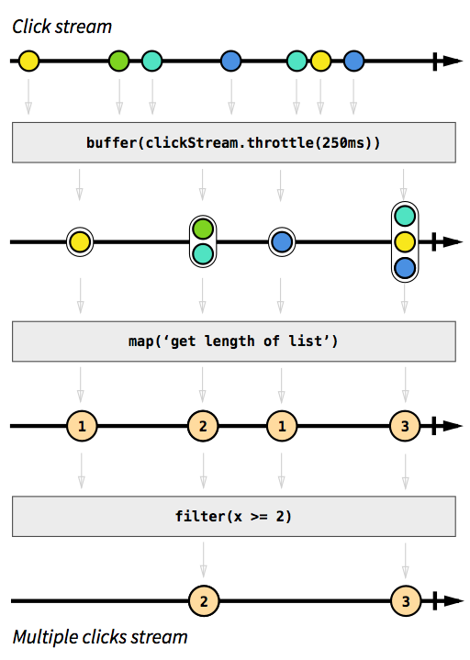

Slide 9
Reactive programming is programming with asynchronous data streams

Slide 10

The introduction to reactive programming you’ve been missing
Want to read more?
https://gist.github.com/staltz/868e7e9bc2a7b8c1f754
André Medeiros

Slide 11
CONCEPTS

Slide 12
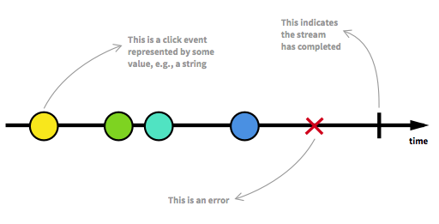
The Observable

Slide 13
OBSERVABLE

Slide 14

OBSERVABLE
onComplete()
onError()
onNext()
OBSERVER

Slide 15
OBSERVABLE
onComplete()
onError()
onNext()
OBSERVER

Slide 16

OBSERVABLE
SUBSCRIPTION
onComplete()
onError()
onNext()
OBSERVER

Slide 17
OBSERVABLE
SUBSCRIPTION_1
SUBSCRIPTION_3
SUBSCRIPTION_2
onComplete()
onError()
onNext()
onComplete()
onError()
onNext()
onComplete()
onError()
onNext()
OBSERVER_1
OBSERVER_3
OBSERVER_2

Slide 18
Observable = Stream, Producer
Observer = Consumer
Subscription = Contract

Slide 19
LET’S CODE!

Slide 20
Search Widget Example
Implement dynamic “search”

Slide 21
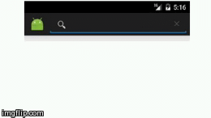
DON’T want to trigger a search for every letter

Slide 22
Trigger only after a small period of inactivity

Slide 23
Search Widget Example
Implement dynamic “search”
Encrypt the query

Slide 24
Search Widget Example
Implement dynamic “search”
Encrypt the query
Do something if the query matches the key word

Slide 25
RxJava by Square

Slide 26
Reactive programming changes the way of thinking

Slide 27
RxJava
Enables reactive programming: Observables, Observers, Subscriptions, Subjects, etc.
Offers an extensive toolbox of operators to transform Observables.
Provides the capability of switching threads effortlessly.
It is possible to create your own operators.

Slide 28

WELCOME
TO THE DARK SIDE

