Slide 1
Reactive Programming

Slide 2
What is reactive programming?
Concepts
Let’s Code!

Slide 3
What is reactive programming?
Concepts
Let’s Code!

Slide 4
What is reactive?
Show a dialog after a double click

Slide 5
What is reactive?
Show a dialog after a double click
Multiple clicks == double clicks

Slide 6
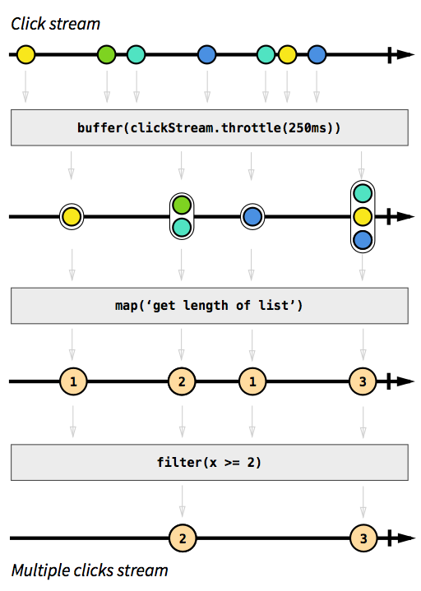
What is reactive?

Slide 7
What is reactive?

Slide 8
What is reactive?

Slide 9
What is reactive?

Slide 10
What is reactive?
Reactive programming is programming with asynchronous data streams

Slide 11
What is reactive programming?
Concepts
Let’s Code!

Slide 12
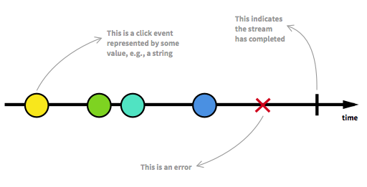
Concepts
The Observable

Slide 13
Concepts
Observable

Slide 14

Concepts
Observable
onComplete()
onError()
onNext()
Observer

Slide 15
Concepts
Observable
observable.subscribe(observer)
onComplete()
onError()
onNext()
Observer

Slide 16
Concepts
Observable
Subscription =
observable.subscribe(observer)
onComplete()
onError()
onNext()
Observer

Slide 17
Concepts
Observable
Subscription_1 =
observable.subscribe(observer_3)
Subscription_2 =
observable.subscribe(observer_2)
Subscription_3 =
observable.subscribe(observer_3)
onComplete()
onError()
onNext()
onComplete()
onError()
onNext()
onComplete()
onError()
onNext()
Observer_1
Observer_3
Observer_2

Slide 18
Concepts
Observable
Events
Events
Events
onComplete()
onError()
onNext()
onComplete()
onError()
onNext()
onComplete()
onError()
onNext()
Observer_1
Observer_3
Observer_2

Slide 19
Concepts
Observable = Stream, Producer
Observer = Consumer
Subscription = Contract

Slide 20
What is reactive programming?
Concepts
Let’s Code!

Slide 21
Let’s Code!
Search Widget Example
Implement dynamic “search”

Slide 22

Let’s Code!
DON’T want to trigger a search for every letter

Slide 23
Let’s Code!
Trigger only after a small period of inactivity

Slide 24
Let’s Code!
Search Widget Example
Implement dynamic “search”
Encrypt the query

Slide 25
Let’s Code!
Search Widget Example
Implement dynamic “search”
Encrypt the query
Do something if the query matches the key word

Slide 26
RxJava by Netflix
Let’s Code!

Slide 27
Let’s Code!
Subject = Observable + Observer

Slide 28
Let’s Code!
Subject = Observable + Observer
Observer
subject.onNext(A);

Slide 29
Let’s Code!
Subject = Observable + Observer
Observer
subject.onNext(A);
Observable
A

Slide 30
Let’s Code!
Subject = Observable + Observer
Observer
Observer
subject.onNext(A);
subject.onNext(B);
Observable
A
B

Slide 31
Let’s Code!
Subject = Observable + Observer
Observer
Observer
Observer
subject.onNext(A);
subject.onNext(B);
subject.onNext(C);
Observable
A
B
C

Slide 32
Let’s Code!
Subject
Observer
Observer
Observer
subject.onNext(A);
subject.onNext(B);
subject.onNext(C);
Observable
A
B
C

Slide 33
Let’s Code!
Subject
Observer
Observer
Observer
subject.onNext(A);
subject.onNext(B);
subject.onNext(C);
Observable
A
B
C

Slide 34
Reactive programming changes the way of thinking

Slide 35
RxJava
Enables reactive programming: Observables, Observers, Subscriptions, Subjects, etc.
Offers an extensive toolbox of operators to transform Observables.
Provides the capability of switching threads effortlessly.
It is possible to create your own operators.
Notes:
At this point I have to close the first part of the talk saying that RxJava has some issues and characteristics that are important to be aware of.

Slide 36
Cascade
Notes:
Here we have to jump from RxJava to Cascade somehow.

Slide 37

WELCOME
TO THE DARK SIDE

Slide 38
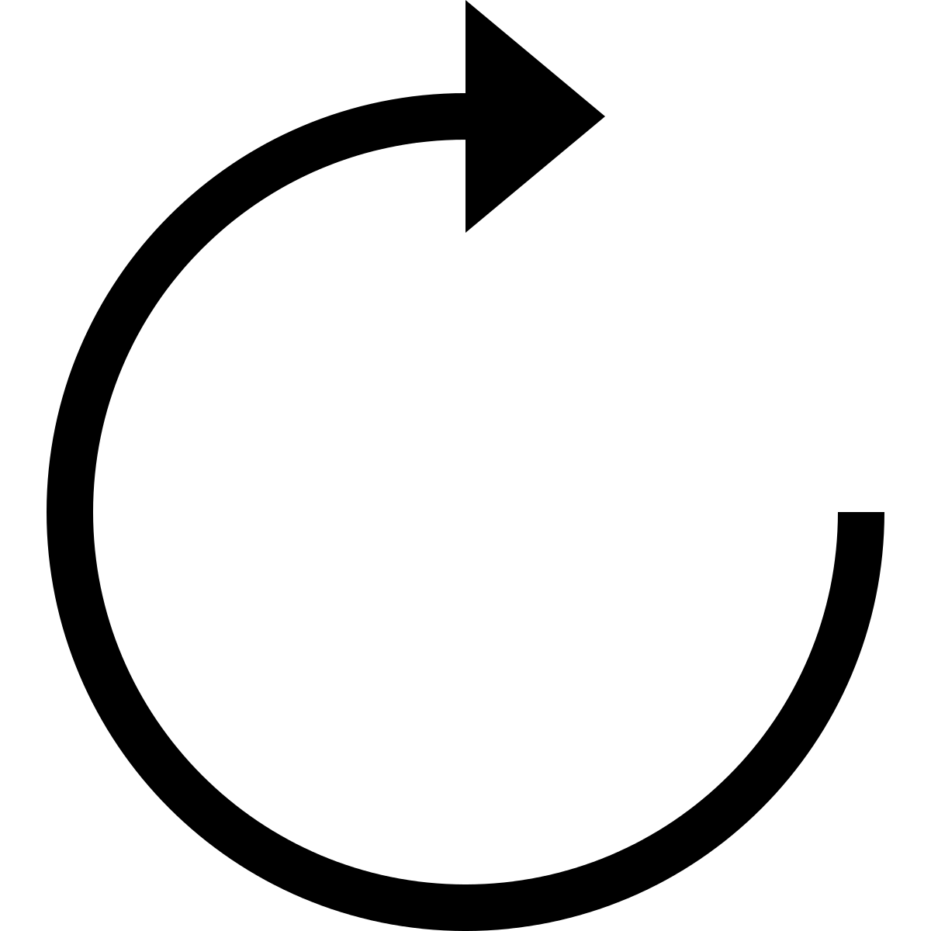
Life-cycle
Event
Activity / Fragment
Transformations in background thread
Observer

Slide 39
Life-cycle
Event
Activity / Fragment
Transformations in background thread
???
Observer
DESTROYED

Slide 40
Life-cycle
Event
Activity / Fragment
Transformations in background thread
???
Observer
DESTROYED
CRASH + MEMORY LEAK

Slide 41

Life-cycle
Bind the observable to the Activity/Fragment life-cycle
Activity/Fragment
Observable
AppObservable.bindActivity(activity, observable);
AppObservable.bindFragment(fragment, observable);

Slide 42
Life-cycle
Handle the subscriptions
&
unsubscribe!

Slide 43
Life-cycle
Enable Strict Mode

Slide 44
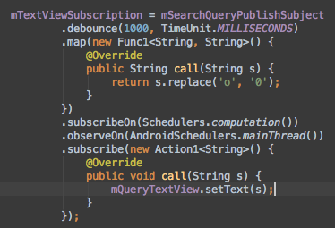
Error Handling
Actions
Notes:
RxJava does not swallow exceptions (as it should be). It is possible to subscribe an Action instead of an Observer. In the piece of code above if there is a null pointer exception inside the map operator the app will crash because the error is not handled.

Slide 45
Error Handling
Error event ends the subscription
Notes:
Another characteristic of RxJava is that the error event terminates the subscription. What if this is not the desired behavior? What if we want to maintain the subscription? There are some operators to workaround.

Slide 46
Error Handling
Error event ends the subscription
There are some workarounds
Operators
Notes:
Another characteristic of RxJava is that the error event terminates the subscription. What if this is not the desired behavior? What if we want to maintain the subscription? There are some operators to workaround.

Slide 47
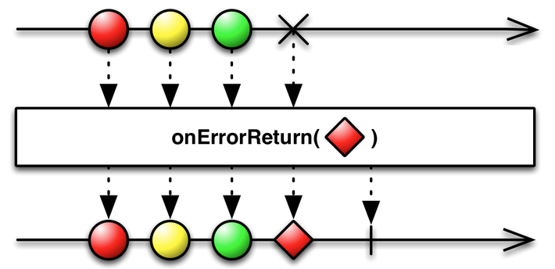
Error Handling
Operators for Error Handling
Notes:
onErrorReturn mirrors the behavior of the observable but when there is an error it emits the passed element and completes. The resulting observable never errors.

Slide 48
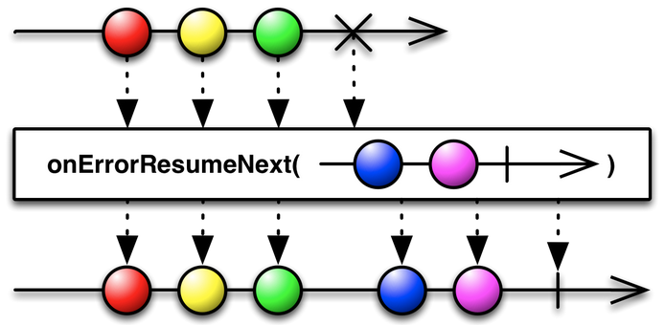
Error Handling
Operators for Error Handling
Notes:
onErrorResumeNext switches to a different observable (passed to the method) when there is an error. The resulting Observable never errors.

Slide 49
Logs
Using RxJava everywhere
Observes
VIEW
MODEL
Observes

Slide 50
Logs
Where is the trigger?
Events that trigger other events
Longer chains
Logs with RxJava internals
Higher complexity
DIFFICULT TO TRACK DOWN!

Slide 51
Debugging
The internals are not easy to follow
Very complex library in the inside

Slide 52
Assumptions
See the picture and assume how it works internally
Unexpected things can happen internally
Test the operators first
Assert your assumptions
Notes:
An operator can unsubscribe and/or subscribe internally, it can also switch threads.

Slide 53
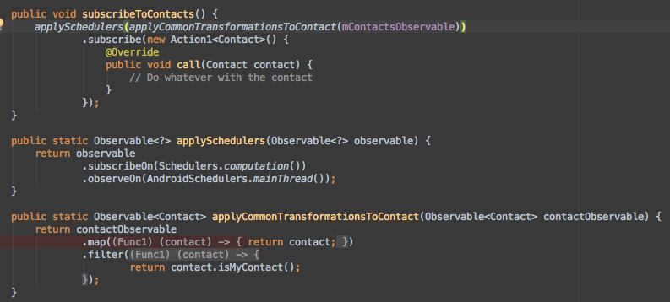
Break the chain
It is NOT good to break chain

Slide 54
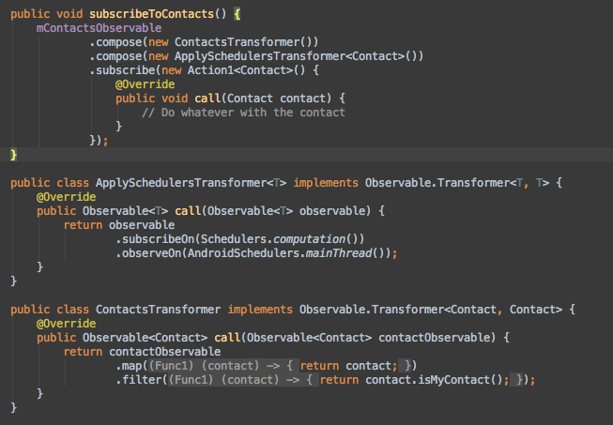
Break the chain
USE the operators
Compose()

Slide 55
Back Pressure
What if the observable produces faster than the observer can consume?

Slide 56
Back Pressure
What if the observable produces faster than the observer can consume?
It has to go through all the transformations
Takes time

Slide 57
Back Pressure
What if the observable produces faster than the observer can consume?
It has to go through all the transformations
Takes time
How to handle backpressure:
https://github.com/ReactiveX/RxJava/wiki/Backpressure

Slide 58
Hot & Cold Observables
When does an Observable start emitting items?

Slide 59
Hot & Cold Observables
Hot Observable
subscribe
Observer

Slide 60
Hot & Cold Observables
Cold Observable
subscribe
Observer

Slide 61
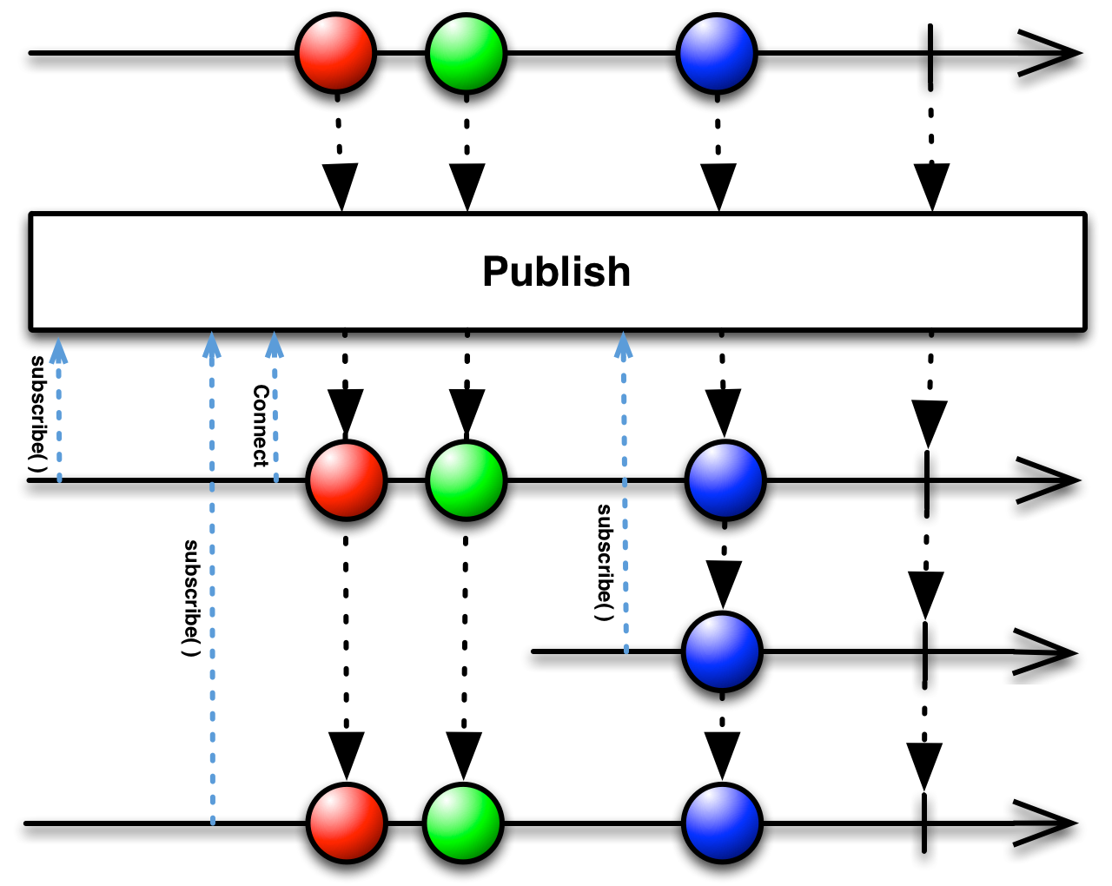
Hot & Cold Observables
Connectable Observable

Slide 62
The introduction to RxJava you’ve been missing:
https://gist.github.com/staltz/868e7e9bc2a7b8c1f754
Reference architecture for Android using RxJava:
https://github.com/tehmou/rx-android-architecture
Don’t break the chain:
http://blog.danlew.net/2015/03/02/dont-break-the-chain/
Reactive wiki:
http://reactivex.io/
Top 7 tips for RxJava on Android:
http://futurice.com/blog/top-7-tips-for-rxjava-on-android

Slide 63
Interactive diagrams of Rx Observables: http://rxmarbles.com/

