Slide 1
FINAL Review Sample network for an ENTERPRISE, by installing network-based firewall
2010030151 K S Satyavarsan
2010030071 Jyothin Movva
2010030040 Devaraj Acharya
Guide
Dr. P Lalitha Surya Kumari

Slide 2
INTRODUCTION
An enterprise network is the backbone for facilitating an organization’s communications and connecting computers and devices throughout departments. An enterprise network environment is usually configured to facilitate access to data and insight into analytics.
Enterprise networking refers to the physical, virtual and logical design of a network, and how the various software, hardware and protocols work together to transmit data. When it comes to enterprise networking, every organization has different needs, and in the era of digital transformation, modern enterprises are relying more on software-driven solutions to power intelligent network architecture, automation and design.

Slide 3
ABSTRACT
In this project we are going to design a network for an enterprise with firewall
We will be using different topologies and various other things we studied in this course to design this network
Firewall is used for network security and its job is to monitor and filter incoming and outgoing network traffic in order to keep the network safe from any vulnerabilities or threats

Slide 4
OBJECTIVE OF NETWORK
Secure Service: The main objective of this network is to provide secure administrative computing service to an enterprise.
Versatile Information Processing: The network will enable users to retrieve, process, and store ASCII and non-ASCII text, still graphics, audio, and video from any connected computer.
Collaboration: The network will combine the power and capabilities of diverse equipment across the enterprise to provide a collaborative medium that helps users combine their skills regardless of their physical location. A network for this enterprise will enable people to share information and ideas easily so they can work more efficiently and productively.

Slide 5
LITERATURE REVIEW
Name | Publishers | Summary
Enterprise Network Design and Implementation using Cisco Packet Tracer | Aisha Muhammad Aisha Abdulrahman Abba Kashim Kyari Mohammed Abuhuraira Abubakar Published year: December 2020 | When creating an Enterprise network, divide the network into appropriate areas Define clear boundaries between each of the areas.
Designing Network Design Spaces | Ilija Radosavovic Raj Prateek Kosaraju Ross Girshick Kaiming He Piotr Dollar Published year: 2020 | Understanding of network design and discover design principles that generalize across settings. Instead of focusing on designing individual network instances, we design network design spaces that parametrize populations of networks.
Planning, designing and implementing an enterprise network in a developing nation | Augustine C. Odinma* Sergey Butakov Evgeny Grakhov Felix Bollou Published year: 2018 | This paper briefly discusses the architecture of an enterprise network. It examines the barriers to planning, designing and implementing an enterprise network in some developing nation

Slide 6
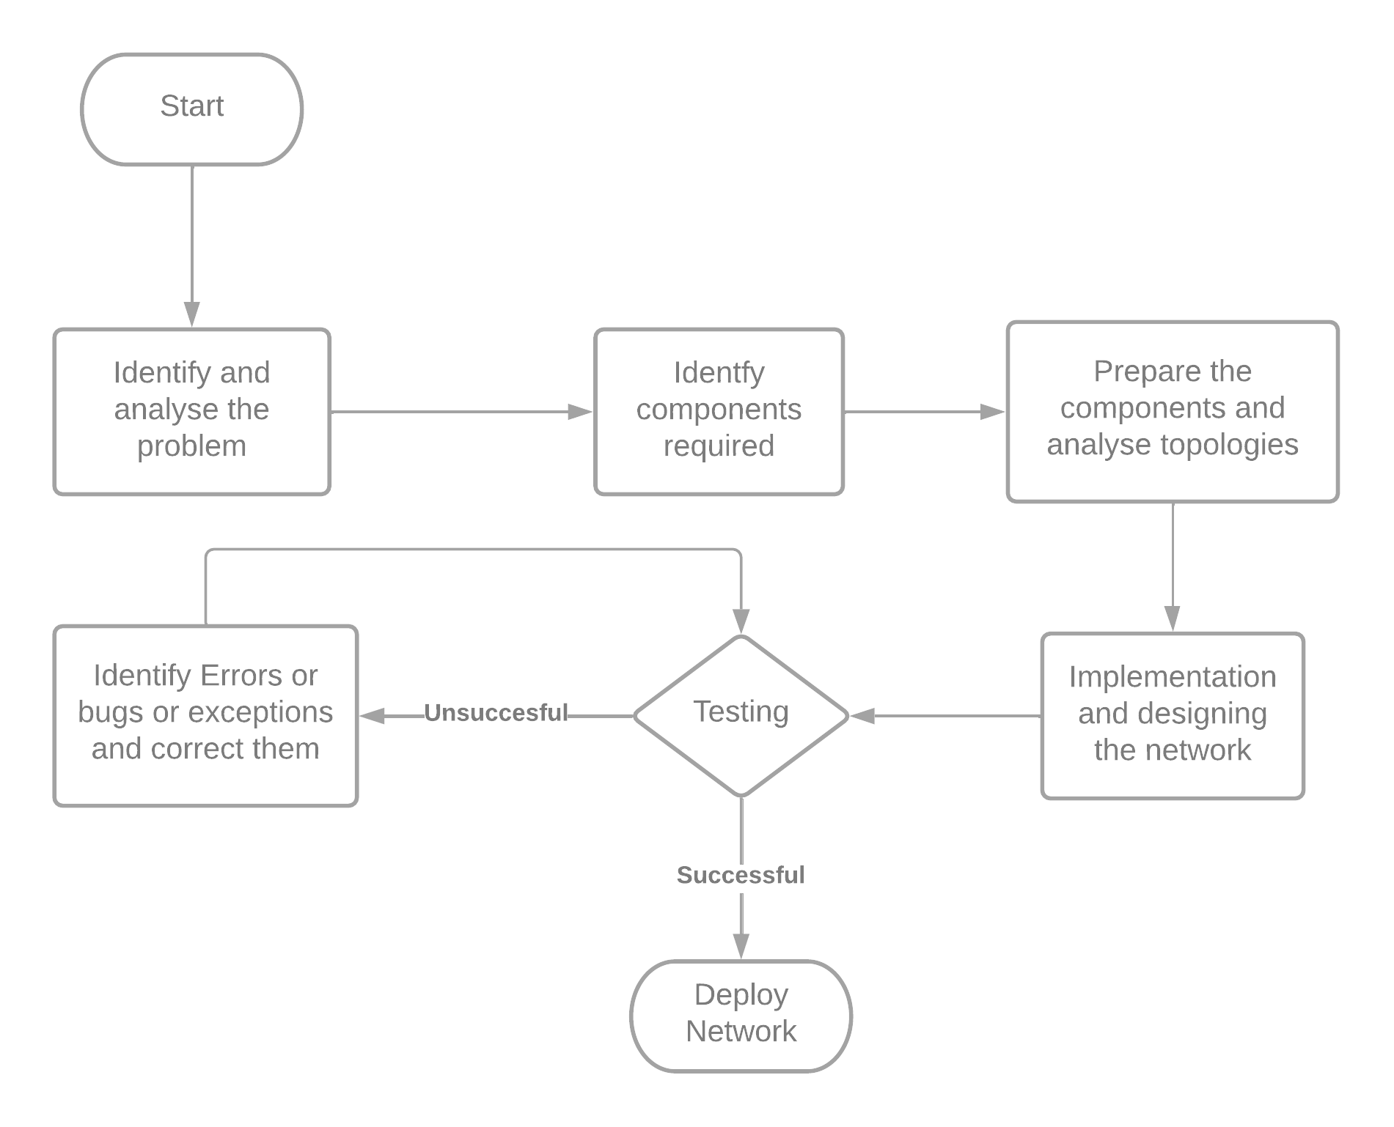
IMPLEMENTATION FLOWCHART(GENERAL)

Slide 7
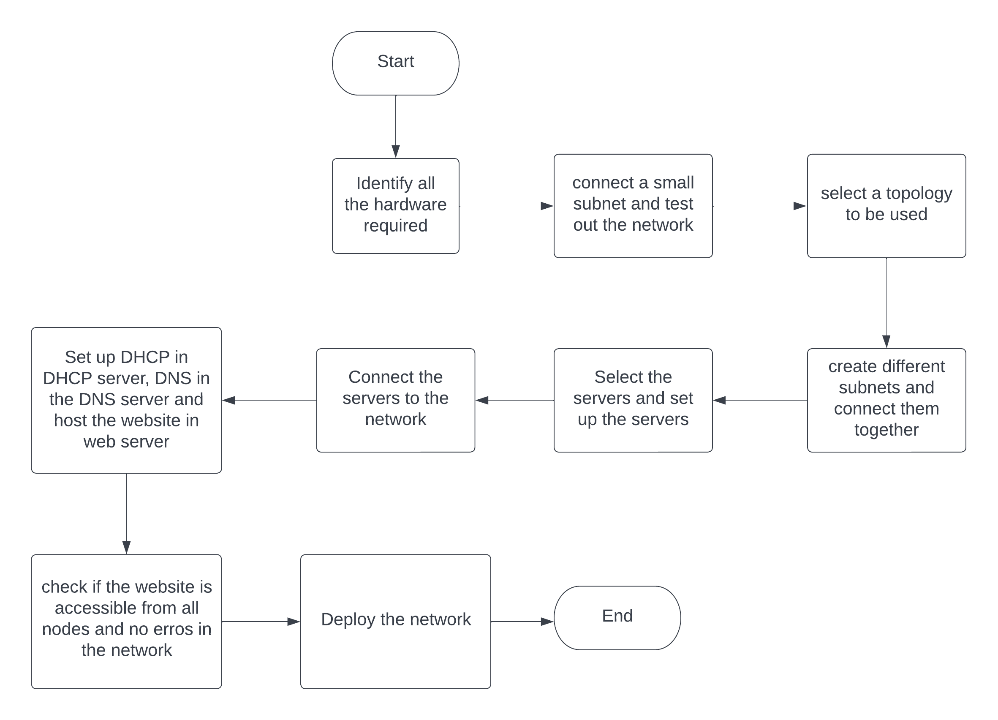
IMPLEMENTATION FLOWCHART(SPECIFIC)

Slide 8
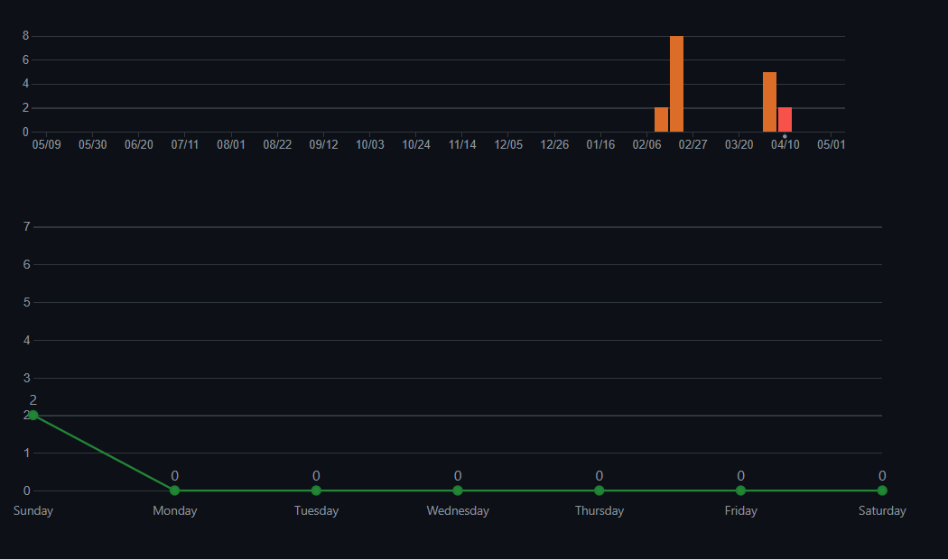
GITHUB COMMITS

Slide 9
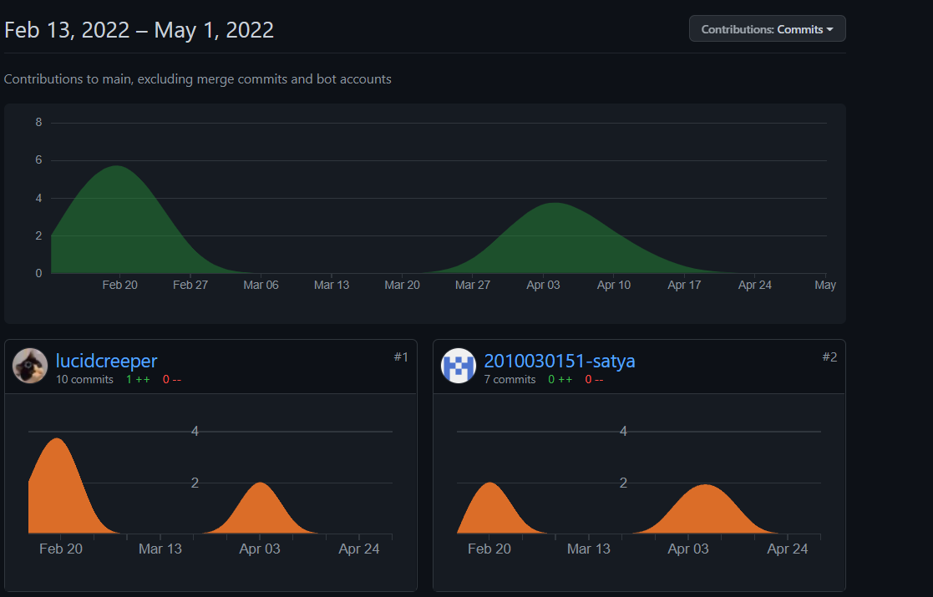
GITHUB COMMITS

Slide 10
WORK PROGRESS
Implemented a institution network with multiple subnets interconnected with each other.
DNS implemented through a separate server
Made a website for an enterprise which can be accessed from all nodes

Slide 11
METHODS
Software required:
windows 10 or later
Cisco Packet Tracer
Hardware to support the software requirements.

Slide 12
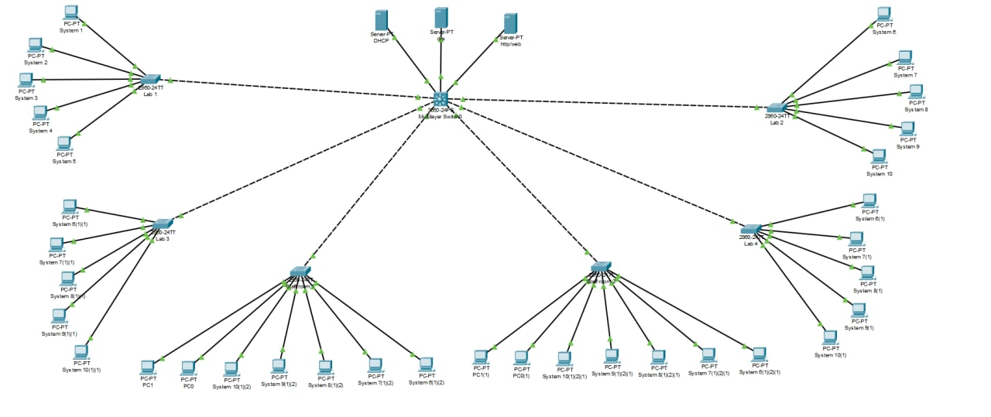
ALPHA TESTING (TOPOLOGY)

Slide 13
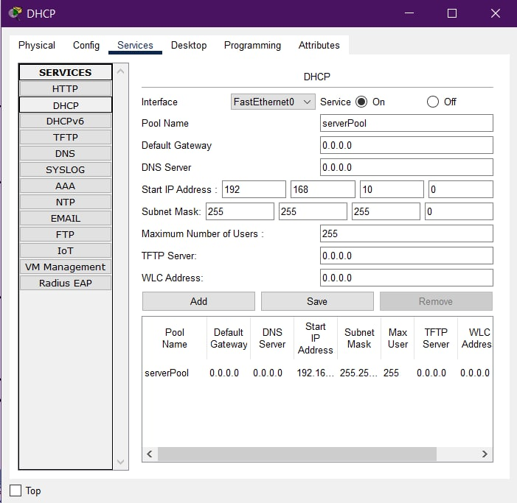
ALPHA TESTING (DHCP SERVER)
Dynamic Host Configuration Protocol (DHCP) is a network management protocol used to automate the process of configuring devices on IP networks, thus allowing them to use network services such as DNS, NTP, and any communication protocol based on UDP or TCP.
A DHCP server dynamically assigns an IP address and other network configuration parameters to each device on a network so they can communicate with other IP networks.

Slide 14
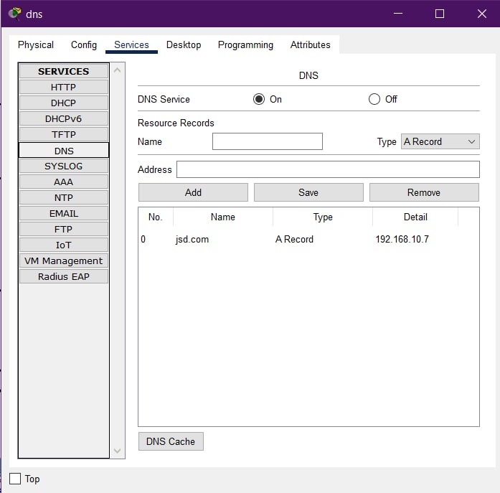
ALPHA TESTING (DNS SERVER)
The Domain Name System (DNS) is called the phonebook of the Internet. When a user types a domain name or website address into the address bar of the browser, the DNS server is responsible for translating the domain name to a specific IP address, driving it to the correct website.
A DNS server is a server that manages the domain name system or DNS protocols, matching Internet domain names and IP addresses. The DNS server may also manage domain resolution services.
In the DNS server, there is a database of domain names, host information, DNS records and network data. The DNS server will search records to return a result. This process allows DNS clients to access the DNS server through a web browser.

Slide 15
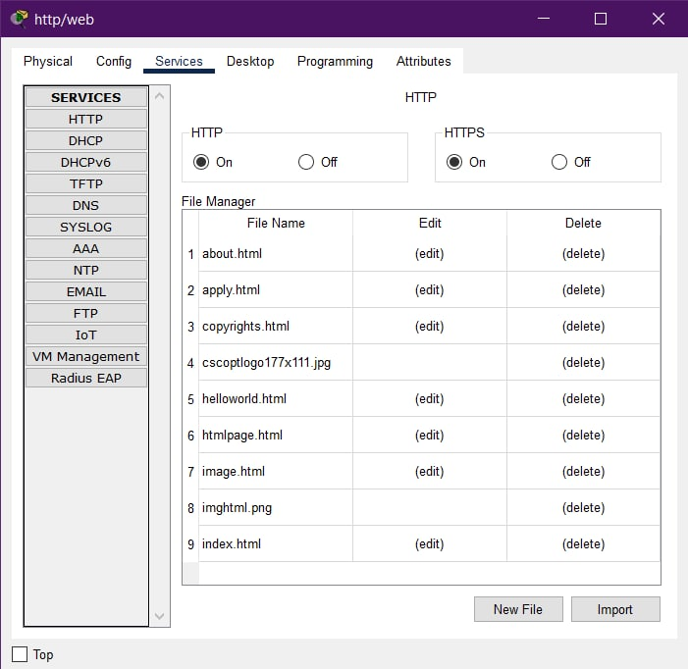
ALPHA TESTING (WEB SERVER)
A web server is a computer that runs websites. It's a computer program that distributes web pages as they are requisitioned. The basic objective of the web server is to store, process and deliver web pages to the users.
This intercommunication is done using Hypertext Transfer Protocol (HTTP). These web pages are mostly static content that includes HTML documents, images, style sheets, test etc.
When anyone requests for a website by adding the URL or web address on a web browser’s address bar (for example www.google.com), the browser sends a request to the Internet for viewing the corresponding web page for that address.

Slide 16
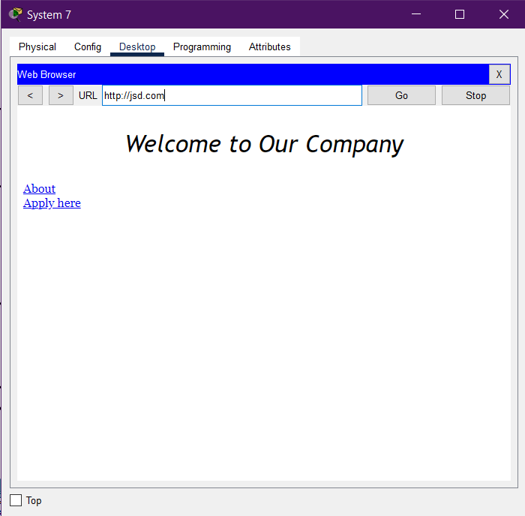
ALPHA TESTING (WEBSITE)
This shows the main/Home page that we created.
This website is hosted on our web server.

Slide 17
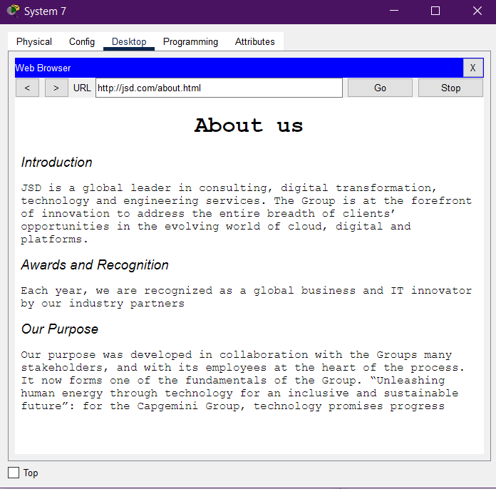
ALPHA TESTING (WEBSITE)
This shows the about page from our website.
This webpage can be accessed from the home page.

Slide 18
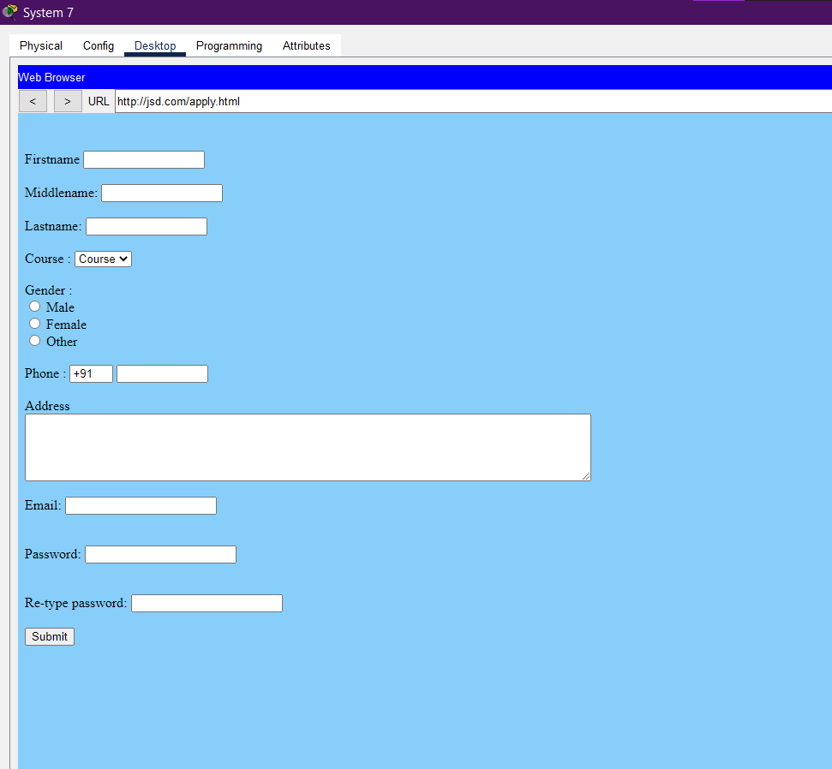
ALPHA TESTING (WEBSITE)
This page can be used to apply for a job in the company.
This has elements like text fields, text areas and button which can be used to map various functions.

Slide 19
CONCLUSION AND FUTURE WORK
The topology of the network is completely functional.
Multiple LANS are implemented to simulate a real-life enterprise
Firewall is setup and can be used to restrict any node from accessing the website which is being hosted on a server.
A website is hosted on the server for an enterprise which can be accessed from all nodes

Slide 20
SUGGESTIONS

Slide 21
THANK YOU

