Slide 1
SPACE EFFICIENT APPLICATION FOR REACHABILITY OF SOURCE TO DESTINATION IN A ROBOT NAVIGATION SYSTEM.
Guided by Dr. Udaya Rani Gurala
By
Jyothin Movva – 2010030071
KS Satyavarsan – 2010030151
Devaraj Achrya – 2010030040
Snehith Kamepalli - 2010030341
KARTHIK – 2010030329

Slide 2
ABSTRACT
The problem of graph Reachability is to decide whether there is a path from one vertex to another in a given graph
In this project will we try to implement a space efficient algorithm for reachability in directed geometric graph.

Slide 3
PROBLEM STATEMENT AND DOMAIN
Space - Efficient Algorithms for Reachability in Directed Geometric Graphs
Domain – Graph exploration and implementations

Slide 4
SOLUTION STRATEGY
The algorithm used in the project is Dijkstra’s shortest path from source to destination

Slide 5
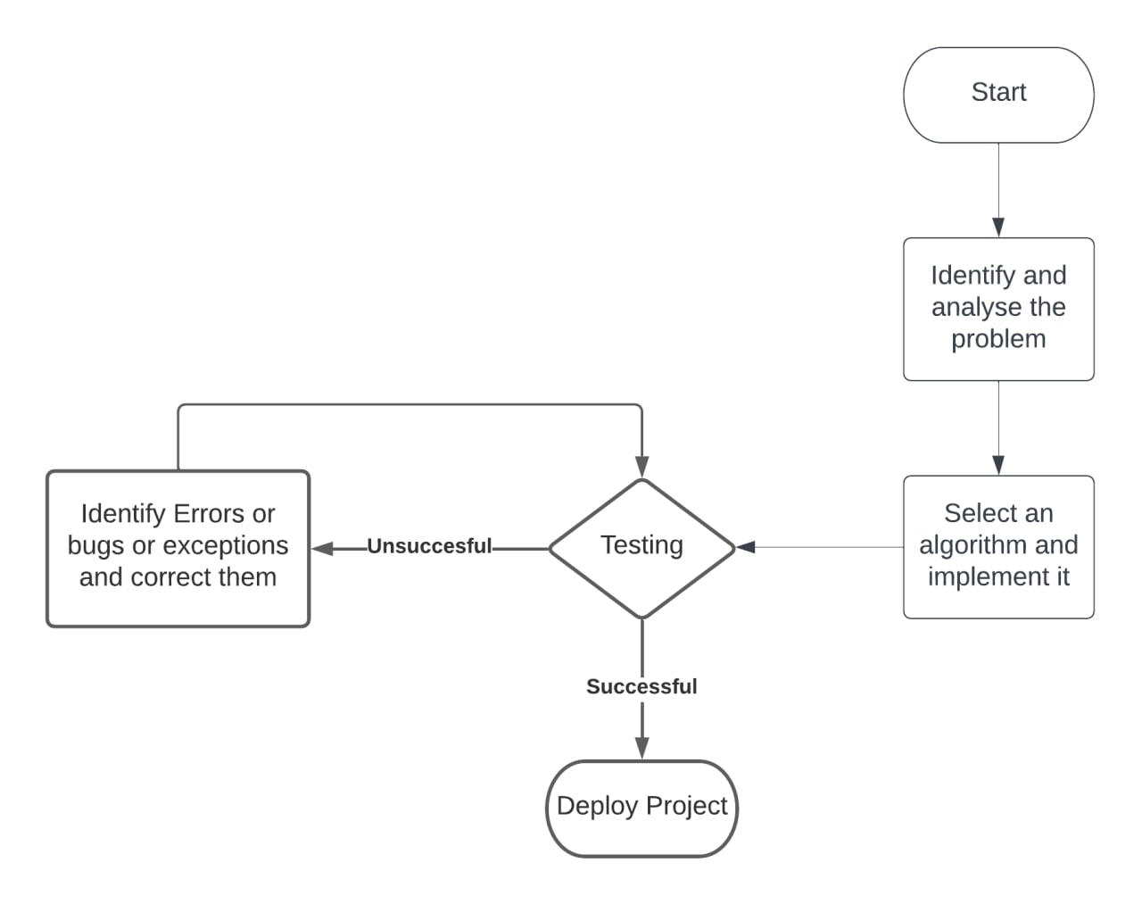
IMPLEMETATION FLOWCHART

Slide 6
HARDWARE AND SOFTWARE
Hardware – any computer with a working web browser and an input device.
Software – windows 10,visual studio code and python.
Webhosting – flask

Slide 7
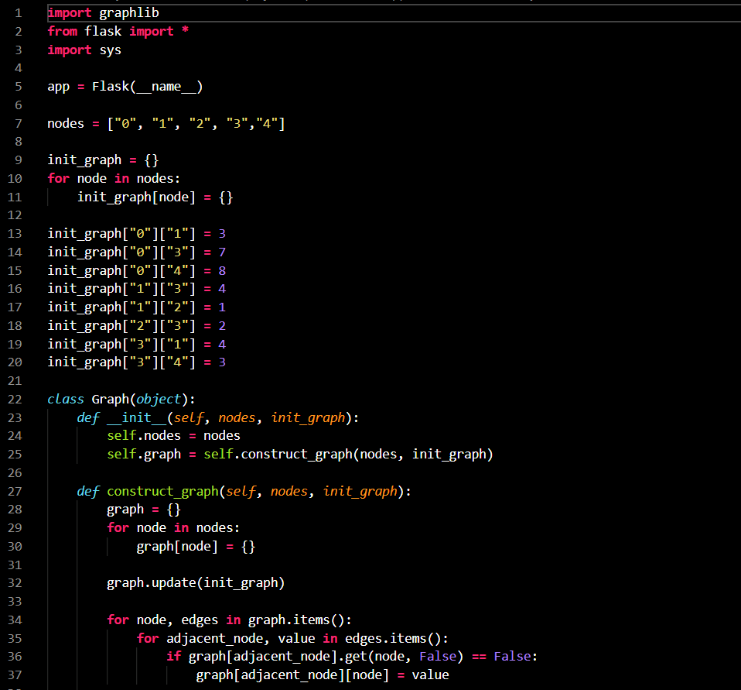
IMPLEMENTATION

Slide 8
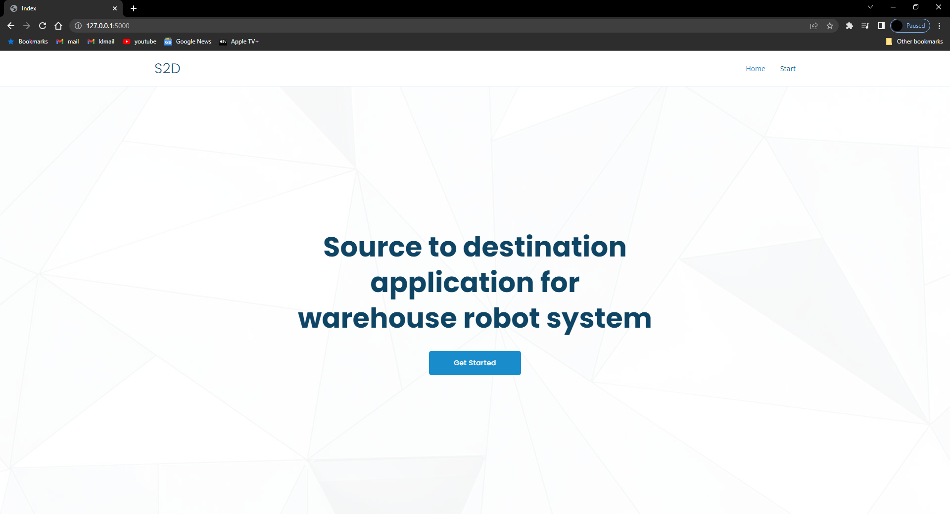
RESULTS

Slide 9
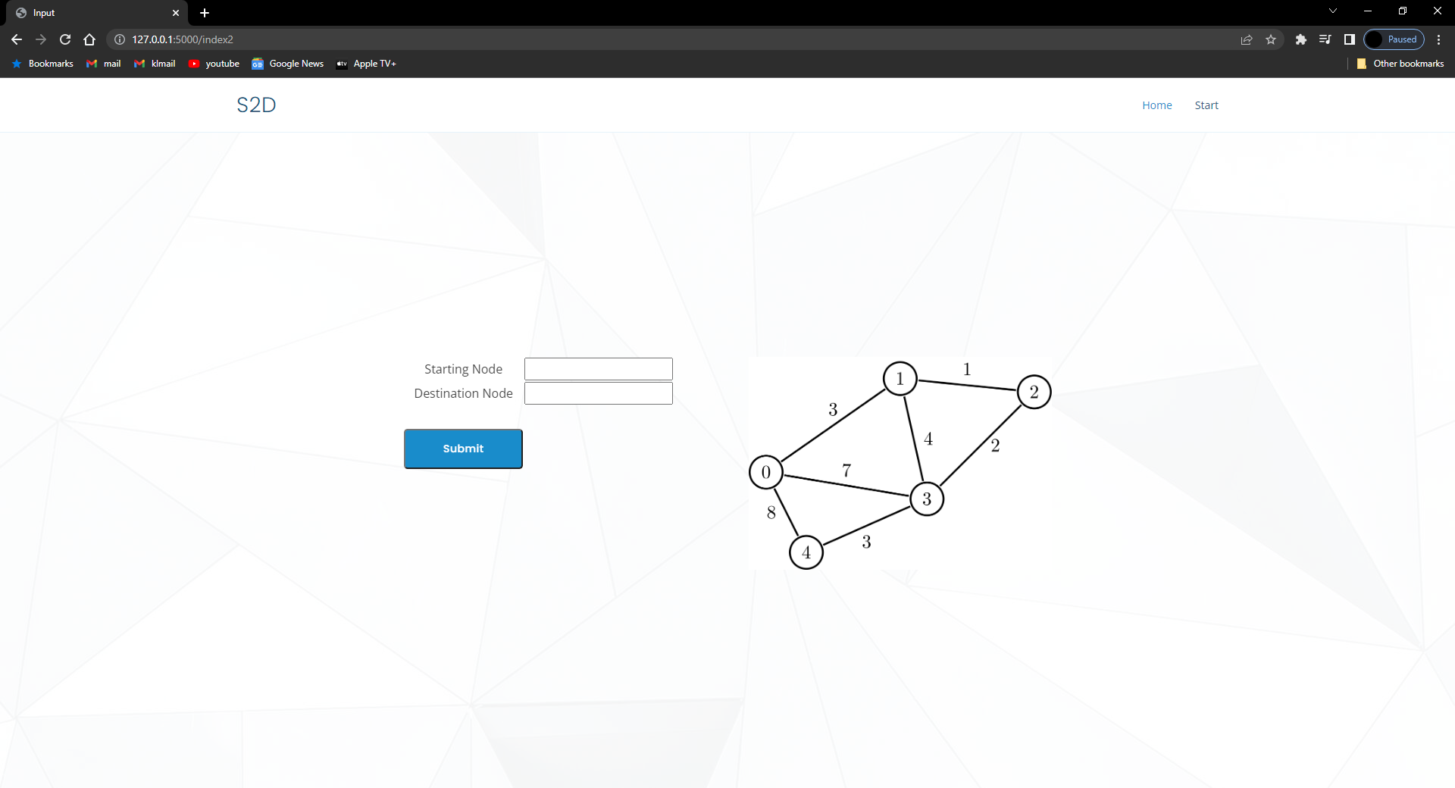
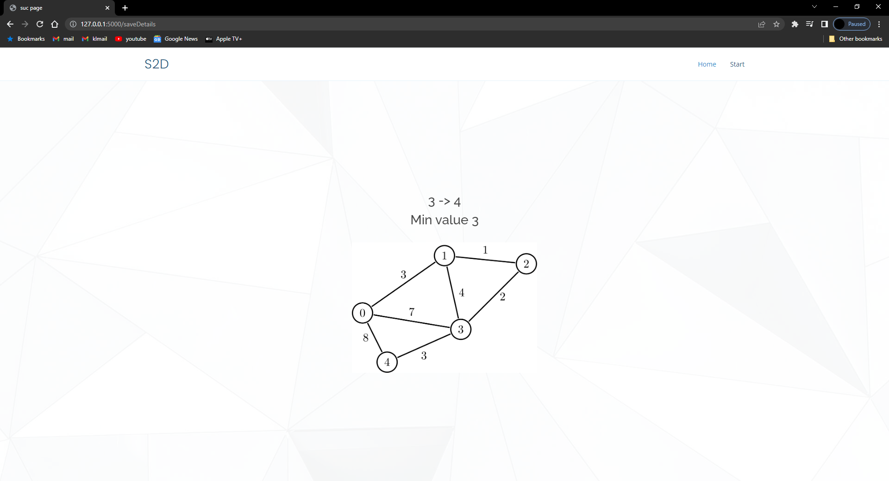

Slide 10
FUTURE SCOPE
Adding an ability to enter the node by the user is will be an advantage to our current method
Moving the web hosting service to Django or hosting it in a web server for testing will be appropriate representation of the intended real-life use

Slide 11
Suggestions

Slide 12
Thank you

