Slide 1
SPACE EFFICIENT APPLICATION FOR REACHABILITY OF SOURCE TO DESTINATION IN A ROBOT NAVIGATION SYSTEM.
Guided by Dr. Udaya Rani Gurala
By
Jyothin Movva – 2010030071
KS Satyavarsan – 2010030151
Devaraj Achrya – 2010030040
Snehith Kamepalli - 2010030341
KARTHIK – 2010030329

Slide 2
PROBLEM STATEMENT AND DOMAIN
Space - Efficient Algorithms for Reachability in Directed Geometric Graphs
Domain – Graph exploration and implimentations

Slide 3
ABSTRACT
The problem of graph Reachability is to decide whether there is a path from one vertex to another in a given graph
In this project will we try to implement a space efficient algorithm for reachability in directed geometric graph.

Slide 4
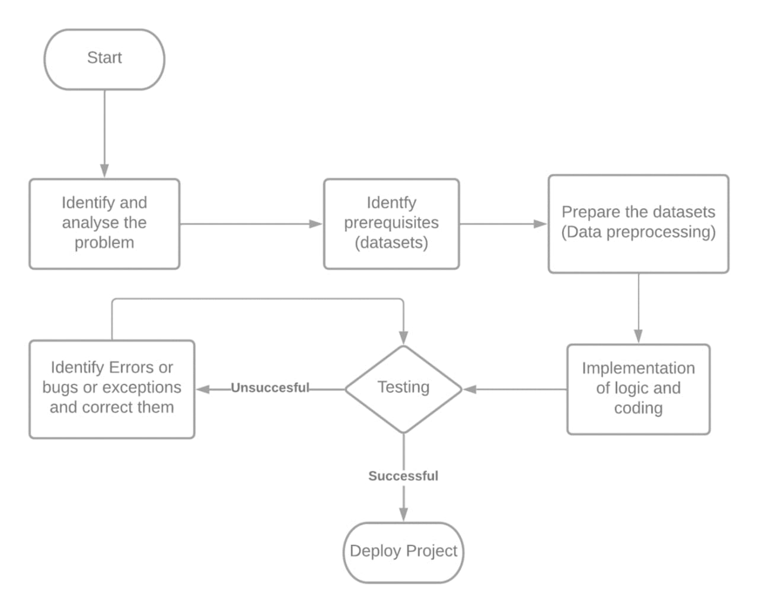
IMPLEMETATION FLOWCHART

Slide 5
LITERATURE REVIEW
Improved Space Efficient Algorithms for BFS, DFS and Applications
(Niranka Banerjee, Sankardeep Chakraborty, Venkatesh Raman)
Abstract- Explores the time and space complexities of BFS and DFS and experiments on the algorithms to improve the relative space complexity.
Space-Efficient Algorithms for Reachability in Geometric Graphs (Sujoy Bhore and Rahul Jain)
Abstract – the paper explains the space related optimizations while maintaining a polynomial time bound.

Slide 6
APPLICATION
The applications will find the shortest path for robot so it can spend less resources reaching that destination.
Since the computers in a mobile robot can be limiting the problem statement objective of using the most space saving algorithm is justified.

Slide 7
DATA STRUCTURES
Graph data structure
Python – dictionary

Slide 8
WORK PROGRESS
Working algorithm
Working web interface

Slide 9
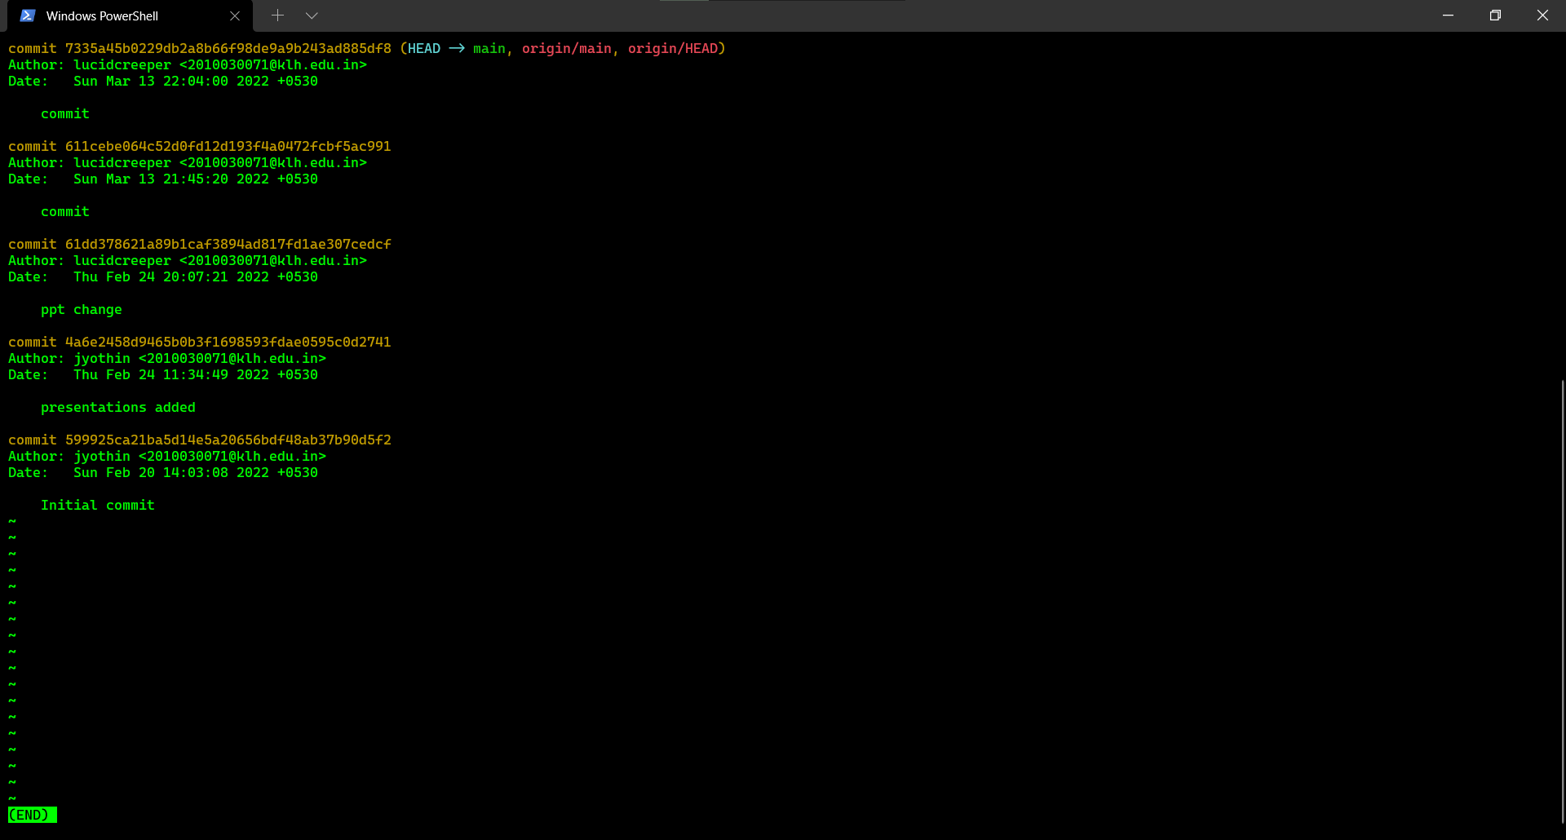
GIT COMMITS

Slide 10
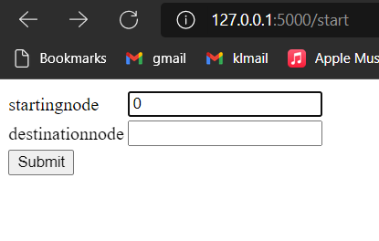
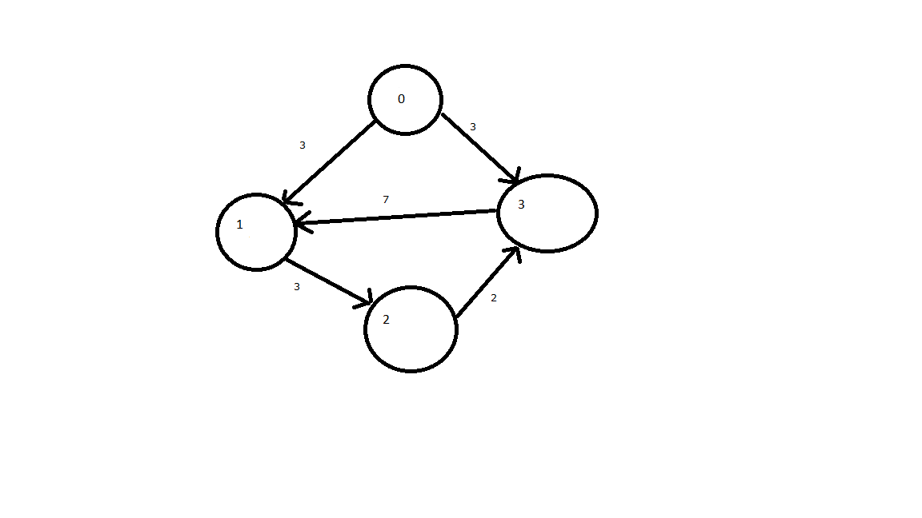
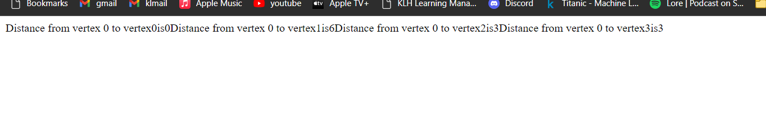
APLHA TESTING

Slide 11
Suggestions

Slide 12
Thank you

