Slide 1
SPACE EFFICIENT APPLICATION FOR REACHABILITY OF SOURCE TO DESTINATION IN A ROBOT NAVIGATION SYSTEM.
Guided by Dr. Udaya Rani Gurala
By
Jyothin Movva – 2010030071
KS Satyavarsan – 2010030151
Devaraj Achrya – 2010030040
Snehith Kamepalli - 2010030341
KARTHIK – 2010030329

Slide 2
PROBLEM STATEMENT AND DOMAIN
Space - Efficient Algorithms for Reachability in Directed Geometric Graphs
Domain – Graph exploration and implimentations

Slide 3
ABSTRACT
The problem of graph Reachability is to decide whether there is a path from one vertex to another in a given graph
In this project will we try to implement a space efficient algorithm for reachability in directed geometric graph.

Slide 4
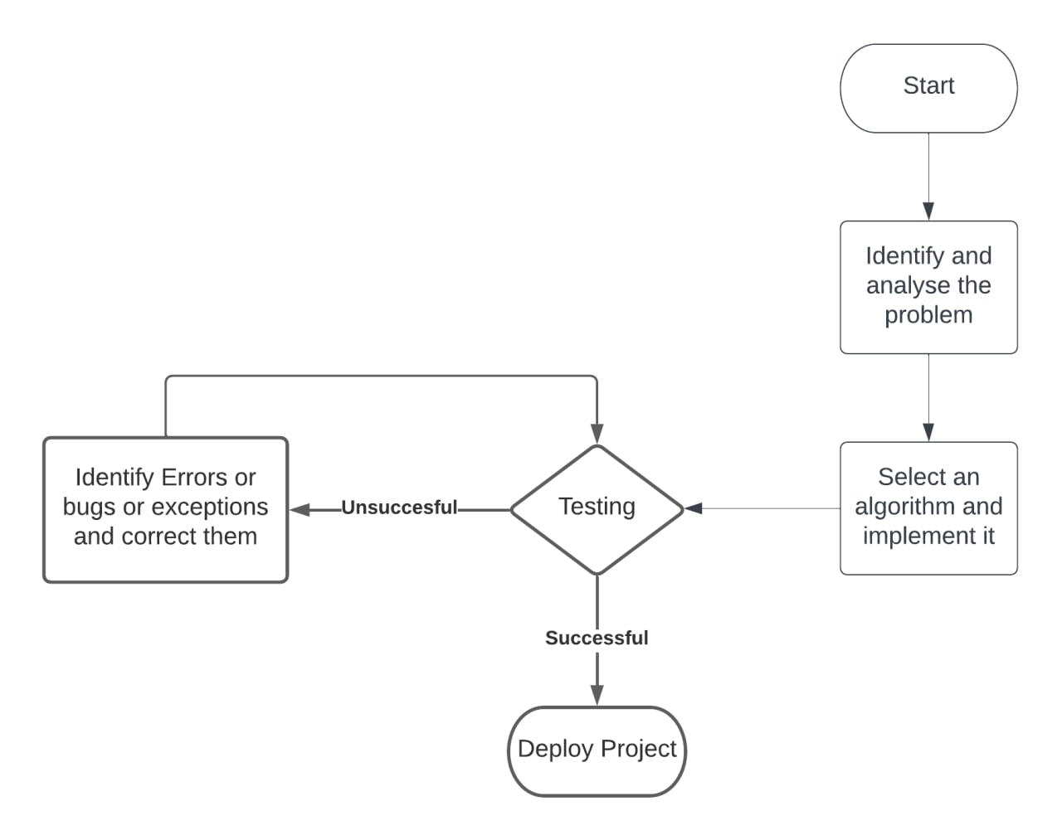
IMPLEMETATION FLOWCHART

Slide 5
LITERATURE REVIEW
Improved Space Efficient Algorithms for BFS, DFS and Applications
(Niranka Banerjee, Sankardeep Chakraborty, Venkatesh Raman)
Abstract- Explores the time and space complexities of BFS and DFS and experiments on the algorithms to improve the relative space complexity.
Space-Efficient Algorithms for Reachability in Geometric Graphs (Sujoy Bhore and Rahul Jain)
Abstract – the paper explains the space related optimizations while maintaining a polynomial time bound.

Slide 6
APPLICATION
The applications will find the shortest path for robot so it can spend less resources reaching that destination.
Since the computers in moving robots have space and power limitations, using Shortest distance technique will help us achieve better efficiency

Slide 7
DATA STRUCTURES
Graph data structure
Python – priority queue

Slide 8
WORK PROGRESS
Working algorithm
Working web interface

Slide 9
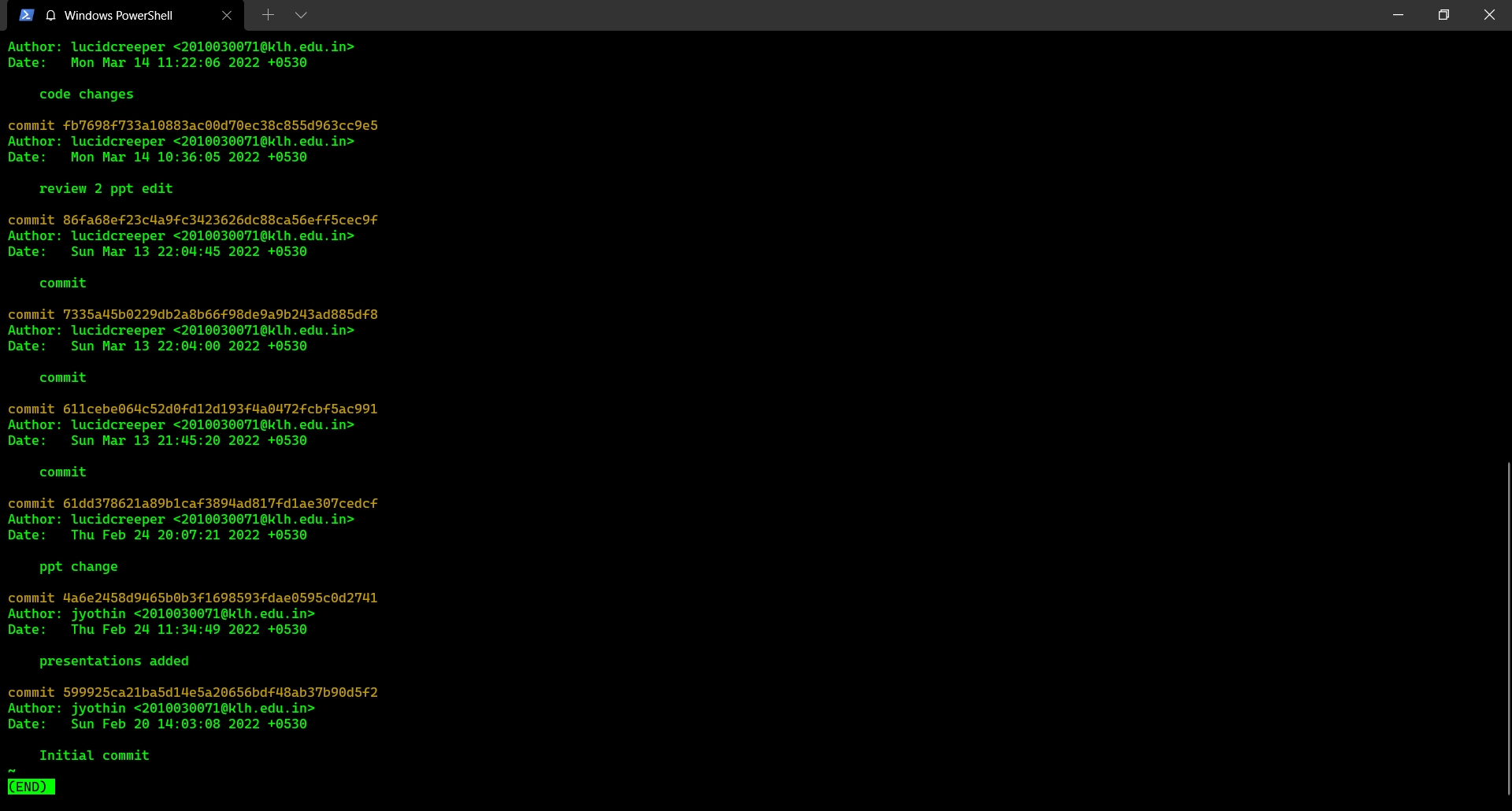
GIT COMMITS

Slide 10
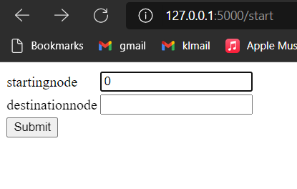
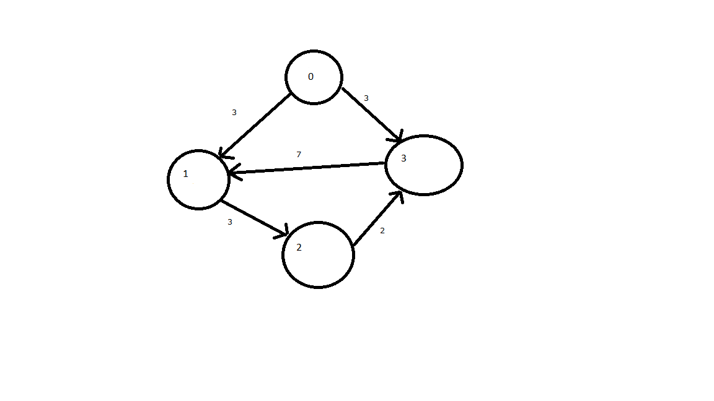

APLHA TESTING

Slide 11
Suggestions

Slide 12
Thank you

