Slide 1
SPACE EFFICIENT APPLICATION FOR REACHABILITY OF SOURCE TO DESTINATION IN A ROBOT NAVIGATION SYSTEM.
Guided by Dr. Udaya Rani Gurala
By
Jyothin Movva – 2010030071
KS Satyavarsan – 2010030151
Devaraj Achrya – 2010030040
Snehith Kamepalli - 2010030341
KARTHIK – 2010030329

Slide 2
INTRODUCTION
Problem statement of the project is “Space - Efficient Algorithms for Reachability in Directed Geometric Graphs Using the problem statement as the base we came up with an application to find the shortest distance between a source to destination for a warehouse robot system. The domain of the application comes under graph exploration and implementations The applications will find the shortest path for robot so it can spend less resources reaching that destination

Slide 3
ABSTRACT
The problem of graph Reachability is to decide whether there is a path from one vertex to another in a given graph
In this project will we try to implement a space efficient algorithm for reachability in directed geometric graph.
The applications will find the shortest path for robot so it can spend less resources reaching that destination.
Since the computers in moving robots have space and power limitations, using shortest distance technique will help us achieve better efficiency

Slide 4
PROBLEM STATEMENT AND DOMAIN
Space - Efficient Algorithms for Reachability in Directed Geometric Graphs
Domain – Graph exploration and implementations

Slide 5
LITERATURE REVIEW
S.NO | Authors | Title | Publishing | Techniques
1 | Niranka Banerjee, Sankardeep Chakraborty, Venkatesh Raman | Improved Space Efficient Algorithms for BFS, DFS and Applications | Agronomy for Sustainable Development volume (2015) | Explores the time and space complexities of BFS and DFS and experiments on the algorithms to improve the relative space complexity
2 | Sujoy Bhore and Rahul Jain | Space-Efficient Algorithms for Reachability in Geometric Graphs | IEEE (2015) | The paper explains the space related optimizations while maintaining a polynomial time bound.
3 | WangShu-Xi | The Improved Dijkstra's Shortest Path Algorithm and Its Application | School of Information Technology, The University of International Business and Economics, Bei Jing, China, (2017) | The shortest path problem exists in variety of areas. A well known shortest path algorithm is Dijkstra's, also called “label algorithm”.
4 | A Fitriansyah, N W Parwati, DR Wardhani and N Kustian | Dijkstra's Algorithm to Find Shortest Path of Tourist Destination in Bali | Journal of Physics: Conference Series, Volume 1338, The 2nd International Conference on Applied Sciences Mathematics and Informatics 9–11 August 2018, Bandar Lampung, Indonesia (2019) | Bali is one of many small island in Indonesia and referred as "The Island of Gods". Bali has varieties of tourist destination e.g. art villages, ecotourism, historical building, spiritual tourism and temples. Dijkstra's algorithm is an algorithm that used to be solution in finding shortest path problem. It can be use to find the shortest route between one tourist destination and all other tourist destinations.

Slide 6
SOLUTION STRATEGY
The algorithm used in the project is Dijkstra’s shortest path from source to destination
It is easy to implement with the graph data structure and the time and space complexity is comparable with other solutions.
Prerequisites before implementing the algorithm
Visiting the nodes
Exploration of nodes
Depth first search algorithm and functionality
Time complexity – O(logV)
Space complexity - O(V) .
Since the computers in a mobile robot can be limiting the problem statement objective of using the most space saving algorithm is justified.

Slide 7
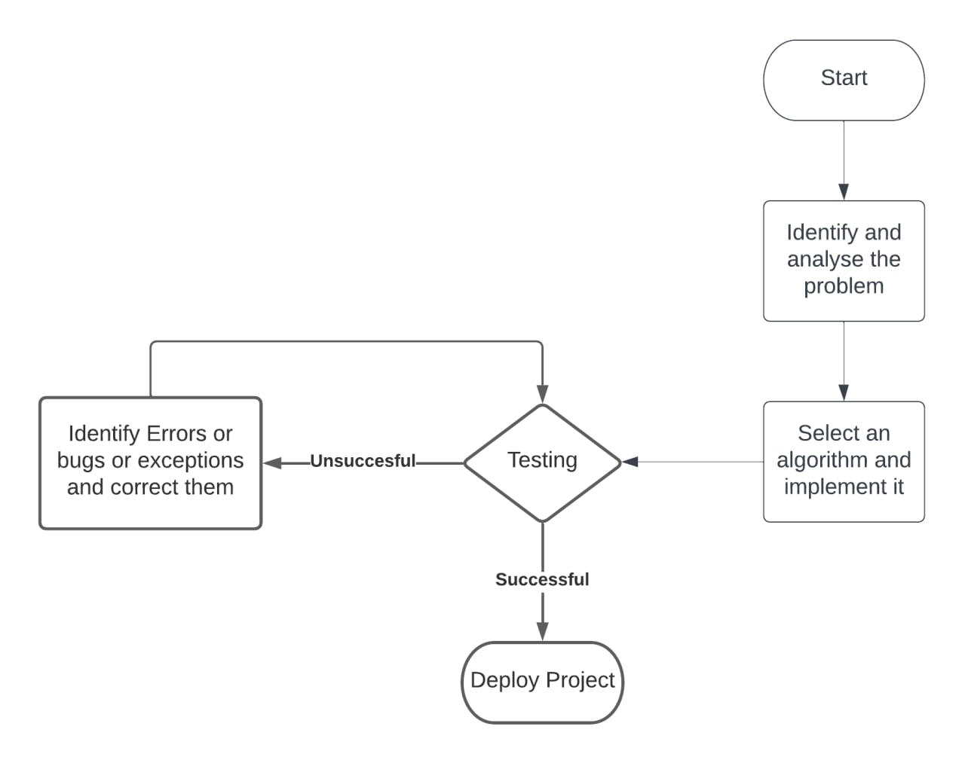
IMPLEMETATION FLOWCHART

Slide 8
HARDWARE AND SOFTWARE
Hardware –
Processor –
1. AMD Athlon 3000G and above
2. Intel i3 4th gen and above
Ram – 4Gs
Storage - 240gs SSD / 512gb HHD
Software – windows 10,visual studio code and python.
Webhosting – flask

Slide 9
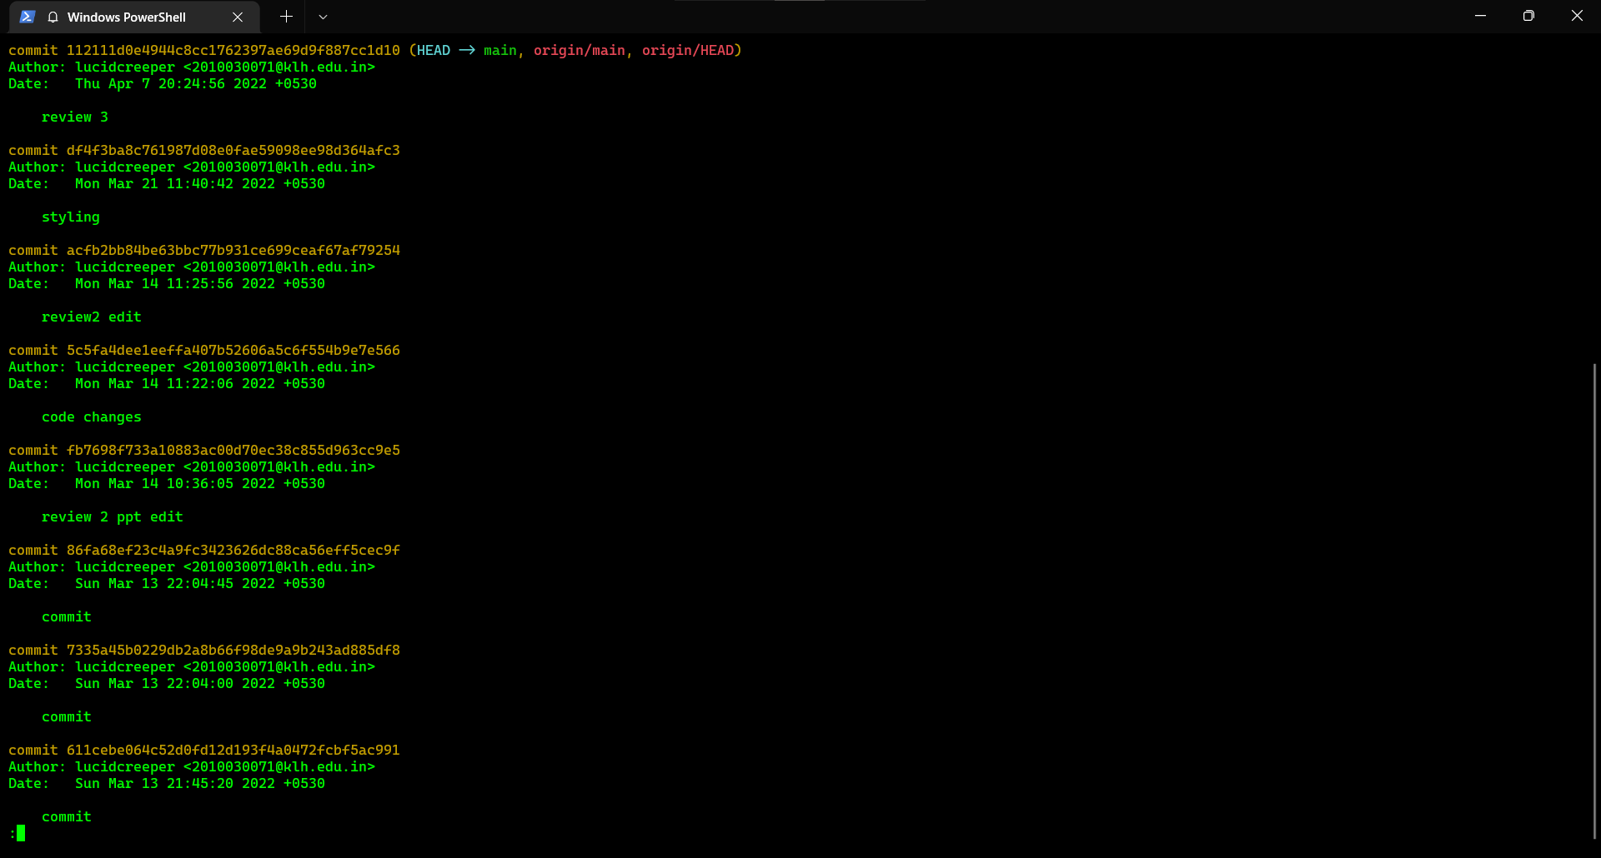
GITHUB COMMITS

Slide 10
WORK PROGRESS
The problem of graph Reachability is to decide whether there is a path from one vertex to another in a given graph
In this project will we try to implement a space efficient algorithm for reachability in directed geometric graph.

Slide 11
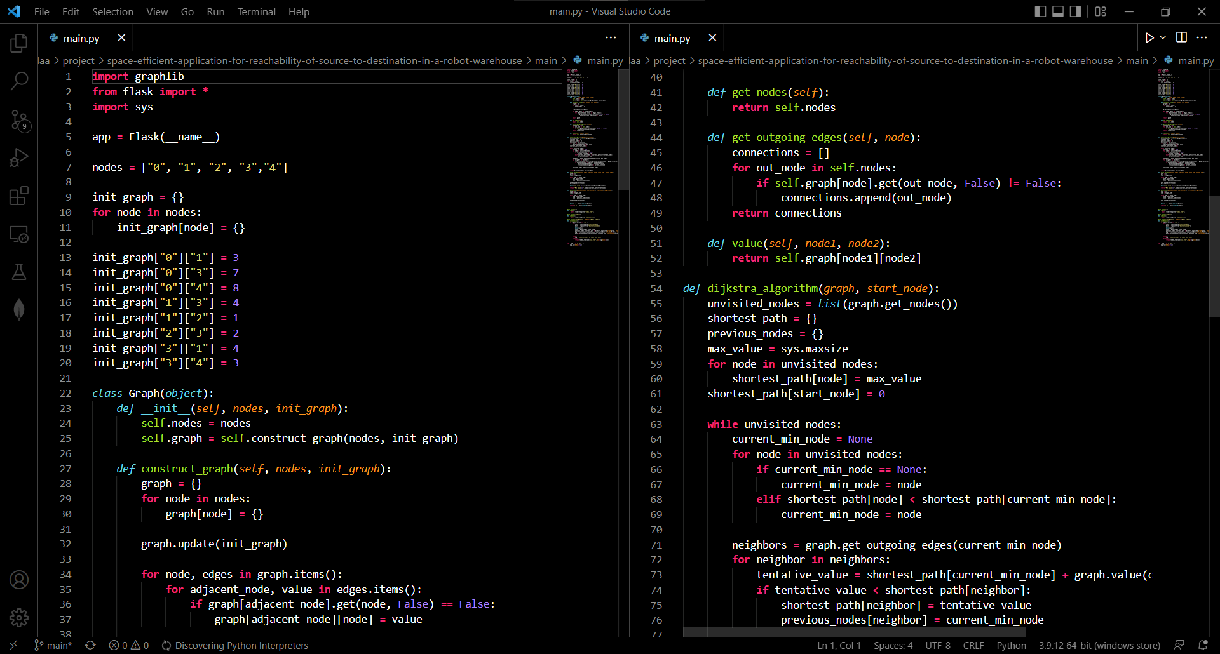
IMPLEMENTATION

Slide 12
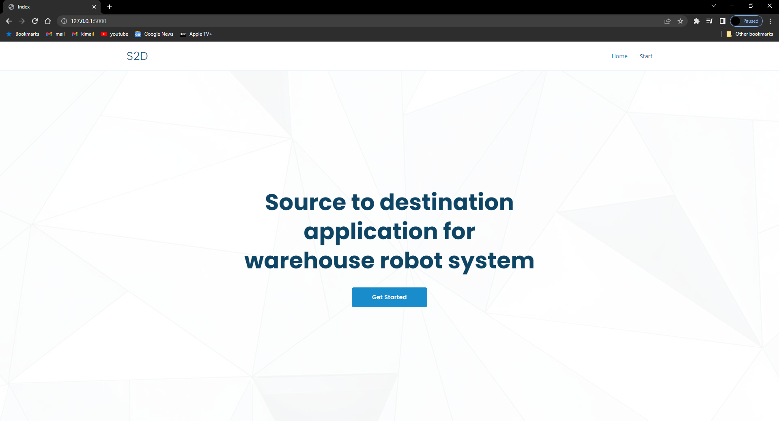
RESULTS

Slide 13
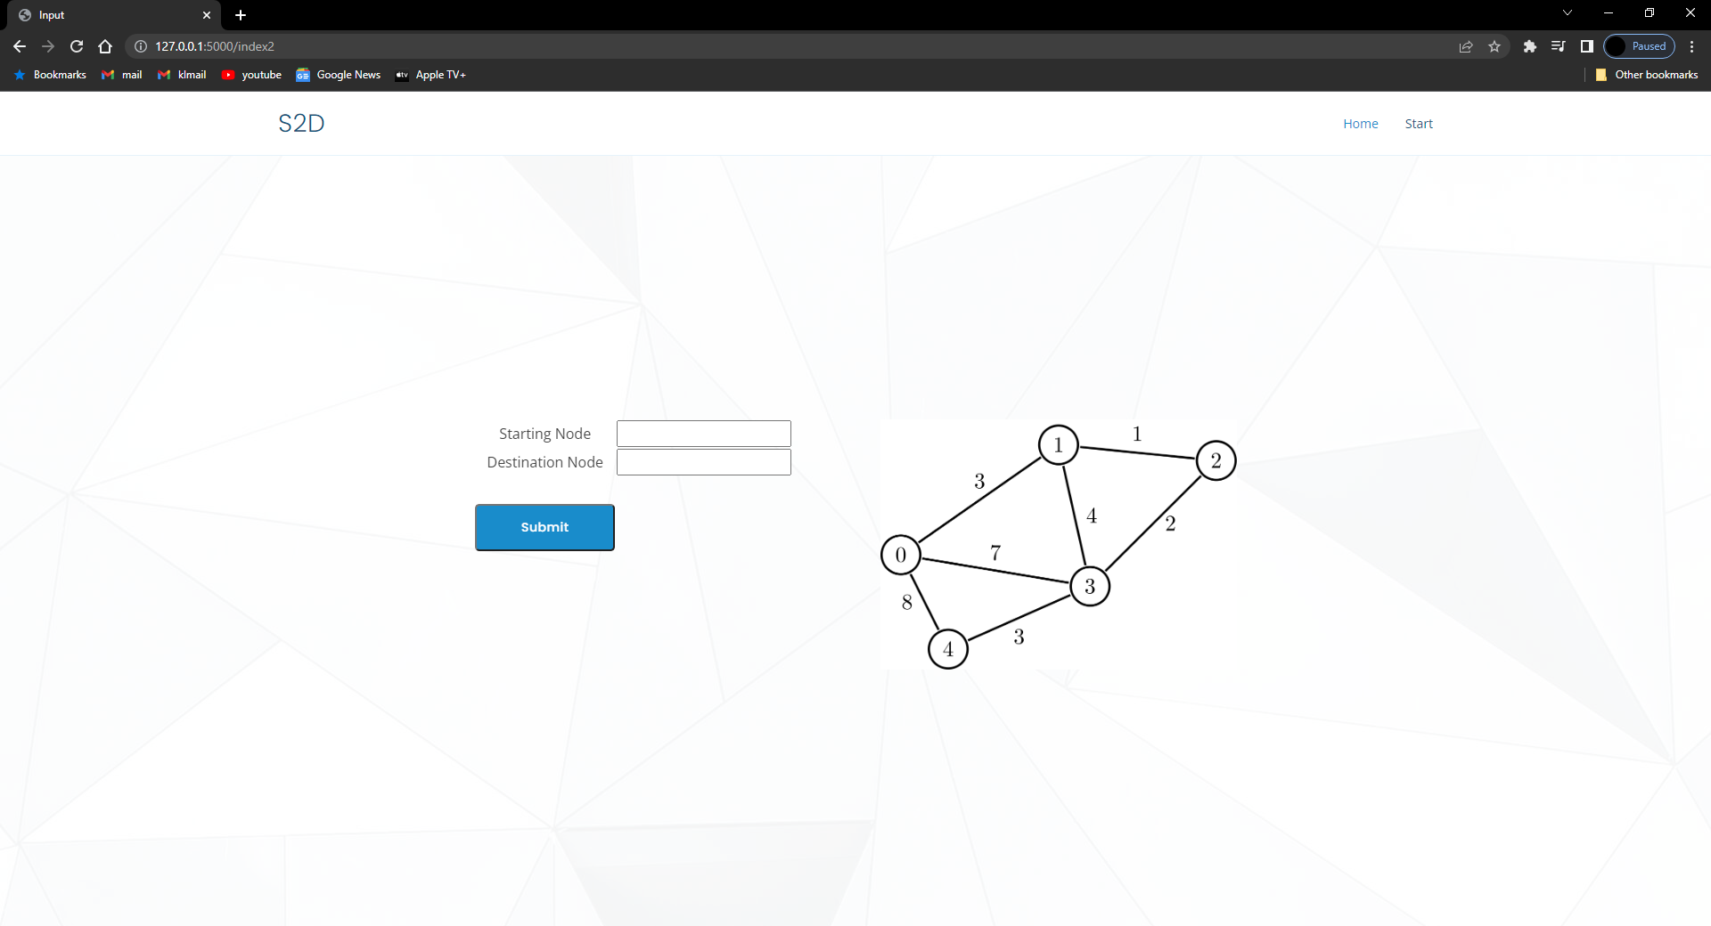
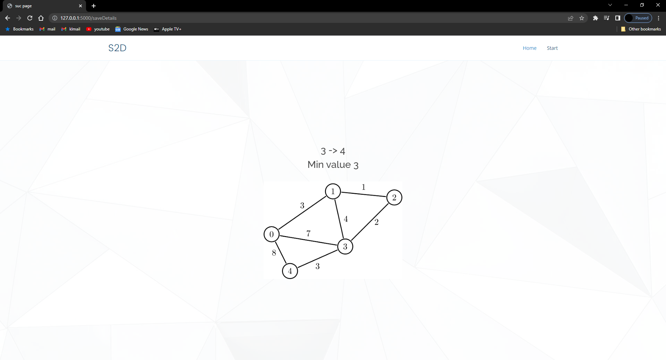

Slide 14
FUTURE SCOPE
Adding an ability to enter the node by the user is will be an advantage to our current method
Moving the web hosting service to Django or hosting it in a web server for testing will be appropriate representation of the intended real-life use

Slide 15
Suggestions

Slide 16
Thank you

