Slide 1
REVIEW 1
Devaraj Acharya – 2010030040
KS Satyavarsan – 2010030151
Jyothin Movva - 2010030071

Slide 2
PROBLEM STATEMENT
ANT COLONY OPTIMIZATION

Slide 3
INTRODUCTION
Ant colony optimization algorithm (ACO) is a probabilistic technique for solving computational problems which can be reduced to finding good paths through graphs.
Swarm intelligence

Slide 4
About ACO
Algorithms such as the Particle Swarm Optimization (PSO) and Ant Colony Optimization (ACO) are examples of swarm intelligence and metaheuristics.
Optimization techniques have evolved based on evolutionary algorithms and there by opened the domain of metaheuristic.

Slide 5
About ACO
ACO technique is purely inspired from the foraging behavior of ant colonies.
Ants communicate with each other using sound, touch and pheromone.
Pheromones are organic chemical compounds secreted by the ants that trigger a social response in members of same species.

Slide 6
About ACO
Ants live in community nests and the underlying principle of ACO is to observe the movement of the ants from their nests in order to search for food in the shortest possible path.
This randomized search opens up multiple routes from the nest to the food source.

Slide 7
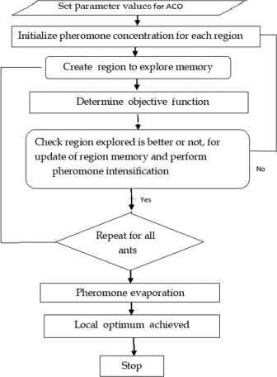
Algorithm

Slide 8
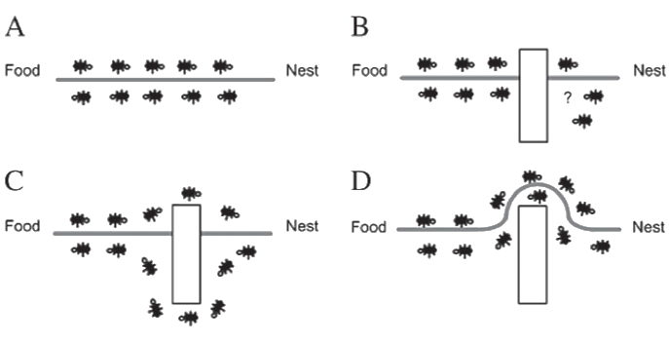
example

Slide 10
SUGGESTIONS

Slide 11
THANK YOU

