Slide 1
BUS TICKET GENERATOR
BY JYOTHIN MOVVA
SARVESH LATH
T YESHWANTH REDDY

Slide 2
INTRODUCTION
THE PROJECT IS A BASED ON THE KL UNIVERSITY BUS SYSTEM AND THE PROGRAM DEVELOPED ADDS A FEATURE TO THE SYSTEM WHICH CAN BENEFIT THE USERS.

Slide 3
TOPICS USED IN THE PROGRAM
STRUCTURES
FUNCTIONS
FILES

Slide 4
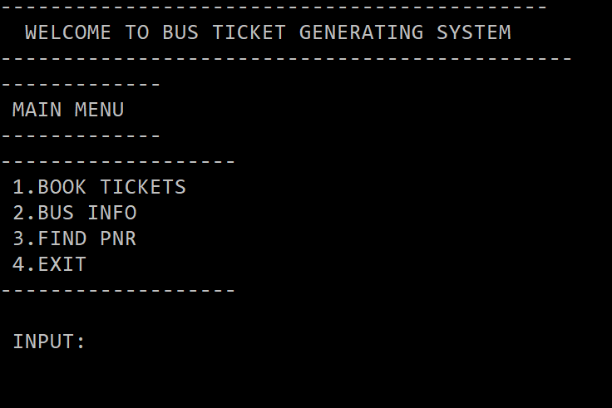
MAIN MENU

Slide 5
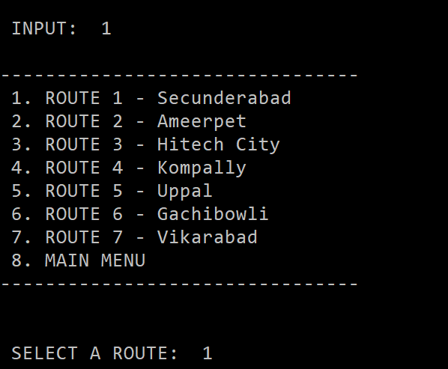
BOOKING PORTAL

Slide 6
LIVE DEMONSTRATION

Slide 7
MEMORY FUNCTIONALITY
TWO FILES WERE CREATED DURING THE PROGRAM
BUS.TXT
COUNT.TXT

Slide 8
THANK YOU

