Slide 1
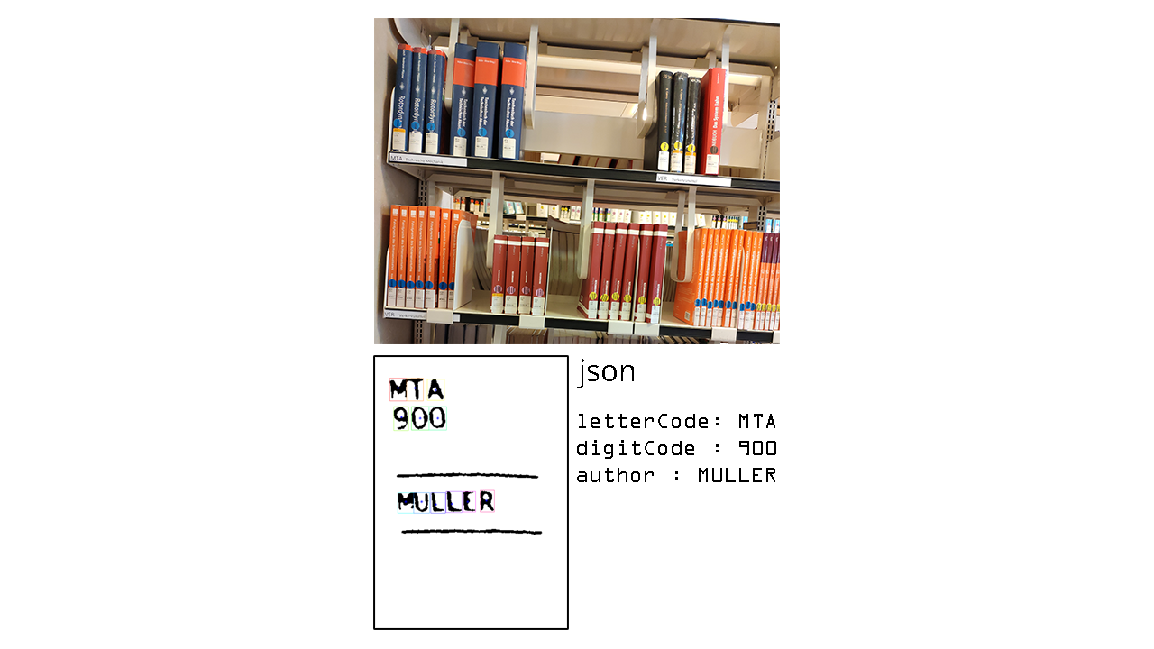
lib-indexer
EDBV WS 2019/2020: AG C 3
Anand Eichner (11808244)
Laurenz Edmund Fiala (11807869)
Anna Nieto-Berezhinskaya (01223066)
Aleksandar Vucenovic (01635282)

Slide 2
Final Prerequisites
New
Labels have to be bright enough for thresholding
Old
The books must be vertically aligned (+-5°)
The image must not be tilted more than 30°
Resolution must be high enough for OCR
The image must be a RGB image
The image must high enough contrast
White balance must be applied in the image

Slide 3
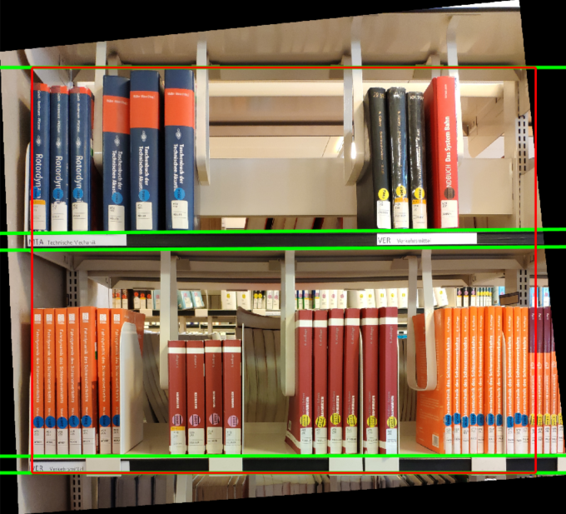
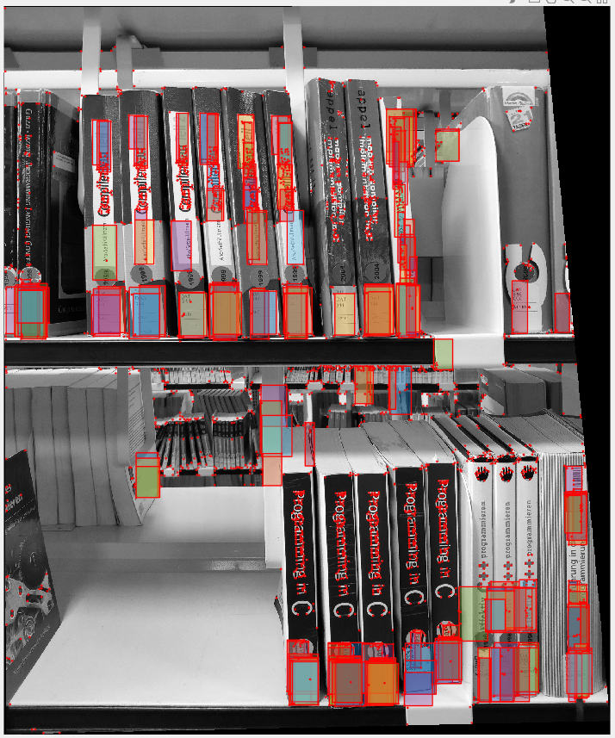
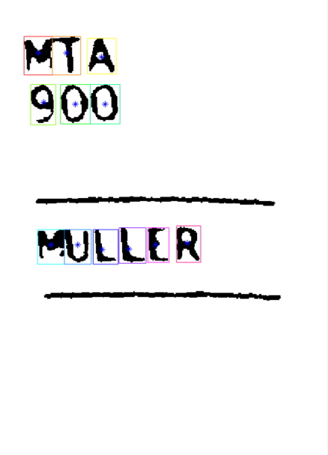
Pipeline
Perspective Correction
Preprocessing
Hough-Transformation
Geometric Image Transformation
Label Detection
Preprocessing
Integral Imaging
Otsu Threshold
Preprocessing for OCR
Dilation
Regionprops + Segment (“Word”) sorting
OCR
Normalized Cross Coefficient Algorithm
Sum of squared Differences Algorithm
Actual: “MTA 900 MÜLLER”
SSD: “HTA SQQ YVLLLR”
NCC: “LLL LLL FLJJR”

Slide 4
Problems
Label Detection
Some labels aren’t rectangles
Some labels are too dark
Some labels are very thin
False positives
Perspective Correction
Wrong line detection bloated RAM
Preprocessing OCR
Sorting and Segmenting Words
OCR
Resolution of letters is small
NCC padding might be a problem (giving too many L’s)
SSD isn’t the most precise algorithm
X still a problem
X solved

Slide 5
Evaluation
Qualitative
Which patterns do we have to recognize?
Shelves -> Labels -> Blobs (Potential characters) -> Characters
How does the image have to be transformed, to enable a good label detection
Gauss-Filter
Convolution Kernel for Harris choosen bigger
What indexing is useful, and how do we make the results human-readable?
We use a Matlab struct for the data, which is being transformed into a .json format
Additionally the labels and words are sorted from top left to bottom right
Which pre-processing do we need for the OCR to work properly?
Binarizing, Dilation, Regionprops, Slicing, Segmentation into Patches/Blobs

Slide 6
Evaluation
Quantitative
How many books/labels do we recognize in average?
About ~80%
Welche Auflösung ist notwendig, um akzeptable Ergebnisse zu erzielen?
Hängt von der Entfernung zu den Labels ab
How does the tilting of the image affect the label detection
Through image straightening we ensure, that there are only minimal changes in the OCR
The more tilting there is the better the resolution must be
How does the degree of fullness of the shelves affect the label detection
Less background is good as we get less false positives
Thin books could be seen as one big label

Slide 7
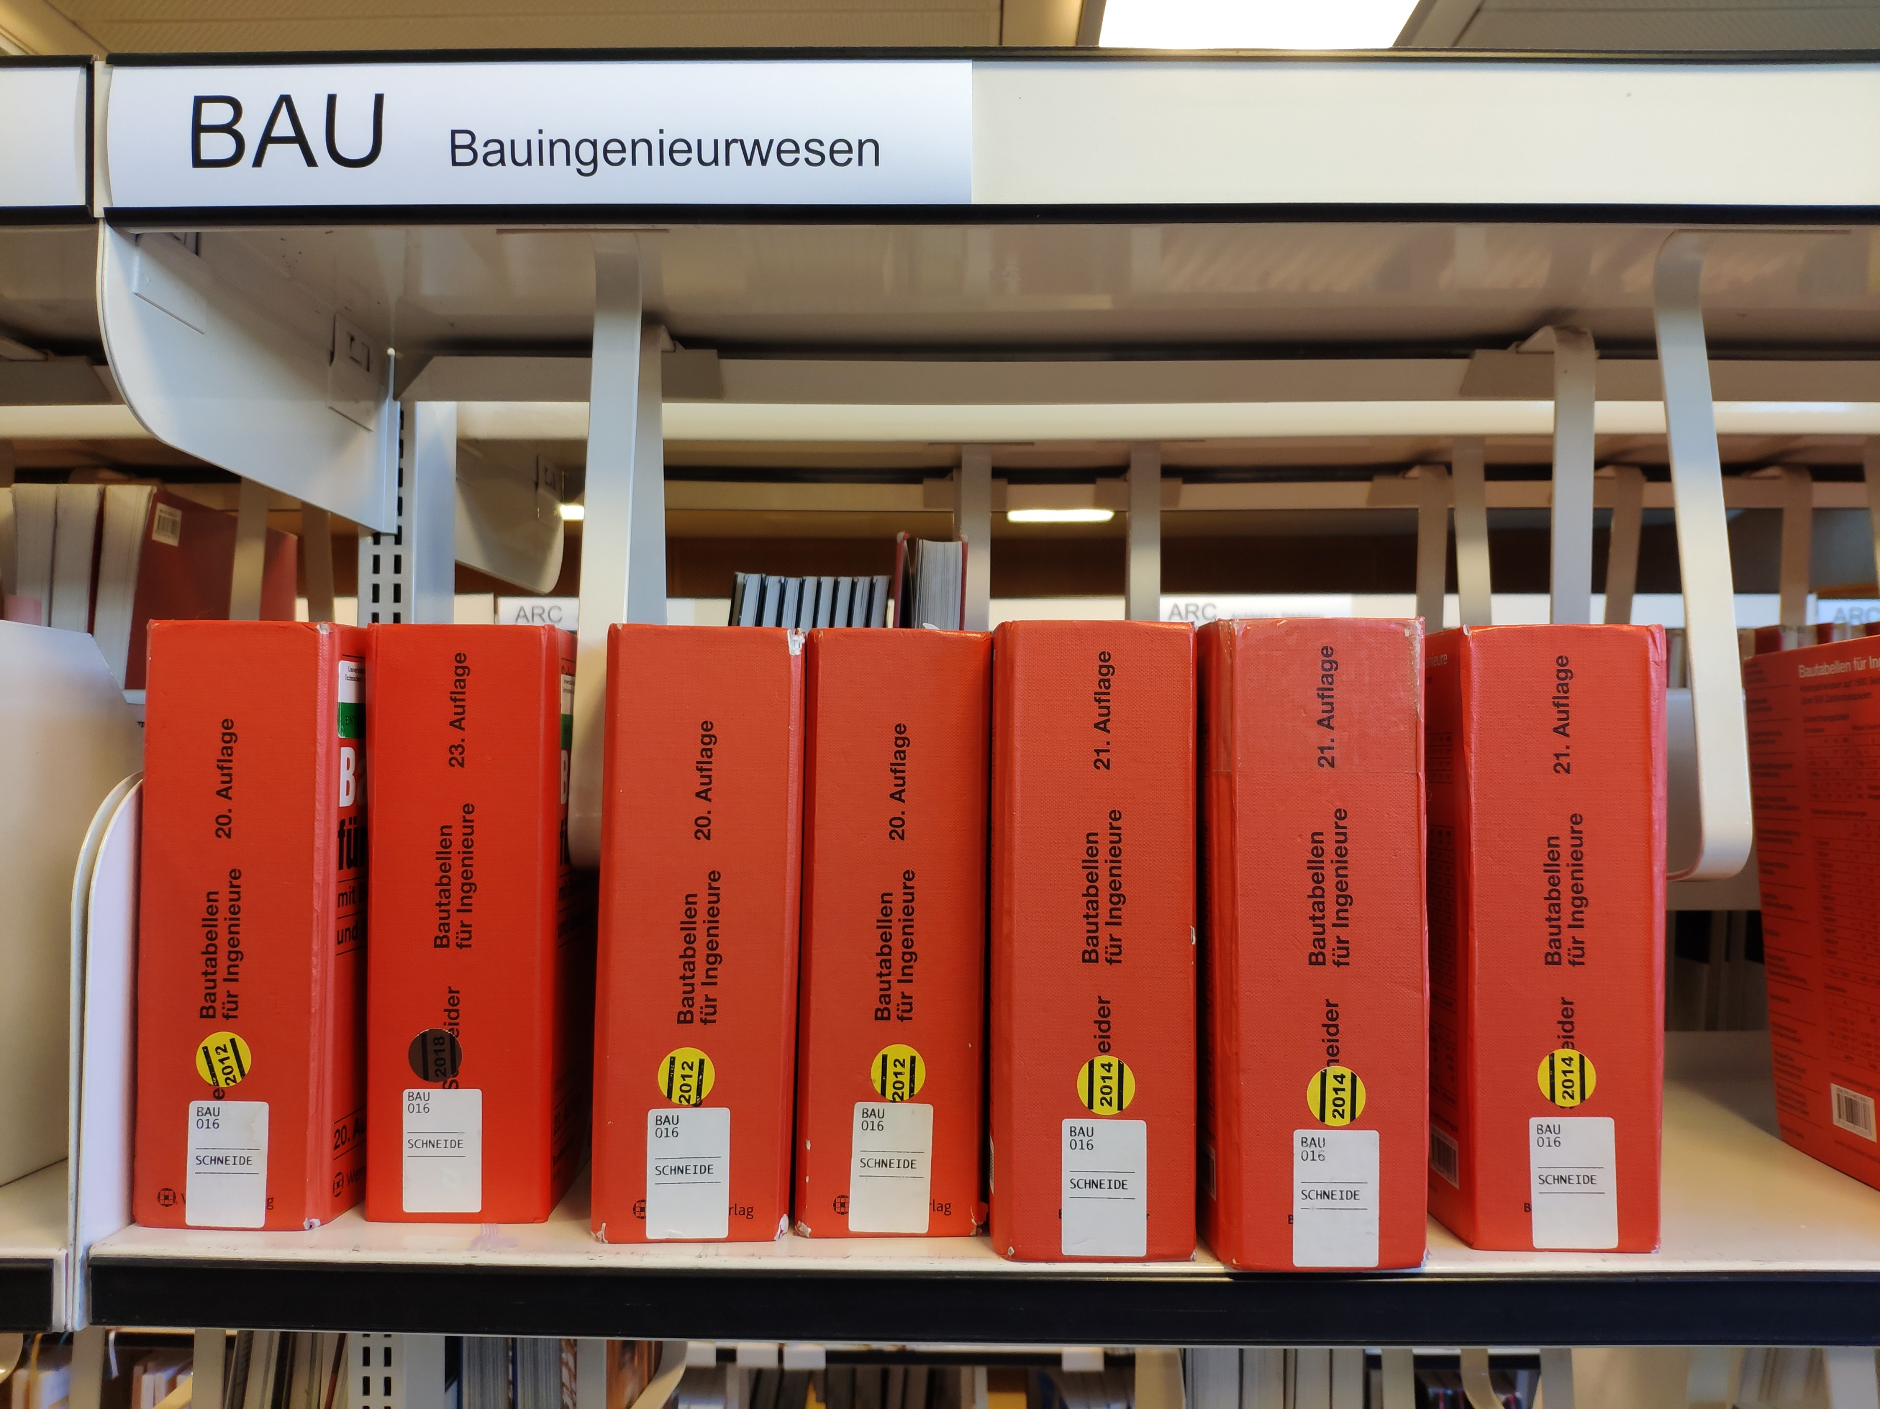
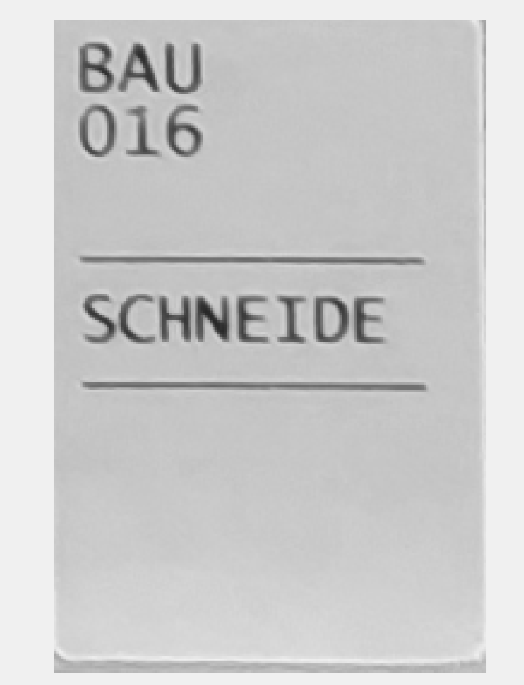
Result
Used Dataset:
One of the labels detected:
Result in json:
{"wordOne":"BAU","wordTwo":"107","author":"SCHNLTDL","bounds":[3428,2462,3603,2727]},

Slide 8
THANKS FOR LISTENING

