Slide 1
MyoMusic
Team # 33
Jeremy Schembri
Alexandre Gagnon
Imran Jameel
Brian Zhu
Victor Dyotte
Lucie Bélanger

Slide 2
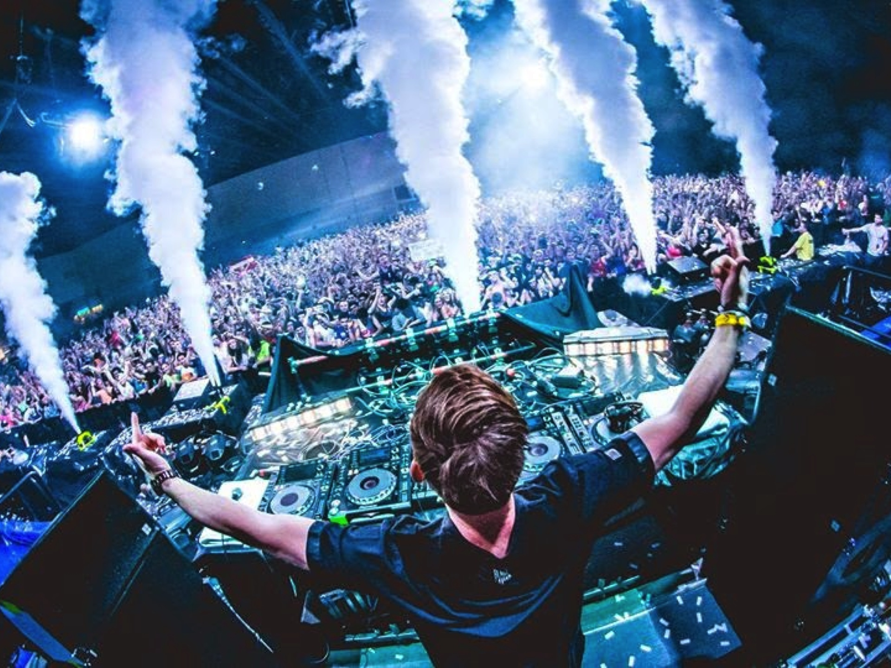
Motivation
Musical curiosity
Live performance exploration
Crowd engagement

Slide 3
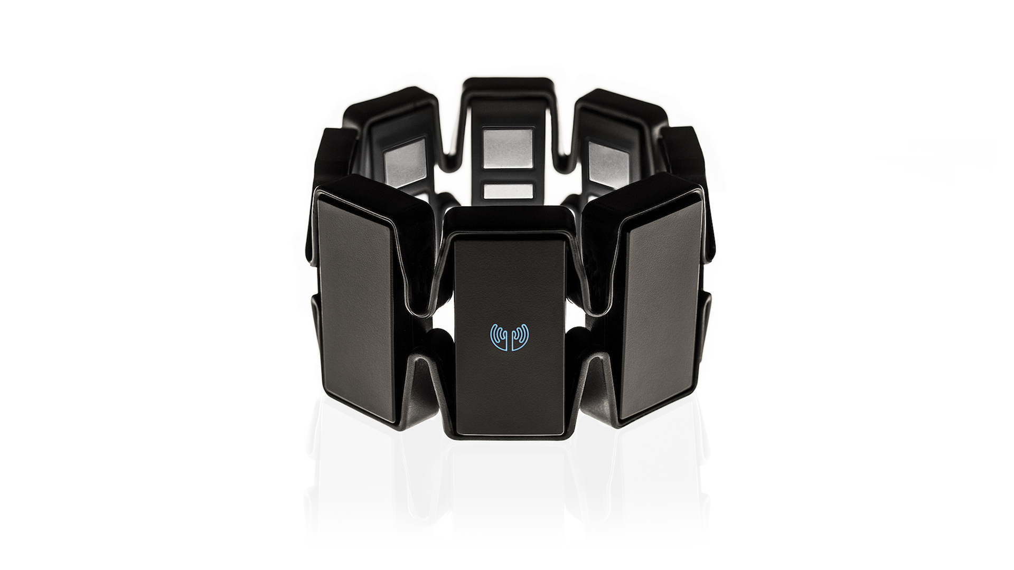
Start with a great device

Slide 4
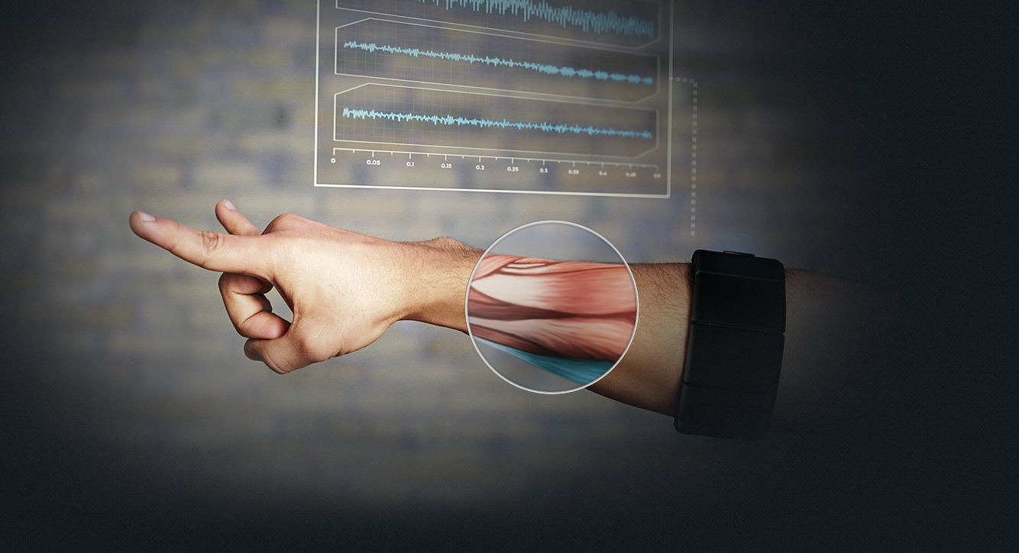
Figure out how to use it

Slide 5

Plug it into your favorite synth

Slide 6
The next steps
Get a Myo
Create extra artistic plugins
User tests with creators (lean approach)
Stand-alone mixing graphical UI
And …

Slide 7
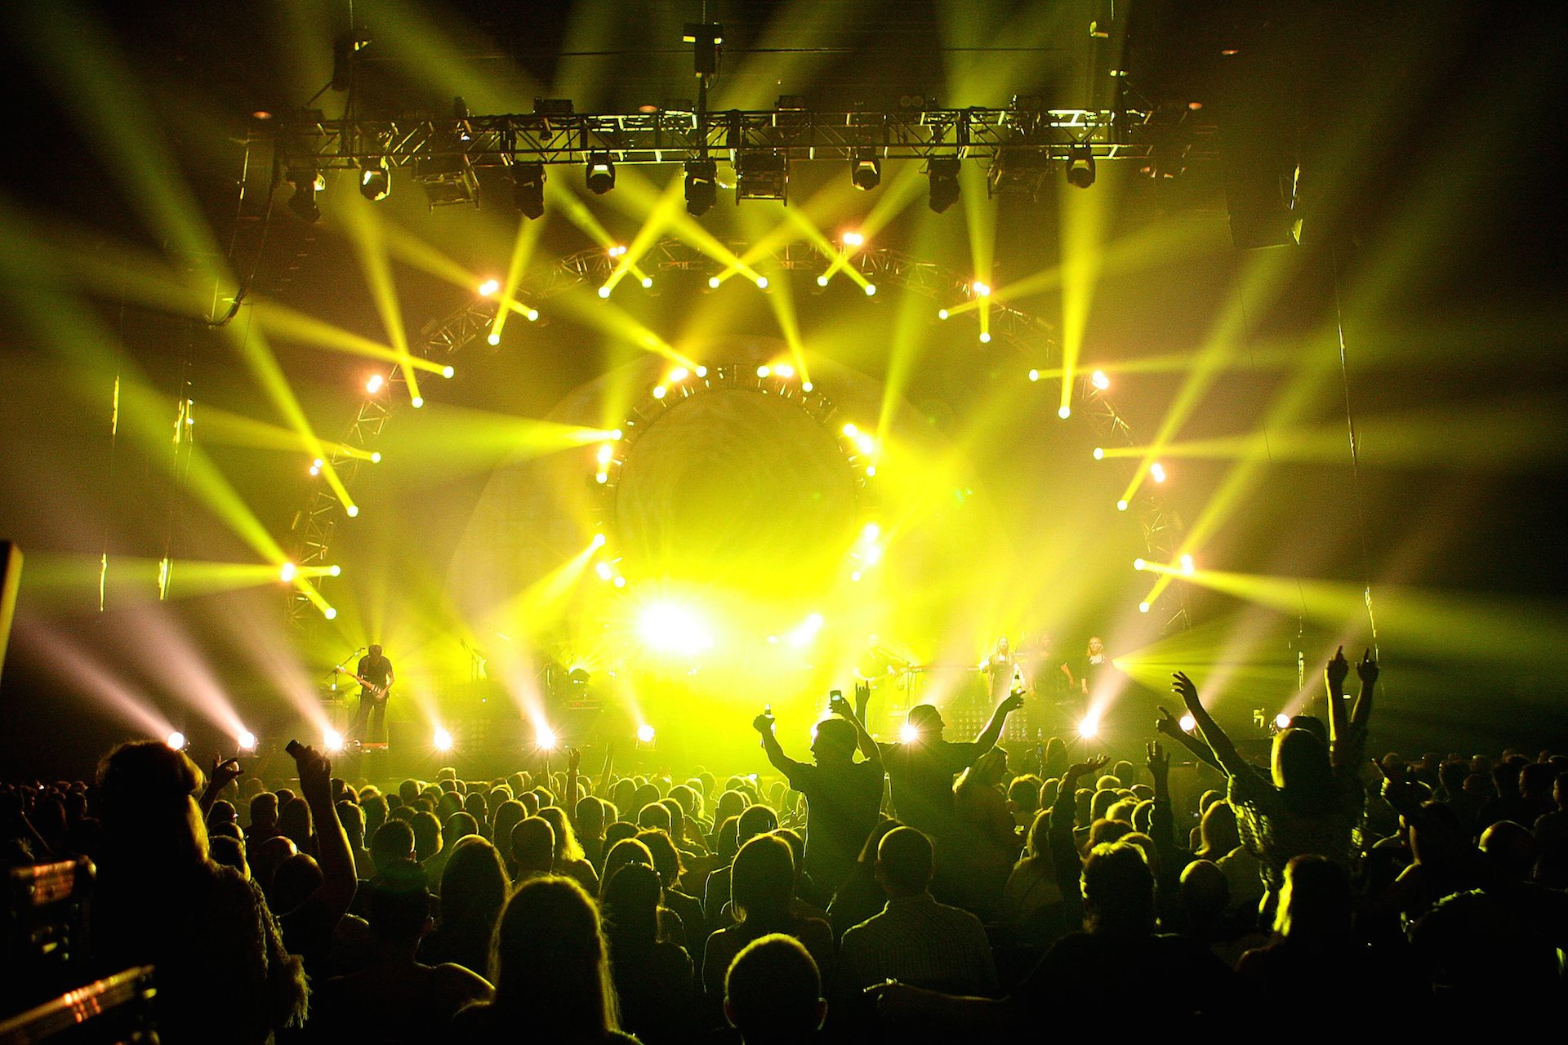
Become a rock star!

