Slide 1
Myo Music
Team # 33
Jeremy Schembri
Alexandre Gagnon
Imran Jameel
Brian Zhu
Victor Dyotte
Lucie Bélanger

Slide 2
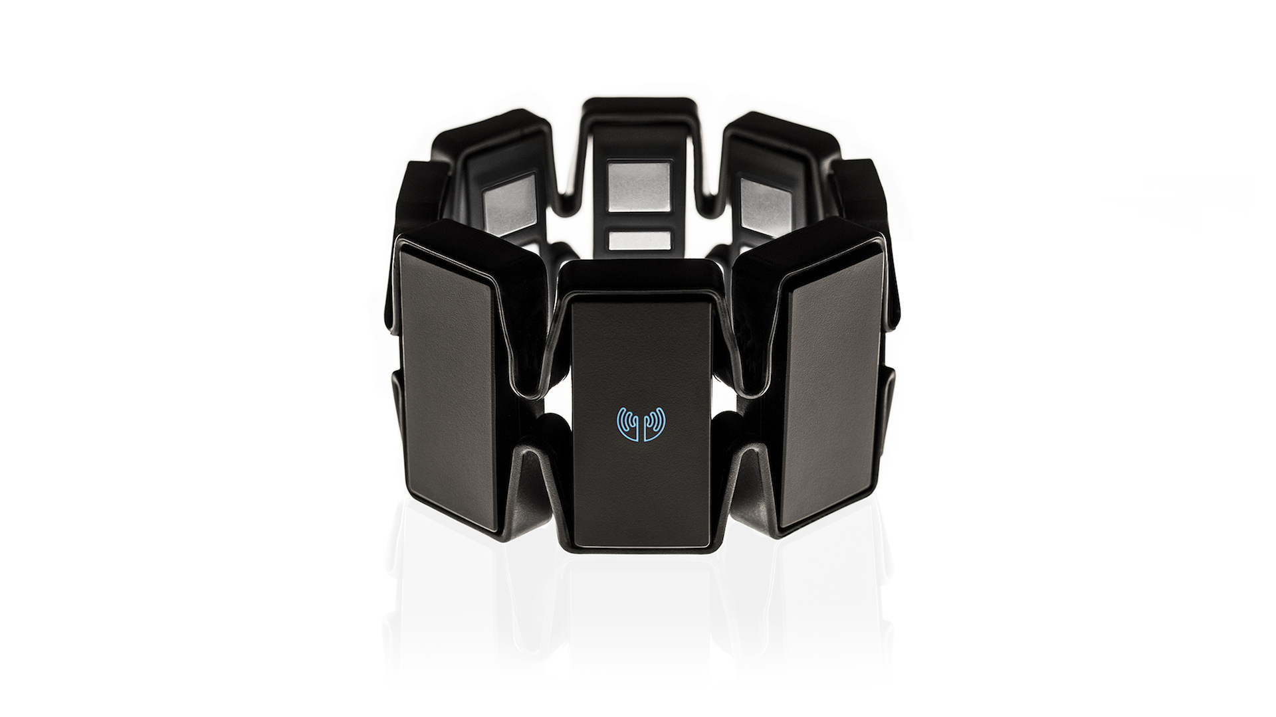
Start with a great device

Slide 3
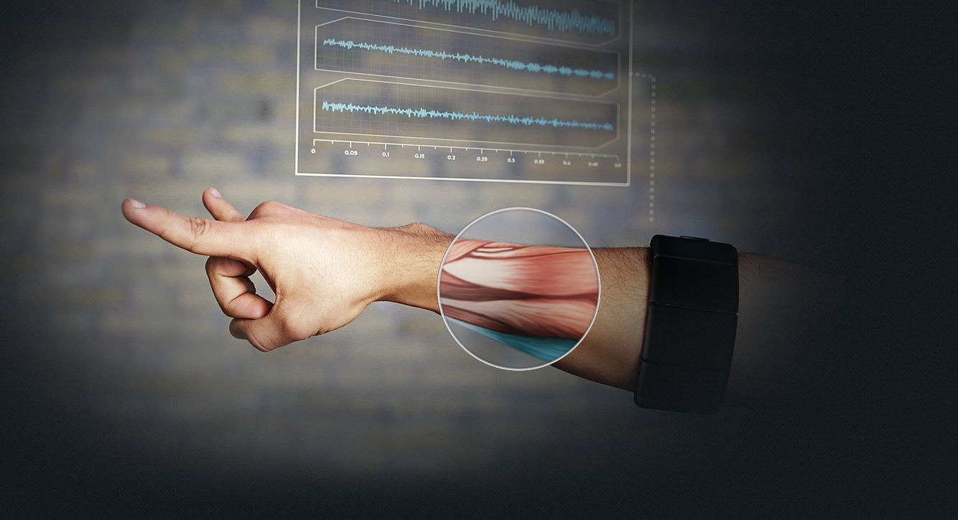
Figureout how to use it

Slide 4

Plug it into your favorite synth

Slide 5

Become a rock star!

Slide 6
Thank you!
Team # 33
Jeremy Schembri
Alexandre Gagnon
Imran Jameel
Brian Zhu
Victor Dyotte
Lucie Bélanger

Slide 7
