Slide 1

MyoMusic
Team # 33
Jeremy Schembri
Alexandre Gagnon
Imran Jameel
Brian Zhu
Victor Dyotte
Lucie Bélanger

Slide 2
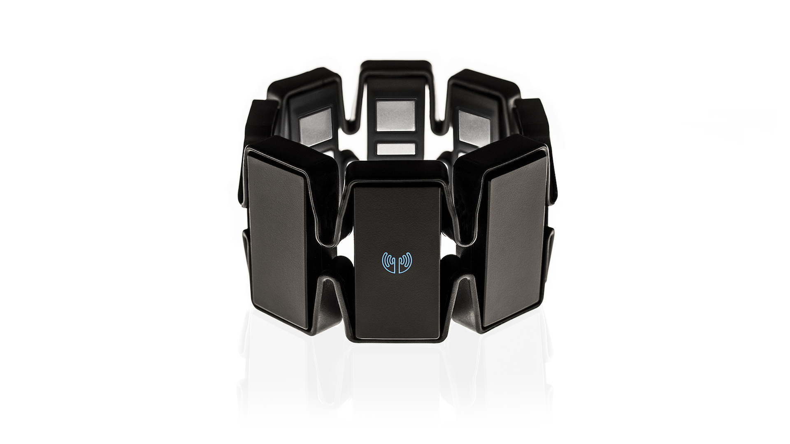

Slide 3


Slide 4
Problem
Growing electronic music industry
DJ occupation more competitive
Differentiate oneself from another
Crowd-to-DJ engagement

Slide 5
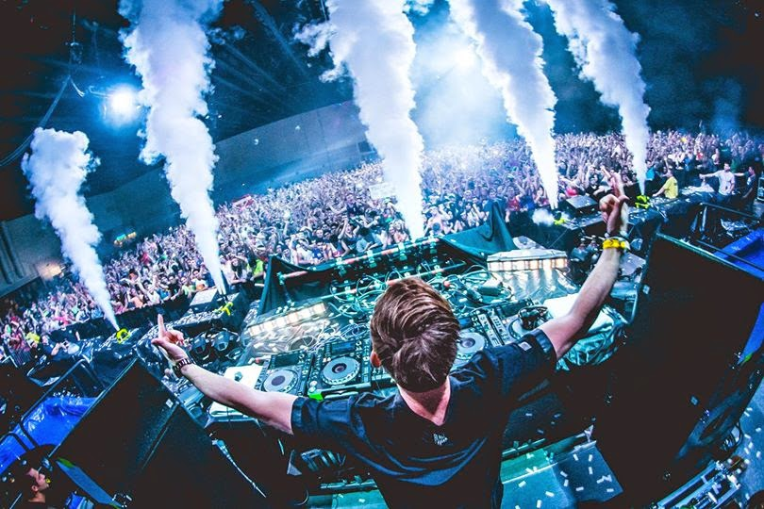

Slide 6
Thank you!
Team # 33
Jeremy Schembri
Alexandre Gagnon
Imran Jameel
Brian Zhu
Victor Dyotte
Lucie Bélanger

