Slide 1
MyoMusic
Wearable Sound
Jeremy Schembri
Alexandre Gagnon
Imran Jameel
Brian Zhu
Victor Dyotte
Lucie Bélanger

Slide 2
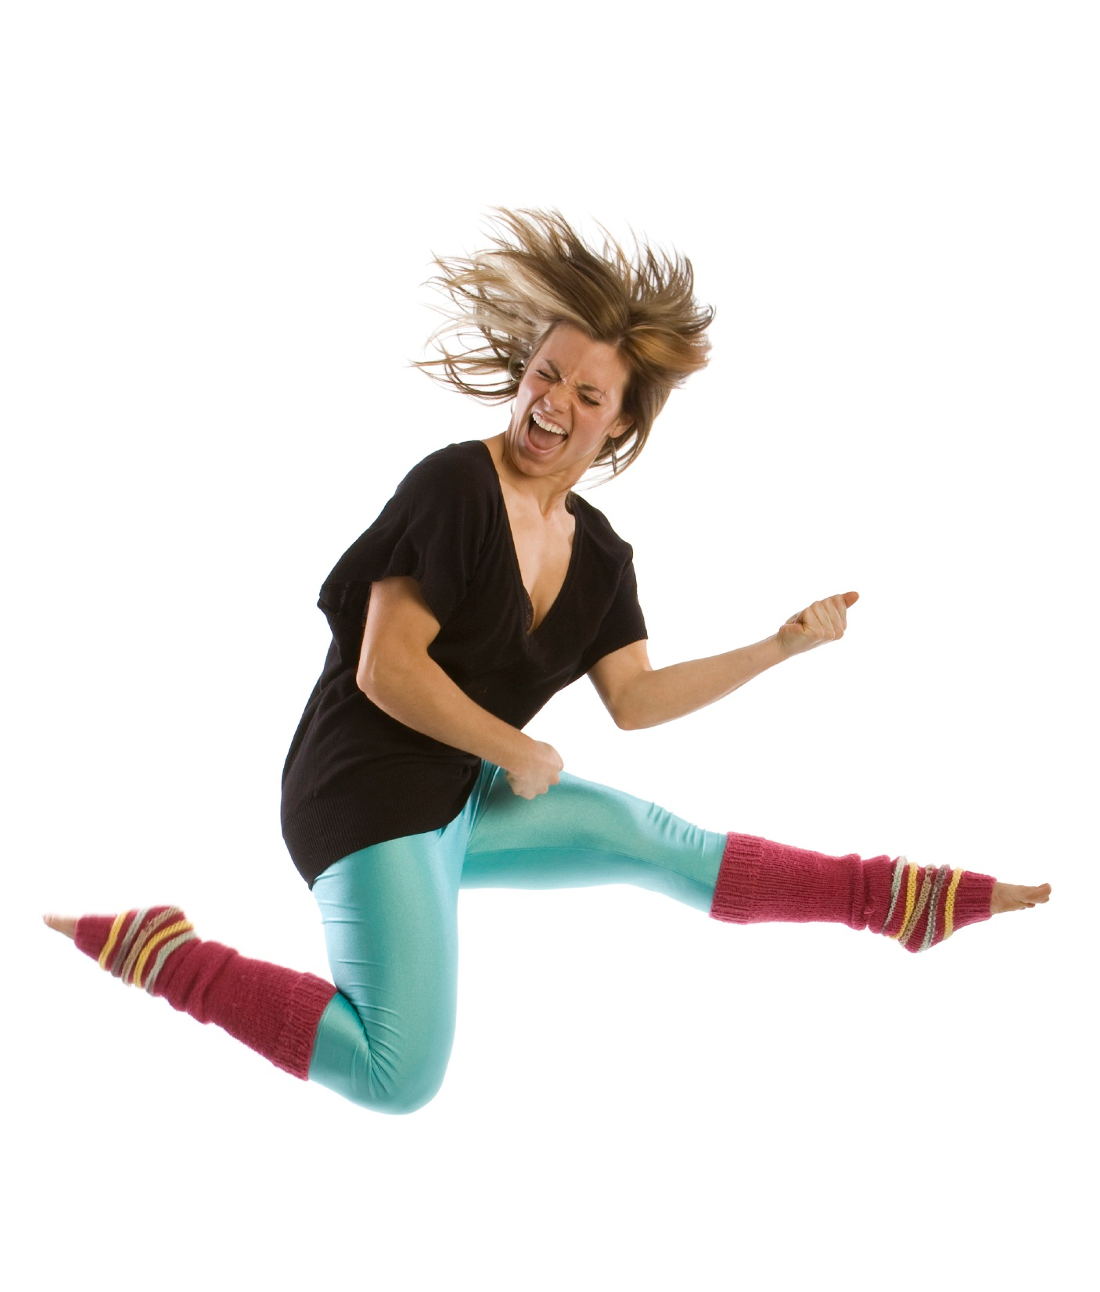

Slide 3
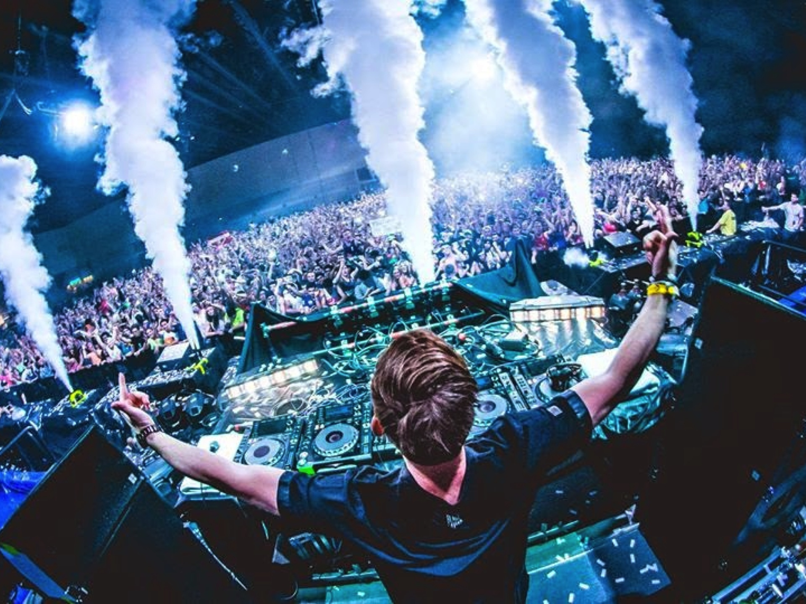
Motivation
Musical curiosity
Live performance exploration
Crowd engagement

Slide 4
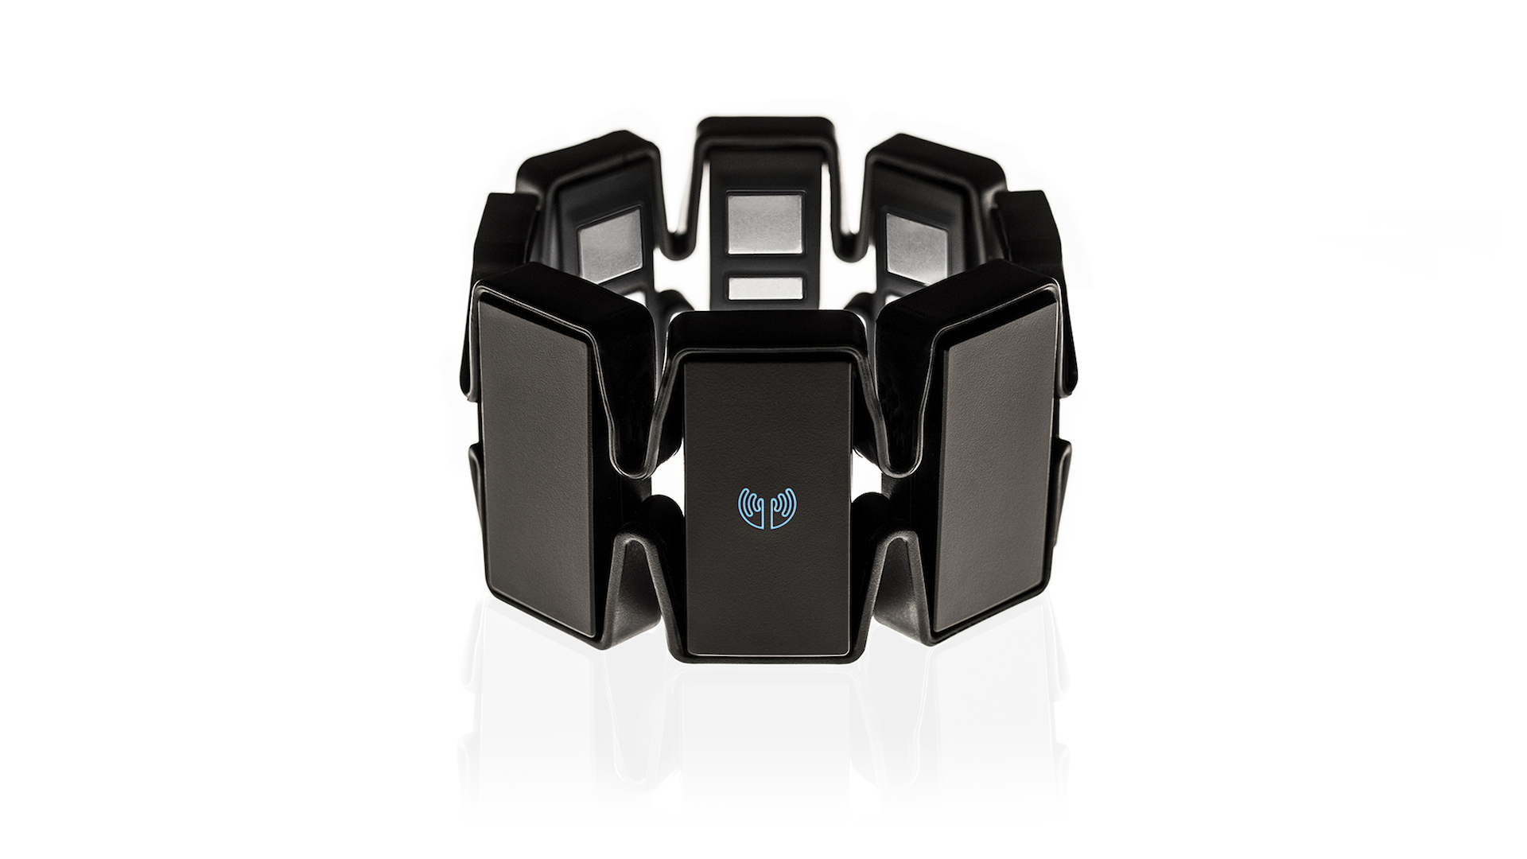
Start with a great device
Thalmic Labs Myo

Slide 5
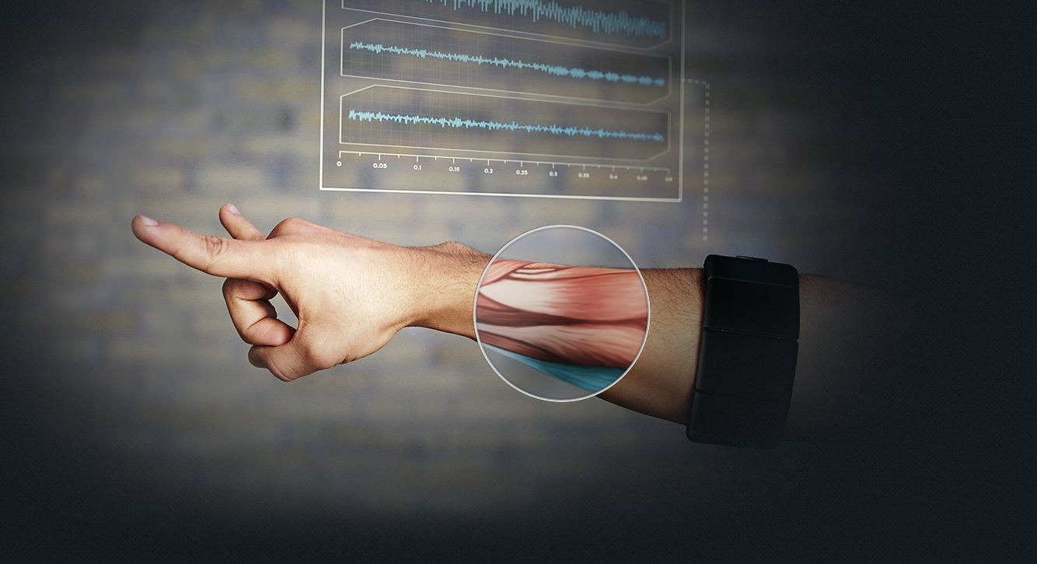
Figure out how to use it

Slide 6
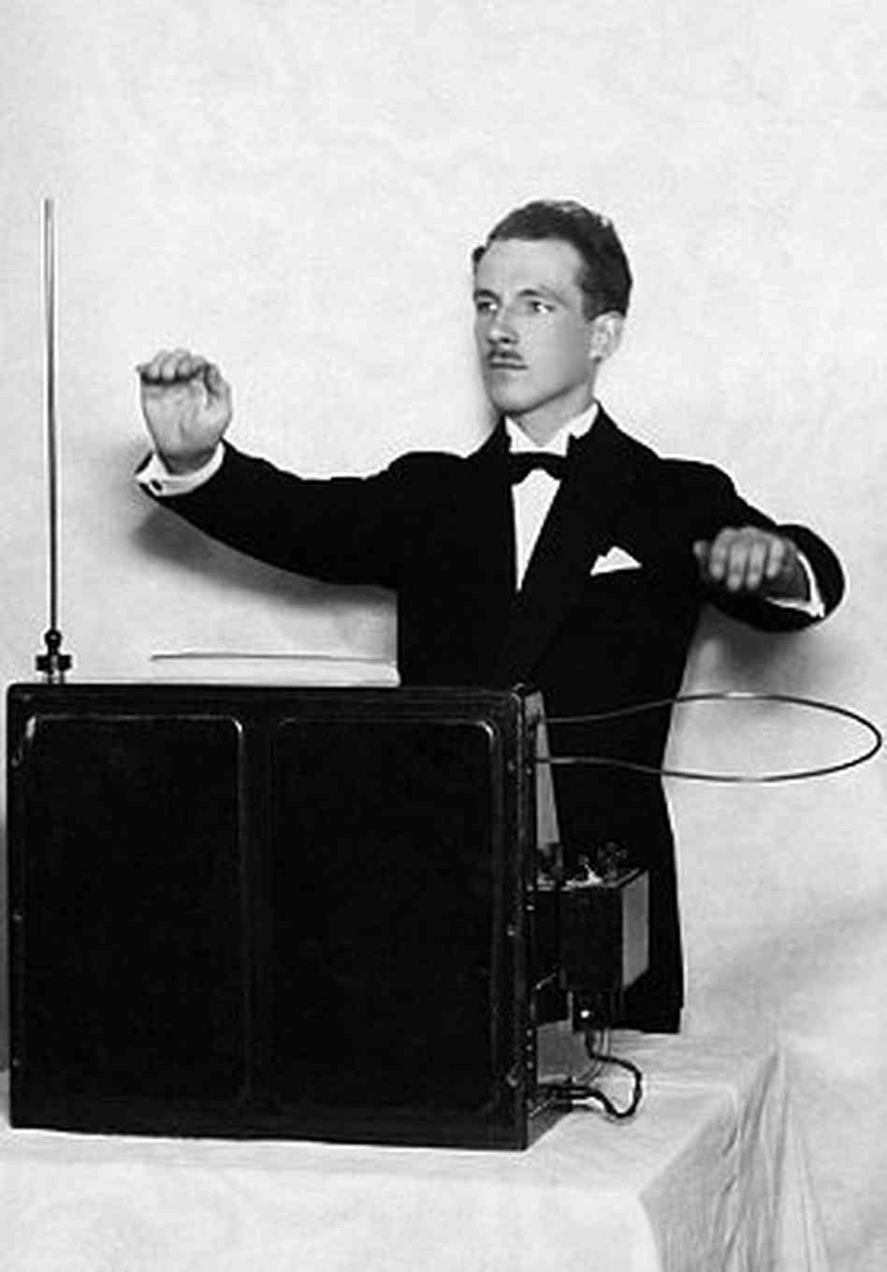

Slide 7
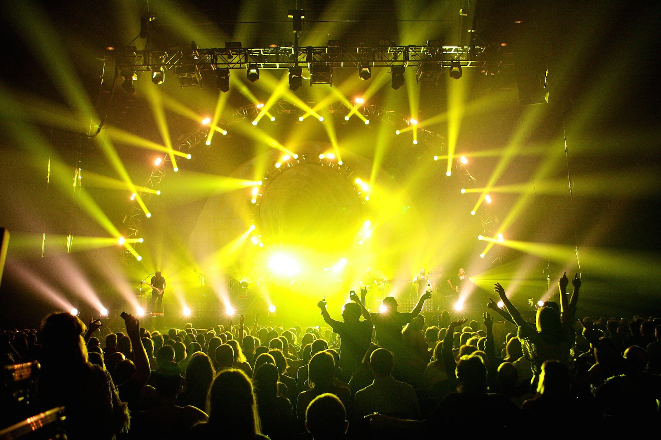
Become a rock star!

