Slide 1

Concepts and Models of Knowledge Engineering
Car Proposes Actions
Based on the Current State
Group 5: Bobko Yuliia, Ligori Armela, Farkhondeh Mehran, Mühlbauer Thomas, Tekhov Oleksii

Slide 2
Problem: How to choose car actions?
Multiple variables to consider
Which action is more important?
Client’s input to consider
Regular logic cannot properly handle ambiguity

Slide 3
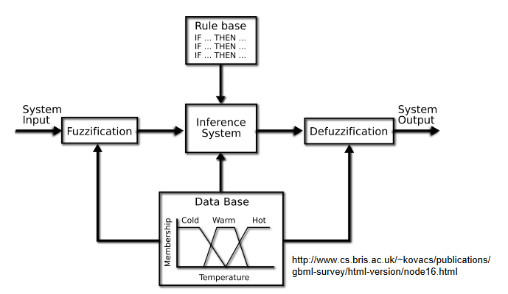
Solution: Fuzzy Inference System
Input: environmental values
Output: proposed actions
Rules that map input to output

Slide 4
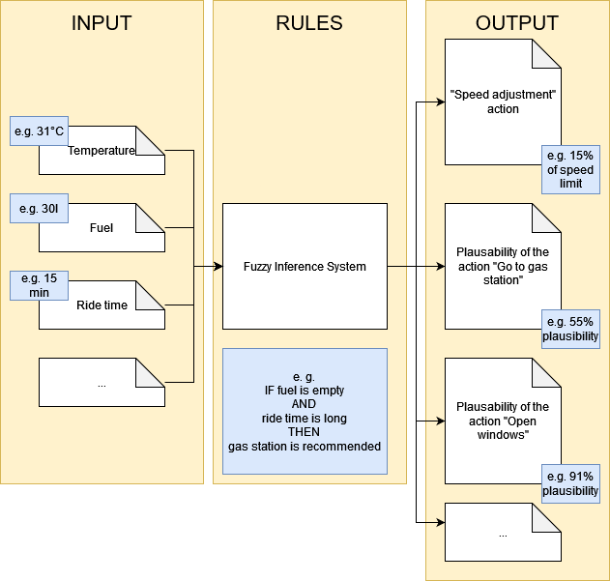
Overview of the proposed system

Slide 5
Input variables
Variable name | Description
Temperature | Current temperature in Celsius
Ride time | Length of the current ride in minutes
Fuel level | Current quantity of fuel in liters
Traffic congestion | Mean average speed of the selected route in km/h
Car’s maintenance history | Condition of the car presented as a range (very poorly maintained – very well maintained)
Points of interest (POI) | Number of POI in the area presented as a range (scarce – abundant)
Visibility | Clarity of sight calculated by car’s sensors
Daytime | Time of the day in hours

Slide 6
Output variables
Variable name | Description
Gas station | Refuel the car and provide intensive to the rider
Open windows | Open the windows based on POI and visibility
Supply customer with a snack and water | Provide snacks and water based on ride time and temperature
Adjust speed | Adjust speed of the car based on visibility and traffic congestion
Go to the maintenance | Fix the car based on ride time and maintenance history
Recommend a stop | Advise stop if area has POIs
Headlight intensity | Adjust headlight intensity based on visibility and daytime
Recommend car-sharing | Recommend to split ride with other rides based on daytime and traffic

Slide 7
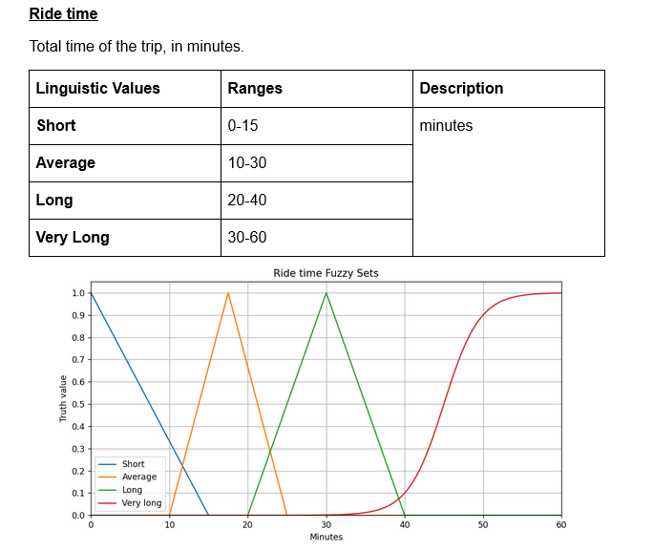
Example input variable
Ranges = Fuzzy Sets
Describe variable with human language: “short ride time”
Overlapping sets provide ambiguity

Slide 8
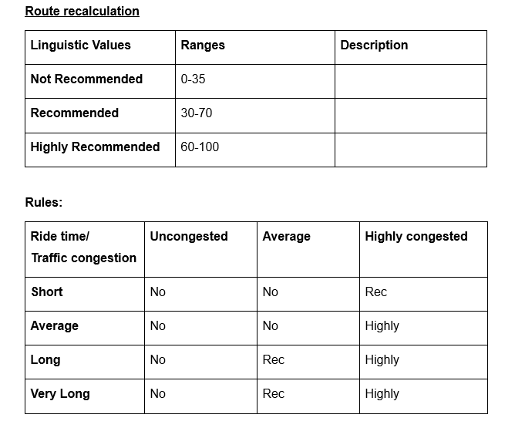
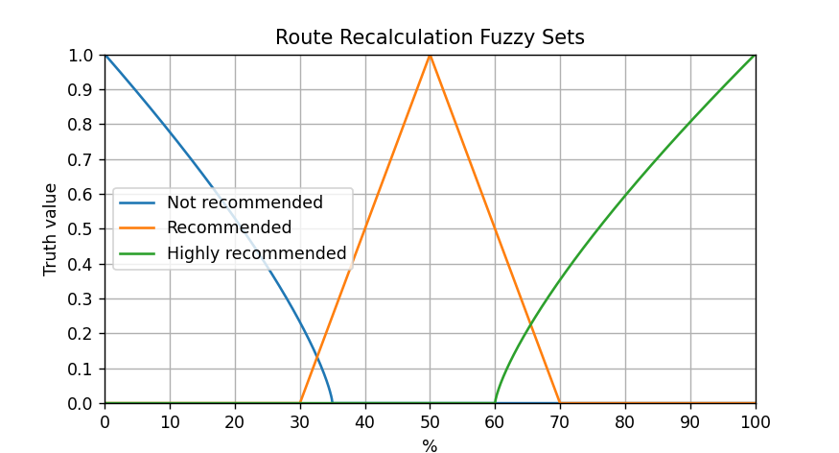
Example output variable (recommendation)
Same idea as input variables
Rules based on two inputs
Output is the plausibility of action
Can be compared to other actions

Slide 9
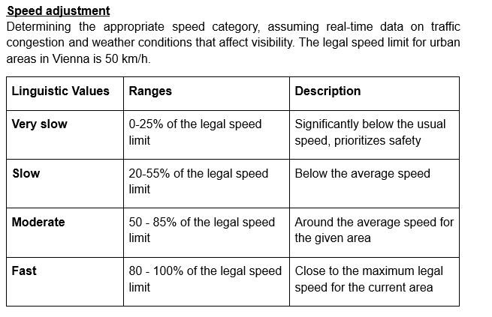
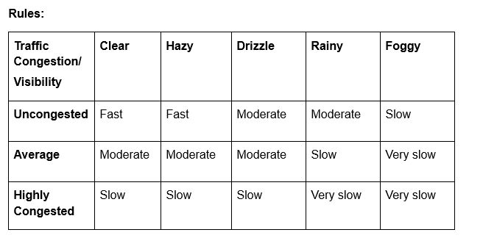
Example output variable (value)
Different interpretation of the output value
Output is specific to the action
Cannot be compared to other actions

Slide 10
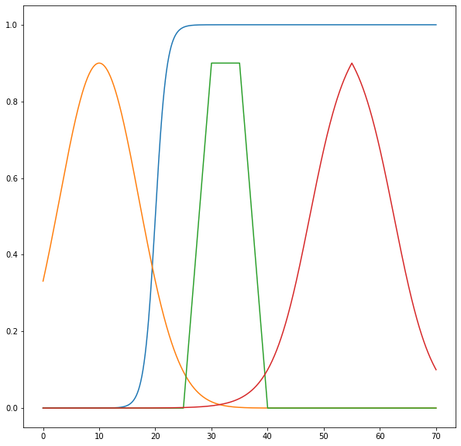
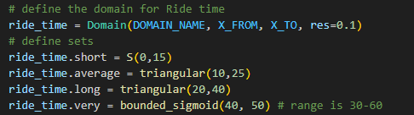
Fuzzy Logic for Python
Handles fuzzification
Handles defuzzification using the COG (center of gravity) method
Provides functions for fuzzy sets: linear, triangular, trapezoid, sigmoid…
Provides hedges (very) and combinators (and, or)
https://github.com/Python-Fuzzylogic/fuzzylogic/blob/master/docs/Showcase.ipynb

Slide 11




Tools and technologies
Docker
Python
Flask Framework
Swagger API
fuzzylogic
matplotlib

Slide 12
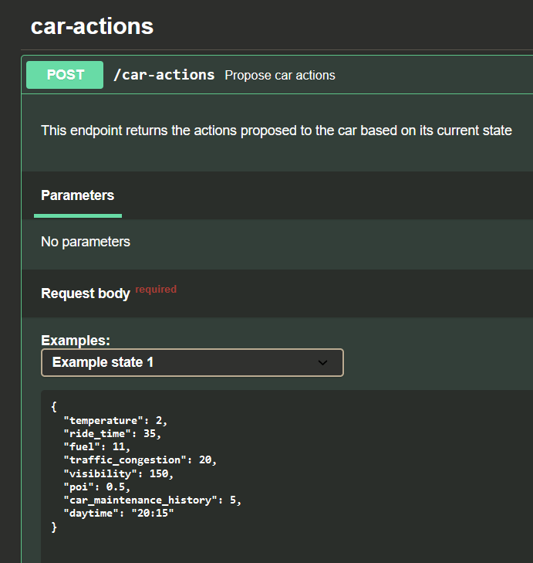
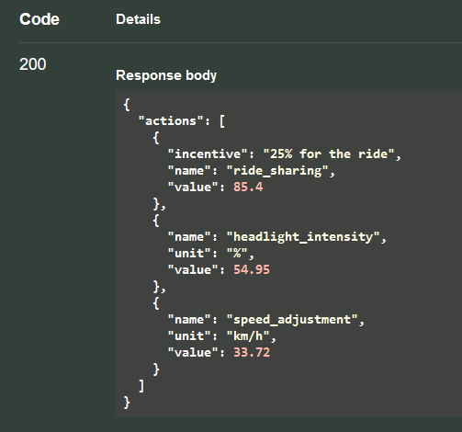
Swagger API Endpoint

Slide 13
DEMO

Slide 14
Evaluation of the solution
What worked well:
High ambiguity
Meaningful output (including incentives)
Easy to use
Easy to modify (fine-tune variables and rules)
What can be improved:
More fuzzy sets for output variables
More complexity for the sets’ functions
Simulations can be done to analyse the results

Slide 15
Questions?
Thank you!

