Slide 1
Auto-wah pedal
A Python implementation by Simon Guilloud and Lucie Perrotta

Slide 2
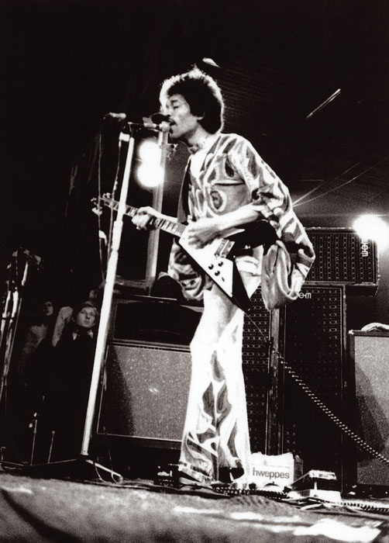
The Auto-wah pedal
Inspired from the Wah pedal
Widely used starting from the early 70s by guitar and trumpet musicians
Automatically adjusts the peak frequency depending on the signal’s intensity
Jimmy Hendrix

Slide 3
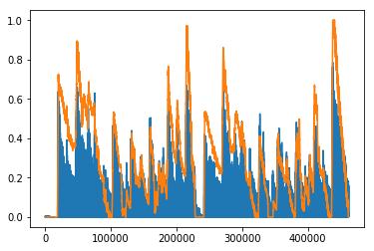
First, let’s compute the envelope
In blue, the input signal (mono)
In orange, the envelope of the signal

Slide 4
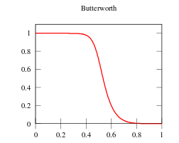
The wah sound
The name of wah is an onomatopoeia for the characteristic sound it gives to the instrument.
This corresponds to a Modified Butterworth lowpass filter (with a peak at the high end) to the signal.
The filter’s lowpass cutoff frequency depends on the envelope value.

Slide 5
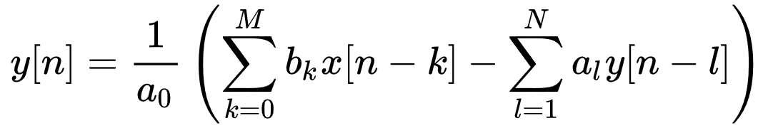
Time-dependent Wah filter
IIR lowpass Butterworth filter
X is the dry guitar signal
Y is the past wah’ed guitar signal

