Slide 1
PouchDB
14507587

Slide 2
PouchDB - Basic Characteristics
open-source JavaScript database
In-browser database
  Browser support: IndexedDB or WebSQL
Inspired by CouchDB
Designed for applications that should work offline as well as they work online
  Applications can store data locally
  Once the servers are back online, everything is synchronized

Slide 3
Download and installation
I download everything through terminal (any linux-like terminal should work)
PouchDB can be installed using npm:
  npm install --save pouchdb
  If you don’t have npm, first run: sudo apt install npm
For the purposes of my app, pouchdb-server is also needed:
  npm install -g pouchdb-server
Web page with further information: https://pouchdb.com/

Slide 4
PouchDB in HTML
PouchDB should be included in every script that uses it
  I included the links from unpkg:
  The first link is for including pouchdb, the second link is for pouchdb-find (or Mango queries), that allows using secondary indexes (“find all documents that satisfy some conditions”)

Slide 5
Supported Data Models
PouchDB is a document store (document-oriented database system)
  Records (documents) do not need to have a uniform structure
  The types of the values of individual columns can be different for each record.
  Columns can have more than one value (arrays).
  Records can have a nested structure.
PouchDB document:
  In JSON format
  Each document has folowing fields:
    _id (string) – document identifier, unique
    _rev (string) – a revision marker, a randomly-generated ID that changes
    whenever a document is created or updated

Slide 6
DML Operations
Create a new local database: var db = new PouchDB('name');
Create a new remote database (or connect to an existing one): var db = new PouchDB('link');
  link should be path to a database in CouchDB
Storing a document: db.put(doc);
Get a document with _id: db.get(id).then(function (doc) { // do somethinf with doc });
Updating document: db.get(id).then( function (doc) {
                // do update on doc
                return db.put(doc);
                });
Remove a document: db.get(id).then(function (doc) {
                return db.remove(doc);
                });
Find all documents that satisfy some conditions: db.find({
                selector: { // conditions }
                // options
                });

Slide 7
Querying
Bulk operations:
  db.allDocs([options], [callback])
    Read all documents from database “db” (SQL: SELECT * FROM db)
  db.bulkDocs(docs, [options], [callback])
    Write all docs to database “db” (SQL: repeated INSERT)
db.get(docId, [options], [callback])
  Fetch a document with _id matching docId (SQL: SELECT * FROM db where _id = docId)
db.find(request [, callback])
  return the list of documents that match the request (SQL: SELECT * FROM db where *some conditions* )
  (in separate plugin pouchdb-find)

Slide 8
Chosen Domain
Articles Database System
Entities:
  Article – database articles
  Person – database people
    Author, Reader – separate entities
    Both are stored in people database, but Author has an additional attribute
  Comment – database comments
  BranchOffice – database offices

Slide 9
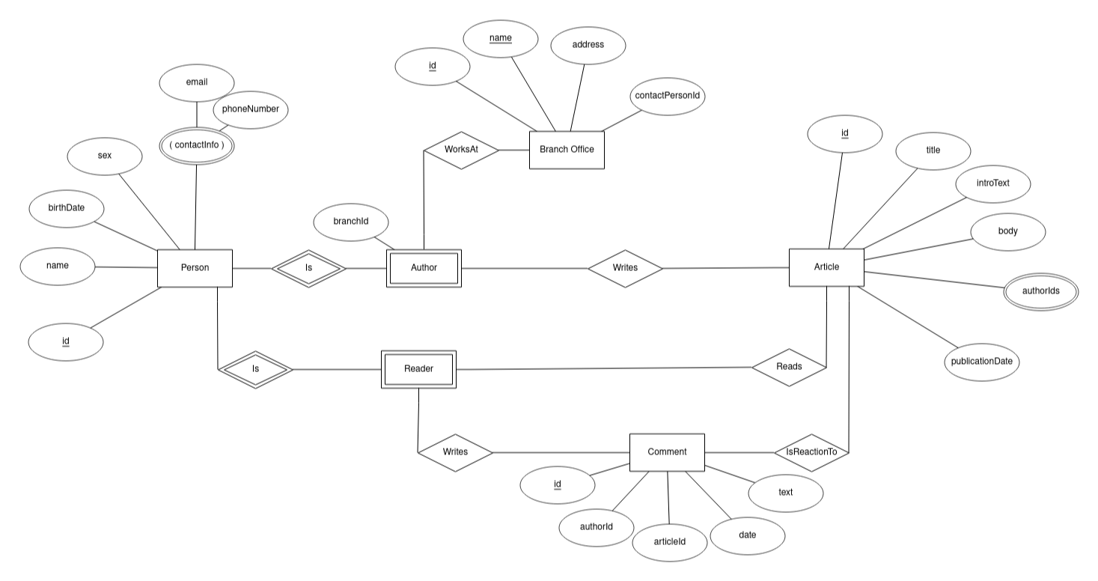

ER schema

Slide 10
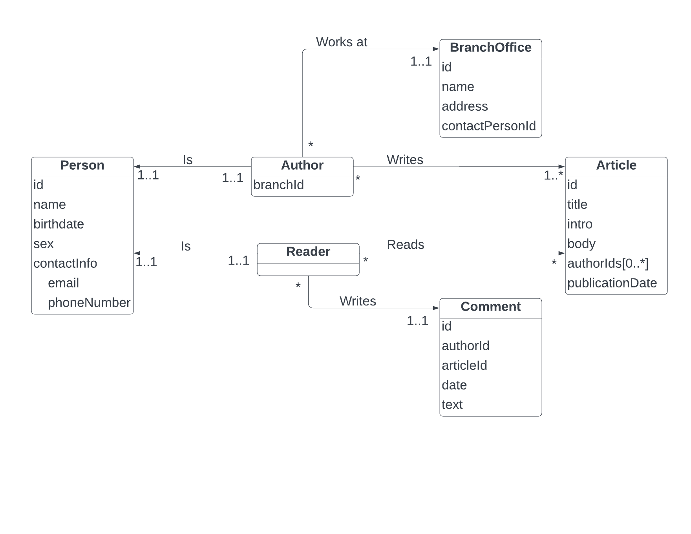
Logical (Database) Schema

Slide 11
Sample Data
I downloaded the list of people:
  https://media.githubusercontent.com/media/datablist/sample-csv-files/main/files/people/people-1000.csv
  I then assigned first 50 as authors and the rest as readers
I generated articles and comments with the help of ChatGPT
  I specified fields and presented some ideas and the AI generated some articles/comments in json format (which I had to correct, because there was a lot of mistakes)
I wrote the json with branch offices myself

Slide 12
Queries + Description
I created a simple application that uses my database
  Article Database System
Each page (except the main page) uses some query to get wanted data from the database
  On the bottom of each page (except main and /all.html) you can see how long the query took
    e.g.:
Each query can be found in the corresponding HTML code as a JS script

Slide 13
Query: get branch office details
URL: http://localhost:63342/pouchDbArticles/office.html?id=5
HTML file: /office.html
Office ID is specified as a GET parameter
Office is accessed using get()
  Get office with specified id:
Then contact email is needed - get()
  Get person with contactPersonId of the office
  and retrieve their email:

Slide 14
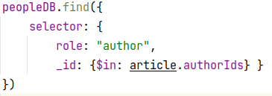
Query: get an article and all related comments
URL: http://localhost:63342/pouchDbArticles/articleWithComments.html?id=1
HTML file: /articleWithComments.html
Article ID is specified as a GET parameter
The article is accessed using get()
  Get article with specified id:
Then the list of authors is needed – find()
  Get all author names that have one
  of the given ids (author IDs):
Finally, the comments are needed – find()
  Get all comments that have articleId as the specified id (from URL):

Slide 15
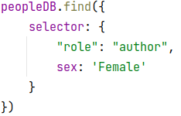

Query: Get all female authors + their articles
URL: http://localhost:63342/pouchDbArticles/femalesWithArticles.html
HTML file: /femalesWithArticles.html
Get all female authors using find()
  Get all authors that have sex = ‘Female’:
Get all of their articles
  Get all articles that have only one author and their ID matches current female author:

Slide 16



Other queries
Get person based on their email:
Get all article documents:
Get all comment documents:
Get person with specified id:
Get all readers:

Slide 17
Demonstration of Work with the System
Articles Database System usage
  Start PouchDB server: pouchdb-server start
    The response should look like: pouchdb-server has started on http://127.0.0.1:5984/
  Open the main page of the app in a browser and move around with provided links

Slide 18

Example usage of the application
Open main page (index.html) → List of all articles → The Importance of Cybersecurity → Go to article page with comments:

Slide 19
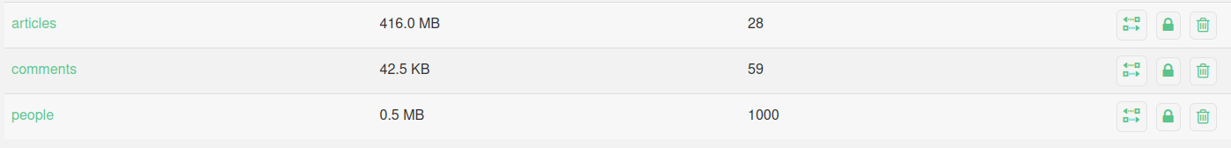
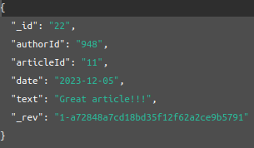
Demonstration of Work with the System
PouchDB usage
  Go to http://localhost:5984/_utils/#/_all_dbs
  There is a list of all local databases – once you start the app and read from a database, you can see the database here and inspect it:
  Detail of a comment with _id: “10”:

Slide 20
Results of Experiments, Commentary
PouchDB is really easy to use in JS code
The documentation is really good (https://pouchdb.com/)
The final application is a whole application, not just a set of random scripts (which is something that I expected at the beginning, so I am pleasantly surprised)
It was quite complicated to start using pouchdb, especially pouchdb-find. There were a lot of different information about how the scripts should be imported

Slide 21
List of Additional Files
video.mp4 – video presentation
ER_diagram.png – ER diagram of the database
ER_diagram.erdplus – script for the ER diagram
Logical_Database_Schema.png – schema of the attributes and relationships
README.md – contains instructions for installation and usage

