Slide 1
Team CodeBros
PROBLEM
Team no.17
Tittle-
MediMitra is a full-stack web application designed to help users manage their medication schedules through smart reminders, integrating Google Home for voice assistance.
Voice enabled medicines reminder
Description:
Many patients, especially the elderly and those with chronic illnesses, often forget to take their medications, which can lead to serious health issues or hospital visits. The Centers for Disease Control and Prevention (CDC) estimates that medication nonadherence (not taking medication as prescribed) causes 30% to 50% of chronic disease treatment failures and 125,000 deaths per year.
Built with Next.js for the frontend and FastAPI for the backend, it enables users to securely log in using Google OAuth, add medications with details like dosage and frequency, and set verbal reminders via Google Assistant.
The application features a user-friendly dashboard for tracking reminders, as well as an admin panel for managing user accounts.
With a focus on enhancing user experience, MediMitra combines modern web technologies and AI-driven functionalities to improve health outcomes by reducing missed doses and facilitating seamless medication management.

Slide 2
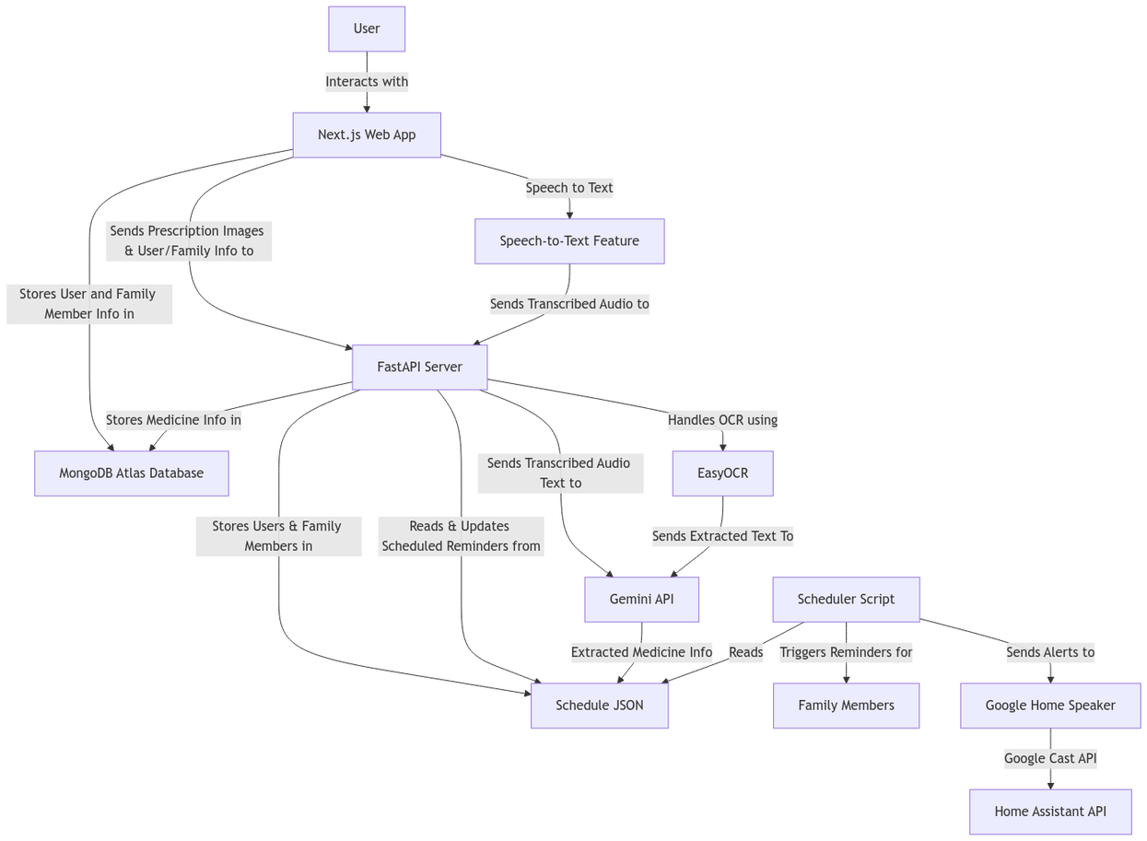
SOLUTION
Team CodeBros
Key Features:
Personalized Reminders based on your unique prescription needs
Interactive Voice Assistance - voice-enabled medicine reminder for timely reminders
Prescription to medicine schedule using OCR techniques.
Seamless integration with smart devices like Google Home

Slide 3
BENEFITS & FUTURE SCOPE
Team CodeBros
Speech to Text for Reminder Setup
Marketplace for Buying Medicines
Seamless Integration with Smart Devices
By integrating marketplace it allow users to easily purchase medications when they are running low.
It can later include features like Automatic Refill Alerts and helping people buy medicines from verified pharmacies near them
Users can easily set up medication reminders using speech to text, making it accessible for those with limited tech skills or mobility.
Seamless integration with smart devices like Google Home and create medicine reminder routines for multiple family members in the family

