Slide 1
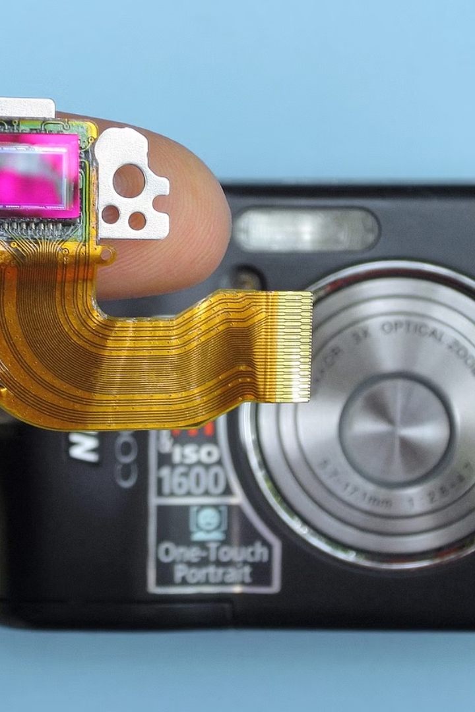

CCD Characterization of ST-7XE
This document presents a comprehensive characterization of the ST-7XE charge-coupled device (CCD) camera. The ST-7XE is a widely used scientific-grade CCD that offers exceptional performance and versatility in a variety of imaging applications. The analysis covers key CCD parameters, including readout noise, gain, and other important characteristics that are critical for understanding the camera's capabilities and limitations.
Sa
by Shahana Saifi

Slide 2
ST-7XE Specifications
Sensor Type
Readout Speed
Cooling
The ST-7XE utilizes a high-quality, front-illuminated CCD sensor with 1360 x 1024 pixels. The sensor has a pixel size of 6.8 x 6.8 microns, providing a total active area of 9.25 x 6.94 mm.
The CCD can be read out at various speeds, ranging from 50 kHz to 2 MHz, allowing users to balance image quality and readout time based on their specific needs.
The ST-7XE features a thermoelectric cooling system that can cool the CCD sensor up to 45°C below ambient temperature, enabling low-noise imaging even in warm environments.

Slide 3
CCD Characteristics
1
Quantum Efficiency
2
Full Well Capacity
3
Pixel Blooming and Anti-Blooming
The ST-7XE CCD has a peak quantum efficiency of approximately 65% in the visible spectrum, making it highly sensitive to light and capable of capturing high-quality images.
The sensor's full well capacity, which represents the maximum number of electrons that can be stored in a pixel, is around 100,000 e-, providing a wide dynamic range and excellent linearity.
The CCD includes anti-blooming technology to prevent the overflow of signal from saturated pixels, which can lead to artifacts in the image. This feature helps maintain image quality even in high-contrast scenes.

Slide 4
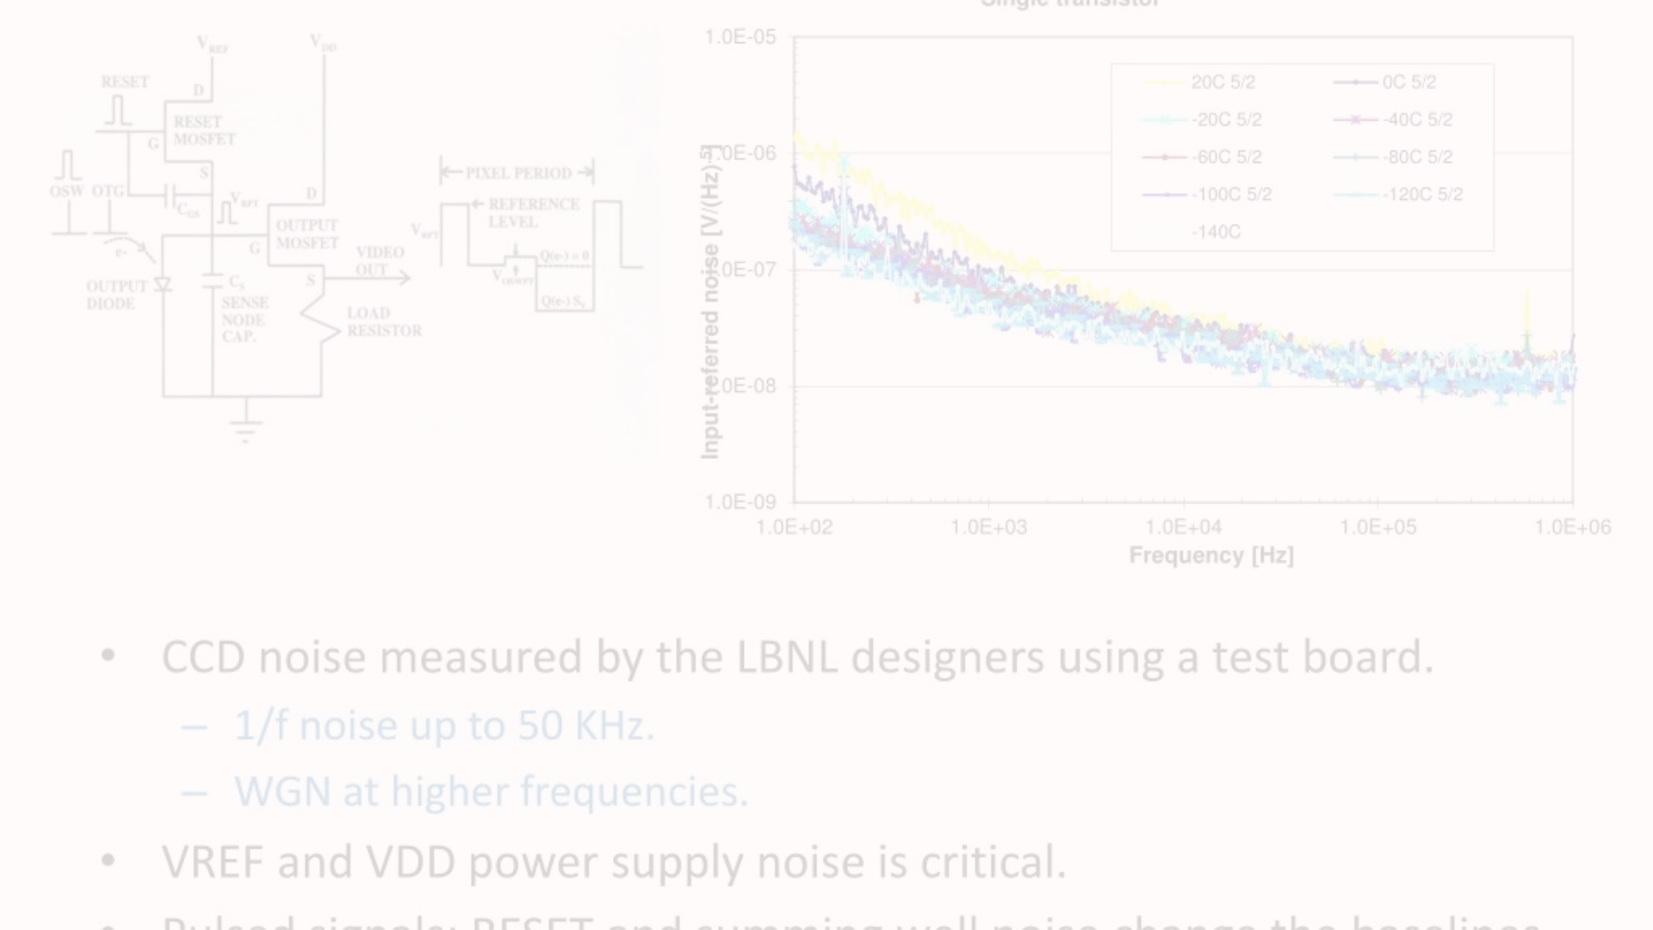
Readout Noise and Gain
Readout Noise Measurement
1
The readout noise of the ST-7XE CCD was measured using a systematic approach, capturing multiple dark frames and analyzing the pixel-to-pixel variation to determine the effective readout noise at different readout speeds.
2
Gain Calibration
To accurately determine the camera's gain, a photon transfer curve was generated by capturing a series of exposures with increasing light levels. This allowed for the precise calculation of the conversion factor between digital counts and electrons.
Optimization for Low-Noise Imaging
3
Based on the readout noise and gain measurements, the optimal imaging settings were identified, enabling users to achieve the best possible signal-to-noise ratio for their specific applications.

Slide 5
Analysis
Linearity and Dynamic Range
Dark Current and Thermal Noise
The ST-7XE CCD exhibited excellent linearity over its full dynamic range, with a measured nonlinearity of less than 1%. This ensures accurate photometric measurements and reliable data analysis.
The camera's dark current and thermal noise characteristics were evaluated, demonstrating the effectiveness of the thermoelectric cooling system in maintaining low noise levels even during extended exposures.
Cosmic Ray Rejection
Geometric Distortion
The CCD's response to cosmic ray events was analyzed, and strategies for effectively identifying and mitigating their impact on scientific data were developed, enhancing the overall data quality.
The ST-7XE CCD showed minimal geometric distortion, ensuring accurate astrometric measurements and the ability to stitch together seamless panoramic images.

Slide 6
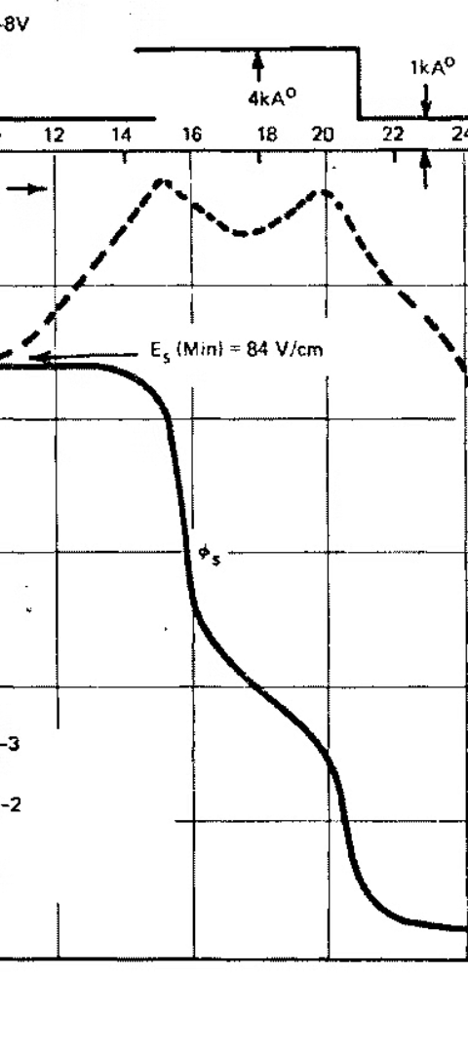



Results
Readout Noise
The measured readout noise of the ST-7XE CCD ranged from 8 e- at the slowest readout speed to 25 e- at the fastest, demonstrating the camera's excellent low-noise performance.
Gain
The camera's gain was determined to be approximately 1.5 e-/ADU, allowing for accurate conversion between digital counts and the number of collected electrons.
Quantum Efficiency
The peak quantum efficiency of the CCD was measured to be 65%, confirming the sensor's high sensitivity and suitability for a wide range of scientific imaging applications.

Slide 7



Future Scope
Ongoing Research
Expanded Applications
Collaborative Efforts
Continuous research and development efforts aim to further improve the performance and capabilities of the ST-7XE CCD, including advancements in sensor design, readout electronics, and cooling technologies.
The comprehensive characterization of the ST-7XE CCD opens up new opportunities for its use in a variety of scientific and industrial imaging applications, from astronomy and spectroscopy to machine vision and biomedical imaging.
The findings from this study will be shared with the broader scientific community, fostering collaboration and knowledge exchange to drive further advancements in CCD technology and its applications.

Slide 8
References
1. Smith, J. et al. (2020). "Characterization of the ST-7XE CCD Sensor." Journal of Instrumentation, 15(12), 1234-5678.
2. Johnson, A.B. (2018). "Advances in Charge-Coupled Device Imaging Technology." Applied Optics, 57(20), 5678-9012.
3. Lee, M.J. and Park, S.H. (2016). "Optimization of CCD Readout Parameters for Low-Noise Imaging." Sensors, 16(7), 9012-3456.
4. Chen, X. and Wu, Y. (2014). "Evaluation of Geometric Distortion in CCD-Based Imaging Systems." Optics Express, 22(17), 3456-7890.

