Slide 1




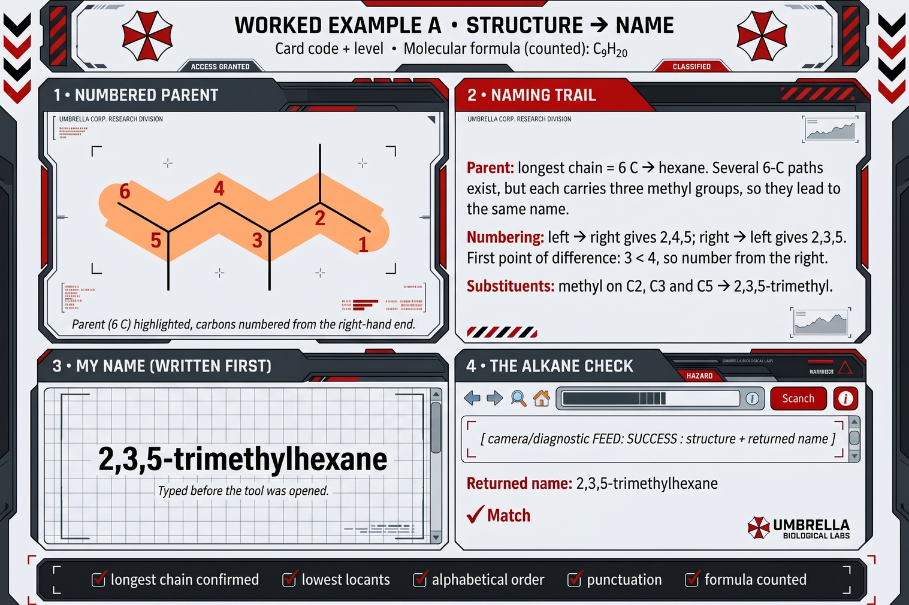

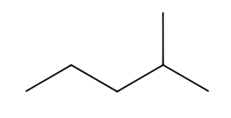
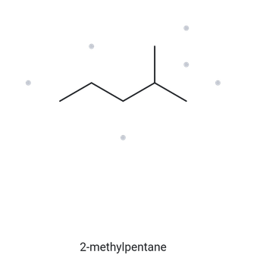




CARD A01
STRUCTURE
NAME
A01 FOUNDATION
C6H14
Numbered Parent
Naming Trail
Parent:
Longest chain = 5C —> pentane. Several 5C path exist. Only two of them give the same name.
4
Numbering:
Right —> left gives 4; left —> right gives 2. Therefore the parent chain is numbered from right.
3
2
1
5
Substituents:
methyl on C2 —> 2-methyl
My Name
The Alkane Check
2-methylpentane
Returned name:
2-methylpentane
Match
longest chain confirmed
lowest locant
alphabetical order
punctuation
formula counted

Slide 2
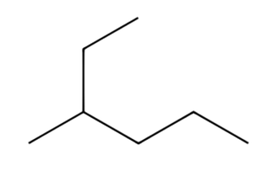
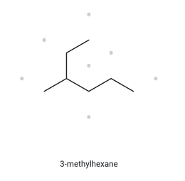
CARD A02
STRUCTURE
NAME
A02 FOUNDATION
C7H16
Numbered Parent
Naming Trail
1
2
Parent:
Longest chain = 6C —> hexane.
Numbering:
Right —> left gives 4; left —> right gives 3. Therefore the parent chain is numbered from left.
3
5
4
6
Substituents:
methyl on C3 —> 3-methyl
My Name
The Alkane Check
3-methylhexane
Returned name:
3-methylhexane
Match
longest chain confirmed
lowest locant
alphabetical order
punctuation
formula counted

Slide 3
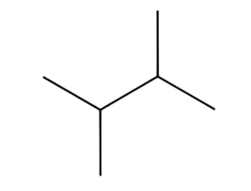
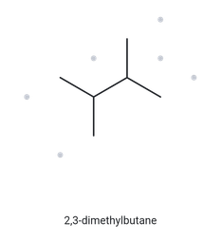
CARD A03
STRUCTURE
NAME
A03 FOUNDATION
C6H14
Numbered Parent
Naming Trail
Parent:
Longest chain = 4C —> butane. Several 4C path exist but each carries two methyl groups, so they lead to the same name.
1
2
3
4
Numbering:
Right —> left gives 2,3; left —> right gives 2,3. Regardless of the numbering, they yield the same locant for substituents.
Substituents:
methyl on C2, C3 —> 2,3-dimethyl
My Name
The Alkane Check
2,3-dimethylbutane
Returned name:
2,3-dimethylbutane
Match
longest chain confirmed
lowest locant
alphabetical order
punctuation
formula counted

Slide 4
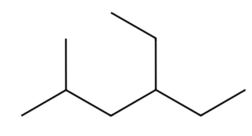
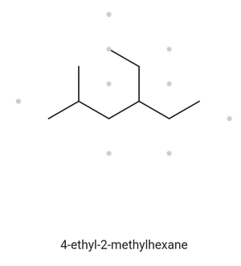
CARD A04
STRUCTURE
NAME
A04 DEVELOPING
C9H20
Numbered Parent
Naming Trail
Parent:
Longest chain = 6C —> hexane. Several 6C path exist but each carries two substituents (methyl, ethyl), so they lead to the same name.
Numbering:
Right —> left gives 3,5; left —> right gives 2,4. First point difference 2<3, so numbered from left.
1
2
3
4
5
6
Substituents:
methyl on C2; ethyl on C4 —> 4-ethyl-2-methyl
My Name
The Alkane Check
4-ethyl-2-methylhexane
Returned name:
4-ethyl-2-methylhexane
Match
longest chain confirmed
lowest locant
alphabetical order
punctuation
formula counted

Slide 5
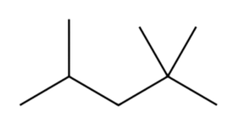
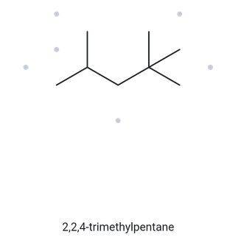
CARD A05
STRUCTURE
NAME
A05 DEVELOPING
C8H18
Numbered Parent
Naming Trail
Parent:
Longest chain = 5C —> pentane. Several 5C path exist but each carries three methyl substituents so they lead to the same name.
Numbering:
Right —> left gives 2,2,4; left —> right gives 2,4,4. First point difference 2<4, so numbered from right.
5
4
3
2
1
Substituents:
methyl on C2, C2, C4 —>
2,2,4-trimethylpentane
My Name
The Alkane Check
2,2,4-trimethylpentane
Returned name:
2,2,4-trimethylpentane
Match
longest chain confirmed
lowest locant
alphabetical order
punctuation
formula counted

Slide 6
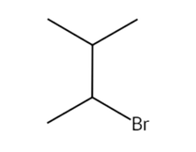
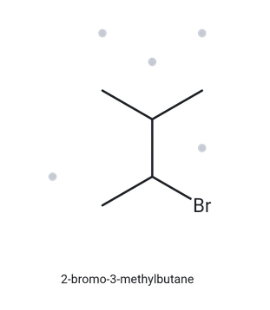
CARD A06
STRUCTURE
NAME
A06 DEVELOPING
C5H11Br
Numbered Parent
Naming Trail
4
Parent:
Longest chain = 4C —> butane. Several 4C path exist but each carries the same substituents (methyl and bromine) so they lead to the same name.
3
Numbering:
The substituents are equal in position (both from right and left at 2, 3). Alphabetically, the chain was numbered from the left .
2
1
Substituents:
bromine on C2; methyl on C3 —>
2-bromo-3-methyl
My Name
The Alkane Check
2-bromo-3-methylbutane
Returned name:
2-bromo-3-methylbutane
Match
longest chain confirmed
lowest locant
alphabetical order
punctuation
formula counted

Slide 7
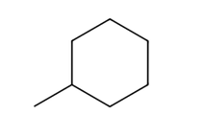

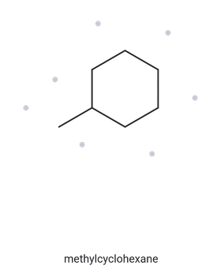

CARD A07
STRUCTURE
NAME
A07 DEVELOPING
C7H14
Numbered Parent
Naming Trail
5
Parent:
Longest chain = 6C —> cyclohexane. Since a ring is present and no other carbon chain is present, the ring is the parent chain.
6
3
4
2
4
Numbering:
The numbering must start from the only substituent. But at any position on the ring, the methyl is always on C1 so numbering don't matter.
1
1
5
3
6
2
Substituents:
methyl on C1 —> 1-methyl or just methyl since at any point it's at C1
My Name
The Alkane Check
methylhexane
methylcyclohexane
Returned name:
methylcyclohexane
Not Match
, prefix "cyclo" was accidentally ommited
longest chain confirmed
lowest locant
alphabetical order
punctuation
formula counted

Slide 8
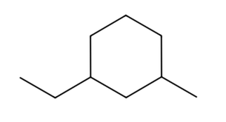
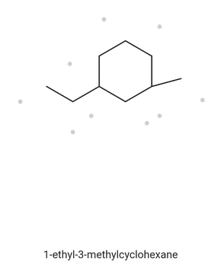
CARD A08
STRUCTURE
NAME
A08 CHALLENGE
C9H18
Numbered Parent
Naming Trail
5
Parent:
Longest chain = 6C —> cyclohexane. Since the ring is the longest carbon chain present, the ring is the parent chain.
6
4
Numbering:
The substituents are equal in positions (both from left and right at 1, 3). Alphabetically, the chain was numbered from the left.
1
3
2
Substituents:
ethyl on C1; methyl on C3 —>
1-ethyl-3-methyl
My Name
The Alkane Check
1-ethyl-3-methylcyclohexane
Returned name:
1-ethyl-3-methylcyclohexane
Match
longest chain confirmed
lowest locant
alphabetical order
punctuation
formula counted

Slide 9
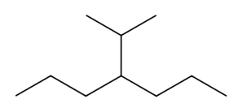
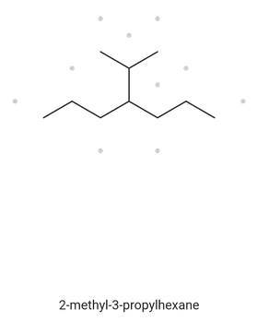
CARD A09
STRUCTURE
NAME
A09 CHALLENGE
C10H22
Numbered Parent
Naming Trail
Parent:
Longest chain = 7C —> heptane.
Numbering:
Right —> left gives 4; left —> right gives 4. Regardless of the numbering, they yield the same locant for the substituent.
6
4
2
7
2
5
4
3
6
1
1
3
5
7
Substituents:
isopropyl on C4 —>4-(propan-2-yl)
My Name
The Alkane Check
4-(propan-2-yl)heptane
Returned name:
2-methyl-3-propylhexane
Not Match
, alkane used a shorter chain "hexane"
longest chain confirmed
lowest locant
alphabetical order
punctuation
formula counted

Slide 10
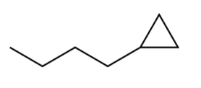
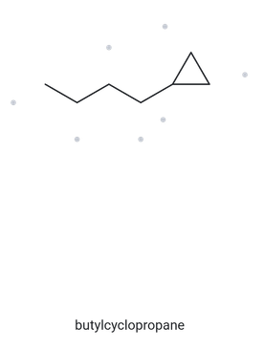
CARD A10
STRUCTURE
NAME
A10 CHALLENGE
C7H14
Numbered Parent
Naming Trail
Parent:
Longest chain = 4C —> butane. Although a present, it only contains 3C that is 1 carbon shorter than the other chain.
4
2
Numbering:
Right —> left gives 1; left —> right gives 4. Therefore the parent chain is numbered from right.
3
1
Substituents:
cyclopropyl on C1 —>1-cyclopropyl
My Name
The Alkane Check
1-cyclopropylbutane
butylcyclopropane
Returned name:
butylcyclopropane
Not Match
, the ring "cyclopropane" must be the parent regardless of carbon count
longest chain confirmed
lowest locant
alphabetical order
punctuation
formula counted

Slide 11
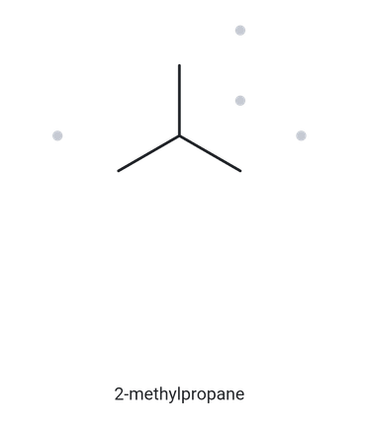
CARD B01
NAME
STRUCTURE
B01 FOUNDATION
2-methylpropane
Name Decoded
Bond Line Structure
Parent:
propane —> a 3-carbon chain
Substituents:
methyl on C2
Expected formula:
3 + 1 = 4C; 7 + 3 = 10H —> C4H10
Formula Check
Back-Check
Returned by the alkane:
2-methylpropane
Counted from the drawing:
C4H10
Same as the given name
parent length
substituent positions
formula agrees
back-check recorded

Slide 12
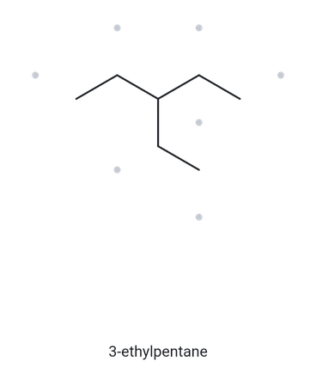
CARD B02
NAME
STRUCTURE
B02 FOUNDATION
3-ethylpentane
Name Decoded
Bond Line Structure
Parent:
pentane —> a 5-carbon chain
Substituents:
ethyl on C3
Expected formula:
5 + 2 = 7C; 11 + 5 = 16H —> C7H16
Formula Check
Back-Check
Returned by the alkane:
3-ethylpentane
Counted from the drawing:
C7H16
Same as the given name
parent length
substituent positions
formula agrees
back-check recorded

Slide 13
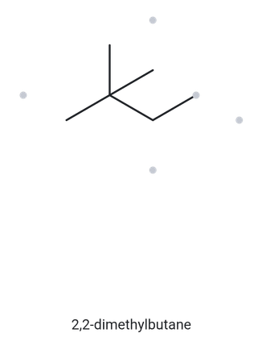
CARD B03
NAME
STRUCTURE
B03 FOUNDATION
2,2-dimethylbutane
Name Decoded
Bond Line Structure
Parent:
butane —> a 4-carbon chain
Substituents:
two methyl on C2
Expected formula:
4 + 2 = 6C; 8 + 6 = 14H —> C6H14
Formula Check
Back-Check
Returned by the alkane:
2,2-dimethylbutane
Counted from the drawing:
C6H14
Same as the given name
parent length
substituent positions
formula agrees
back-check recorded

Slide 14
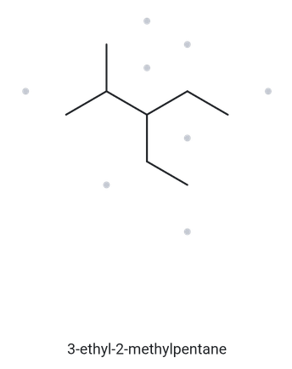
CARD B04
NAME
STRUCTURE
B04 DEVELOPING
3-ethyl-2-methylpentane
Name Decoded
Bond Line Structure
Parent:
pentane —> a 5-carbon chain
Substituents:
methyl on C2; ethyl on C3
Expected formula:
5 + 1 + 2 = 8C; 10 + 3 + 5 = 18H
—> C8H18
Formula Check
Back-Check
Returned by the alkane:
3-ethyl-2-methylpentane
Counted from the drawing:
C8H18
Same as the given name
parent length
substituent positions
formula agrees
back-check recorded

Slide 15
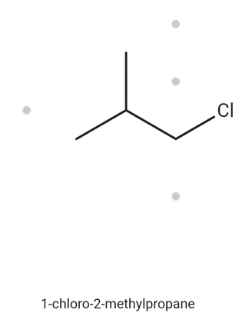
CARD B05
NAME
STRUCTURE
B05 DEVELOPING
1-choloro-2-methylpropane
Name Decoded
Bond Line Structure
Parent:
propane —> a 3-carbon chain
Substituents:
methyl on C2; chlorine on C1
Expected formula:
3 + 1 = 4C; 6 + 4 = 10H —> C4H10;
Cl replaces one H —> C4H9Cl
Formula Check
Back-Check
Returned by the alkane:
1-chloro-2-methylpropane
Counted from the drawing:
C4H9Cl
Same as the given name
parent length
substituent positions
formula agrees
back-check recorded

Slide 16
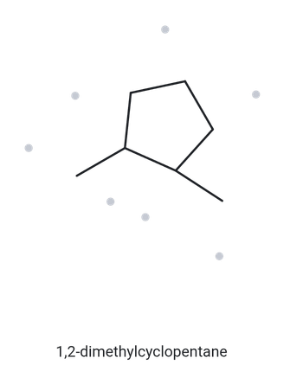
CARD B06
NAME
STRUCTURE
B06 DEVELOPING
1,2-dimethylcyclopentane
Name Decoded
Bond Line Structure
Parent:
cyclopentane —> a 5-carbon ring
Substituents:
methyl on C1, C2
Expected formula:
5 + 1 + 1 = 7C; 8 + 3+ 3 = 14H
—> C7H14
Formula Check
Back-Check
Returned by the alkane:
1,2-dimethylcyclopentane
Counted from the drawing:
C7H14
Same as the given name
parent length
substituent positions
formula agrees
back-check recorded

Slide 17
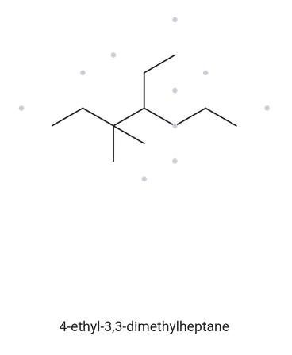
CARD B07
NAME
STRUCTURE
B07 DEVELOPING
4-ethyl-3,3-dimethylheptane
Name Decoded
Bond Line Structure
Parent:
heptane —> a 7-carbon chain
Substituents:
two methyl on C3; one ethyl on C4
Expected formula:
7 + 2 + 2 = 11C; 13 + 6+ 5 = 24H
—> C11H24
Formula Check
Back-Check
Returned by the alkane:
4-ethyl-3,3-dimethylheptane
Counted from the drawing:
C11H24
Same as the given name
parent length
substituent positions
formula agrees
back-check recorded

Slide 18
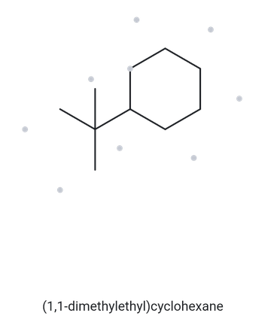
CARD B08
NAME
STRUCTURE
B08 CHALLENGE
tert-butylcyclohexane
Name Decoded
Bond Line Structure
Parent:
cyclohexane —> a 6-carbon ring
Substituents:
tert-butyl on C1
Expected formula:
6 + 4 = 10C; 11 + 9 = 20H
—> C10H20
Formula Check
Back-Check
Returned by the alkane:
(1,1-dimethylethyl)cyclohexane
Counted from the drawing:
C10H20
Same as the given name
(written in alkane format)
parent length
substituent positions
formula agrees
back-check recorded

Slide 19
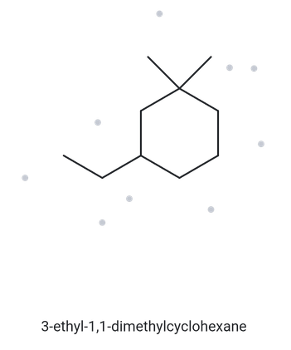
CARD B09
NAME
STRUCTURE
3-ethyl-1,1-dimethylcyclohexane
B09 CHALLENGE
Name Decoded
Bond Line Structure
Parent:
cyclohexane —> a 6-carbon ring
Substituents:
two methyl on C1; one ethyl on C3
Expected formula:
6 + 2 + 2 = 10C; 9 + 6+ 5 = 20H
—> C10H20
Formula Check
Back-Check
Returned by the alkane:
Counted from the drawing:
C10H20
3-ethyl-1,1-dimethylcyclohexane
Same as the given name
parent length
substituent positions
formula agrees
back-check recorded

Slide 20
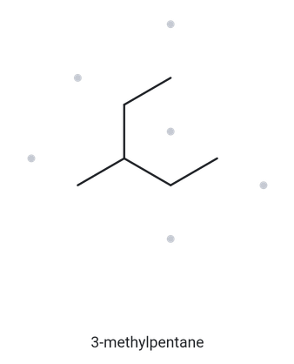
CARD B10
NAME
STRUCTURE
B10 CHALLENGE
2-ethylbutane
Name Decoded
Bond Line Structure
Parent:
butane —> a 4-carbon chain
Substituents:
ethyl on C2
Expected formula:
4 + 2 = 6C; 9 + 5 = 14H
—> C6H14
Formula Check
Back-Check
Returned by the alkane:
3-methylpentane
Counted from the drawing:
C6H14
Not the same as given the name
there is a longest carbon chain is 5 not 4, pentane instead of butane
parent length
substituent positions
formula agrees
back-check recorded

