Slide 1
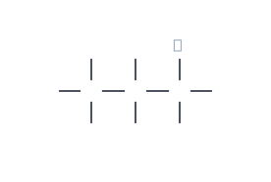






molecule 01
PROPANE
C3H8
C3H8
CH3CH2CH3
VERIFICATION STRIP
atom count verified
bond order checked
che
valence checked
same connectivity confirmed
VERIFY

Slide 2
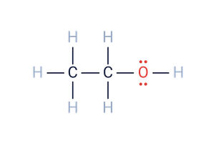

molecule 02
ETHANOL
C2H6O
C2H6O
CH3CH2OH
VERIFICATION STRIP
atom count verified
bond order checked
che
valence checked
same connectivity confirmed
VERIFY

Slide 3
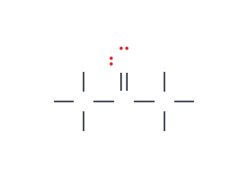

molecule 03
ACETONE
C3H6O
propan-2-one
C3H6O
CH3COCH3
VERIFICATION STRIP
atom count verified
bond order checked
che
valence checked
same connectivity confirmed
VERIFY

Slide 4
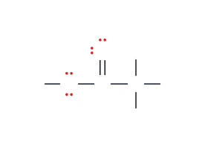

molecule 04
ACETIC ACID
C2H4O2
ethanoic acid
C2H4O2
CH3COOH
VERIFICATION STRIP
atom count verified
bond order checked
che
valence checked
same connectivity confirmed
VERIFY

Slide 5
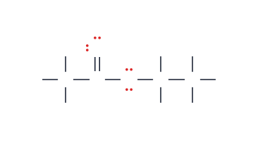

molecule 05
ETHYL ACETATE
C4H8O2
ethyl ethanoate
C4H8O2
CH3COOC2H5
VERIFICATION STRIP
atom count verified
bond order checked
che
valence checked
same connectivity confirmed
VERIFY

Slide 6


molecule 06
CYCLOHEXANE
C6H12
C6H12
(CH2)6
VERIFICATION STRIP
atom count verified
bond order checked
che
valence checked
same connectivity confirmed
VERIFY

Slide 7
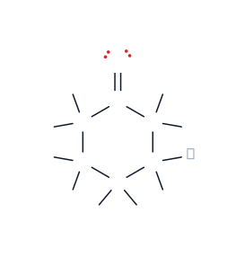

molecule 07
CYCLOHEXANONE
C6H10O
C6H10O
(CH2)5CO
VERIFICATION STRIP
atom count verified
bond order checked
che
valence checked
same connectivity confirmed
VERIFY

Slide 8
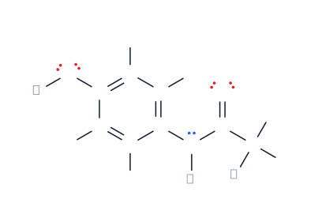
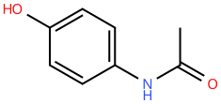
molecule 08
ACETAMINOPHEN
C8H9NO2
N-(4-hydroxyphenyl)acetamide I Paracetamol
C8H9NO2
HOC6H4NHCOCH3
VERIFICATION STRIP
atom count verified
bond order checked
che
valence checked
same connectivity confirmed
VERIFY

Slide 9
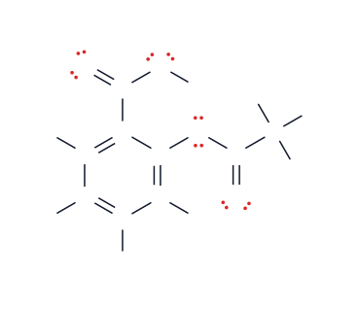
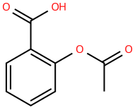
molecule 09
ASPIRIN
C9H8O4
2-acetoxybenzoic acid I acetylsalicylic acid
C9H8O4
CH3COOC6H4COOH
VERIFICATION STRIP
atom count verified
bond order checked
che
valence checked
same connectivity confirmed
VERIFY

Slide 10
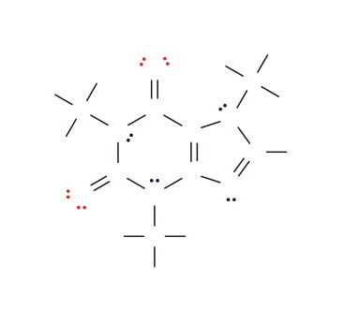
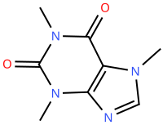
molecule 10
CAFFEINE
C8H10N4O2
1,3,7-Trimethylpurine-2,6-dione
C8H10N4O2
C5HN4O2(CH3)3
VERIFICATION STRIP
atom count verified
bond order checked
che
valence checked
same connectivity confirmed
VERIFY

