Slide 1
WORKPLACE AGE DIVERSITY
Notes:
Hello my name is Lucile, I will be presenting to you my most recent findings on Workplace Age Diversity, what it is, why it’s so relevant to many growing companies.

Slide 2
TODAY’S PRESENTATION
KEY TAKE AWAY
Implication & Future Studies
RESULTS
HYPOTHESIS
Independent t-test
ANALYSIS
QUESTION
EXPLORATORY DATA ANALYSIS
Python & Google CoLab
INTRODUCTION
Notes:
In today’s presentation, I uncover the best and worst source of talent acquisition for ensuring Age Diversity. I also test if there is a meaningful statistical difference in the means of job performance between commonly represented and under-represented age groups.
As you can see I will start with a brief introduction to why it’s necessary for today’s HR professionals to be wary of fairly representation of both young and old employees, walk you thorugh some research questions I derived from running basic exploratory data analysis using Python, list Hypotheses I used to frame my statistical testing and report its results. I will wrap up today’s presentation on a few key take aways and directions for future studies on the topic as well.
Although the data set I used is synthetic, with similar information available, the following analysis can be repeated and applied to companies looking to improve their age diversity profiles.

Slide 3

INTRODUCING “AGE DIVERSITY”
Exploratory Data Analysis
HR Dataset
Notes:
The data set I looked at for this study covered HR data

Slide 4

INTRODUCING “AGE DIVERSITY”
Exploratory Data Analysis
HR Dataset
311 Employees
Notes:
Of 311 employees

Slide 5

INTRODUCING “AGE DIVERSITY”
Exploratory Data Analysis
HR Dataset
311 Employees
36 Key Variables
Notes:
And featured 36 different key variables.
Included gender, DOB, Salary, AGE, Performance scores, manger ID and so on.
To help me frame my research question I decided to assume that the company I am looking at discovered a recently growing demand for a diversified workforce in terms of age. For instance, there could have been external demand from the stakeholders that the organization appeal to a much broader—old and young—customer demographic. First, we begin by analyzing the current diversity profile.

Slide 6
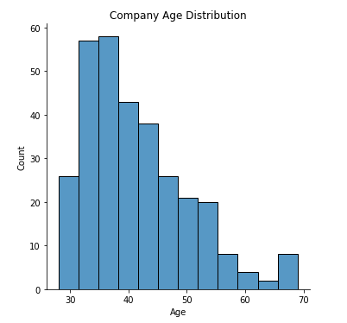
COMPANY AGE DISTRIBUTION
Notes:
This is what the profile looked like age distribution for this particular company was heavily skewed.

Slide 7
COMPANY AGE DISTRIBUTION
80%
20%
‘Represented’
Employees in age groups 30-50
‘Under-represented’
Employees in all other age groups
Notes:
In fact I found that the employees falling into the 30 - 40 and 40 - 50 age groups make up roughly 80% of total employees.
It's now clear to us that the age distribution is heavily skewed to the left, and that there is room for systematic improvement.
NTURALLY MY NEXT STEP WAS TO examine how age diversity is influenced by current recruiting practices. Which recruitment sources are we currently sourcing and hiring from?

Slide 8
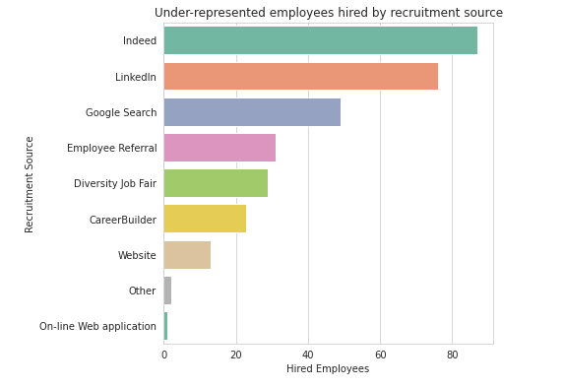
HEADCOUNT BY RECRUITMENT SOURCE
Notes:
Here is a histogram of headcount grouped by recruitment sources. As you can see there are nine available sources for talent acquisiton.
From this chart,
We see that Indeed, LinkedIn, and Google Search are the top 3 sources of recruitment for the company in terms of headcount. In other words, The three social networking sites source the highest volume of employees in the company. Company Website, Other, and On-line Web applications are the bottom 3. Our next question is: Besides the headcounts, which recruitment source hires the highest ratio of under-represented employees
Which recruitment source hires the highest ratio of under-represented candidates? In other words, which of the nine recruitment sources should the company focus its talent sourcing from if it were to improve its age diversity profile? Which source should the company avoid?

Slide 9
HEADCOUNT BY RECRUITMENT SOURCE
Which recruitment source hires the highest ratio of under-represented employees?
Notes:
which recruitment source hires the highest ratio of under-represented employees
In other words, which of the nine recruitment sources should the company focus its talent sourcing from if it were to improve its age diversity profile? Which source should the company avoid?

Slide 10
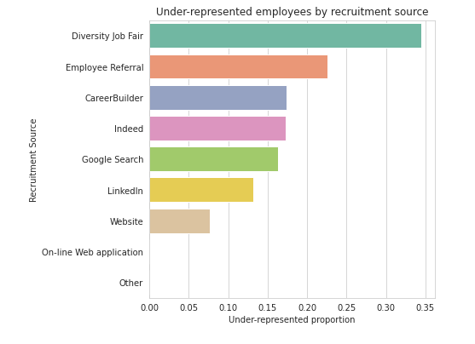
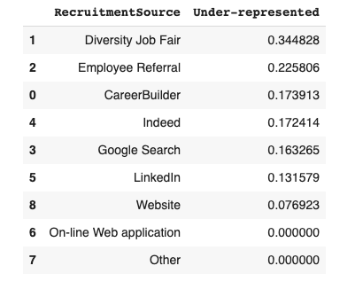
UNDER-REPRESENTED RATIO BY RECRUITMENT SOURCE
Notes:
Here is the under-represented to represented employee ratio grouped by recruitment sources.
Right off the bat, we see that both On-line Web applications and Other recruitment sources yield a 0.00 Under-represented-to-Represented ratio. The two sources are not efficient in increasing Workplace Age Diversity.
We see thaat the Diversity Job Fair hires the highest Under-represented-to-Represented employee ratio than any other source at 0.34. Although social-networking sites are great for increasing headcount, Diversity Job Fair and Employee Referral proved to be better sourced in making the company more diverse. They should be encouraged and expanded to improve the company's age diversity profile. Given none of the available sources yield an under-represented ratio of 0.35, the organization seems far behind when it comes to age diversity, and no recruitment source is distinctly efficient. Much more robust programs for promoting Workplace Age Diversity is needed.

Slide 11
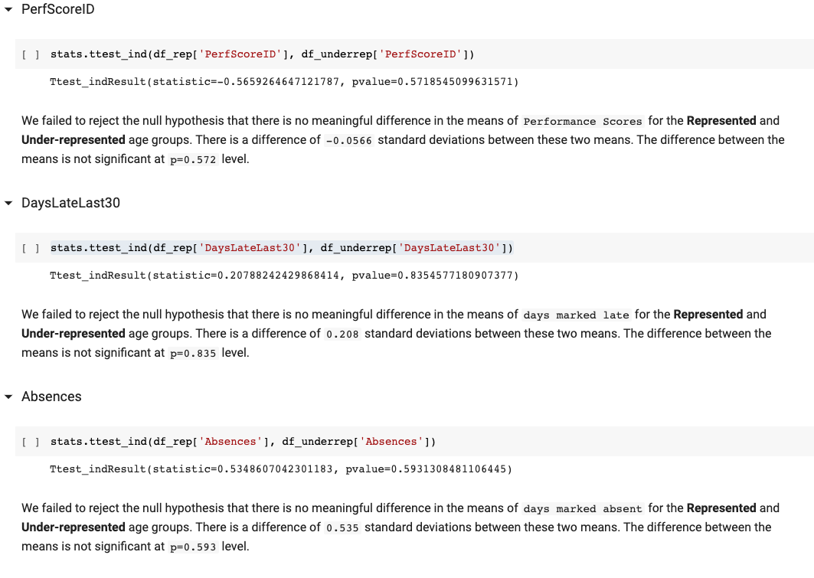
HYPOTHESIS TESTING
Notes:
We were able to boil down to a couple of recruitment sources that contribute to more inclusive age representations, but why should the company care? One might argue that the Represented age group is the most qualified in terms of their work abilities, thus dismissing the need to re-evaluate current recruiting practices.
Similar negative ageist attitudes are widely held across societies and not confined to one social or ethnic group. These assume an inevitable decline in work abilities from both young and old workers, thus justify using age as a “proxy” for inferior job performance. These assumptions are invalid. There are wide variations in the rate and amount of decline—if any—in different types of workers and jobs. I wanted to test and prove that Age is a poor proxy for these deficiencies.
I ran three hypothesis testing to prove that there was no statistical difference in means of performance between the two age groups.

Slide 12
KEY TAKE AWAY
1. Diversity Job Fair and Employee Referrals are the best available sources of recruitment from a workplace Age Diversity standpoint.
Notes:
On A Final Note
Workplace Age Diversity creates opportunities for the organization to leverage the unique backgrounds and characteristics of all employees to contribute to its success. some key findings we covered my analysis in regards to Workplace Age Diversity include, one,

Slide 13
KEY TAKE AWAY
1. Diversity Job Fair and Employee Referrals are the best available sources of recruitment from a workplace Age Diversity standpoint.
2. We should digress from the current social network-centric approach to talent acquisition to a more diversity-centric, age-friendly approach to recruitment.

Slide 14
KEY TAKE AWAY
1. Diversity Job Fair and Employee Referrals are the best available sources of recruitment from a workplace Age Diversity standpoint.
2. We should digress from the current social network-centric approach to talent acquisition to a more diversity-centric, age-friendly approach to recruitment.
3. There are no statistically significant differences in the means of PerfScore,
DaysLateLast30, and Absences between the commonly represented and under-
represented age groups, thus invalidating the argument that the under-represented are 'unqualified.'
Notes:
And lastly, Future studies on mixed-age work teams should focus on demonstrating how age diversity climate within an organization could have the potential to improve performance and lower employee turnover.

