Slide 1




R Studio
and Statistics
TYPE OF FARM & FINANCIAL SITUATION ACCORDING TO THE FARMER PROFILE
Presentation By:
Edward ANNANG
Charline CANTAU
Lucille COUVANT
Anthony DA-SILVA

Slide 2
Introduction
Dataset _ First tour
Analysis _ Data observation
Conclusion
Summary
2

Slide 3

Overview Of The DATA
Collation on data on 7203 farm across France.
Captures their income source activities.
Details about the operation manager such as age range and training level.
The Data is a mixture of numerical value, characters and integer references to expanded modalities.
The data has been formated to display integer values for each data description even for information such as gender.
Large saturated datasheet that requires repeated cross referrencing to extended sheets for complete understanding.
Data sheet with missing inputs within some categories.
Data dictionnary
3

Slide 4








Six Variables
technico-economic orientation
OTEXE
age
TRA05
gender
SEXEP
revenue
CHAFF
unit of work
UTATO
standardized revenue
STREV
4

Slide 5
Our variables
Code | Definitions | Data Type
OTEXE | Technico-economic orientation in 17 positions (2007 typology) | Char
CHAFF | Revenues (in euros) | num
SEXEP | Code Gender of the farm manager | Char
UTATO | Total number of AWUs (in AWUs) | num
TRA05 | Age range of the farm manager | Char
STREV | Standadized Revenue | num
5

Slide 6
Problematic & Objectives
1
Discover links between data
2
Observe age and revenue correlation
How does the farmer's profile influence the production ?
3
Draw conclusions on farm type and revenue
6
Notes:
# * What is the context of the presentation?
# * What is the problematic of the presentation?
# * What are the main objectives of the presentation?
# * What are the main questions that we want to answer with this presentation?
# * Why ? / What is the relationship with real world problems?

Slide 7
Reviewing of the Chosen Columns
We were interested in finding if there are any significant correlations such as follows :
Does the age of the farm manager contribute to the farm’s annual revenue, assuming their age range represents their performance levels ?
Is there a preference between the genders for a particular farm type?
Is there a significant difference between the ratio of Annual work units to Annual revenue?
Do older Farmers earn more than younger farmer?
7

Slide 8
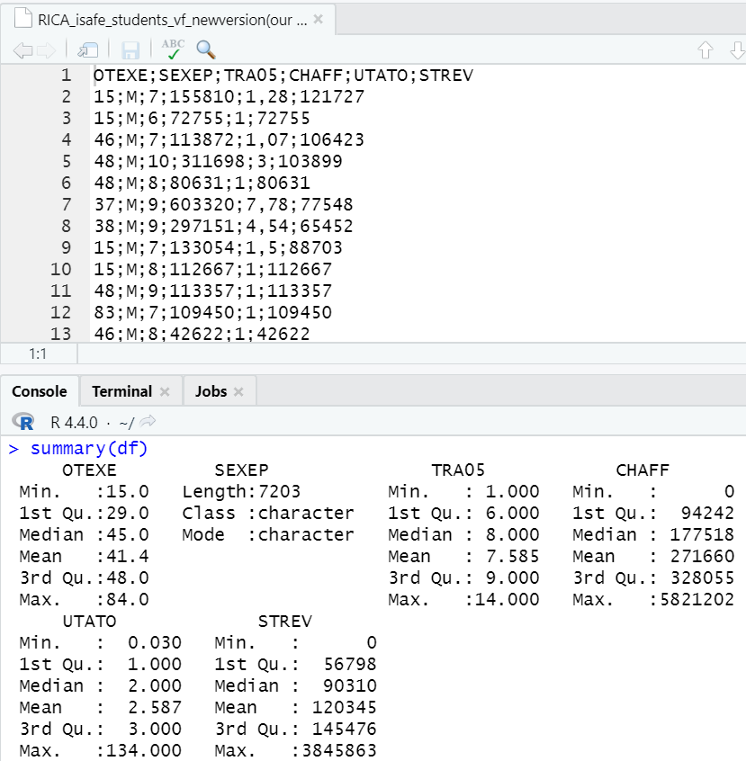

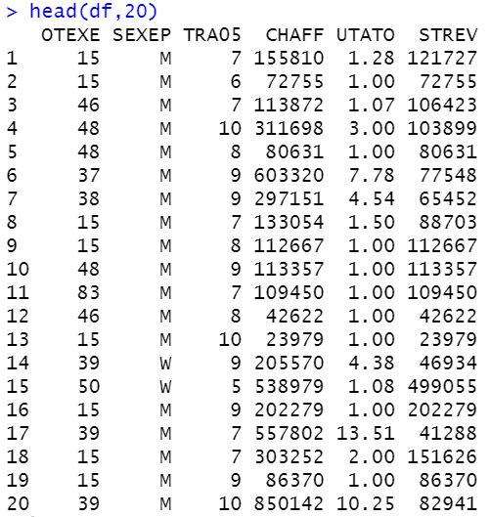
Overview
8
Notes:
* Generic Data Exploration :
# * Summary of the dataset
# * Structure of the dataset
# * Missing values
# * Correlation between the variables
# * etc.
* What kind of data cleaning did you perform on the dataset?

Slide 9
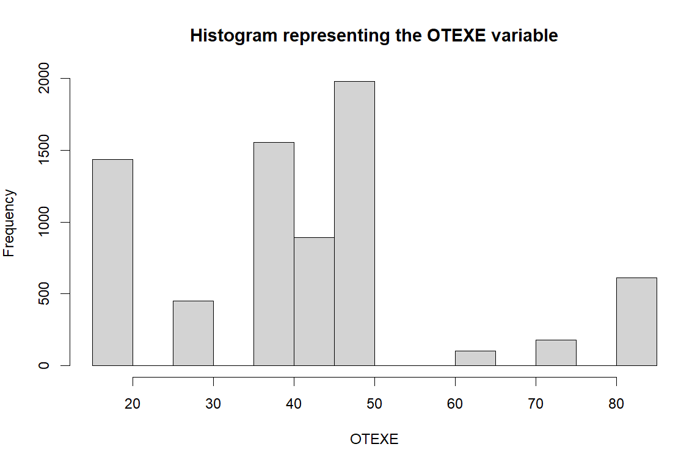
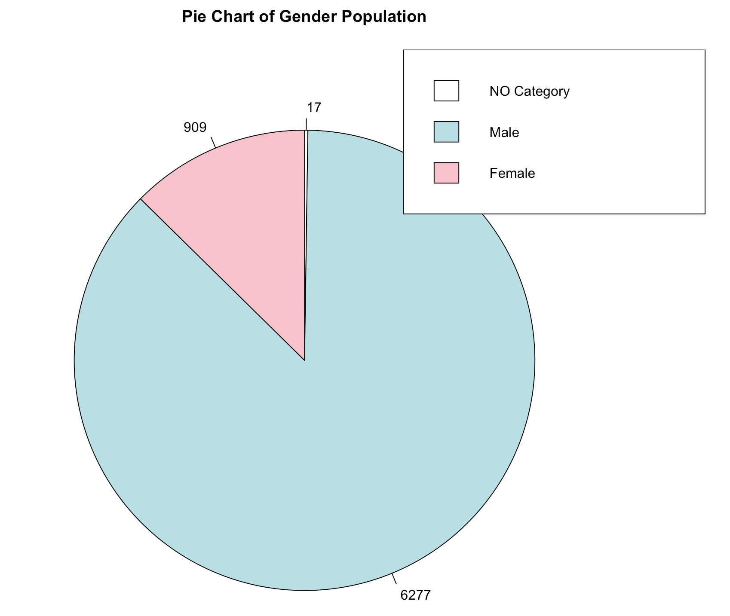
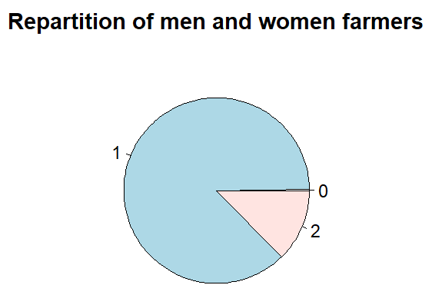
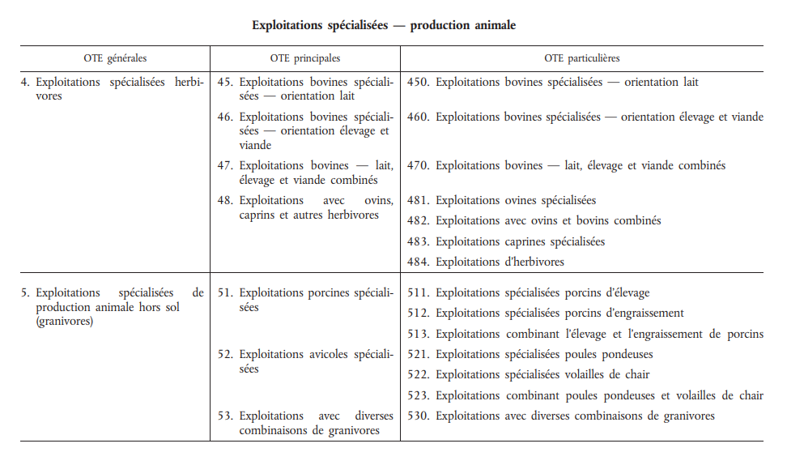
Technico-orientation / gender
Large majority of farmers being of sexe 1 (men) compared to sexe 2 (women)
Technico orientation of farms spread in categories
9
Notes:
# Creating an histogram to have an overview of the OTEXE variable
hist(base$OTEXE,
main = "Histogram representing the OTEXE variable",
xlab = "OTEXE",
ylab = "Frequency")
pie(table(base$SEXEP),
main = "Repartition of men and women farmers")

Slide 10
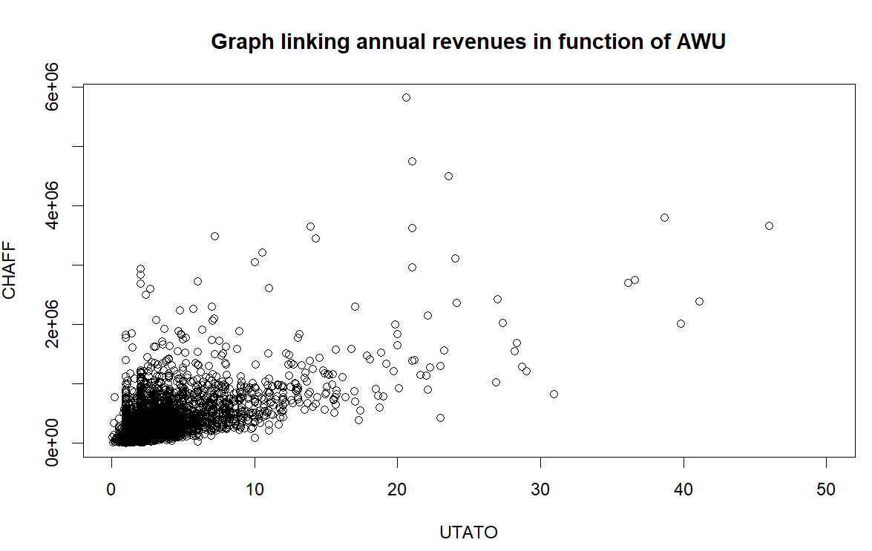
Annual revenues / AWU
Concentration of points
--> AWU : between 1 and 8 AWU
--> annual revenues : between 0 and 1 000 000 ($)
Significant relationship btw CHAFF and UTATO
10
Notes:
base$CHAFF <- as.numeric(as.character(base$CHAFF))
plot(base$UTATO, base$CHAFF, xlim = c(0,50),
xlab = "UTATO", ylab = "CHAFF",
main = "Graph linking annual revenues in function of AWU")

Slide 11
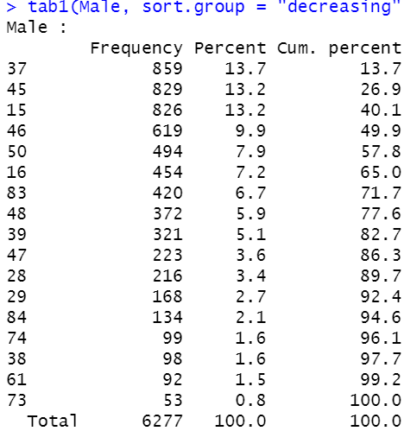
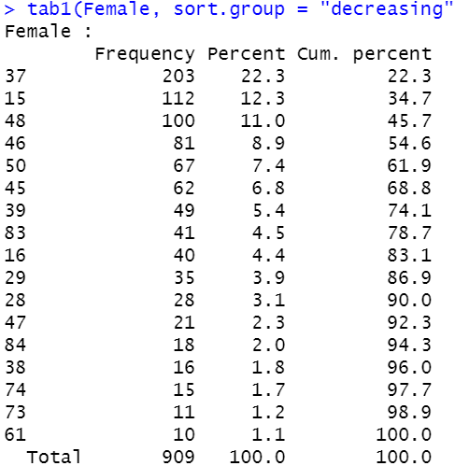

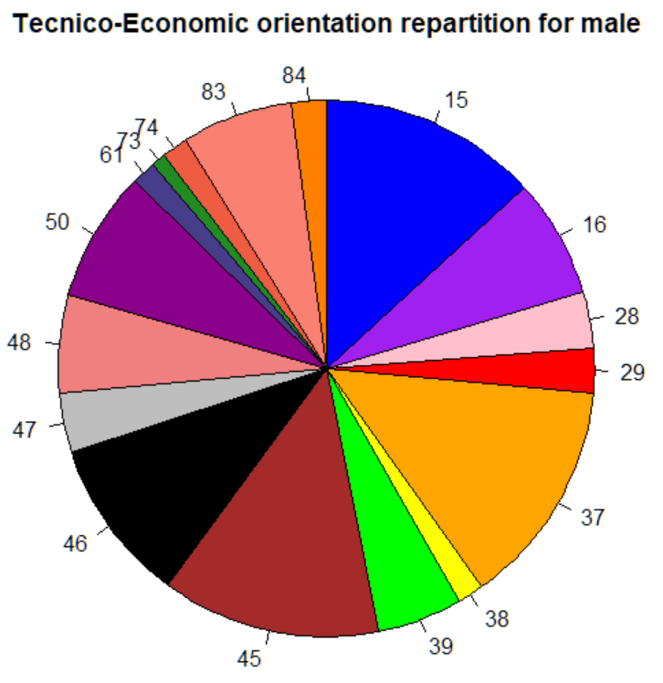
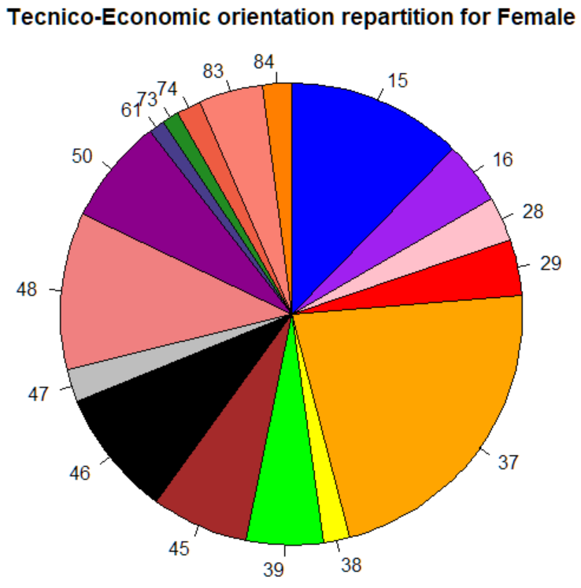

GENDER/
FARM TYPE
Specialist cereal, oilseed & protein crop farms
Specialized dairy cattle farms
Farms with sheep, goats and other herbivores
Farms
specializing in quality viticulture
11
Notes:
# male pie chart
> Male = subset(df$OTEXE, df$SEXEP == 1)
> tab1(Male, sort.group = "decreasing", cum.percent = TRUE)
> pie(c(13.2, 7.2, 3.4, 2.7, 13.7, 1.6, 5.1, 13.2, 9.9, 3.6, 5.9, 7.9, 1.5, 0.8, 1.6, 6.7, 2.1),
+ clockwise=TRUE, radius=1,
+ main="Tecnico-Economic orientation repartition for male",
+ col=c("blue","purple","pink","red","orange","yellow","green","brown","black","gray","lightcoral","darkmagenta","darkslateblue","forestgreen","tomato2", "salmon","darkorange1"), label=c("15", "16", "28", "29", "37", "38", "39", "45", "46", "47", "48", "50", "61", "73", "74", "83", "84"))
# female pie chart
> Female = subset(df$OTEXE, df$SEXEP == 2)
> tab1(Female, sort.group = "decreasing", cum.percent = TRUE)
> pie(c(12.3, 4.4, 3.1, 3.9, 22.3, 1.8, 5.4, 6.8, 8.9, 2.3, 11.0, 7.4, 1.1, 1.2, 1.7, 4.5, 2.0), clockwise=TRUE, radius=1,
+ main="Tecnico-Economic orientation repartition for Female",
+ col=c("blue","purple","pink","red","orange","yellow","green","brown","black","gray","lightcoral","darkmagenta","darkslateblue","forestgreen","tomato2", "salmon","darkorange1"), label=c("15", "16", "28", "29", "37", "38", "39", "45", "46", "47", "48", "50", "61", "73", "74", "83", "84"))

Slide 12
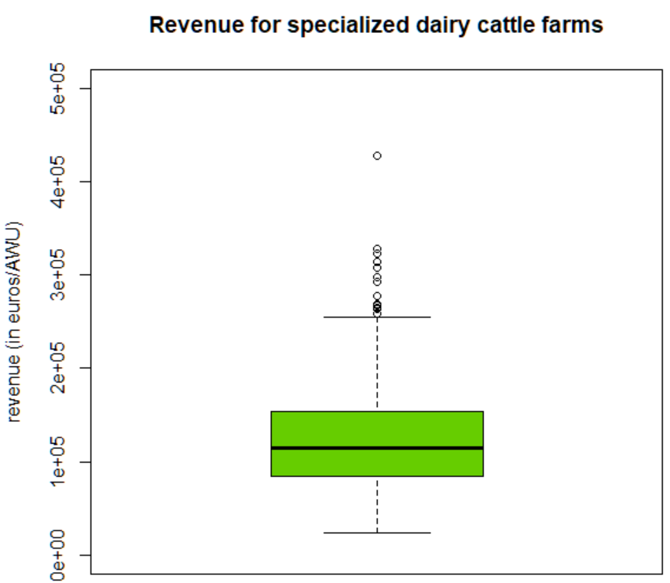
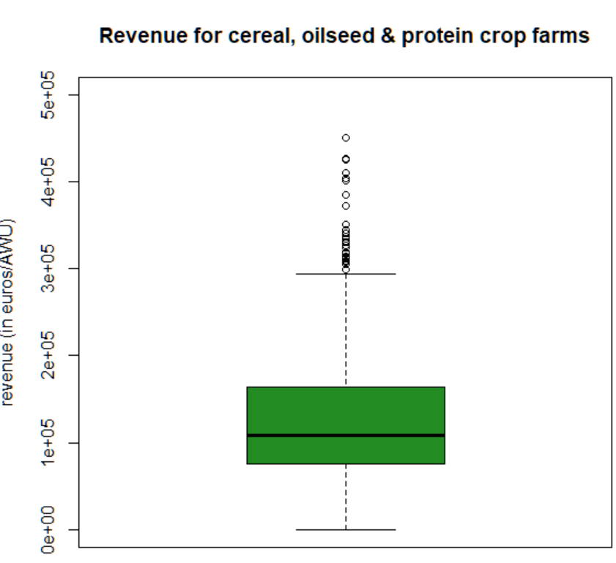
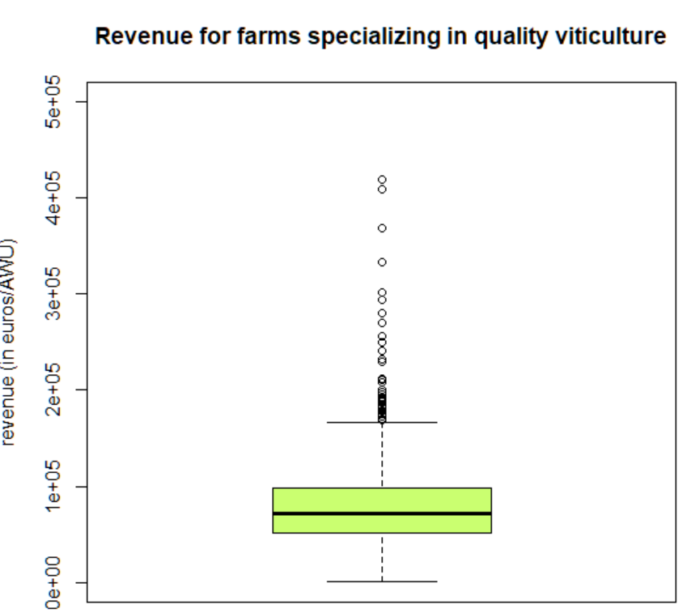
FARM TYPE/STANDARD. REVENUE
12
Notes:
> type15 = subset(df$standardized.revenue, df$OTEXE == 15)
> type45 = subset(df$standardized.revenue, df$OTEXE == 45)
> type37 = subset(df$standardized.revenue, df$OTEXE == 37)
> type48 = subset(df$standardized.revenue, df$OTEXE == 48)
> type50 = subset(df$standardized.revenue, df$OTEXE == 50)
> boxplot(type15,main="Revenue for cereal, oilseed & protein crop farms",ylab="revenue (in euros/AWU)",col="forestgreen", ylim=c(0,500000))
> boxplot(type37,main="Revenue for farms specializing in quality viticulture",ylab="revenue (in euros/AWU)",col="darkolivegreen1", ylim=c(0,500000))
> boxplot(type45,main="Revenue for specialized dairy cattle farms",ylab="revenue (in euros/AWU)",col="chartreuse3", ylim=c(0,500000))
> boxplot(type48,main="Revenue for farms with sheep, goats & other herbivores",ylab="revenue (in euros/AWU)",col="gold", ylim=c(0,500000))
> boxplot(type50,main="Revenue for granivore farms",ylab="revenue (in euros/AWU)",col="goldenrod1", ylim=c(0,500000))
> boxplot(type50,main="Revenue for granivore farms",ylab="revenue (in euros/AWU)",col="goldenrod1", ylim=c(0,1000000))

Slide 13
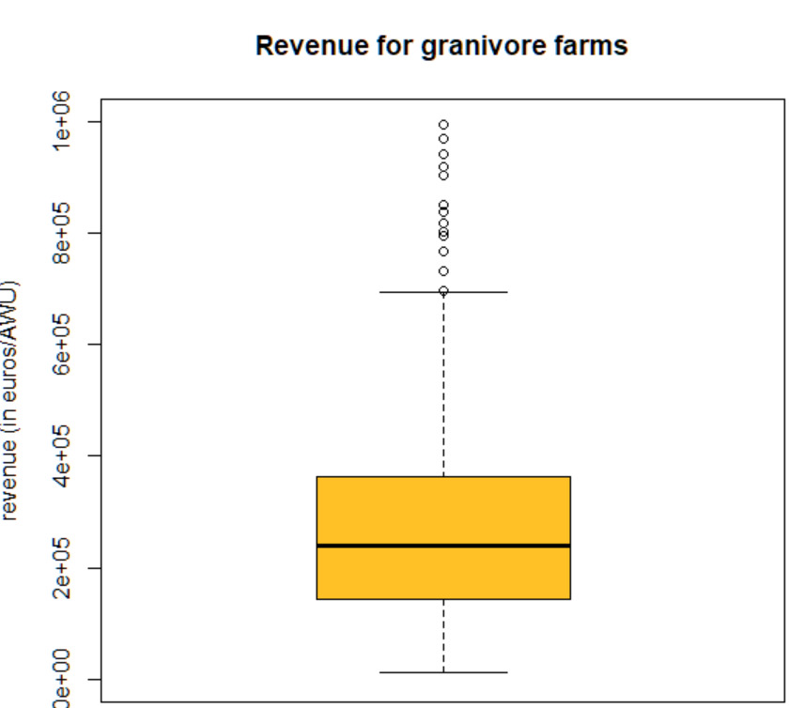
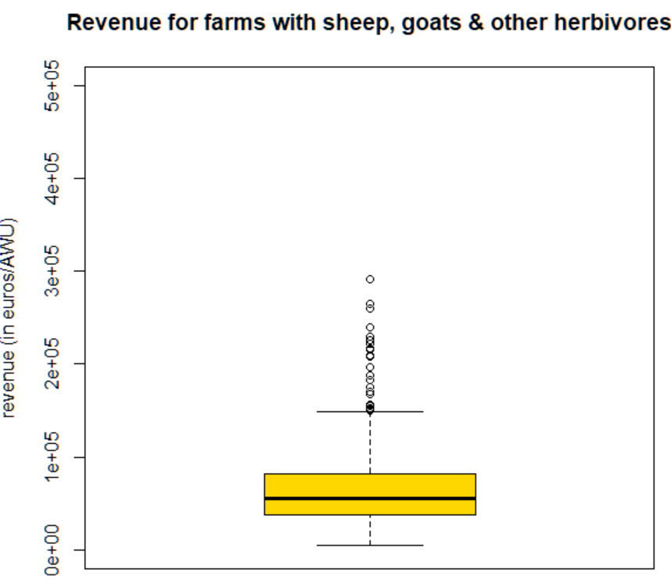
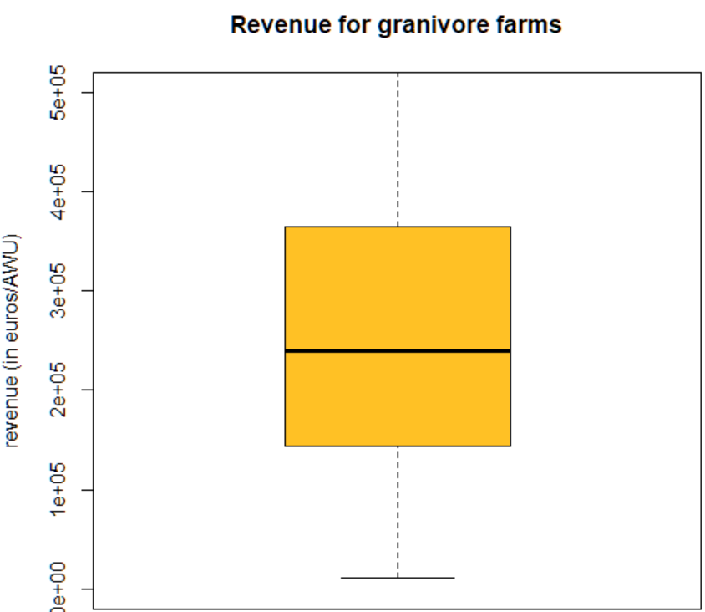

FARM TYPE/STANDARD. REVENUE
Ranking of the Tecnico-Economic orientation according to the standardized revenue:
1. Granivore farms
2. Cereal, oilseed & protein crop farms
3. Specialized dairy cattle farms
4. Specializing in quality viticulture
5. Farms with sheep, goats & other herbivores
13
Notes:
> type15 = subset(df$standardized.revenue, df$OTEXE == 15)
> type45 = subset(df$standardized.revenue, df$OTEXE == 45)
> type37 = subset(df$standardized.revenue, df$OTEXE == 37)
> type48 = subset(df$standardized.revenue, df$OTEXE == 48)
> type50 = subset(df$standardized.revenue, df$OTEXE == 50)
> boxplot(type15,main="Revenue for cereal, oilseed & protein crop farms",ylab="revenue (in euros/AWU)",col="forestgreen", ylim=c(0,500000))
> boxplot(type37,main="Revenue for farms specializing in quality viticulture",ylab="revenue (in euros/AWU)",col="darkolivegreen1", ylim=c(0,500000))
> boxplot(type45,main="Revenue for specialized dairy cattle farms",ylab="revenue (in euros/AWU)",col="chartreuse3", ylim=c(0,500000))
> boxplot(type48,main="Revenue for farms with sheep, goats & other herbivores",ylab="revenue (in euros/AWU)",col="gold", ylim=c(0,500000))
> boxplot(type50,main="Revenue for granivore farms",ylab="revenue (in euros/AWU)",col="goldenrod1", ylim=c(0,500000))
> boxplot(type50,main="Revenue for granivore farms",ylab="revenue (in euros/AWU)",col="goldenrod1", ylim=c(0,1000000))

Slide 14
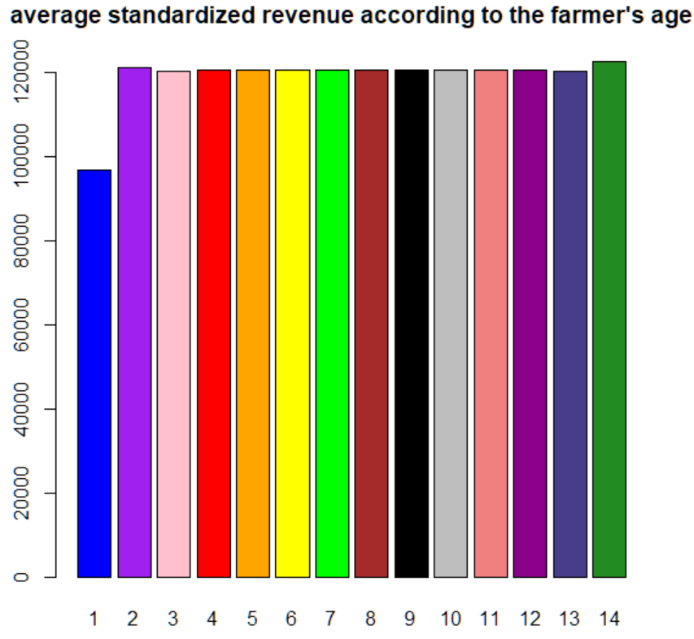
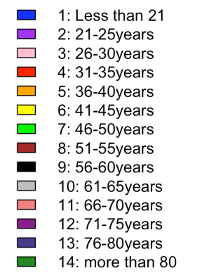
STANDARD. REVENUE/AGE
Upstream calculation of averages
14
Notes:
> barplot(c(96855,120998,120100,120431,120417,120345,120360,120366,120376,120355,120493,120489,120217,122451), col=c("blue","purple","pink","red","orange","yellow","green","brown","black","gray","lightcoral","darkmagenta","darkslateblue","forestgreen"),
+ horiz=FALSE, main = "average standardized revenue according to the farmer's age", names=c("1","2","3","4","5","6","7","8","9","10","11","12","13","14"))
+ legend.text=c("1: Less than 21","2: 21-25years", "3: 26-30years","4: 31-35years","5: 36-40years","6: 41-45years","7: 46-50years","8: 51-55years","9: 56-60years","10: 61-65years","11: 66-70years","12: 71-75years","13: 76-80years", "14: more than 80")

Slide 15
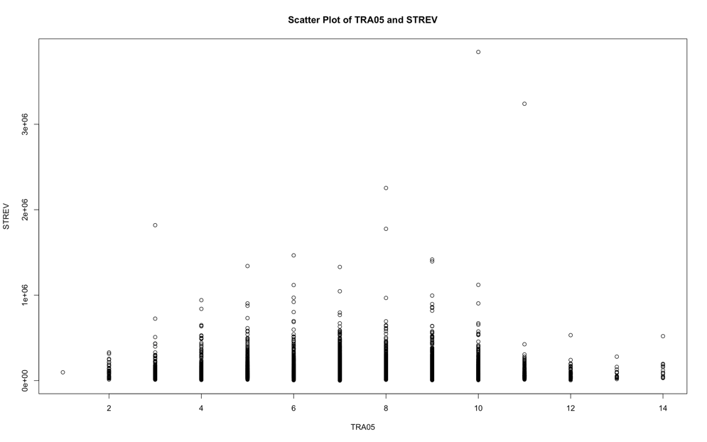
T-TEST
P-value
< 2,2e-16
So smaller than 0,05
H0 accepted
There’s no significant differences
Scatter plot
TRA05 and STREV
15
Notes:
t.test(df$STREV, df$TRA05)
result <- t.test(df$TRA05, df$STREV)
# Create box plot
boxplot(df$TRA05, df$STREV, names = c("TRA05", "STREV"), main = "Box Plot of TRA05 and STREV", ylab = "Values")
# Create scatter plot
plot(df$TRA05, df$STREV, main = "Scatter Plot of TRA05 and STREV", xlab = "TRA05", ylab = "STREV")

Slide 16
Global observations & conclusions
Majority of farms held by male, among which they mainly practice viticulture, specialized protein crop production and dairy cattling ==> diversity of types is more evenly spread than for women (viticulture dominates largely)
The farm types that produce the highest revenues are the less numerous ones
Profile of farms that earn the most are older than 80 or between 21-25 years old ==> but overall, no significant difference in revenues depending on the age
By a causal link, the farm type that earns the least of the 4 studied is "farms with sheep, goats and other herbivores". Most of these farms are run by women, which means they earn less than their peers.
16

Slide 17
Sources
OTEX classification, Agreste (2008) : https://agreste.agriculture.gouv.fr/agreste-web/download/methode/N-Otex/TypologieExploitation_ReglementCE_08decembre2008.pdf
RICA database
Github, Alexandre Gazagnes (2024) : https://github.com/AlexandreGazagnes/Unilasalle-Public-Ressources/tree/main/2a-statistical-tests
17

Slide 18




End
Thank you
Do you have any questions?
18

