Slide 1
Upper Air Reports

Slide 2
Upper Air Reports
Information on the measurement and coding of upper air data is contained in the Federal Meteorological Handbook No. 3. The contents of the handbook can be found that the following URL
http://www.ofcm.gov/fmh3/fmh3.htm

Slide 3
Basic Definitions
Radiosonde is a balloon-borne instrument used to measure and transmit simultaneously meteorological data while ascending through the atmosphere. The instrument consists of sensors for the measurement of pressure, temperature and relative humidity.

Slide 4
Definitions (cont.)
Rawinsonde is a radiosonde that is tracked to provide wind speed and direction.
Pibal (Pilot balloon) is an uninstrumented balloon that is tracked to provide information on wind speed and direction.

Slide 5
Mandatory and Significant Levels
All soundings must include the Standard Pressure Levels (Mandatory Levels) of 1000, 925, 850, 700, 500, 400, 300, 250, 200, 150, 100, 70, 50, 30, 20, 10 hPa.
Significant Levels are additional levels that appear in soundings and they are chosen according to criteria listed in Chapter 5 of the Federal Meteorological Handbook No. 3.

Slide 6
Tropopause
In a sounding the tropopause is the first (i.e. the lowest) level at which the lapse rate decreases to 2°C/km, and the average lapse rate from this level to any higher level within the next 2 km does not exceed 2°C/km.

Slide 7
Maximum Wind Level
The maximum wind level is any wind level with a wind speed of 60 knots or greater and whose wind speed is 20 knots faster than any level above or below it.

Slide 8
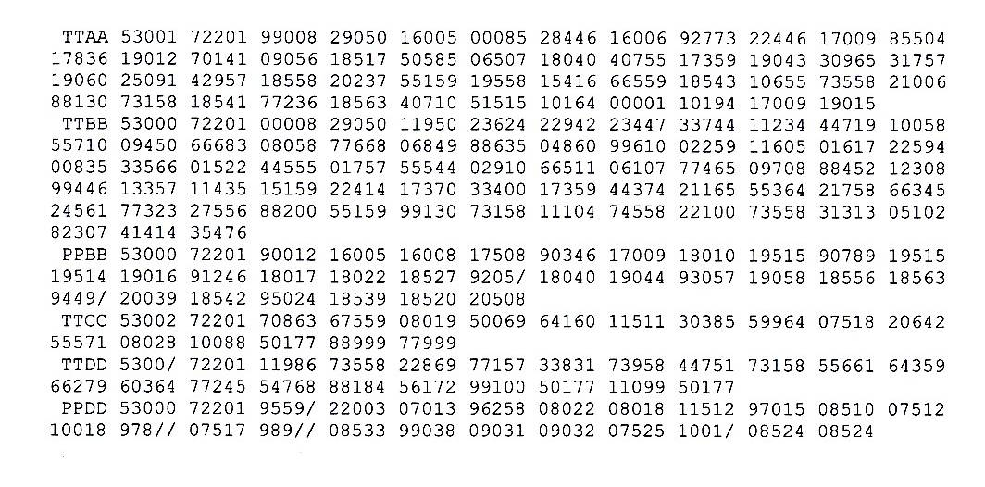
Sample Rawinsonde Report

Slide 9
Upper Air Codes
M_{i}M_{i}M_{j}M_{j} YYGGI_{d} IIiii
M_{i}M_{i} = TT indicates temperature coded message
M_{i}M_{i} = PP indicates upper wind coded message

Slide 10
Upper Air Codes (cont.)
M_{j}M_{j} = AA indicates mandatory levels below 100 hPa
M_{j}M_{j} = BB indicates significant levels below 100 hPa
M_{j}M_{j} = CC indicates mandatory levels above 100hPa
M_{j}M_{j} = DD indicates significant levels above 100 hPa

Slide 11
Upper Air Codes (cont.)
YY indicates the day of the month.
NOTE: when YY>50, it indicates that wind speeds are in knots. In this case YY-50 equals the day of the month.
GG indicates the hour of the sounding in UTC.

Slide 12
Upper Air Codes (cont.)
I_{d} indicates the hundreds (for part AA) or the tens (for part CC) of HPa of the last wind report.
IIiii indicates the five digit WMO identification number of the upper air station where the rawinsonde was launched.

Slide 13
Example of first three groups
TTAA 53001 72201
TTAA indicates the temperature coded message for the mandatory levels below 100hPa,
53 indicates the wind speeds are in knots and the sounding is for the third day of the month,

Slide 14
Example (cont.)
00 indicates the sounding was for 0000 UTC,
1 indicates that highest wind report in this part of the message is 100 hPa,
72201 is the WMO identification number for Key West, Florida.

Slide 15
Upper Air Code (cont.)
The format of the next three groups is
99P_{o}P_{o}P_{o} TTTDD dddff
where
99 indicates that data from the surface follows,

Slide 16
Upper Air Code (cont.)
P_{o}P_{o}P_{o} indicates the surface pressure in whole hPa.
Note: if the surface pressure is greater than 999 hPa, the first digit (1) is omitted.

Slide 17
Upper Air Code (cont.)
TTT indicates the temperature in tenths of a degree Celsius.
Note: if TTT is an even number, it indicates that the temperature is positive (i.e. greater than 0°C) and if TTT is a odd number it indicates that the temperature is negative (i.e. less than 0°C).

Slide 18
Upper Air Code (cont.)
DD indicates the dew point depression.
The dew point depression is equal to the temperature minus the dew point temperature.

Slide 19
Dew Point Depression (cont.)
If DD≤50, then divide by 10 to get the dew point depression in tenths of a degree Celsius.
If DD>50, then subtract 50 to get the dew point depression in whole degrees Celsius.

Slide 20
Upper Air Code (Cont.)
dddff indicates wind direction and speed.
ddd indicates wind direction.
ff indicates wind speed.
If ddd is not divisible by 5, then 1 has been added to the wind direction, and 100 must be added to ff to get the wind speed in knots.

Slide 21
Example
99008 29050 16005
99 indicates the surface groups follow,
008 indicates that the surface pressure is 1008 hPa,

Slide 22
Example (Cont.)
29050
290 indicates that the temperature at the surface is 29.0°C,
50 indicates that the dew point depression at the surface is 5.0°C,

Slide 23
Example (Cont.)
16005
160 indicates that the wind at the surface is blowing from 160° (i.e the south-southeast), and
05 indicates that the wind speed at the surface is 5 knots.

Slide 24
Upper Air Code (Cont.)
The format for the remaining groups of mandatory level data is
PPZZZ TTTDD dddff

Slide 25
Upper Air Code (cont.)
PP indicates the code for the mandatory pressure level of that group,
ZZZ indicates the code for the geopotential height of the rawinsonde when it reached that mandatory level

Slide 26
Upper Air Code (cont.)
TTT indicates the temperature at the mandatory level in tenths of a degree Celsius.
DD indicates the dew point depression at the mandatory level.

Slide 27
Upper Air Code (Cont.)
ddd indicates the wind direction reported for the mandatory level,
ff indicates the wind speed reported for the mandatory level.
Note: TTT, DD, ddd, and ff all use the same formats as for the surface group.

Slide 28
Geopotential Height Codes
1000 hPa – ZZZ is the geopotential height.
925 hPa – ZZZ is the geopotential height.
850 hPa – place a 1 in front of ZZZ to get the geopotential height.

Slide 29
Geopotential Height Codes (Cont.)
700 hPa – when ZZZ is greater than 500 place a 2 in front of ZZZ to get the geopotential height, and when ZZZ is less than 500 place a 3 in front to get the geopotential height.

Slide 30
Geopotential Heights (Cont.)
500, 400, 300 hPa – place a 0 after ZZZ to get the geopotential height.
250, 200, 150, 100 hPa – place a 1 in front of ZZZ and a 0 after ZZZ to get the geopotential height.

Slide 31
Tropopause Level
The tropopause information is given by the
88 group, which has the format
88P_{t}P_{t}P_{t} TTTDD dddff
where P_{t}P_{t}P_{t} indicates the pressure at the tropopause in hPa.

Slide 32
Tropopause Level (Cont.)
For example,
88130 73158 18541
would indicate
the pressure at the tropopause is 130 hPa,

Slide 33
Tropopause Level (cont.)
temperature at the tropopause is -73.1°C,
dew point depression at the tropopause is
8°C,
the wind direction at the tropopause is 185°,
the wind speed at the tropopause is 41 kts.

Slide 34
Maximum Wind Groups
The maximum wind level is reported in the 77 or in the 66 groups.
A 77 group indicates that the level for which the maximum wind data are reported does not coincide with the top of the wind sounding.

Slide 35
Maximum Wind Groups (Cont.)
A 66 group indicates that the top of the wind sounding corresponds to the highest wind speed observed throughout the ascent.

Slide 36
Maximum Wind Groups (Cont.)
The maximum wind groups have the format
MWP_{m}P_{m}P_{m} dddff
where
MW = 77 or 66,

Slide 37
Maximum Wind Groups (Cont.)
P_{m}P_{m}P_{m} indicates the pressure of the maximum wind level in hPa,
ddd is the wind direction at the maximum wind level in degrees,
ff is the wind speed at the maximum wind level in knots.

Slide 38
Maximum Wind Level Example
77236 18563
maximum wind level = 236 hPa
wind direction = 185°
wind speed = 63 kts

Slide 39
Wind Shear
The 4 group indicates wind shear information. The format is
4v_{b}v_{b}v_{a}v_{a}

Slide 40
Wind Shear (Cont.)
v_{b}v_{b} indicates the absolute value of the vector difference between the maximum wind and the wind 1 km below the maximum wind.
v_{a}v_{a} indicates the absolute value of the vector difference between the maximum wind and the wind 1 km above the level of the maximum wind.

Slide 41
Supplemental Data
51515 indicates that supplemental data follows.

Slide 42
The Lifted Index Group
The Lifted Index (LI) is the difference between the temperature of the environment at 500 hPa and the temperature of a parcel lifted to the 500 hPa level.
LI = T_{environment(500 hPa)} – T_{parcel(500 hPa)}

Slide 43
Lifted Index Group (Cont.)
The format of the Lifted Index group is
10164 LLLLL
where LLLLL indicates the Lifted Index in tenths of a degree Celsius.
If LLLLL > 50, subtract 50 and divide by 10 to get LI.
If LLLLL ≤ 50, divide by ten to get LI.
If LLLLL is an odd number, then LI<0.

Slide 44
Lifted Index Example
10164 00001 would indicate LI = -0.1°C

Slide 45
Mean Low Level Winds
The 10194 group indicates that the Mean Low Level Wind groups follow. The format of the Mean Low Level Wind groups is
10194 d₁d₁d₁f₁f₁ d₂d₂d₂f₂f₂

Slide 46
Mean Low Level Winds (Cont.)
The first group after 10194 indicates the mean wind direction and wind speed for the layer from the surface to 5000 feet.
The second group after 10194 indicates the mean wind direction and wind speed for the layer from 5000 to 10,000 feet.

Slide 47
Significant Levels Below 100 hPa
Temperature and Dew Point Depression for the significant levels below the 100 hPa level are given in the TTBB group.
Note: the TTBB groups do not contain any wind information.

Slide 48
TTBB Groups
The first five groups in the TTBB groups are identical to the first five groups in the TTAA groups, except for I_{d} = 0.
The remaining groups have the format
nnPPP TTTDD

Slide 49
TTBB Groups (Cont.)
nn = 11, 22, 33, 44, 55, 66, 77, 88, 99, repeated as necessary, and indicates the order of the groups.
PPP indicates the pressure of the significant level
TTT indicates temperature
DD indicates dew point depression

Slide 50
TTBB Supplemental Information
31313 s_{r}r_{a}r_{a}s_{a}s_{a} 8GGgg (9s_{n}T_{W}T_{W}T_{W})
31313 indicates that supplemental information follows
s_{r} indicates the code for the solar radiation correction

Slide 51
r_{a}r_{a} indicates the type of radiosonde/sounding system used
s_{a}s_{a} indicates the tracking technique and the status of the system used
8GGgg indicates the launch time in UTC

Slide 52
(9s_{n}T_{W}T_{W}T_{W}) indicates the Sea Surface Temperature (SST) in tenths of degree Celsius for shipboard launches.
s_{n} indicates the sign of the SST
T_{W}T_{W}T_{W} indicates the SST in tenths of degrees Celsius

Slide 53
TTBB Supplemental Information (Cont.)
41414 N_{h}C_{L}hC_{M}C_{H}
41414 indicates that cloud information follows
N_{h} indicates the cloud coverage in the lowest layer of low or middle clouds

Slide 54
C_{L} indicates the type of low cloud
h indicates the height above the surface of the lowest cloud seen
C_{M} indicates the type of middle cloud
C_{H} indicates the type of high cloud

Slide 55
Upper Wind Code
PPBB YYGGI_{d} IIiii 9tuuu dddff dddff dddff
PPBB indicates wind data from the levels below 100 hPa.
9 indicate that a new group of data follows

Slide 56
Upper Wind Code (Cont.)
t indicates the tens of thousands of feet
uuu indicates the ones unit of the height in thousands for feet for each of the three groups that follow

Slide 57
Upper Wind Code Example
90012 16005 16008 17508
indicates that the wind at
0000 feet is 160° at 5 kts
1000 feet is 160° at 8 kts
2000 feet is 175° at 8 kts

Slide 58
Above 100 hPa
TTCC indicates the mandatory levels above 100 hPa
TTDD indicates the significant levels above 100 hPa
PPDD indicates the significant wind levels above 100 hPa
Note: pressures are given in tenths of a hPa above 100hPa

