Slide 1
Test
I2C
PIC16
Buck Click
3
Production
Image (.HEX)
Serial BL
7
PC
Demo GUI
6
HID Click
PIC18
Clicker
4
8
5
I2C
HID
Serial CDC
FS USB
2
9
PIC18 HID
BL
PIC16 Serial BL
HID BL
1

Slide 2
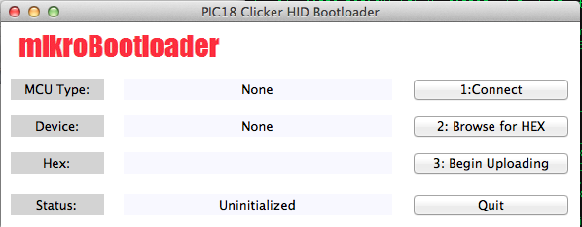
2 - HIDBoot.py

Slide 3
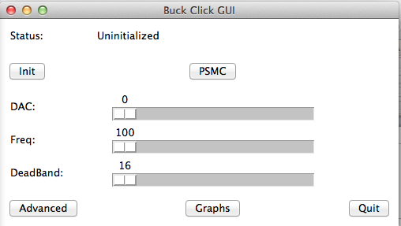
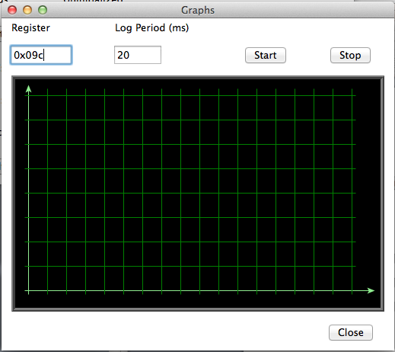
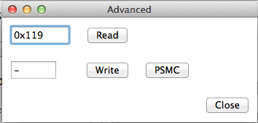
6 - BuckGUI.py

Slide 4
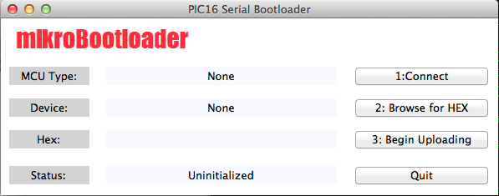
9 - SerialBoot16.py

