Slide 1
A murine model of glucocorticoid myopathy alleviation using androgen therapy
Nicolae Lucian Sandor
July 13th, 2015

Slide 2
Outline
Medical premises
In vivo model
In vitro model
Future directions

Slide 3
Glucocorticoids in humans
Stress hormones working towards hyperglycemia
Activate immunosuppressive mechanisms
expression of the decoy IL1R-II
macrophage apoptosis.
Prescribed to ~1% per annum.
Effects include
edema*
osteopenia
insulin resistance
muscle loss.
*Mineralocorticoid.

Slide 4
Glucocorticoid myopathy
“Proximal weakness”
Myofiber condition
Loss of volume, mass, force
Increased catabolism:
higher urinary nitrogen
methylhistidine
Some translation component

Slide 5
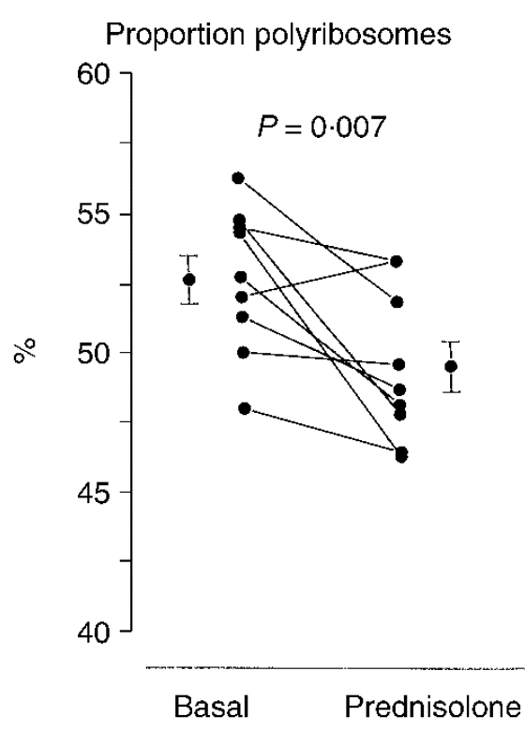
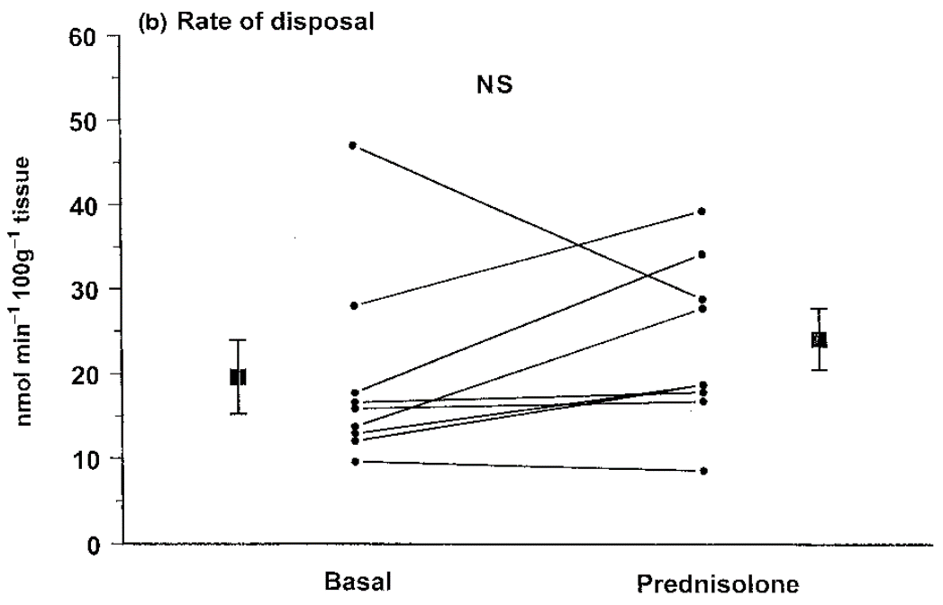
“Some” translation component?
Three-day prednisone on healthy volunteers (Lofberg et al., Eur J Clin Invest, 2002)

Slide 6
Therapeutic approaches to GM
Cessation or surgery, if possible.
Inhibitors of synthesis.
Receptor blockers.
Anabolic adjuvants.

Slide 7
Androgen - glucocorticoid natural interaction
Muscle loss is ampler in males
Males with hypercortisolism have lower testosterone
… but females with hypercortisolism have hirsutism

Slide 8
Androgen muscle protection
Androgenic - anabolic - ergogenic hypothesis
Effective in sarcopenia of aging, HIV+, COPD*, heart failure*
Higher amino acid uptake in muscle
Some anti-catabolic component

Slide 9
Studies of glucocorticoid - testosterone interaction
Two decades as part of standard of care.
Crawford et al. (2003) showed Testo addition to chronic GC causes:
higher bone density
improved muscle mass and strength
better quality of life.
How?

Slide 10
Medical condition
Glucocorticoids cause muscle loss
In males, this loss of muscle is associated with moderate hypoandrogenism
Testosterone supplementation reduce the loss of muscle
Safer alternatives to testosterone are needed

Slide 11
Animal models
Glucocorticoids stimulate some fat deposits, confounding arm diameter measurements.
Horses get hyperglycemia.
Dogs get increased urinary nitrogen.
Rodents are best.

Slide 12
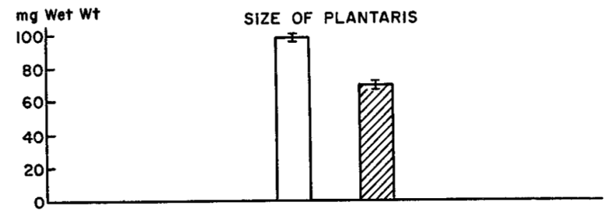
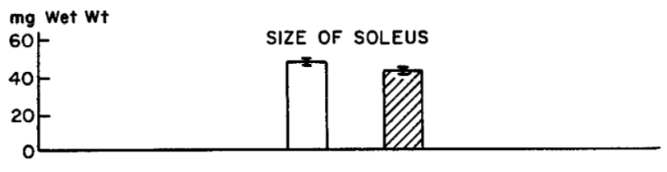
Rats respond to glucocorticoids
Hatched bars represent seven-day 10 mg/kg cortisone on adult male rats
(Goldberg, JBC, 1969).

Slide 13
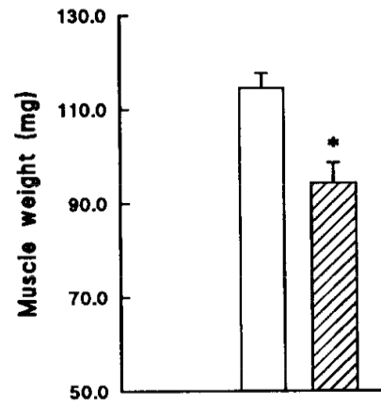
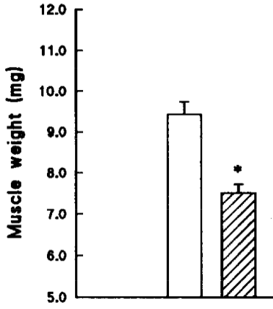
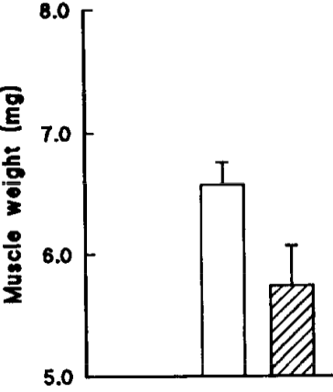
Mice respond to glucocorticoids
Gastrocnemius
Extensor digitorum
Soleus
Hatched bars for ten-day 5 mg/kg dexamethasone on male mice
(Agbenyega et al., Comp Physiol, 1992).

Slide 14
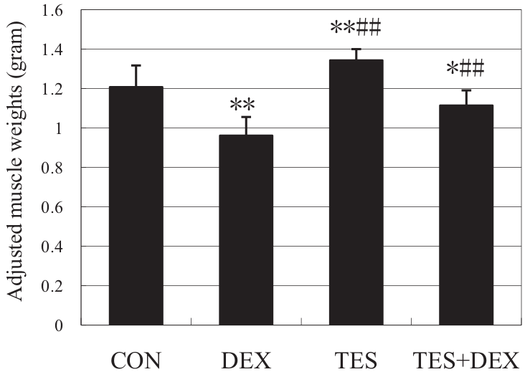
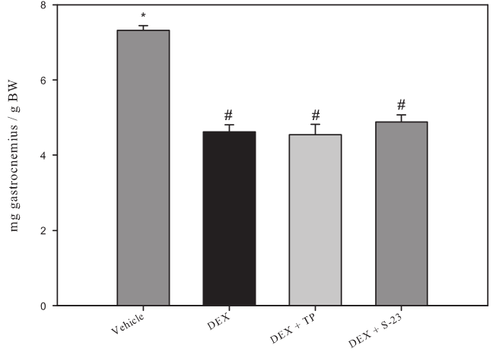
Rat muscles are protected by testosterone co-administration
... Or are they?
Gastrocnemius. Ten-day dexamethasone
± 5 mg/kg testosterone (Yin, J Trauma, 2009).
Gastrocnemius. Eight-day dexamethasone
± 25 mg/kg testosterone (Jones, Endocrinology, 2010).

Slide 15
First hypothesis
Testosterone alleviates dexamethasone-induced muscle atrophy in mice.

Slide 16

In vivo test
± 10 mg / kg D, ± 28 mg / kg T
Tissue collection
V
D
D+T
Time (days)

Slide 17
Body weight time course
body weight
(% gain)

Slide 18
A different kind of time course
body weight
(% gain)

Slide 19
Body composition
fat mass
gain (g)
lean mass
loss (g)

Slide 20
Individual muscles
gastrocnemius (g)
triceps br. (g)
quadriceps (g)
levator ani (g)
tibialis ant. (g)

Slide 21
Conclusion so far
Testosterone reduces dexamethasone-induced reduction in mouse muscle mass.

Slide 22
Metabolic mechanisms of Dexa
Increase in urinary 3MH demonstrates dexamethasone’s pro-catabolic action.
Proteasome is dexamethasone’s main effector:
E3 ligases upregulated
amino acid release decreases by 80% when treated with MG132.
Other proteolytic mechanisms are involved.

Slide 23
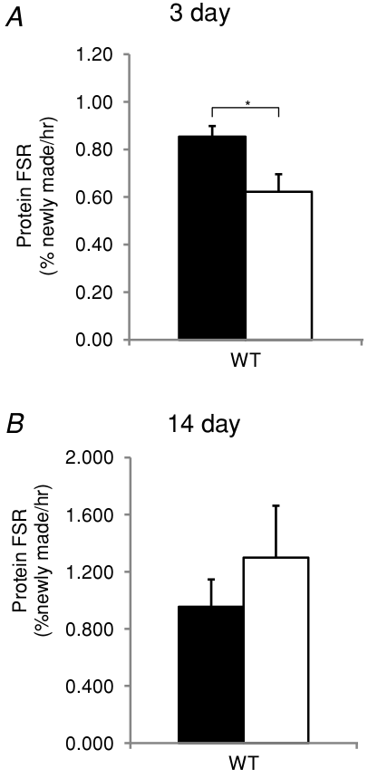
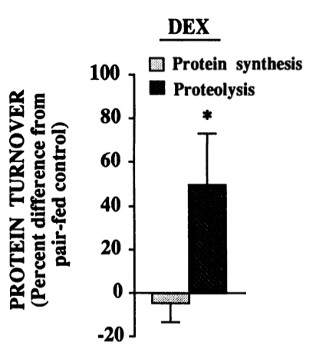
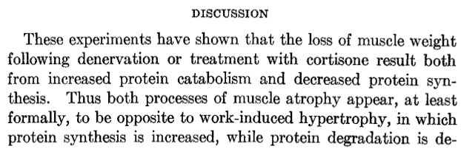
Protein synthesis and Dexa
Caveats:
(Goldberg, JBC, 1969).
Four days, 0.5 mg/kg dexamethasone on male rats
(Dardevet et al., JCI, 1995).
3 mg/kg dexamethasone on male mice
(Baehr et al., J Physiol, 2012).
More caveats later.

Slide 24
Testosterone effect on atrophying muscle
Indirect studies (microarray, molecular markers) in glucocorticoid myopathy.
Anti-proteolytic in rescue of castration (Serra, Sandor et al., 2012).

Slide 25
Second hypothesis
Testosterone’s myoprotective action in the context of dexamethasone atrophy is based on inhibiting the latter’s proteolytic effects.

Slide 26
E3 ligases
gastrocnemius MuRF1 mRNA
quadriceps MuRF1 mRNA
gastrocnemius MAFbx mRNA
quadriceps MAFbx mRNA
one day
three days
seven days

Slide 27
Chymotrypsin-like activity
quadriceps proteasome catalytic activity (rel.u.)
triceps proteasome catalytic activity (rel.u.)
one day
three days
seven days

Slide 28
Autophagy-related genes
gastrocnemius beclin mRNA
gastrocnemius cathepsin L mRNA
gastrocnemius LC3 mRNA
one day
three days
seven days

Slide 29
Cathepsin L activity
gastrocnemius autophagosome catalytic activity (rel.u.)
quadriceps autophagosome catalytic activity (rel.u.)
triceps autophagosome catalytic activity (rel.u.)
one day
three days
seven days

Slide 30
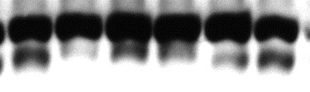

Gastrocnemius LC3 isoforms
slow >
LC3
fast >
GAPDH
Dexa | - | - | + | + | + | +
Testo | - | - | - | - | + | +
LC3-II normalized to GAPDH
LC3-II normalized to LC3-I

Slide 31
Calpain activity
gastrocnemius calpain catalytic activity (rel.u.)
one day
three days
seven days

Slide 32


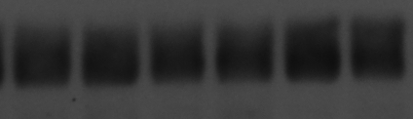

Translation regulators
Ⓟ-eIF2α
eIF3f
GAPDH
GAPDH
Dexa | — | — | + | + | + | +
Testo | — | — | — | — | + | +
Dexa | — | — | + | + | + | +
Testo | — | — | — | — | + | +
Ⓟ-eIF2α
eIF3-f
gastrocnemius, day 7

Slide 33
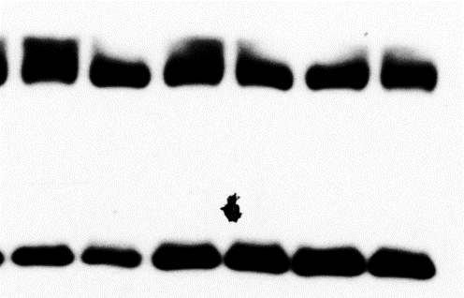
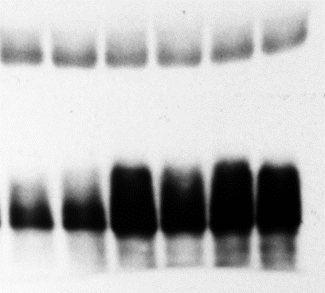
4E-BP
GAPDH
GAPDH
Ⓟ-4EBP
total 4EBP
Dexa | — | — | + | + | + | +
Testo | — | — | — | — | + | +
Dexa | — | — | + | + | + | +
Testo | — | — | — | — | + | +
total 4EBP
Ⓟ-4EBP
gastrocnemius, day 7

Slide 34
Conclusions so far
Dexamethasone-induced loss of muscle is correlated with an increase in proteasome activity and E3 ligases expression.
Rescue by testosterone co-administration is correlated with proteasome repression.
Autophagy, calpains, protein synthesis changes could not explain the phenotype.

Slide 35
Transcriptional effects of Dexa
Myostatin
Klf15
GR
MuRF1
muscle
loss
Dexa
Foxo
4EBP

Slide 36
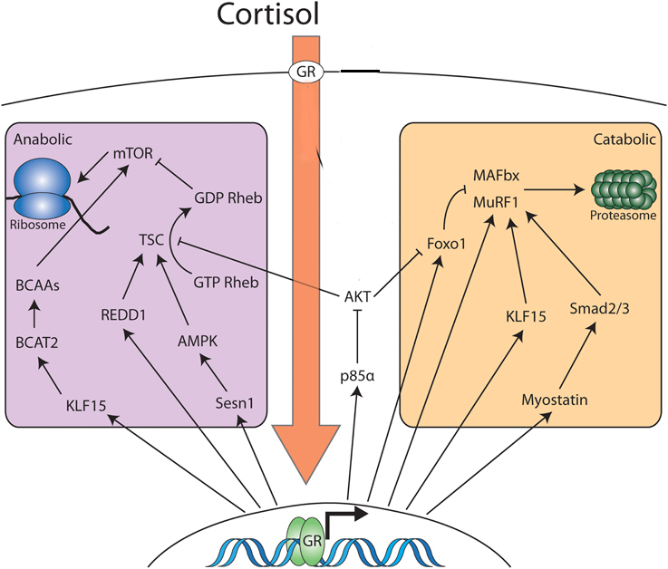
More transcriptional effects of Dexa
Modified from Braun and Jones, Front Physiol, 2015.

Slide 37
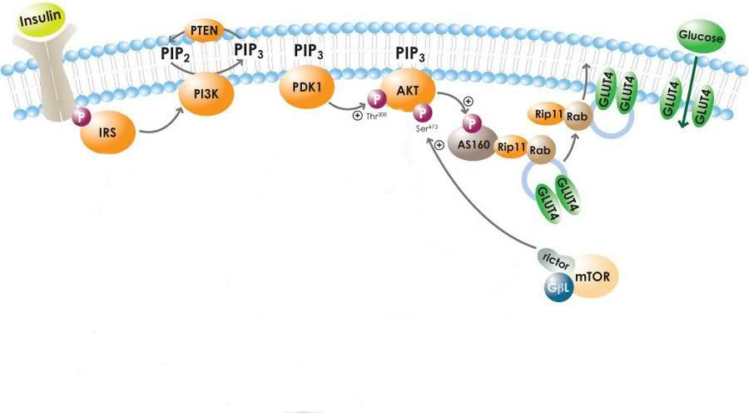
Glucose metabolism insights
May, 2010
Glucocorticoids increase glucose, insulin, but lower glucose uptake.
Putative points of inhibition include IRS 1 and PI3K.

Slide 38
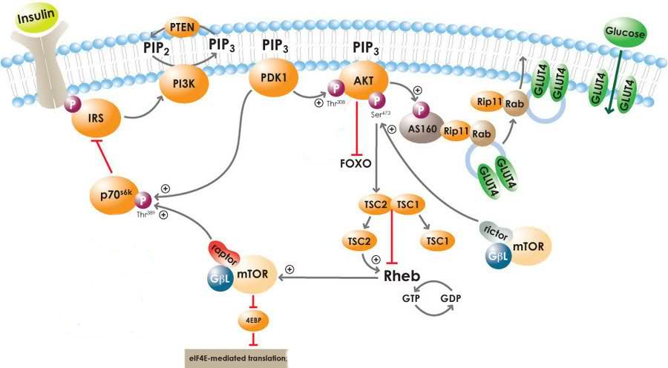
Akt desensitization

Slide 39
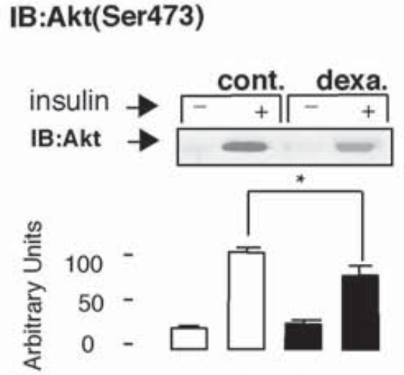
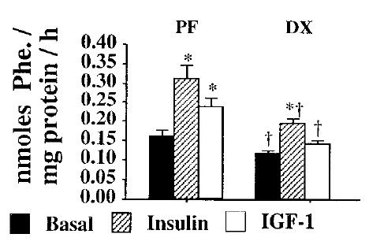
Combination of permanent and conditional actions
Dardevet et al., J Endocr, 1998.
Rojas et al., Endocrin, 2003.

Slide 40
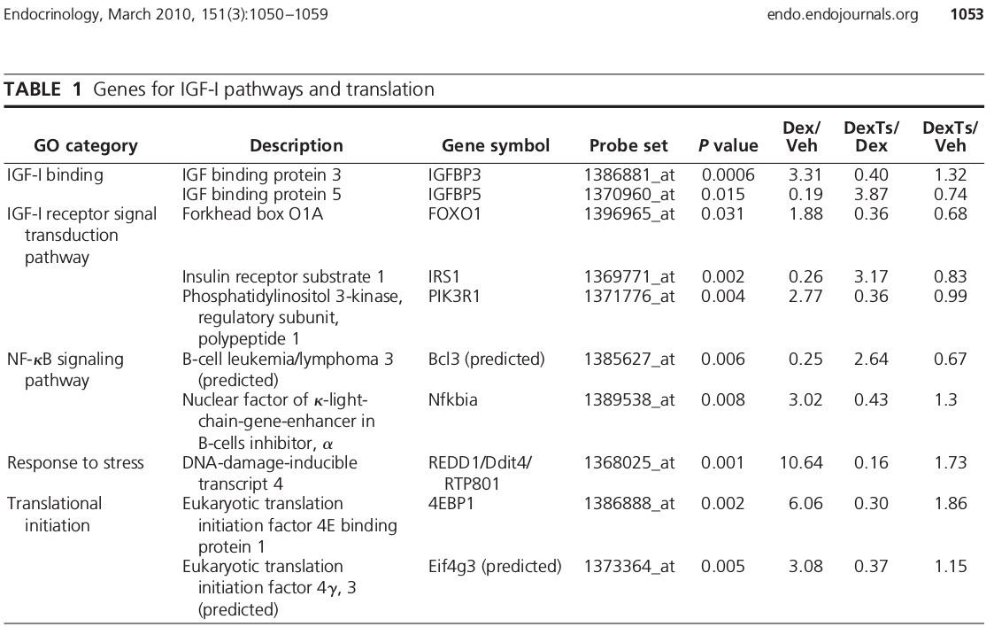
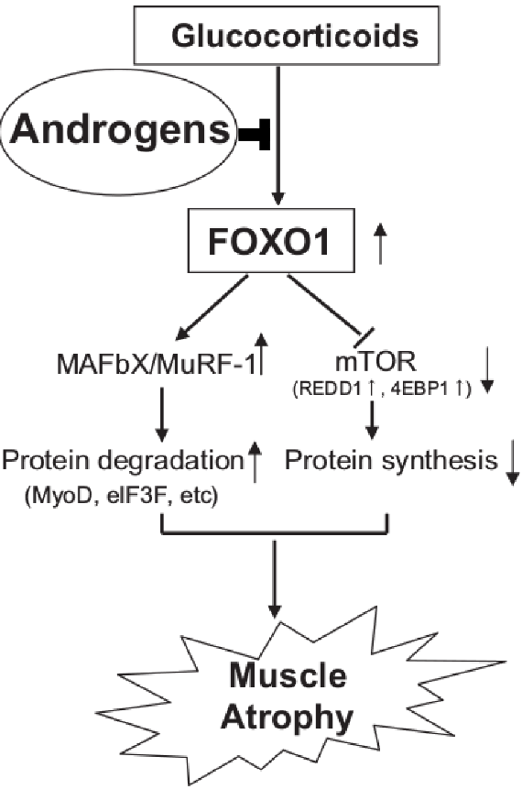
Testosterone mechanisms
Qin et al., BBRC, 2010.
Wu et al., Endocrinology, 2010.

Slide 41
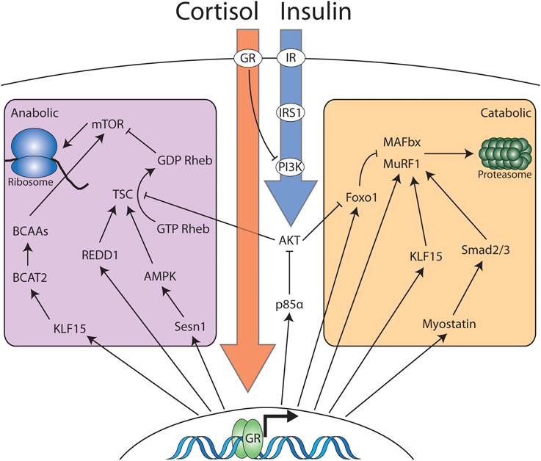
Upstream of Foxo
Braun and Jones, Front Physiol, 2015.

Slide 43
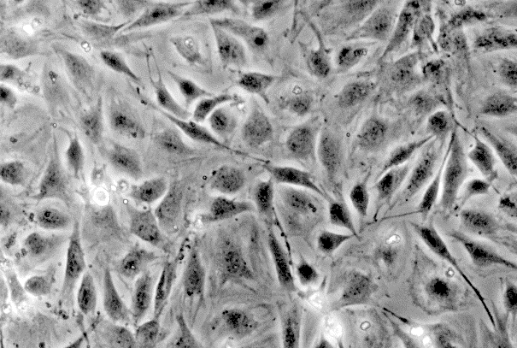
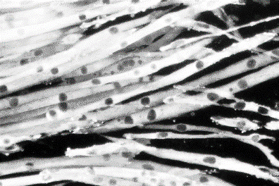


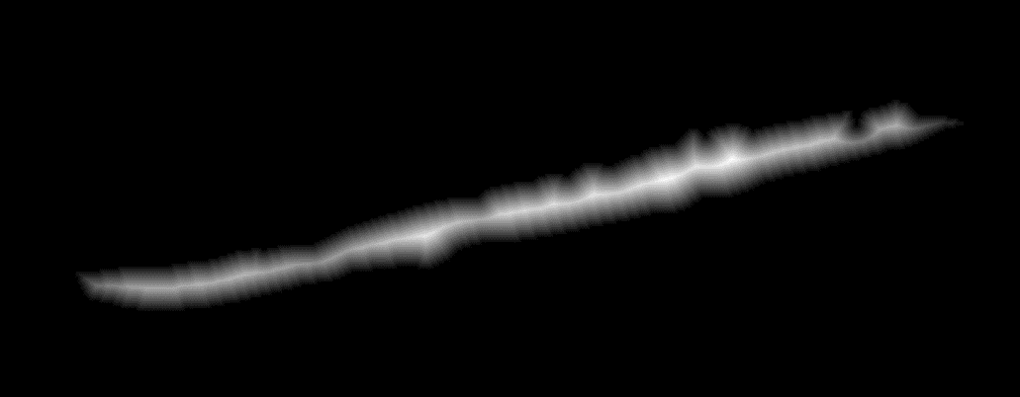
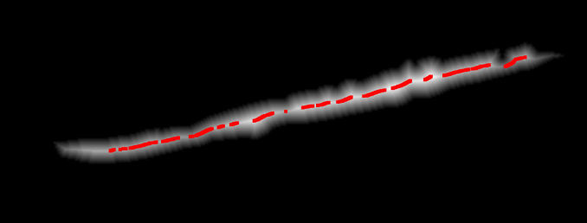
In vitro model
Start differentiation
DM
Time
(days)
Undifferentiated
Differentiated
(B) Matlab
(A) Photoshop

Slide 44
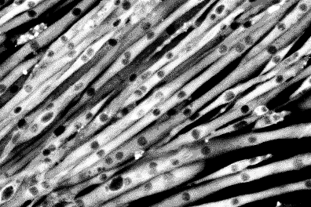
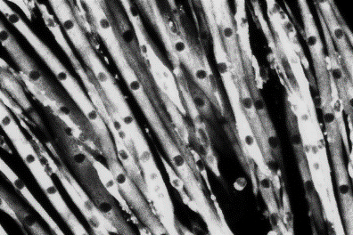
In vitro model
Start differentiation
Start pharmacological treatments
DM
±T±D
Time
(days)
Vehicle
Differentiated
average cell diameter (rel. u.)
50 µM Dexa
Dexa +
300 nM Testo

Slide 45
More in vitro evidence
Start differentiation
Start pharmacological treatments
1 d
DM
±T±D
Time
(days)
2 d
DM
±T±D
total protein (rel. u.)

