Slide 1
CS5412 / Lecture 19 Apache Architecture
Ken Birman & Kishore Pusukuri, Spring 2020

Slide 2
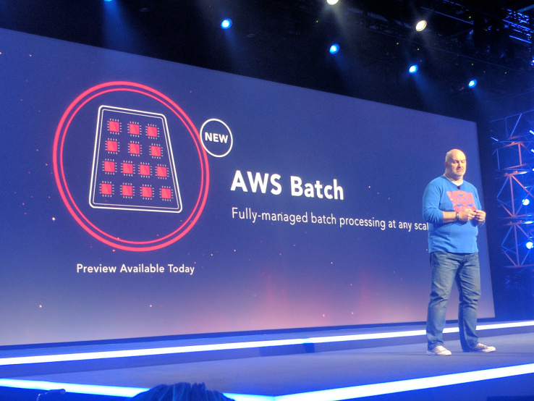
Batched, Sharded computing on BIG DATA with Apache
Last time we heard about big data (IoT will make things even bigger).
Today’s non-IoT systems shard the data and store it in files or other forms of databases. We use SQL expressions in massively parallel programs to search or compute functions over these huge data sets.
Apache is the most widely used big data processing framework
Notes:
Apache is the “base” system on which many web servers were originally layered, and then it expanded to also include the mostly popular big data frameworks, like Hadoop. But it is not the only such system. In fact all the main vendors have ones of their own.

Slide 3
Why batch?
The core issue is overhead. Doing things one by one incurs high overheads.
Updating data in a batch pays the overhead once on behalf of many events, hence we “amortize” those costs. The advantage can be huge.
But batching must accumulate enough individual updates to justify running the big parallel batched computation. Tradeoff: Delay versus efficiency.
Notes:
The most important things we will hear about in these lectures (a few of them) center on these principles:
Keeping data sharded at all times. So there are always key-value collections, always hashed over sets of servers.
Processing requests in big batches that often can all be handled in parallel, with one computation doing lots of requests all at once rather than one by one. For example rather than update the availability count for one product at Amazon, the store might update the counts for 10,000 at a time. Those would be the batch elements – the batch is the full set of 10,000 and the individual update is just one among many.
This model is beneficial because the overheads of getting to the place where the update will occur can be quite high compared to doing the update (for an inventory count the actual operation is just a +/- action, but the logic to find the proper counter can be substantial). So doing a lot at once shares (“amortizes”) costs over lots of requests and this drives down the average overhead in a huge way. A 100x throughput improvement wouldn’t be at all unusual.

Slide 4
A Typical Big Data System
Batch Processing
Analytical SQL
Stream Processing
Machine Learning
Other Applications
Resource Manager (Workload Manager, Task Scheduler, etc.)
Data Ingestion Systems
Data Storage (File Systems, Database, etc.)
Popular BigData Systems: Apache Hadoop, Apache Spark
Notes:
These layers show how one component might be built upon a different component.

Slide 5

A Typical Big Data System
Batch Processing
Analytical SQL
Stream Processing
Machine Learning
Other Applications
Zookeeper: Used to “manage” the entire structure including for subsystems in it.
Resource Manager (Workload Manager, Task Scheduler, etc.)
Data Ingestion Systems
Data Storage (File Systems, Database, etc.)
Popular BigData Systems: Apache Hadoop, Apache Spark
Notes:
Zookeeper is the Apache solution for managing complex systems. Keep in mind that each “box” might have tens or hundreds of processes participating in it, as a pool. But that pool needs to be internally coordinated and fault-tolerance. Zookeeper is used for these aspects, as a powerful and universal configuration manager.

Slide 6
Cloud systems have many “file Systems”
Before we discuss Zookeeper, let’s think about file systems. Clouds have many! One is for bulk storage: some form of “global file system” or GFS.
At Google, it is actually called GFS. HDFS (which we will study) is an open-source version of GFS.
At Amazon, S3 plays this role
Azure uses “Azure storage fabric”
Derecho can be used as a file system too (object store and FFFS_{v2})
Notes:
To see how we use Zookeeper we can first drill into the structure of the Apache file system, which is one of many subsystems that depend on Zookeeper.
In Apache it is HDFS that plays this role.

Slide 7
How do they (all) work?
A “Name Node” service runs, fault-tolerantly, and tracks file meta-data (like a Linux inode): Name, create/update time, size, seek pointer, etc.
The name node also tells your application which data nodes hold the file.
Very common to use a simple DHT scheme to fragment the NameNode into subsets, hopefully spreading the work around. DataNodes are hashed at the block level (large blocks)
Some form of primary/backup scheme for fault-tolerance, like chain replication. Writes are automatically forwarded from the primary to the backup.
Notes:
The “roles” we are talking about correspond to separate processes that all need to be running. So with these file systems we have one or perhaps a group of processes that track the directory structure (the “meta-data”). These are the name-nodes.
Then we have other separate processes, the data-nodes. Those are also in a group, and might also be sub-structured into little shards of two replicas each.

Slide 8
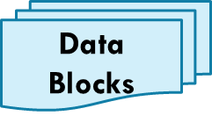
How do they work?
NameNode
Metadata: file owner, access permissions, time of creation, … Plus: Which DataNodes hold its data blocks
open
File MetaData
Copy of metadata
read
DataNode
DataNode
DataNode
DataNode
DataNode
DataNode
DataNode
DataNode
File data

Slide 9
Many file systems that scale really well aren’t great for locking/consistency
The majority of sharded and scalable file systems turn out to be slow or incapable of supporting consistency via file locking, for many reasons.
So many application use two file systems: one for bulk data, and Zookeeper for configuration management, coordination, failure sensing.
This permits some forms of consistency even if not everything.
Notes:
Let’s not talk about Derecho today. Apache doesn’t currently use it.
Instead we will focus on Zookeeper, even though it is similar to Derecho in many ways.
The hard thing to get used to is that even though we are building Apache HDFS, a file system, it depends on Zookeeper which is also a file system. They even have the same API! But despite this, Zookeeper is used in very different ways and provides different guarantees to the users.

Slide 10
Zookeeper use cases
The need in many systems is for a place to store configuration, parameters, lists of which machines are running, which nodes are “primary” or “backup”, etc.
We desire a file system interface, but “strong, fault-tolerant semantics”
Zookeeper is widely used in this role. Stronger guarantees than GFS.
Data lives in (small) files.
Zookeeper is quite slow and not very scalable.
Notes:
A first thing to realize is that unlike HDFS with its name node(s) and data nodes, Zookeeper is just one replicated service with 2 or 3 members in it. It isn’t designed to scale well, and doesn’t scale well. Even the files it holds need to be small.

Slide 11
Apache Zookeeper and μ-services
Zookeeper can manage information in your system
IP addresses, version numbers, and other configuration information of your μ-services.
The health of the μ-service.
The step count for an iterative calculation.
Group membership
Notes:
Despite limitations it can be used for many purposes!

Slide 12
Most popular Zookeeper API?
They offer a novel form of “conditional file replace”
Exactly like the conditional “put” operation in Derecho’s object store.
Files have version numbers in Zookeeper.
A program can read version 5, update it, and tell the system to replace the file creating version 6. But this can fail if there was a race and you lost the race. You could would just loop and retry from version 6.
It avoids the need for locking and this helps Zookeeper scale better.
Notes:
Conditional replace works like this:
You read some file and at the same time, learn that it is version 4 of that file.
Now your code rewrites the whole file, telling Zookeeper that this needs to be version 5.
The write will succeed if there are no concurrent writers. But if some concurrent writer is creating version 4 at the same time, only one can win the race.
If you win the race your version is saved. If you lose the race, Zookeeper rejects the entire update: it says “sorry, version 5 already exists!” Then your code can loop, rereading the file at step (1).
The big win is that we didn’t need locks. This is a very popular option!

Slide 13
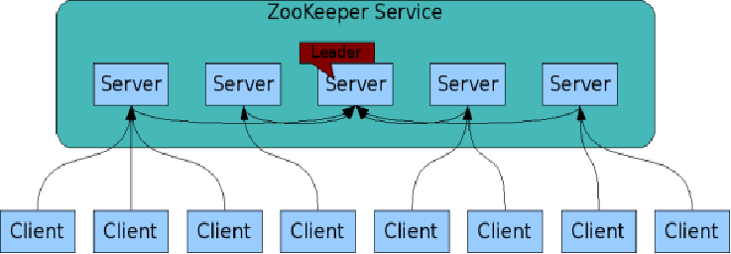
The ZooKeeper Service
Zookeeper is itself an interesting distributed system
These are your μ-services
ZooKeeper Service is replicated over a set of machines
All machines store a copy of the data in memory (!). Checkpointed to disk if you wish.
A leader is elected on service startup
Clients only connect to a single ZooKeeper server & maintains a TCP connection.
Client can read from any Zookeeper server.
Writes go through the leader & need majority consensus.
https://cwiki.apache.org/confluence/display/ZOOKEEPER/ProjectDescription

Slide 14

Is Zookeeper using Paxos?
Early work on Zookeeper actually did use Paxos, but it was too slow
They settled on a model that uses atomic multicast with dynamic membership management and in-memory data (like virtual synchrony).
But they also checkpoint Zookeeper every 5s if you like (you can control the frequency), so if it crashes it won’t lose more than 5s of data.
Notes:
In early lectures we learned about Paxos. Zookeeper originally tried to use Paxos (it is actually based on Google’s Chubby, a Paxos-based service). But that was too slow.
So they modified the guarantees and use atomic multicast (like Derecho!) coupled with checkpointing. This is not as strong as Paxos because there is a window in which data can be stored, but still lost if a crash were to happen.
You cannot reduce this window to 0. It has a smallest value of 1s.

Slide 15

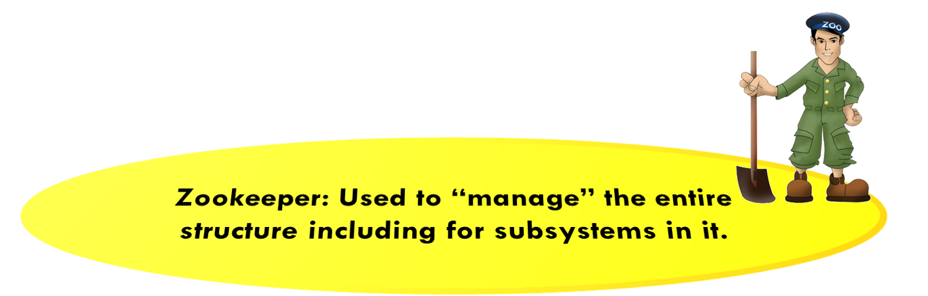
Rest of the Apache Hadoop Ecosystem
Map Reduce
Hive
Pig
Other Applications
Spark Stream
Yet Another Resource Negotiator (YARN)
Data Ingest Systems
e.g., Apache Kafka, Flume, etc
Hadoop NoSQL Database (HBase)
Hadoop Distributed File System (HDFS)
Cluster

Slide 16
Hadoop Distributed File System (HDFS)
HDFS is the storage layer for Hadoop BigData System
HDFS is based on the Google File System (GFS)
Fault-tolerant distributed file system
Designed to turn a computing cluster (a large collection of loosely connected compute nodes) into a massively scalable pool of storage
Provides redundant storage for massive amounts of data -- scales up to 100PB and beyond

Slide 17
HDFS: Some Limitations
Files can be created, deleted, and you can write to the end, but not update them in the middle.
A big update might not be atomic (if your application happens to crash while writes are being done)
Not appropriate for real-time, low-latency processing -- have to close the file immediately after writing to make data visible, hence a real time task would be forced to create too many files
Centralized metadata storage -- multiple single points of failures
Name node is a scaling (and potential reliability) weak spot.

Slide 18
Hadoop Database (HBase)
A NoSQL database built on HDFS
A table can have thousands of columns
Supports very large amounts of data and high throughput
HBase has a weak consistency model, but there are ways to use it safely
Random access, low latency
Notes:
Once we have files in a file system we can layer a database over it.

Slide 19
HBase
Hbase design actually is based on Google’s Bigtable
A NoSQL distributed database/map built on top of HDFS
Designed for Distribution, Scale, and Speed
Relational Database (RDBMS) vs NoSQL Database:
RDBMS → vertical scaling (expensive) → not appropriate for BigData
NoSQL → horizontal scaling / sharding (cheap) → appropriate for BigData

Slide 20
Reminder: RDBMS vs NoSQL (1)
BASE not ACID:
RDBMS (ACID): Atomicity, Consistency, Isolation, Durability
NoSQL (BASE): Basically Available Soft state Eventually consistency
The idea is that by giving up ACID constraints, one can achieve much higher availability, performance, and scalability
e.g. most of the systems call themselves “eventually consistent”, meaning that updates are eventually propagated to all nodes

Slide 21
RDBMS vs NoSQL (2)
NoSQL (e.g., CouchDB, HBase) is a good choice for 100 Millions/Billions of rows
RDBMS (e.g., mysql) is a good choice for a few thousand/millions of rows
NoSQL → eventual consistency (e.g., CouchDB) or weak consistency (HBase). HBase actually is “consistent” but only if used in specific ways.

Slide 22
HBase: Data Model (1)
Notes:
The concept is insanely scalable. We shard the rows, the columns and even can shard a single value in a single (row,column) cell! This is the most ambitious use of key-value sharding in the cloud today (this, and BigTable, on which it was based).

Slide 23
HBase: Data Model (2)
Sorted rows: support billions of rows
Columns: Supports millions of columns
Cell: intersection of row and column
Can have multiple values (which are time-stamped)
Can be empty. No storage/processing overheads

Slide 24
HBase: Table

Slide 25
HBase: Horizontal Splits (Regions)

Slide 26
Hbase Architecture (Region Server)
Notes:
Analogous to data node of HDFS

Slide 27
HBase Architecture

Slide 28
HBase Architecture: Column Family (1)

Slide 29
HBase Architecture: Column Family (2)

Slide 30
HBase Architecture: Column Family (3)
Data (column families) stored in separate files (Hfiles)
Tune Performance
In-memory
Compression
Needs to be specified by the user

Slide 31
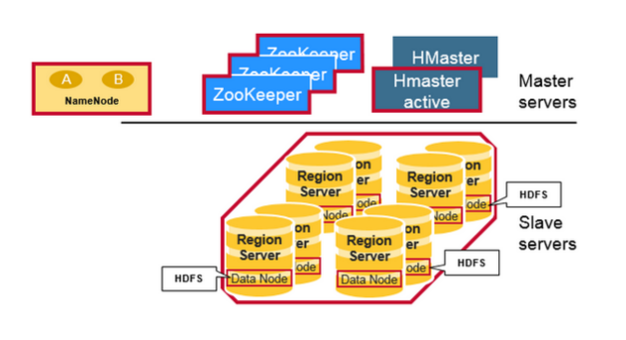
HBase Architecture (1)
HBase is composed of three types of servers in a master slave type of architecture: Region Server, Hbase Master, ZooKeeper.
Region Server:
Clients communicate with RegionServers (slaves) directly for accessing data
Serves data for reads and writes.
These region servers are assigned to the HDFS data nodes to preserve data locality.

Slide 32
HBase Architecture (2)
HBase Master: coordinates region servers, handles DDL (create, delete tables) operations.
Zookeeper: HBase uses ZooKeeper as a distributed coordination service to maintain server state in the cluster.

Slide 33
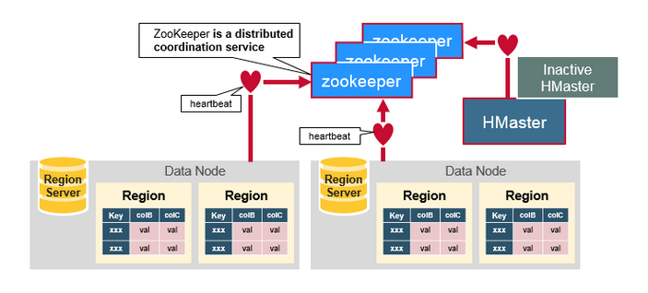
HDFS uses ZooKeeper as its coordinator
Maintains region server state in the cluster
Provides server failure notification
Uses consensus to guarantee common shared state

Slide 34
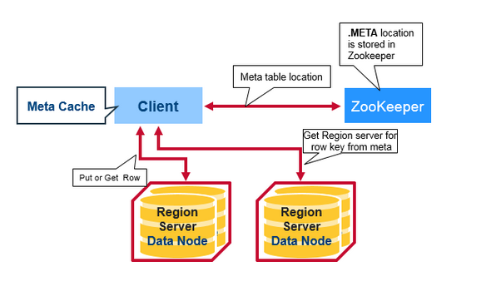
How do these components work together?
Region servers and the active HBase Master connect with a session to ZooKeeper
A special HBase Catalog table “META table” → Holds the location of the regions in the cluster.
ZooKeeper stores the location of the META table.
Notes:
There is a special HBase Catalog table called the META table, which holds the location of the regions in the cluster. ZooKeeper stores the location of the META table.

Slide 35
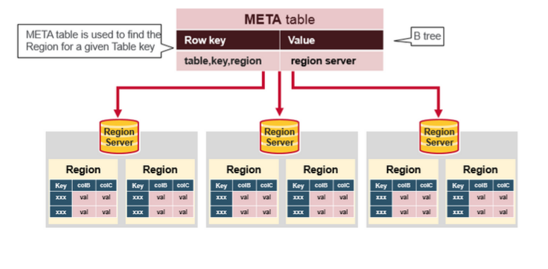
HBase: Meta table
The META table is an HBase table that keeps a list of all regions in the system.
This META table is like a B Tree

Slide 36
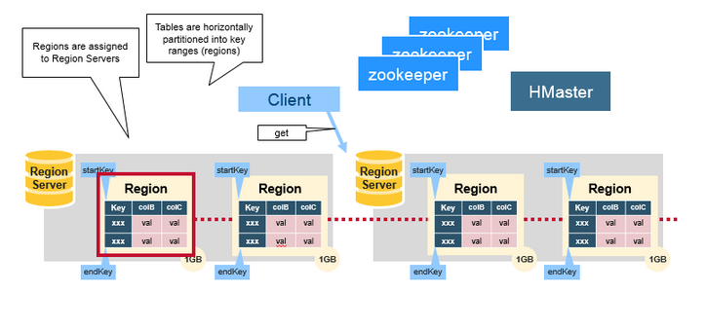
HBase: Reads/Writes
The client gets the Region server that hosts the META table from ZooKeeper
The client will query (get/put) the META server to get the region server corresponding to the rowkey it wants to access
It will get the Row from the corresponding Region Server.

Slide 37
HBase: Some Limitations
Not ideal for large objects (>50MB per cell), e.g., videos -- the problem is “write amplification” -- when HDFS reorganizes data to compact large unchanging data, extensive copying occurs
Not ideal for storing data chronologically (time as primary index), e.g., machine logs organized by time-stamps cause write hot-spots.
Notes:
When we created FFFS at Cornell, the chronological aspect interested us. But as of now we actually have not tried to create a temporal HBASE over FFFS.

Slide 38
HBase vs HDFS
Hbase is a NoSQL distributed store layer (on top of HDFS). It is for faster random, realtime read/write access to the big data stored in HDFS.
HBase
Stores data as key-value stores in columnar fashion. Records in HBase are stored according to the rowkey and that sequential search is common
Provides low latency access to small amounts of data from within a large data set
Provides flexible data model
HDFS
Stores data as flat files
Optimized for streaming access of large files -- doesn’t support random read/write
Follows write-once read-many model

Slide 39
Hadoop Resource Management
Yet Another Resource Negotiator (YARN)
YARN is a core component of Hadoop, manages all the resources of a Hadoop cluster.
Using selectable criteria such as fairness, it effectively allocates resources of Hadoop cluster to multiple data processing jobs
Batch jobs (e.g., MapReduce, Spark)
Streaming Jobs (e.g., Spark streaming)
Analytics jobs (e.g., Impala, Spark)

Slide 40
Hadoop Ecosystem (Resource Manager)
Map Reduce
Hive
Pig
Other Applications
Spark Stream
Data Ingest Systems
e.g., Apache Kafka, Flume, etc
Resource manager
Yet Another Resource Negotiator (YARN)
Hadoop Distributed File System (HDFS)
Hadoop NoSQL Database (HBase)
Notes:
In this picture “resource manager” means “scheduler”. YARN decides which tasks to run, on which machines, and when to do that. It also tracks cache contents and controls what cached data to keep around. And it even decides how much memory to give each task, and how much disk storage.

Slide 41
YARN Concepts (1)
Container:
YARN uses an abstraction of resources called a container for managing resources -- an unit of computation of a slave node, i.e., a certain amount of CPU, Memory, Disk, etc., resources. Tied to Mesos container model.
A single job may run in one or more containers – a set of containers would be used to encapsulate highly parallel Hadoop jobs.
The main goal of YARN is effectively allocating containers to multiple data processing jobs.

Slide 42
YARN Concepts (2)
Three Main components of YARN:
Application Master, Node Manager, and Resource Manager (a.k.a. YARN Daemon Processes)
Application Master:
Single instance per job.
Spawned within a container when a new job is submitted by a client
Requests additional containers for handling of any sub-tasks.
Node Manager: Single instance per slave node. Responsible for monitoring and reporting on local container status (all containers on slave node).

Slide 43
YARN Concepts (3)
Three Main components of YARN:
Application Master, Node Manager, and Resource Manager (aka The YARN Daemon Processes)
Resource Manager: arbitrates system resources between competing jobs. It has two main components:
Scheduler (Global scheduler): Responsible for allocating resources to the jobs subject to familiar constraints of capacities, queues etc.
Application Manager: Responsible for accepting job-submissions and provides the service for restarting the ApplicationMaster container on failure.

Slide 44
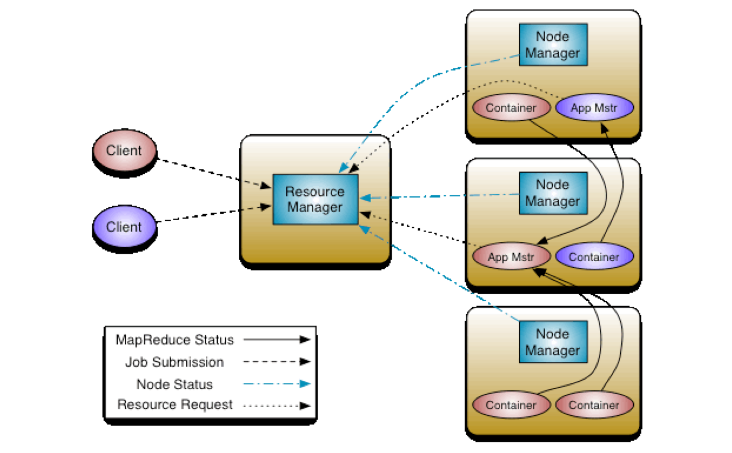
YARN Concepts (4)
How do the components of YARN work together?
Image source: http://hadoop.apache.org/docs/r2.4.1/hadoop-yarn/hadoop-yarn-site/YARN.html

Slide 45
Hadoop Ecosystem (Processing Layer)
Processing
Map Reduce
Hive
Pig
Other Applications
Spark Stream
Data Ingest Systems
e.g., Apache Kafka, Flume, etc
Yet Another Resource Negotiator (YARN)
Hadoop Distributed File System (HDFS)
Hadoop NoSQL Database (HBase)

Slide 46
Hadoop Data Processing Frameworks
Hadoop data processing (software) framework:
Abstracts the complexity of distributed programming
For easily writing applications which process vast amounts of data in-parallel on large clusters
Two popular frameworks:
MapReduce: used for individual batch (long running) jobs
Spark: for streaming, interactive, and iterative batch jobs
Note: Spark is more than a framework. We will learn more about this in future lectures

Slide 47
Map Reduce (“Just a taste”)
MapReduce allows a style of parallel programming designed for:
Distributing (parallelizing) a task easily across multiple nodes of a cluster
Allows programmers to describe processing in terms of simple map and reduce functions
Invisible management of hardware and software failures
Easy management of very large-scale data
Notes:
The last slides illustrate the ultra-famous MapReduce concept (or Hadoop if you prefer the free open-source version)

Slide 48
MapReduce: Terminology
A MapReduce job starts with a collection of input elements of a single type -- technically, all types are key-value pairs
A MapReduce job/application is a complete execution of Mappers and Reducers over a dataset
Mapper applies the map functions to a single input element
Application of the reduce function to one key and its list of values is a Reducer
Many mappers/reducers grouped in a Map/Reduce task (the unit of parallelism)

Slide 49
MapReduce: Phases
Map
Each Map task (typically) operates on a single HDFS block -- Map tasks (usually) run on the node where the block is stored
The output of the Map function is a set of 0, 1, or more key-value pairs
Shuffle and Sort
Sorts and consolidates intermediate data from all mappers -- sorts all the key-value pairs by key, forming key-(list of values) pairs.
Happens as Map tasks complete and before Reduce tasks start
Reduce
Operates on shuffled/sorted intermediate data (Map task output) -- the Reduce function is applied to each key-(list of values). Produces final output.

Slide 50
Example: Word Count (1)
The Problem:
We have a large file of documents (the input elements)
Documents are words separated by whitespace.
Count the number of times each distinct word appears in the file.

Slide 51
Example: Word Count (2)
Why Do We Care About Counting Words?
Word count is challenging over massive amounts of data
Using a single compute node would be too time-consuming
Using distributed nodes requires moving data
Number of unique words can easily exceed available memory -- would need to store to disk
Many common tasks are very similar to word count, e.g., log file analysis

Slide 52
Word Count Using MapReduce (1)
map(key, value):
// key: document ID; value: text of document
FOR (each word w IN value)
emit(w, 1);
reduce(key, value-list):
// key: a word; value-list: a list of integers
result = 0;
FOR (each integer v on value-list)
result += v;
emit(key, result);

Slide 53
Word Count Using MapReduce (2)
Result
Input
aardvark 1
cat 1
mat 1
on 2
sat 2
sofa 1
the 4
the cat sat on the mat
the aardvark sat on the sofa
Map & Reduce

Slide 54
Word Count: Mapper
the 1
cat 1
sat 1
on 1
the 1
mat 1
Map
Input
the cat sat on the mat
the aardvark sat on the sofa
the 1
aardvark 1
sat 1
on 1
the 1
sofa 1
Map

Slide 55
Word Count: Shuffle & Sort
the 1
cat 1
sat 1
on 1
the 1
mat 1
Intermediate Data
aardvark 1
cat 1
mat 1
on 1,1
sat 1,1
sofa 1
the 1,1,1,1
Shuffle & Sort
Mapper Output
the 1
aardvark 1
sat 1
on 1
the 1
sofa 1

Slide 56
Word Count: Reducer
Reduce
Reducer Output
Result
aardvark 1
aardvark 1
cat 1
mat 1
on 2
sat 2
sofa 1
the 4
Intermediate Data
Reduce
cat 1
aardvark 1
cat 1
mat 1
on 1,1
sat 1,1
sofa 1
the 1,1,1,1
Reduce
mat 1
Reduce
on 2
Reduce
sat 2
sofa 1
Reduce
the 4
Reduce

Slide 57
MapReduce: Coping With Failures
MapReduce is designed to deal with compute nodes failing to execute a Map task or Reduce task.
Re-execute failed tasks, not whole jobs/applications.
Key point: MapReduce tasks produce no visible output until the entire set of tasks is completed. If a task or sub task somehow completes more than once, only the earliest output is retained.
Thus, we can restart a Map task that failed without fear that a Reduce task has already used some output of the failed Map task.

Slide 58
SUMMARY
With really huge data sets, or changing data collected from huge numbers of clients, it often is not practical to use a classic database model where each incoming event triggers its own updates.
So we shift towards batch processing, highly parallel: many updates and many “answers” all computed as one task.
Then cache the results to enable fast tier-one/two reactions later.

