Slide 1
Jquery

Slide 2
Effect Methods

Slide 3
.show()
.show([speed][, callback])
$('.target').show();

Slide 4
<div class="content">
<div class="trigger button">Trigger</div>
<div class="target"><img src="hat.gif" width="80" height="54" alt="Hat" /></div>
<div class="log"></div>
</div>
$('.trigger').click(function() {
$('.target').show('slow', function() {
$(this).log('Effect complete.');
});
});

Slide 5
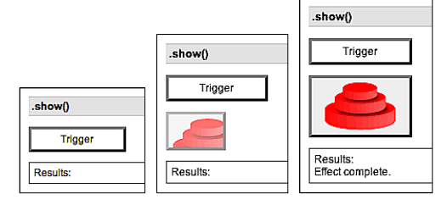

Slide 6
.hide()
.hide([speed][, callback])
$('.target').hide();

Slide 7
<div class="content">
<div class="trigger button">Trigger</div>
<div class="target"><img src="hat.gif" width="80" height="54"
alt="Hat" /></div>
<div class="log"></div>
</div>
$('.trigger').click(function() {
$('.target').hide('slow', function() {
$(this).log('Effect complete.');
});
});

Slide 8
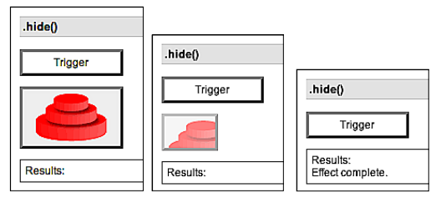

Slide 9
.toggle()
$('.trigger').click(function() {
$('.target').toggle('slow', function() {
$(this).log('Effect complete.');
});
});

Slide 10
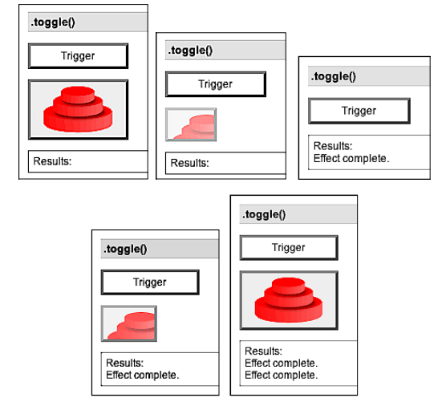

Slide 11
.slideDown()
<div class="content">
<div class="trigger button">Trigger</div>
<div class="target"><img src="hat.gif" width="80" height="54"
alt="Hat" /></div>
<div class="log"></div>
</div>
$('.trigger').click(function() {
$('.target').slideDown('slow', function() {
$(this).log('Effect complete.');
});
});

Slide 12
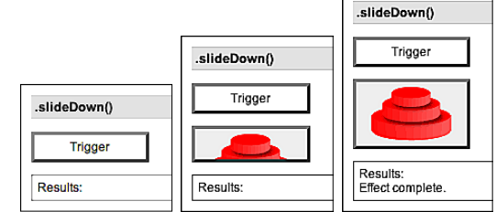

Slide 13
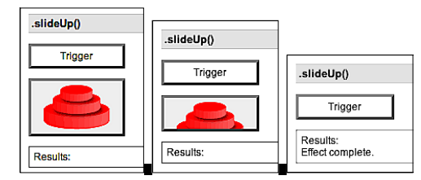
.slideUp()

Slide 14
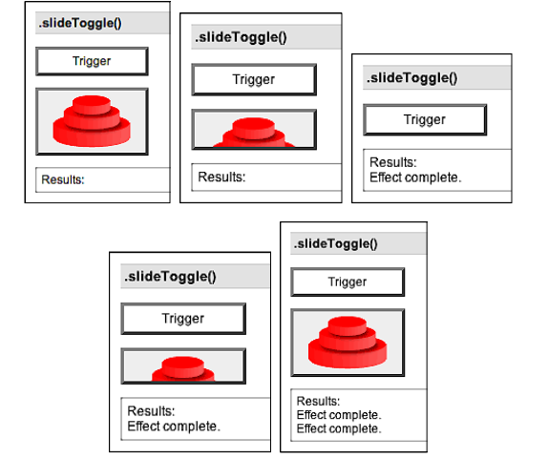
.slideToggle()

Slide 15
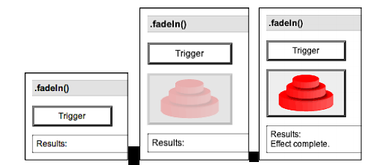
.fadeIn()
.fadeIn([speed][, callback])

Slide 16
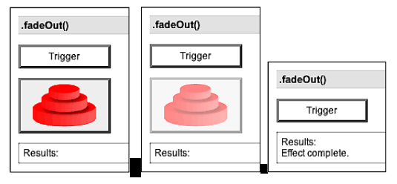
.fadeOut()

Slide 17
.fadeTo()
.fadeTo(speed, opacity[, callback])

Slide 18
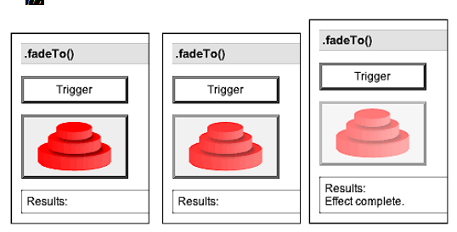
$('.trigger').click(function() {
$('.target').fadeTo('slow', 0.5, function() {
$(this).log('Effect complete.');
});
});

Slide 19
.animate()
style="position: relative; left: 10px;"
$('.trigger').click(function() {
$('.target').animate({
'width': 300,
'left': 100,
'opacity': 0.25
}, 'slow', function() {
$(this).log('Effect complete.');
});
});

