Slide 1
用 iSQL*Plus 生成易读的输出
Notes:
进度表： 时间 主题
35 minutes 讲演
35 minutes 练习
70 minutes 总共

Slide 2
目标
完成本课后, 您应当能够执行下列操作：
生成有替换变量的查询
定制 iSQL*Plus 环境
生成更易读的输出
创建和执行脚本文件
Notes:
课程目标
在本课中，你将学习怎样包含 iSQL*Plus 命令来产生更易阅读的 SQL 输出。
你能够创建包含 WHERE 子句的命令文件来限制所显示的行。为了改变条件，你可以在每次命令文件运行时使用替换变量。替换变量可以代替 WHERE 子句中的值，文本串，甚至一个列或一个表名。

Slide 3
替换变量
我想查询不同的值。
... salary = ? …
… department_id = ? …
... last_name = ? ...
用户
Notes:
替换变量
在此以前的例子都是硬编码的，在已完成的应用程序中，用户将触发报表，并且报表将无进一步提示地运行。数据范围将被在 iSQL*Plus 脚本文件中的固定的 WHERE 子句预先确定。
用 iSQL*Plus，你可以创建有提示的报表，使用替换变量提示用户提供他们自己的值来限制返回数据的范围。你可以在命令文件或在单个的 SQL 语句中嵌入替换变量。一个变量可以被认为是一个容器，在其中值被临时存储，当语句运行时，值被替换。
教师注释
演示：7_varno.sql, 7_varyes.sql
目的：举例说明用一个带替换变量的大小写敏感的查询返回所有的行。
在 iSQL*Plus 9.0.1.0.1 中，当使用 & 替换 和 通配符 (%) 于字符值时，有一处 BUG。
该 BUG 已经被报告。7_varyes.sql 在 iSQL*Plus 中将产生一个错误，但对于学生使用其他产品 (例如: Forms、Reports) 的后续课程，概念是重要的。你可以在 SQL*Plus 中示范 7_varyes.sql。

Slide 4
替换变量
iSQL*Plus 替换变量用于：
临时存储变量
  单 & 符号
  双 & 符号
  DEFINE 命令
在 SQL 语句之间传递变量
动态改变页眉和页脚
Notes:
替换变量
在 iSQL*Plus 中，你可以使用单个的 & 替换变量临时存储值。
你可以用 DEFINE 命令在 iSQL*Plus 中预先确定变量。DEFINE 创建并指定一个只到变量。
限制数据范围的例子
报告只获得当前的范围或指定的日期范围
报告涉及的数据只与用户请求的报告有关
只显示给定部门中的人员
其他的交互式作用
交互作用不限制用户直接与 WHERE 子句的交互。同样的规则可以用于完成其他目的。例如：
动态改变页眉和页脚
从文件而不是从人那里获得输入值
从一个 SQL 语句到另一个 SQL 语句传递值
iSQL*Plus 不支持用户输入的确认检查。
教师注释
替换变量可以用在 SQL 和 iSQL*Plus 命令的任何地方，除了在命令提示符后作为第一个单词。

Slide 5
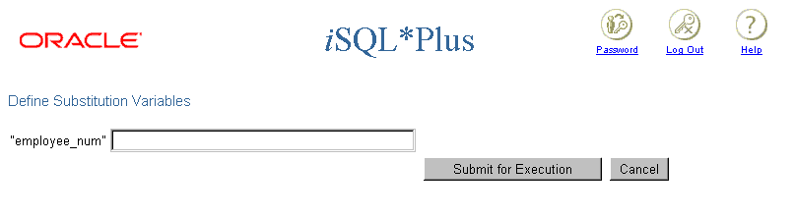
使用 & 替换变量
用一个带有前缀 & 的变量提示用户输入一个值
SELECT employee_id, last_name, salary, department_id
FROM employees
WHERE employee_id = &employee_num ;
Notes:
Single-Ampersand Substitution Variable
When running a report, users often want to restrict the data returned dynamically. iSQL*Plus provides this flexibility by means of user variables. Use an ampersand (&) to identify each variable in your SQL statement. You do not need to define the value of each variable.
The example on the slide creates an iSQL*Plus substitution variable for an employee number. When the statement is executed, iSQL*Plus prompts the user for an employee number and then displays the employee number, last name, salary, and department number for that employee.
With the single ampersand, the user is prompted every time the command is executed, if the variable does not exist.

Slide 6
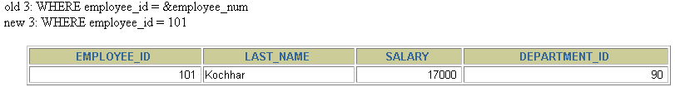
使用 & 替换变量
2
101
1
Notes:
Single-Ampersand Substitution Variable
When iSQL*Plus detects that the SQL statement contains an &, you are prompted to enter a value for the substitution variable named in the SQL statement. Once you enter a value and click the Submit for Execution button, the results are displayed in the output area of your iSQL*Plus session.

Slide 7

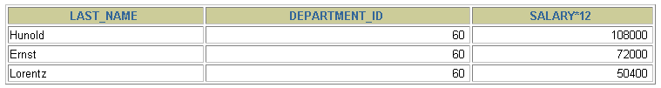
替换变量的字符和数字值
日期和字符值放在单引号之间
SELECT last_name, department_id, salary*12
FROM employees
WHERE job_id = '&job_title' ;
Notes:
Specifying Character and Date Values with Substitution Variables
In a WHERE clause, date and character values must be enclosed within single quotation marks. The same rule applies to the substitution variables.
Enclose the variable in single quotation marks within the SQL statement itself.
The slide shows a query to retrieve the employee names, department numbers, and annual salaries of all employees based on the job title value of the iSQL*Plus substitution variable.
Note: You can also use functions such as UPPER and LOWER with the ampersand. Use UPPER('&job_title') so that the user does not have to enter the job title in uppercase.

Slide 8
指定列名、表达式和文本
用替换变量可以提供：
WHERE 条件
ORDER BY 子句
列表达式
表名
输入 SELECT 语句
Notes:
Specifying Column Names, Expressions, and Text
Not only can you use the substitution variables in the WHERE clause of a SQL statement, but these variables can also be used to substitute for column names, expressions, or text.
Example
Display the employee number and any other column and any condition of employees.
SELECT employee_id, &column_name
FROM employees
WHERE &condition;
If you do not enter a value for the substitution variable, you will get an error when you execute the preceding statement.
Note: A substitution variable can be used anywhere in the SELECT statement, except as the first word entered at the command prompt.

Slide 9
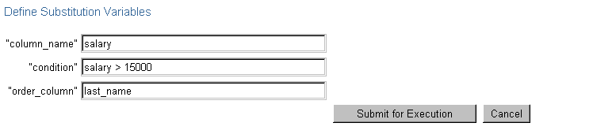
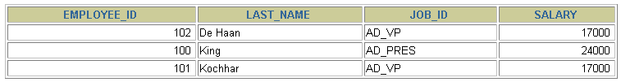
指定列名、表达式和文本
SELECT employee_id, last_name, job_id,
&column_name
FROM employees
WHERE &condition
ORDER BY &order_column ;
Notes:
Specifying Column Names, Expressions, and Text (continued)
The slide example displays the employee number, name, job title, and any other column specified by the user at run time, from the EMPLOYEES table. You can also specify the condition for retrieval of rows and the column name by which the resultant data has to be ordered.
Instructor Note
Demo: 7_expr.sql
Purpose: To illustrate changing column names and conditions by using substitution variables

Slide 10
定义替换变量
可以用 iSQL*Plus DEFINE 命令预先定义变量
  DEFINE variable = value 创建一个 CHAR 数据类型的用户变量
如果需要预先定义一个带空格的变量，在使用 DEFINE 命令时，必须将变量放在单引号中
一个已定义的变量在本会话期间有效
Notes:
Defining Substitution Variables
You can predefine user variables before executing a SELECT statement. iSQL*Plus provides the DEFINE command for defining and setting substitution variables:
Instructor Note
Mention that iSQL*Plus commands can continue onto multiple lines and that they require the continuation character, the hyphen.

Slide 11
DEFINE 和 UNDEFINE 命令
一个变量保持其定义，直到：
  使用 UNDEFINE 命令清除它
  退出 iSQL*Plus
可以用 DEFINE 命令检验所做的改变
DEFINE job_title = IT_PROG
DEFINE job_title
DEFINE JOB_TITLE = "IT_PROG" (CHAR)
UNDEFINE job_title
DEFINE job_title
SP2-0135: symbol job_title is UNDEFINED
Notes:
The DEFINE and UNDEFINE Commands
Variables are defined until you either:
Issue the UNDEFINE command on a variable
Exit iSQL*Plus
When you undefine variables, you can verify your changes with the DEFINE command. When you exit iSQL*Plus, variables defined during that session are lost.

Slide 12
使用带 & 替换变量的 DEFINE 命令
使用 DEFINE 命令创建替换变量
在 SQL 语句中用一个带 & 前缀的变量来替换
DEFINE employee_num = 200
SELECT employee_id, last_name, salary, department_id
FROM employees
WHERE employee_id = &employee_num ;
Notes:
Using the DEFINE Command
The example on the slide creates an iSQL*Plus substitution variable for an employee number by using the DEFINE command, and at run time displays the employee number, name, salary, and department number for that employee.
Because the variable is created using the iSQL*Plus DEFINE command, the user is not prompted to enter a value for the employee number. Instead, the defined variable value is automatically substituted in the SELECT statement.
The EMPLOYEE_NUM substitution variable is present in the session until the user undefines it or exits the iSQL*Plus session.

Slide 13
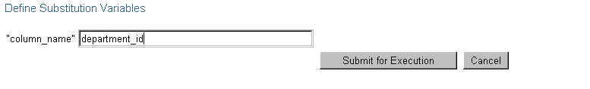
使用 && 替换变量
如果你想要重复使用变量的值而不需要每次提示用户输入，可以使用 &&
SELECT employee_id, last_name, job_id, &&column_name
FROM employees
ORDER BY &column_name;
…
Notes:
Double-Ampersand Substitution Variable
You can use the double-ampersand (&&) substitution variable if you want to reuse the variable value without prompting the user each time. The user will see the prompt for the value only once. In the example on the slide, the user is asked to give the value for variable column_name only once. The value supplied by the user (department_id) is used both for display and ordering of data.
iSQL*Plus stores the value supplied by using the DEFINE command; it will use it again whenever you reference the variable name. Once a user variable is in place, you need to use the UNDEFINE command to delete it.

Slide 14
使用 VERIFY 命令
用 VERIFY 命令来交替显示，替换变量在 iSQL*Plus 执行替换之前和之后的值
SET VERIFY ON
SELECT employee_id, last_name, salary, department_id
FROM employees
WHERE employee_id = &employee_num;
old 3: WHERE employee_id = &employee_num
new 3: WHERE employee_id = 200
Notes:
The VERIFY Command
To confirm the changes in the SQL statement, use the iSQL*Plus VERIFY command. Setting SET VERIFY ON forces iSQL*Plus to display the text of a command before and after it replaces substitution variables with values.
The example on the slide displays the old as well as the new value of the EMPLOYEE_ID column.

Slide 15
定制 iSQL*Plus 环境
用 SET 命令控制当前会话
用 SHOW 命令检验所做的设置
SET system_variable value
SET ECHO ON
SHOW ECHO
echo ON
Notes:
Customizing the iSQL*Plus Environment
You can control the environment in which iSQL*Plus is currently operating by using the SET commands.
Syntax
SET system_variable value
In the syntax:
system_variable is a variable that controls one aspect of the session environment
value is a value for the system variable
You can verify what you have set by using the SHOW command. The SHOW command on the slide checks whether ECHO had been set on or off.
To see all SET variable values, use the SHOW ALL command.
For more information, see iSQL*Plus User’s Guide and Reference, “Command Reference.”

Slide 16
SET 命令变量
ARRAYSIZE {20 | n}
FEEDBACK {6 | n |OFF | ON}
HEADING {OFF | ON}
LONG {80 | n}| ON | text}
SET HEADING OFF
SHOW HEADING
HEADING OFF
Notes:
SET Command Variables
Note: The value n represents a numeric value. The underlined values indicate default values. If you enter no value with the variable, iSQL*Plus assumes the default value.

Slide 17
iSQL*Plus 格式化命令
  COLUMN [column option]
  TTITLE [text | OFF | ON]
  BTITLE [text | OFF | ON]
  BREAK [ON report_element]
Notes:
Obtaining More Readable Reports
You can control the report features by using the following commands:
Guidelines
All format commands remain in effect until the end of the iSQL*Plus session or until the format setting is overwritten or cleared.
Remember to reset your iSQL*Plus settings to the default values after every report.
There is no command for setting an iSQL*Plus variable to its default value; you must know the specific value or log out and log in again.
If you give an alias to your column, you must reference the alias name, not the column name.

Slide 18
COLUMN 命令
控制一个列的显示：
CLE[AR]: 清除任何列格式
HEA[DING] text: 设置列标题
FOR[MAT] format: 用一个格式化模板改变列的显示
NOPRINT | PRINT
NULL
COL[UMN] [{column|alias} [option]]
Notes:
COLUMN Command Options

Slide 19
使用 COLUMN 命令
创建列标题
COLUMN last_name HEADING 'Employee|Name'
COLUMN salary JUSTIFY LEFT FORMAT $99,990.00
COLUMN manager FORMAT 999999999 NULL 'No manager'
显示当前对 LAST_NAME 列的设置
COLUMN last_name
清除对 LAST_NAME 列的设置
COLUMN last_name CLEAR
Notes:
Displaying or Clearing Settings
To show or clear the current COLUMN command settings, use the following commands:

Slide 20
COLUMN 格式化模板
元素
9
0
$
L
.
,
说明
单精度无前导零数字
强制前导零
浮动美圆符号
本国货币
小数点的位置
千位分隔符
举例
999999
099999
$9999
L9999
9999.99
9,999
结果
1234
001234
$1234
L1234
1234.00
1,234
Notes:
COLUMN Format Models
The slide displays sample COLUMN format models.
The Oracle server displays a string of pound signs (#) in place of a whole number whose digits exceed the number of digits provided in the format model. It also displays pound signs in place of a value whose format model is alphanumeric but whose actual value is numeric.

Slide 21
使用 BREAK 命令
用 BREAK 命令禁止重复值
BREAK ON job_id
Notes:
BREAK 命令
用 BREAK 命令来把行分成几个部分，并且禁止完全相同的值。为了确保 BREAK 命令有效，使用子句定制那些你正在阻断的列。
语法
BREAK on column[|alias|row]
在语法中：
column[|alias|row 禁止重复显示一个给定列的值
使用 CLEAR 命令清除所有 BREAK 设置：
CLEAR BREAK
控制记录显示分组顺序
break on deptno
（不显示重复值）
select deptno,ename
from emp
order by deptno;
（ORDER BY子句用于控制BREAK）
显示为
10 clark
niller
20 smith
scott
30 allen
blake
每次只有一个BREAK命令起作用，但一次可以在多个列上使用BREAK命令
break on 列名1 on 列名2
记录分组
break on deptno skip 2
select deptno,ename
from emp
order by deptno;
每个deptno之间空两行
clear break（取消BREAK命令）
break on page（每次从一新页开始）
break on report（每次从一新报表开始）
break on page on report（联合使用）
分组计算
break on deptno skip 2
compute sum of sal on deptno
计算每个部门的工资总和
skip子句使部门之间的信息分隔开

Slide 22
使用 TTITLE 和 BTITLE 命令
显示页眉和页脚
设置报告页眉
设置报告页脚
TTI[TLE] [text|OFF|ON]
TTITLE 'Salary|Report'
BTITLE 'Confidential'
Notes:
The TTITLE and BTITLE Commands
Use the TTITLE command to format page headers and the BTITLE command for footers. Footers appear at the bottom of the page.
The syntax for BTITLE and TTITLE is identical. Only the syntax for TTITLE is shown. You can use the vertical bar (|) to split the text of the title across several lines.
Syntax
TTI[TLE]|BTI[TLE] [text|OFF|ON]
In the syntax:
text represents the title text (enter single quotes if the text is more than one word).
OFF|ON toggles the title either off or on. It is not visible when turned off.
The TTITLE example on the slide sets the report header to display Salary centered on one line and Report centered below it. The BTITLE example sets the report footer to display Confidential. TTITLE automatically puts the date and a page number on the report.

Slide 23
Using the TTITLE and BTITLE Commands
Display headers and footers.
Set the report header.
Set the report footer.
TTI[TLE] [text|OFF|ON]
TTITLE 'Salary|Report'
BTITLE 'Confidential'
Notes:
The TTITLE and BTITLE Commands (continued)
Note: The slide gives an abridged syntax for TTITLE and BTITLE. Various options for TTITLE and BTITLE are covered in another SQL course.
Instructor Note
SQL*Plus 3.3 introduced the commands REPHEADER and REPFOOTER. REPHEADER places and formats a specified report header at the top of each report or lists the current REPHEADER definition. REPFOOTER places and formats a specified report footer at the bottom of each report or lists the current REPFOOTER definition.

Slide 24
创建脚本文件来运行一个报告
  1. 创建并且测试 SQL SELECT 语句
  2. 保存 SELECT 语句到脚本文件中
  3. 装载脚本文件到一个编辑器中
  4. 在 SELECT 语句的前加格式化命令
  5. 检验跟随 SELECT 语句的终止字符
Notes:
Creating a Script File to Run a Report
You can either enter each of the iSQL*Plus commands at the SQL prompt or put all the commands, including the SELECT statement, in a command (or script) file. A typical script consists of at least one SELECT statement and several iSQL*Plus commands.
How to Create a Script File
1. Create the SQL SELECT statement at the SQL prompt. Ensure that the data required for the report is accurate before you save the statement to a file and apply formatting commands. Ensure that the relevant ORDER BY clause is included if you intend to use breaks.
2. Save the SELECT statement to a script file.
3. Edit the script file to enter the iSQL*Plus commands.
4. Add the required formatting commands before the SELECT statement. Be certain not to place iSQL*Plus commands within the SELECT statement.
5. Verify that the SELECT statement is followed by a run character, either a semicolon (;) or a slash (/).

Slide 25
创建脚本文件来运行一个报告
  6. 在 SELECT 语句之后清除格式命令
  7. 保存脚本文件
  8. 装载脚本文件到 iSQL*Plus 的文本窗口中，单击执行按钮
Notes:
How to Create a Script File (continued)
6. Add the format-clearing iSQL*Plus commands after the run character. Alternatively, you can store all the format-clearing commands in a reset file.
7. Save the script file with your changes.
8. Load the script file into the iSQL*Plus text window, and click the Execute button.
Guidelines
You can include blank lines between iSQL*Plus commands in a script.
If you have a lengthy iSQL*Plus or SQL*Plus command, you can continue it on the next line by ending the current line with a hyphen (-).
You can abbreviate iSQL*Plus commands.
Include reset commands at the end of the file to restore the original iSQL*Plus environment.
Note: REM represents a remark or comment in iSQL*Plus.

Slide 26
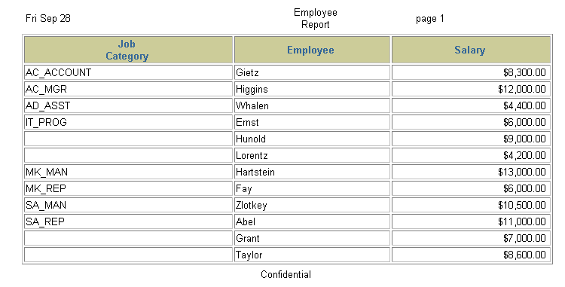
报表样子
…
Notes:
Example
Create a script file to create a report that displays the job ID, last name, and salary for every employee whose salary is less than $15,000. Add a centered, two-line header that reads “Employee Report” and a centered footer that reads “Confidential.” Rename the job title column to read “Job Category” split over two lines. Rename the employee name column to read “Employee.” Rename the salary column to read “Salary” and format it as $2,500.00.

Slide 27
报表样子
…
Notes:
Example (continued)
SET FEEDBACK OFF
TTITLE 'Employee|Report'
BTITLE 'Confidential'
BREAK ON job_id
COLUMN job_id HEADING 'Job|Category'
COLUMN last_name HEADING 'Employee'
COLUMN salary HEADING 'Salary' FORMAT $99,999.99
REM ** Insert SELECT statement
SELECT job_id, last_name, salary
FROM employees
WHERE salary < 15000
ORDER BY job_id, last_name
/
REM clear all formatting commands ...
SET FEEDBACK ON
COLUMN job_id CLEAR
COLUMN last_name CLEAR
COLUMN salary CLEAR
CLEAR BREAK
...

Slide 28
小结
在本课中, 您应该已经学会如何：
使用 iSQL*Plus 替换变量临时存储值
使用 SET 命令控制当前的 iSQL*Plus 环境
使用 COLUMN 命令控制列的显示
使用 BREAK 命令禁止重复的值并且把行分成几个部分
使用 TTITLE 和 BTITLE 命令显示页眉和页脚
Notes:
Summary
In this lesson, you should have learned about substitution variables and how useful they are for running reports. They give you the flexibility to replace values in a WHERE clause, column names, and expressions. You can customize reports by writing script files with:
Single ampersand substitution variables
Double ampersand substitution variables
The DEFINE command
The UNDEFINE command
Substitution variables in the command line
You can create a more readable report by using the following commands:
COLUMN
TTITLE
BTITLE
BREAK

Slide 29
练习 7 概览
本章练习包括下面的主题：
创建一个查询以显示替换变量的值
启动一个含有变量的命令文件
Notes:
Practice 7 Overview
This practice gives you the opportunity to create files that can be run interactively by using substitution variables to create run-time selection criteria.

Slide 30
Notes:
Practice 7
Determine whether the following two statements are true or false:
1. The following statement is valid:
DEFINE & p_val = 100
True/False
2. The DEFINE command is a SQL command.
True/False
3. Write a script to display the employee last name, job, and hire date for all employees who
started between a given range. Concatenate the name and job together, separated by a space
and comma, and label the column Employees. In a separate SQL script file, use the DEFINE command to provide the two ranges. Use the format MM/DD/YYYY. Save the script files as lab7_3a.sql and lab7_3b.sql.
DEFINE low_date = 01/01/1998
DEFINE high_date = 01/01/1999
4. Write a script to display the last names, job IDs, and department names for every employee in a given location. The search condition should allow for case-insensitive searches of the department location. Save the script file as lab7_4.sql.

Slide 31
Notes:
Practice 7 (continued)
5. Modify the code in lab7_4.sql to create a report containing the department name, employee last name, hire date, salary, and annual salary for each employee in a given location. Label the columns DEPARTMENT NAME, EMPLOYEE NAME, START DATE, SALARY, and ANNUAL SALARY, placing the labels on multiple lines. Resave the script as lab7_5.sql, and execute the commands in the script.

