Slide 1
Jquery

Slide 2
DOM Manipulation Methods
操纵DOM方法

Slide 3
.attr(attribute)
<a id="myid" href="/archives/jquery-links.htm" title="A few jQuery
links from long ago">old jQuery links</a>
1. document.getElementById('myid').getAttribute('title')
2. $('#myid').get(0).getAttribute('title')
3. $('#myid')[0].getAttribute('title')

Slide 4
.attr(attribute, value)
.attr(map)
.attr(attribute, function)
<img id="greatphoto" src="brush-seller.jpg" alt="brush seller" />
$('#greatphoto').attr('alt', 'Beijing Brush Seller');
$('#greatphoto').attr('title', 'Beijing Brush Seller – photo by Kelly Clark');

Slide 5
$('#greatphoto').attr({alt:'Beijing Brush Seller', title: 'Beijing Brush Seller – photo by Kelly Clark'});
$('#greatphoto').attr({alt: function() {return 'Beijing ' +
this.alt}, title: function() {return 'Beijing ' +
this.alt + ' – photo by Kelly Clark'}});

Slide 6
.removeAttr()
.removeAttr(attribute)

Slide 7
Style Properties
.css(property)
1. $('div.left').css('float');
2. $('div.left').css('cssFloat');
3. $('div.left').css('styleFloat');
css('background-color') and .css('backgroundColor').

Slide 8
.css(property, value)
.css(map)
.css(property, function)
.css({'background-color':'#ffe', 'border-left': '5px solid #ccc'})
.css({backgroundColor:'#ffe', borderLeft: '5px solid #ccc'})
$('div.example').css('width', function(index) {
return index * 50;
});

Slide 9
height() attr(‘height’)
.height(value)
.width()
.width(value)

Slide 10
Class Attribute
.addClass()
$('p').addClass('myclass yourclass').
$('p').removeClass('myclass noclass').addClass('yourclass')
.removeClass()
$('p').removeClass('myclass yourclass').
$('p').removeClass('myclass').addClass('yourclass')

Slide 11
.toggleClass()
<div class="tumble">Some text.</div>
$('div.tumble').toggleClass('bounce'),

Slide 12
DOM Replacement
.html() ------- innerHTML
$('div.demo-container').html();
<div class="demo-container">
<div class="demo-box">Demonstration Box
</div>
</div>
The result would look like this:
<div class="demo-box">Demonstration Box</div>

Slide 13
.html(HTML)
<div class="demo-container">
<div class="demo-box">Demonstration Box
</div>
</div>
$('div.demo-container'>.html('<p>All new content.
<em>You bet!</em>');
That line of code will replace everything inside <div class="demo-container">:
<div class="demo-container"><p>All new content.
<em>You bet!</em></div>

Slide 14
.text()
<div class="demo-container">
<div class="demo-box">Demonstration Box
</div>
<ul>
<li>list item 1</li>
<li>list <strong>item</strong> 2</li>
</ul>
</div>
The code $('div.demo-container').text() would produce the following result:
Demonstration Boxlist item 1list item 2

Slide 15
.text(text)
<div class="demo-container">
<div class="demo-box">Demonstration Box
</div>
<ul>
<li>list item 1</li>
<li>list <strong>item</strong> 2</li>
</ul>
</div>
The code $('div.demo-container').text('<p>This is a test.</p>') will
produce the following HTML:
<div class="demo-container">&lt;p&gt;This is a test.&lt;/p&gt;</div>
It will appear on a rendered page as though the tags were exposed, like this:
<p>This is a test</p>

Slide 16
.val()

Slide 17
.val(value)

Slide 18
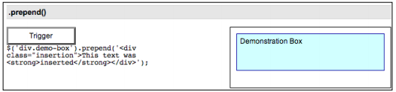
DOM Insertion, Inside
.prepend()
<div class="demo-container">
<div class="demo-box">Demonstration Box
</div>
</div>

Slide 19
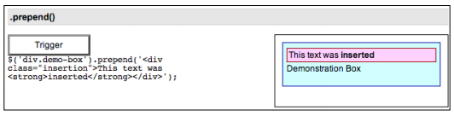
$('div.demo-box').prepend('<div class="insertion">This text was
<strong>inserted</strong></div>');

Slide 20
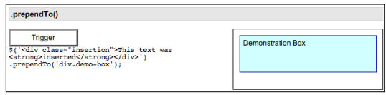
.prependTo()
<div class="demo-container">
<div class="demo-box">Demonstration Box
</div>
</div>

Slide 21
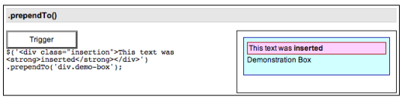
$('<div class="insertion">This text was <strong>inserted</strong>
</div>').prependTo('div.demo-box');

Slide 22
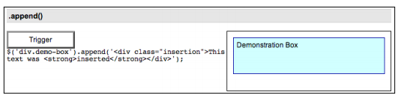
.append()
<div class="demo-container">
<div class="demo-box">Demonstration Box
</div>
</div>

Slide 23
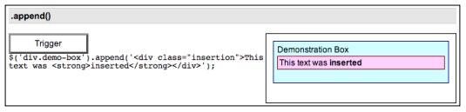
$('div.demo-box').append('<div class="insertion">This text
was <strong>inserted</strong></div>');

Slide 24
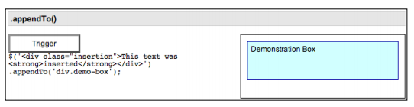
.appendTo()
<div class="demo-container">
<div class="demo-box">Demonstration Box
</div>
</div>

Slide 25
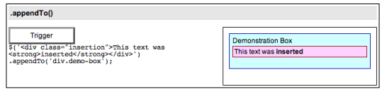
$('<div class="insertion">This text was <strong>inserted</strong>
</div>').appendTo('div.demo-box');

Slide 26
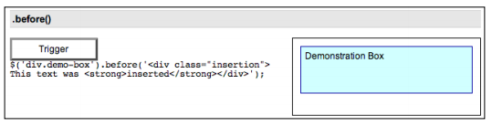
DOM Insertion, Outside
.before()
<div class="demo-container">
<div class="demo-box">Demonstration Box
</div>
</div>

Slide 27
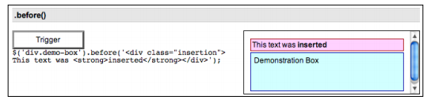
$('div.demo-box').before('<div class="insertion">This text
was <strong>inserted</strong></div>');

Slide 28
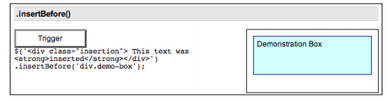
.insertBefore()
<div class="demo-container">
<div class="demo-box">Demonstration Box
</div>
</div>

Slide 29
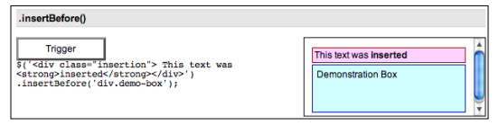
$('<div class="insertion">This text was <strong>inserted</strong>
</div>').insertBefore('div.demo-box');

Slide 30
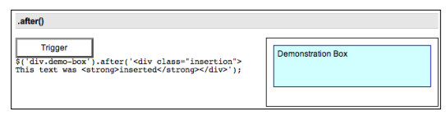
.after()
<div class="demo-container">
<div class="demo-box">Demonstration Box
</div>
</div>

Slide 31
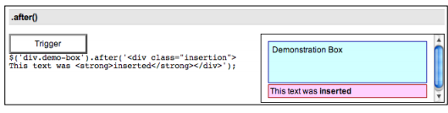
$('div.demo-box').after('<div class="insertion">This text
was <strong>inserted</strong></div>');

Slide 32

.insertAfter()
<div class="demo-container">
<div class="demo-box">Demonstration Box
</div>
</div>

Slide 33
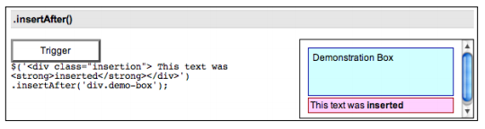
$('<div class="insertion">This text was <strong>inserted</strong>
</div>').insertAfter('div.demo-box');

Slide 34
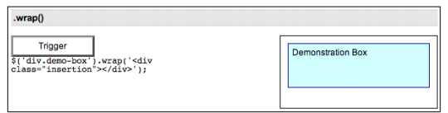
DOM Insertion, Around
.wrap()
<div class="demo-container">
<div class="demo-box">Demonstration Box
</div>
</div>

Slide 35
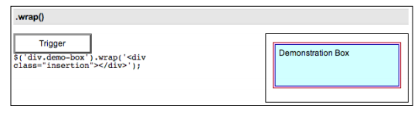
$('div.demo-box').wrap('<div class="insertion"> </div>');

Slide 36
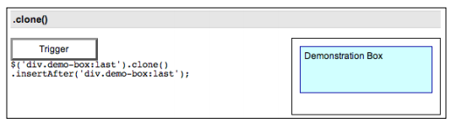
.clone() .clone([deep])
<div class="demo-container">
<div class="demo-box">Demonstration Box
</div>
</div>

Slide 37
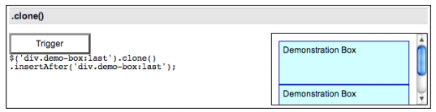
$('div.demo-box:last').clone().insertAfter('div.demo-box:last');

Slide 38
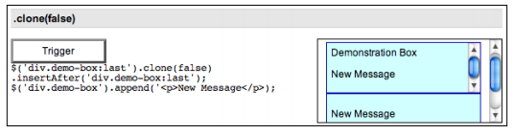
$('div.demo-box:last').clone(false).insertAfter('div.demo-box:last');
$('div.demo-box').append('<p>New Message</p>);

Slide 39
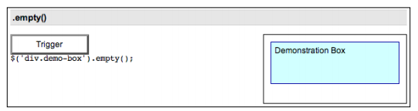
DOM Removal
.empty()
<div class="demo-container">
<div class="demo-box">Demonstration Box
</div>
</div>

Slide 40
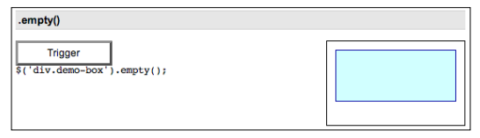
$('div.demo-box').empty();

Slide 41

.remove()
<div class="demo-container">
<div class="demo-box">Demonstration Box
</div>
</div>

Slide 42
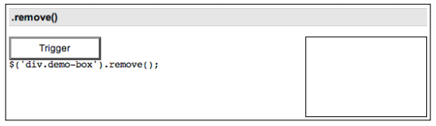
$('div.demo-box').remove()

