Slide 2
Agenda
系统编译
GPIO
DCT

Slide 3
编译
主要的Image文件会生成在：
  out/target/product/<prj name>目录下
  preloader_huaqin73_gb.bin
  Boot.img
  System.img
  Userdata.img
  Recovery.img
  …

Slide 4
编译
编译 步骤
  cd version2/trunk
  source mbldenv.sh
  ./makeMtk –h - 查看帮助
  ./mk listp - 列出当前的project
  ./mk -t huaqin73_gb n kernel – 编译内核，n表示先清除前面的编译结果，再重新编译
  ./makeMtk -t huaqin73_gb r pl – 编译preloader, r表示不清除前面的编译结果，做增量编译
  ./makeMtk -t huaqin73_gb r uboot - 编译uboot
  ./makeMtk huaqin73_gb update-api – update-api
  ./makeMtk huaqin73_gb android - 编译android
  ./makeMtk huaqin73_gb – 编译所有的image

Slide 5
编译log
编译过程中的log位于
  out/target/product
  <prj name>_android.log
  <prj name>_kernel.log
  <prj name>_drvgen.log

Slide 6
GPIO
MT6573 Yusu GPIO Customer Document.pdf
Smart Phone\Software_Customer\Standard Package\ALPS.GB\BSP\Drivers\MT6573 Yusu GPIO Customer Document

Slide 7
Functionality
The driver is used for configure general purpose input/out pin. The main functionality is:
  Configure the GPIO pins as default value in the booting phase
  Provide interface to other module for changing GPIO pin functions when system is running

Slide 8
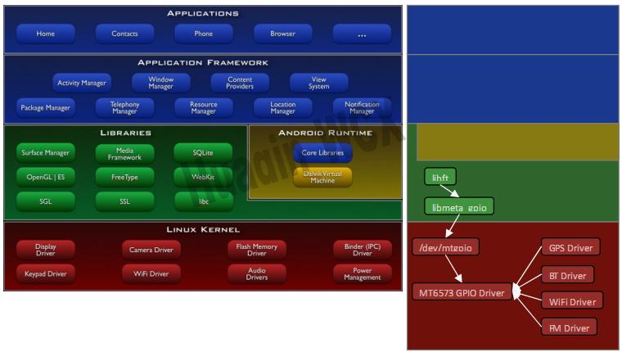
Architecture

Slide 9
GPIO Driver
GPIO driver provides 2 interfaces:
  Kernel space: other driver could invoke the function provide by GPIO driver
  User space: user space program could operate GPIO by sending IOCTL to /dev/mtgpio
In kernel space, other driver modules only call GPIO function to operate GPIO.

Slide 10
GPIO 的属性
GPIO pin 的编号
  1，2，3，4等
GPIO的方向
  In，out
GPIO的模式, 即GPIO多功能
  每个GPIO可以配置为4中模式
GPIO是否可以被上拉或下拉

Slide 11
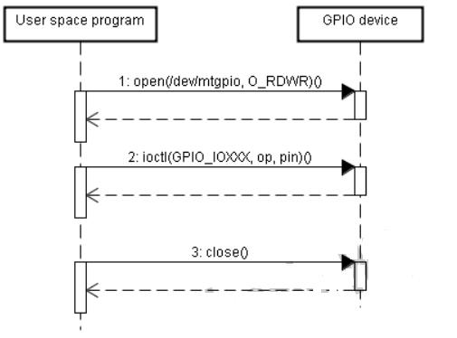
Operate GPIO in User Space

Slide 12
Data Structure
typedef enum GPIO_PIN
{
  GPIO_UNSUPPORTED = -1,
  GPIO0,
  GPIO1,
  GPIO2,
  …
  GPIO202
  GPIO_MAX
  GPIO_MODE_DEFAULT = GPIO_MODE_01,
  } GPIO_PIN;
}
枚举MT6573中的所有的GPIO pins.

Slide 13
GPIO _DIR
In GPIO mode, each GPIO pin could be configured as input or output.
Typedef enum {
  GPIO_DIR_IN = 0,
  GPIO_DIR_OUT = 1,
  GPIO_DIR_DEFAULT = GPIO_DIR_IN,
}GPIO_DIR;

Slide 14
GPIO Mode
Each GPIO pin supports 4 modes, 0 is always GPIO mode.
Typedef enum {
  GPIO_MODE_GPIO = 0,
  GPIO_MODE_00 = 0,
  GPIO_MODE_01 = 1,
  GPIO_MODE_02 =2,
  …
  GPIO_MODE_07 = 7,
  GPIO_MODE_MAX,
  GPIO_MODE_DEFAULT = GPIO_MODE_01,
} GPIO_MODE;

Slide 15
GPIO_PULLEN
Each GPIO pin could be configured as pull enable or pull disable. It depends on the device connecting to the GPIO pin.
Typedef enum {
  GPIO_PULL_DISABLE = 0,
  GPIO_PULL_ENABLE = 1,
  GPIO_PULL_EN_DEFAULT = GPIO_PULL_ENABLE,
}GPIO_PULL_EN;

Slide 16
GPIO_PULL
After one GPIO pin is configured as pull enable, it could be configured as pull-up or pull-down. It depends on the device connecting to the GPIO pin.
Type enum {
  GPIO_PULL_DOWN = 0,
  GPIO_PULL_UP = 1,
  GPIO_PULL_DEFAULT = GPIO_PULL_DOWN,
} GPIO_PULL;

Slide 17
GPIO_INVERSION
The GPIO data could be inverted or un-invered.
Typedef enum {
  GPIO_DATA_UNINV = 0,
  GPIO_DATA_INV = 1,
  GPIO_DATA_INV_DEFAULT = GPIO_DATA_UNINV
} GPIO_INVERSION;

Slide 18
GPIO_OUT
After one gpio pin is configured as output pin, the output value could be configured as high(one) or low(zeor).
Typedef enum {
  GPIO_OUT_ZERO = 0,
  GPIO_OUT_ONE = 1,
  GPIO_OUT_DEFAULT = GPIO_OUT_ZERO,
  GPIO_DATA_OUT_DEFAULT = GPIO_OUT_ZERO, /*compatible with DCT*/
}GPIO_OUT;

Slide 19
GPIO_CLKOUT
There are seven clock output source inside the chip.
Typedef enum {
  CLK_OUT_UNSUPPORTED = -1,
  CLK_OUT0,
  CLK_OUT1,
  …
  CLK_OUT6,
  CLK_OUT7,
  CLK_MAX
}GPIO_CLKOUT;

Slide 20
GPIO_CLKSRC
Each clock output source could be configured as the following clock mode:
Typedef enum CLK_SRC {
  CLK_SRC_UNSUPPORTED = -1,
  CLK_SRC_F32,
  CLK_SRC_FWCDMA,
  CLK_SRC_FGSM,
  CLK_SRC_SYSSLK
  CLK_SRC_GETIX2,
  CLK_SRC_X16W_MCLK,
  CLK_SRC_GMDMCU,
  CLK_SRC_MAX
}GPIO_CLKSRC;

Slide 21
GPIO protection
DCT will generate the default value of each GPIO pin. For protecting the default value in hardware, protection mechansim is designed. Those mechanism are provided in board specific file, which located at mediatek/custom/huaqin73_gb/kernel/core/src/board.c

Slide 22
8.18 GPIO Configuration Register

Slide 23
Direction Select Related Register
Direction Select Register
  This register is used to set pad direction while pad is used as GPIO.
  0: Input; 1: output
Direction Select Set Register
  This register is used to set register bits of pad direction select register
  0: No action; 1: Corresponding bit would be set as 1
Direction Select Reset Register
  This register is used to reset register bits of pad direction select register
  0: No action; 1: Corresponding bit would be reset to 0

Slide 24
Pull Enable Related Registers
Pull Enable Register
  This register is used to activate use of PULL_SEL registers while pad is use as GPIO
  0: Corresponding PULL_SEL register not working
  1: Corresponding PULL_SEL register working
Pull Enable Set Register
  This register is used to set register bits of pad pull select register
  0: No action; 1: Corresponding bit would be set as 1
Pull Enable Reset Register
  This register is used to reset register bits of pad pull select register
  0: No action; 1: Corresponding bit would be reset to 0

Slide 25
Pull Select Related Register
Pull Select Register
  This register is used to set pad pull-up or pull-down while pad is used as GPIO and corresponding pull-enable register is set as 1
  0: pull-down; 1: pull-up
Pull Select Set Register
  This register is used to set register bits of pad Pull Enable Register
  0: No action; 1: Corresponding bit would be set as 1
Pull Select Reset Register
  This register is used to reset register bits of pad Pull Enable Register
  0: No action; 1: Corresponding bit would be set as 0

Slide 26
GPI Invert Enable Related Registers
GPI Invert Enable Register
  This register is used to reverse input of dedicated IO while this pad is used as GPIO.
  0: No reverse, 1: Reverse
GPI Invert Enable Set Register
  This register is used to set register bits of pad GPI Invert Enable register
  0: No action; 1: Corresponding bit would be set as 1
GPI Invert Enable reset Register
  This register is used to reset register bits of pad GPI invert Enable register
  0: No action; 1: Corresponding bit would be set to 0

Slide 27
GPO Related Registers
GPO Register
  This register is output value of dedicated IO while this pad is used as GPO.
  0: output 0; 1: output 1
GPO Set Register
  This register is used to set register bits of corresponding GPO register.
    0: No action; 1: Corresponding bit would be set as 1
GPO Reset Register
  This register is used to reset register bits of corresponding GPO register
  0: No action; 1: Corresponding bit would be reset to 0

Slide 28
GPI Related Register
GPI Register
  This register is input value of dedicated IO while this pad is used as GPI
  0: Input is 0; 1: Input is 1

Slide 29
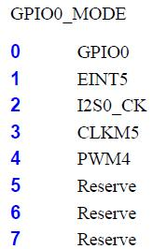
GPIO Mode Select Related Registers
GPIO Mode Select Register
  每个GPIO都可以被配置成多种模式，这就是GPIO的多功能，每个GPIO pin用于那种功能，可以通过这个寄存器来设置。
GPIO Mode Select Set Register
  Set corresponding bit of GPIO Mode Select Register
  0: No action; 1: Set corresponding bit as 1
GPIO Mode Select Reset Register
  Set corresponding bit of GPIO Mode Select Register
  0: No action; 1: Reset corresponding bit to 0
例如GPIO0

Slide 30
DCT - Driver Customization Tool

Slide 31
DCT
DCT is used to customize the key mapping, de-bounce time and Power key setting in Keypad driver.
Key Mapping
De-Bounce time
Power Key Mapping

Slide 32
DCT
Key Mapping 、GPIO等由DCT生成的信息位于mediatek/custom/huaqin73_gb/kernel/dct/dct/codegen.dws
在mediatek\custom\<prj name>下会生成很多文件
对于GPIO的配置情况，请参考MT6573 HW Configuration_20110413_final.pdf@Hardware_Customer\Standard Package\HSPA_EDGE_GPRS\MT6573

Slide 33
DCT
DCT生成的代码位于:
  mediatek/custom/huaqin73_gb/kernel/dct/dct/
  codegen.dws
  cust_adc.h
  cust_eint.h
  cust_gpio_boot.h
  cust_gpio_usage.h
  cust_kpd.h
  pmic_drv.c
  pmic_drv.h

