Slide 1
Modem Bin Update Tool V2
Copyright © MediaTek Inc. All rights reserved.

Slide 2
L1 Modem DVT
2010/02/22
CS1/CS WU

Slide 3
Outline
The Difference of V1 & V2
How to Use Modem-Bin-Update Tool
How to Generate the Init File
The Updated Parameter
How to Debug

Slide 4
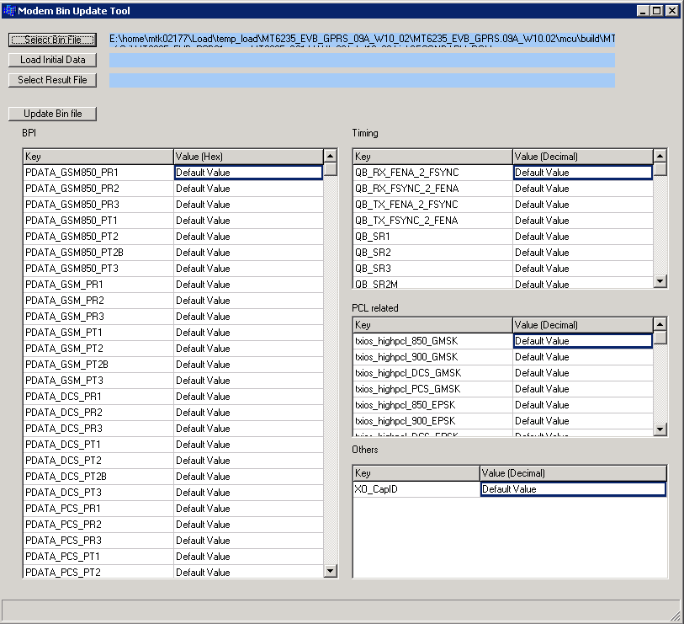
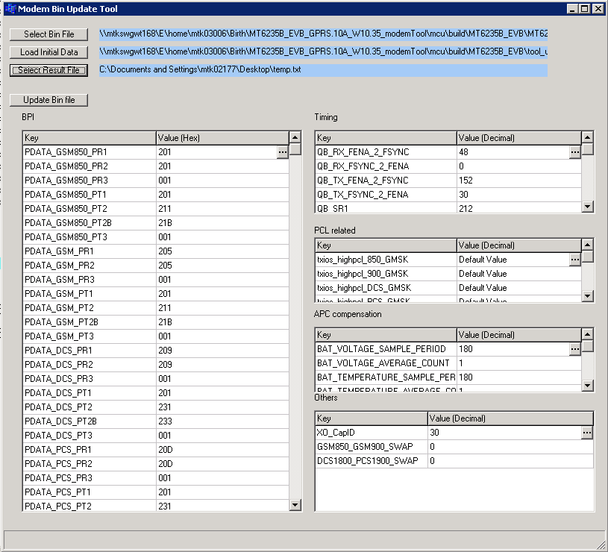
The Difference of V1 & V2

Slide 5
The New Update Variable
Vmode control of GMSK & 8PSK
  PDATA_GMSK
  PDATA_8PSK
Band Swap Control
  GSM850_GSM900_SWAP
  DCS1800_PCS1900_SWAP
VAPC Compensation control

Slide 6
How to Use Modem-Bin-Update Tool

Slide 7
How to Use Modem-Bin-Update Tool
Step1
Choose the modem bin file which we want to update
The parameters which can be updated will be shown here

Slide 8
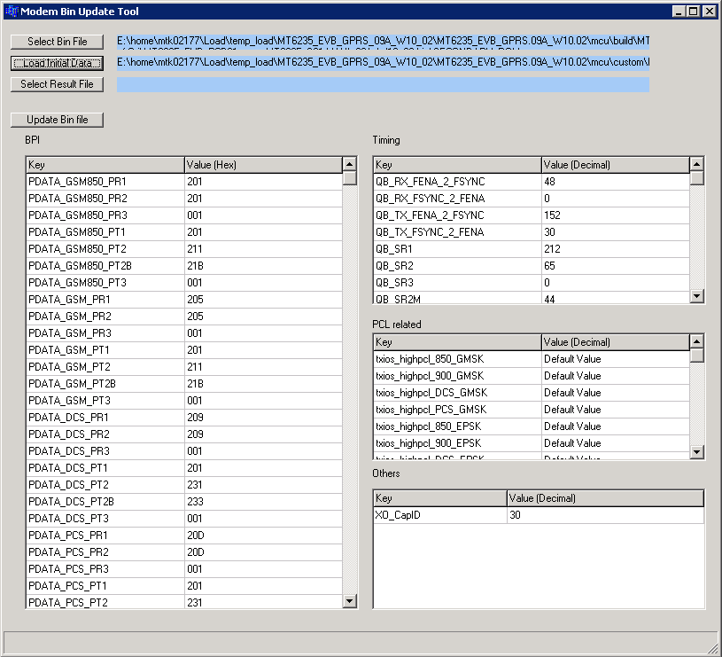
How to Use Modem-Bin-Update Tool
Step2
Choose the init file
Tool will use the setting in the init file to update the data shown in GUI
User also can update the data in GUI

Slide 9
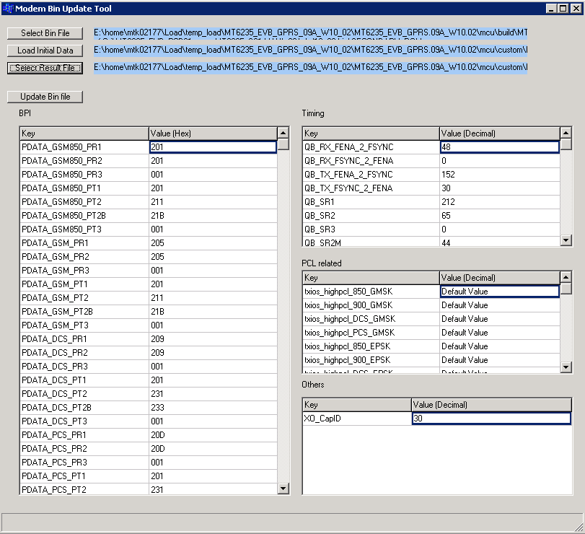
How to Use Modem-Bin-Update Tool
Step3
Choose the result file
Tool will write the user setting into the result file for debugging

Slide 10
How to Use Modem-Bin-Update Tool
Step4
Press this icon, and finish updating the modem bin file

Slide 11
How to Generate the Init File

Slide 12
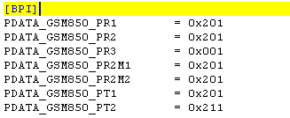
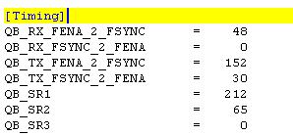
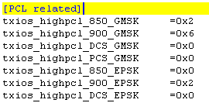


The Format of Init File
There are four groups of RF data
  [Group name]
  RF data = init value
1
2
3
4
5

Slide 13
Data Type
Data Group | Data Type
BPI | hexadecimal
Timing | Decimal
PCL Related | Hexadecimal
APC_Comp | Decimal
Others | Decimal

Slide 14
The Updated Parameter

Slide 15

BPI / Timing Setting (1/)
The data in the red block must be assigned

Slide 16
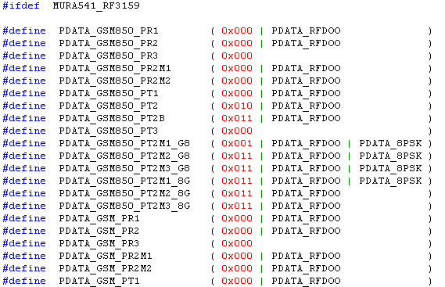
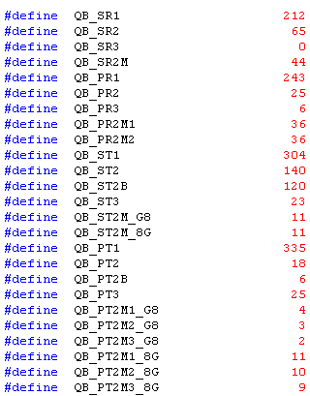
BPI / Timing Setting (2/)
The original BPI / Timing data can be modified in l1d_custom_rf.h
The setting rule in Modem-Bin-Update tool is the same as the original

Slide 17
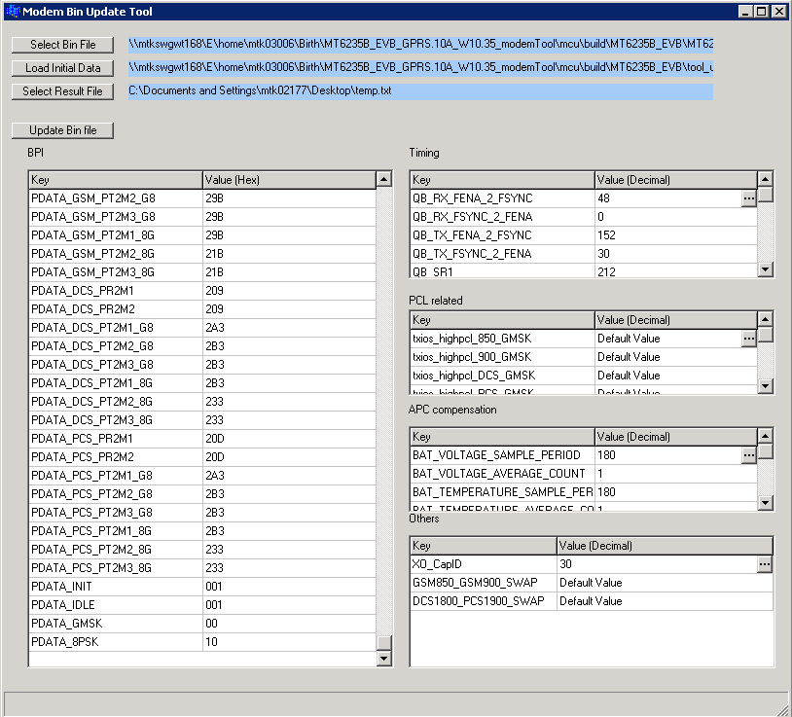
BPI / Timing Setting (3/)
V2 support
Vmode control of GMSK & 8PSK
  PDATA_GMSK
  PDATA_8PSK

Slide 18
TX Power Setting (only for MT6140)
If we don’t assign value in the red block, Tool will use the default value

Slide 19
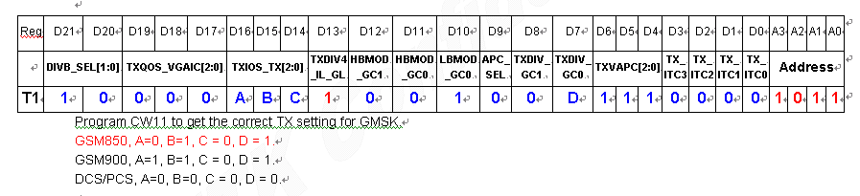
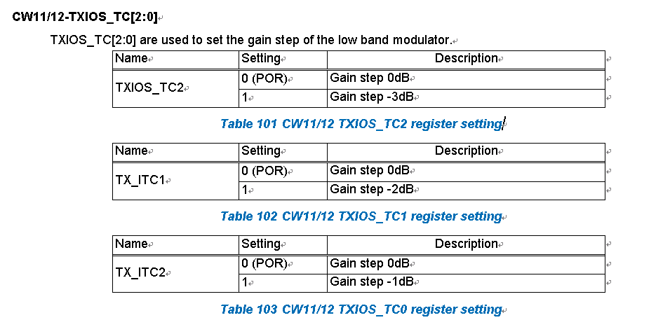
TX_IOS[2:0]
The register TXIOS_TC[2:0] is used the set the low band modulator gain
A
B
C

Slide 20
TX_IOS[2:0]
Item | Parameter | Default Value (Hexidicimal) | Range (Hexidicimal)
1 | txios_highpcl_850_GMSK | 0x2 | 0x0~0x7
2 | txios_highpcl_900_GMSK | 0x6 | 0x0~0x7
3 | txios_highpcl_DCS_GMSK | 0x0 | 0x0~0x7
4 | txios_highpcl_PCS_GMSK | 0x0 | 0x0~0x7
5 | txios_highpcl_850_EPSK | 0x0 | 0x0~0x7
6 | txios_highpcl_900_EPSK | 0x2 | 0x0~0x7
7 | txios_highpcl_DCS_EPSK | 0x0 | 0x0~0x7
8 | txios_highpcl_PCS_EPSK | 0x0 | 0x0~0x7
9 | txios_lowpcl_850_GMSK | 0x2 | 0x0~0x7
10 | txios_lowpcl_900_GMSK | 0x6 | 0x0~0x7
11 | txios_lowpcl_DCS_GMSK | 0x0 | 0x0~0x7
12 | txios_lowpcl_PCS_GMSK | 0x0 | 0x0~0x7
13 | txios_lowpcl_850_EPSK | 0x5 | 0x0~0x7
14 | txios_lowpcl_900_EPSK | 0x7 | 0x0~0x7
15 | txios_lowpcl_DCS_EPSK | 0x0 | 0x0~0x7
16 | txios_lowpcl_PCS_EPSK | 0x0 | 0x0~0x7

Slide 21
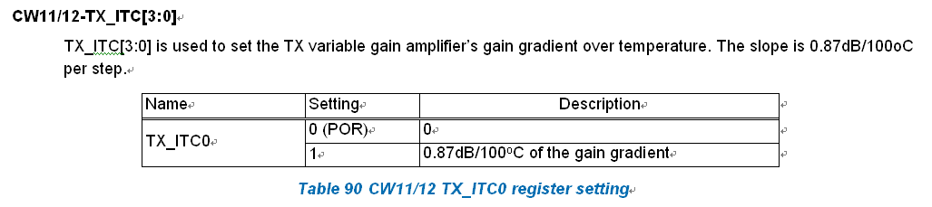
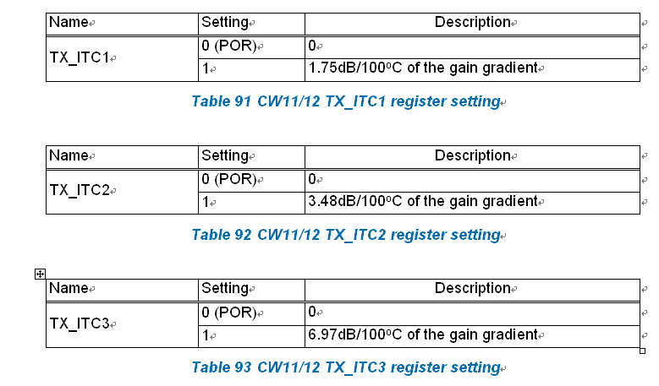
TX_ITC[3:0]
the PA gain is higher and has worse linearity performance at low temperature, so that the 8PSK EVM and ORFS performance are degraded as the temperature is going down

Slide 22
TX_ITC[3:0]
Item | Parameter | Default Value (Hexidicimal) | Range (Hexidicimal)
1 | txitc_highpcl_850_GMSK | 0x0 | 0x0~0xF
2 | txitc_highpcl_900_GMSK | 0x0 | 0x0~0xF
3 | txitc_highpcl_DCS_GMSK | 0x0 | 0x0~0xF
4 | txitc_highpcl_PCS_GMSK | 0x0 | 0x0~0xF
5 | txitc_highpcl_850_EPSK | 0x9 | 0x0~0xF
6 | txitc_highpcl_900_EPSK | 0x9 | 0x0~0xF
7 | txitc_highpcl_DCS_EPSK | 0x7 | 0x0~0xF
8 | txitc_highpcl_PCS_EPSK | 0x7 | 0x0~0xF
9 | txitc_lowpcl_850_GMSK | 0x0 | 0x0~0xF
10 | txitc_lowpcl_900_GMSK | 0x0 | 0x0~0xF
11 | txitc_lowpcl_DCS_GMSK | 0x0 | 0x0~0xF
12 | txitc_lowpcl_PCS_GMSK | 0x0 | 0x0~0xF
13 | txitc_lowpcl_850_EPSK | 0x9 | 0x0~0xF
14 | txitc_lowpcl_900_EPSK | 0x9 | 0x0~0xF
15 | txitc_lowpcl_DCS_EPSK | 0x7 | 0x0~0xF
16 | txitc_lowpcl_PCS_EPSK | 0x7 | 0x0~0xF

Slide 23
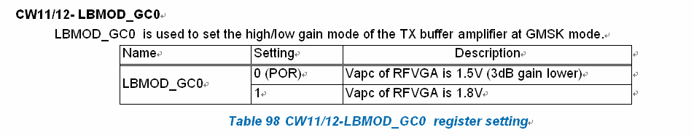
LBMOD_GC0

Slide 24
LBMOD_GC0
Item | Parameter | Default Value (Hexidicimal) | Range (Hexidicimal)
1 | lbmod_gc_highpcl_850_GMSK | 0x1 | 0x0~0x1
2 | lbmod_gc_highpcl_900_GMSK | 0x1 | 0x0~0x1
3 | lbmod_gc_highpcl_DCS_GMSK | 0x1 | 0x0~0x1
4 | lbmod_gc_highpcl_PCS_GMSK | 0x1 | 0x0~0x1
5 | lbmod_gc_highpcl_850_EPSK | 0x1 | 0x0~0x1
6 | lbmod_gc_highpcl_900_EPSK | 0x1 | 0x0~0x1
7 | lbmod_gc_highpcl_DCS_EPSK | 0x1 | 0x0~0x1
8 | lbmod_gc_highpcl_PCS_EPSK | 0x1 | 0x0~0x1
9 | lbmod_gc_lowpcl_850_GMSK | 0x1 | 0x0~0x1
10 | lbmod_gc_lowpcl_900_GMSK | 0x1 | 0x0~0x1
11 | lbmod_gc_lowpcl_DCS_GMSK | 0x1 | 0x0~0x1
12 | lbmod_gc_lowpcl_PCS_GMSK | 0x1 | 0x0~0x1
13 | lbmod_gc_lowpcl_850_EPSK | 0x1 | 0x0~0x1
14 | lbmod_gc_lowpcl_900_EPSK | 0x1 | 0x0~0x1
15 | lbmod_gc_lowpcl_DCS_EPSK | 0x1 | 0x0~0x1
16 | lbmod_gc_lowpcl_PCS_EPSK | 0x1 | 0x0~0x1

Slide 25
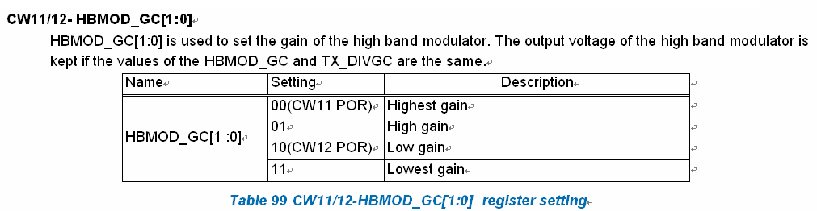
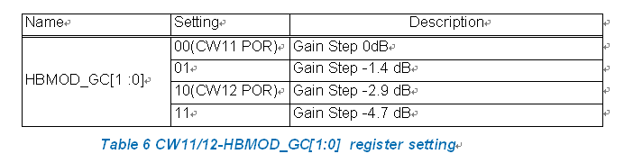
HBMOD_GC

Slide 26
HBMOD_GC
Item | Parameter | Default Value (Hexidicimal) | Range (Hexidicimal)
1 | hbmod_gc_highpcl_850_GMSK | 0x0 | 0x0~0x3
2 | hbmod_gc_highpcl_900_GMSK | 0x0 | 0x0~0x3
3 | hbmod_gc_highpcl_DCS_GMSK | 0x0 | 0x0~0x3
4 | hbmod_gc_highpcl_PCS_GMSK | 0x0 | 0x0~0x3
5 | hbmod_gc_highpcl_850_EPSK | 0x1 | 0x0~0x3
6 | hbmod_gc_highpcl_900_EPSK | 0x1 | 0x0~0x3
7 | hbmod_gc_highpcl_DCS_EPSK | 0x1 | 0x0~0x3
8 | hbmod_gc_highpcl_PCS_EPSK | 0x1 | 0x0~0x3
9 | hbmod_gc_lowpcl_850_GMSK | 0x0 | 0x0~0x3
10 | hbmod_gc_lowpcl_900_GMSK | 0x0 | 0x0~0x3
11 | hbmod_gc_lowpcl_DCS_GMSK | 0x0 | 0x0~0x3
12 | hbmod_gc_lowpcl_PCS_GMSK | 0x0 | 0x0~0x3
13 | hbmod_gc_lowpcl_850_EPSK | 0x1 | 0x0~0x3
14 | hbmod_gc_lowpcl_900_EPSK | 0x1 | 0x0~0x3
15 | hbmod_gc_lowpcl_DCS_EPSK | 0x3 | 0x0~0x3
16 | hbmod_gc_lowpcl_PCS_EPSK | 0x3 | 0x0~0x3

Slide 27
APC Compensation (1/)
V2 support

Slide 28
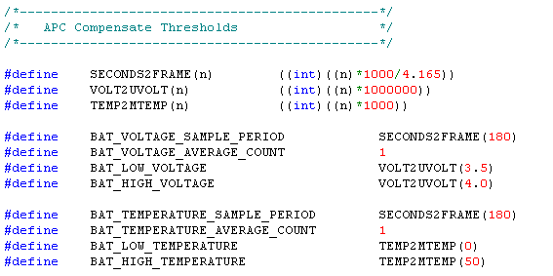
APC Compensation (2/)
V2 support
Item | Parameter | Default Value (Decimail) | Range (Decimal)
1 | BAT_VOLTAGE_SAMPLE_PERIOD | 180 | 0~500
2 | BAT_VOLTAGE_AVERAGE_COUNT | 1 | 1~10
3 | BAT_LOW_VOLTAGE | 3.5 | 0~10
4 | BAT_HIGH_VOLTAGE | 4 | 0~10
5 | BAT_TEMPERATURE_SAMPLE_PERIOD | 180 | 0~500
6 | BAT_TEMPERATURE_AVERAGE_COUNT | 1 | 1~10
7 | BAT_LOW_TEMPERATURE | 0 | -80~80
8 | BAT_HIGH_TEMPERATURE | 50 | -80~80

Slide 29
CAPID Setting
If we don’t assign value in the red block, Tool will use the default value (Capid default value is 30)

Slide 30
BandSwap Setting(2/)
V2 support
If we don’t assign value in the red block, Tool will use the default value

Slide 31
BandSwap Setting(2/)
V2 support
GSM850_GSM900_SWAP
  0:GSM850 Signal go through GSM850, GSM900 Signal go through GSM900 (default)
  1:GSM850 Signal go through GSM900, GSM900 Signal go through GSM850
DCS1800_PCS1900_SWAP
  0:DCS1800 Signal go through DCS1800, PCS1900 Signal go through PCS1900(default)
  1:DCS1800 Signal go through PCS1900, PCS1900 Signal go through DCS1800
Item | Parameter | Default Value (Decimal) | Range (Decimal)
1 | GSM850_GSM900_SWAP | 0 | 0~1
2 | DCS1800_PCS1900_SWAP | 0 | 0~1

Slide 32
How to Debug

