Slide 1
Measuring and Mitigating Security and Privacy Issues on Android Applications
Lucky ONWUZURIKE
November 15, 2018

Slide 2
Motivation

Slide 3
Why Apps?
They often handle and transmit sensitive information
Some have been shown to contain vulnerabilities (e.g., accepting invalid TLS certificate, permission abuse etc.)
The vulnerabilities may be easy to exploit
They may compromise users’ security and privacy
App stores have little incentive to regulate
Some are designed to act maliciously
May not be easily detected
May not be detected if malware actors change technique

Slide 4
Why Apps?
Notes:
Source: Statista (https://www.statista.com/statistics/271491/worldwide-shipments-of-smartphones-since-2009/)

Slide 5


Why Android?

Slide 6
Objectives

Slide 7
Objectives
Detect apps that pose risks to users unintentionally due to vulnerabilities; with a focus on the implementation of security or privacy protocols
Detect apps that pose risks to users intentionally because they are designed to be malicious

Slide 8
Detecting Vulnerable Apps

Slide 9
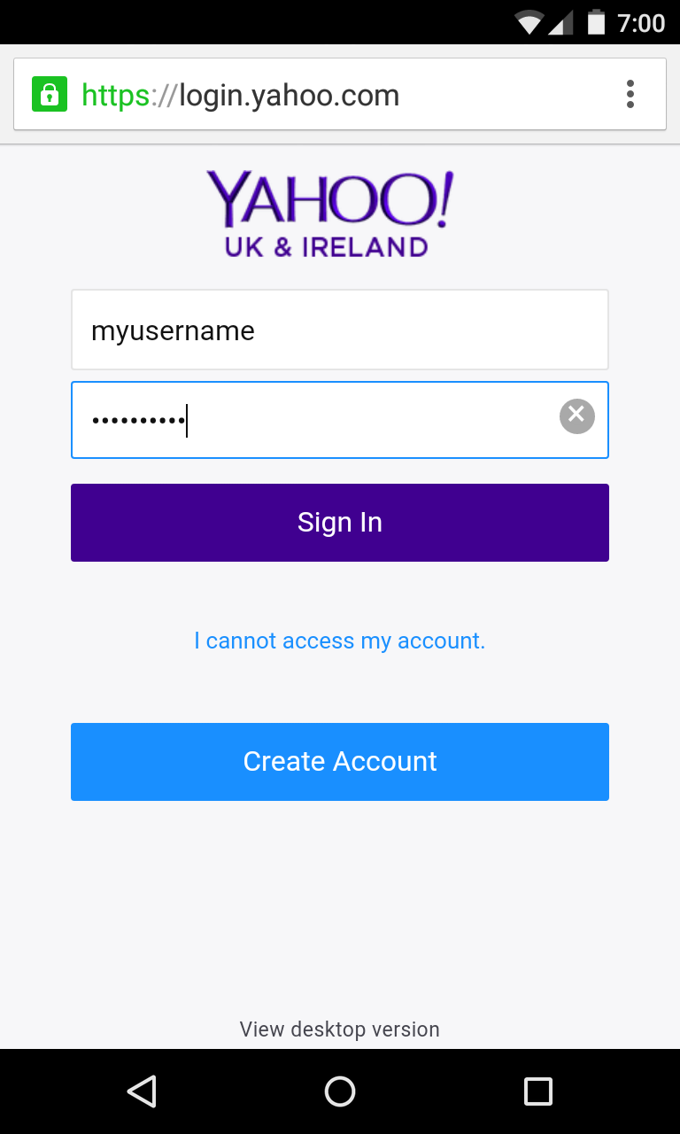
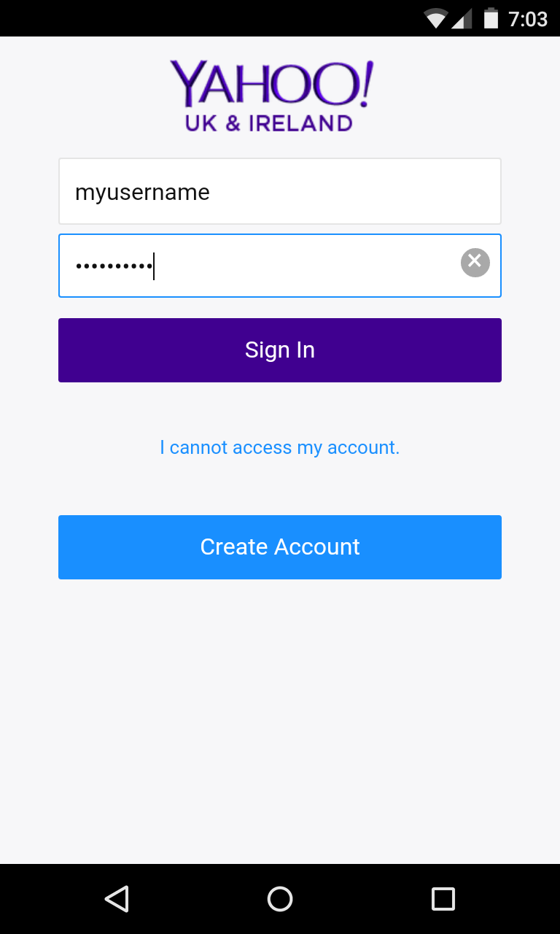
Research Problem
Yahoo Mail on a Mobile Browser and Yahoo Mail App

Slide 10







Research Problem
“NSA Proof”
“True Privacy”
“Messages disappear forever once they are read”
“Complete Privacy”
“Military-grade Encryption”
“Virtually unhackable”
“Full Anonymity”

Slide 11
Research Questions
RQ1: Are vulnerabilities in SSL/TLS implementations that enable successful man-in-the-middle attacks prevalent in Android apps?
RQ2: Do apps that claim to provide security and privacy properties that protect user information actually do?

Slide 12
Experimenting with TLS Vulnerabilities
App Selection
Select 100 popular apps (popular >= 10M downloads)
Our app corpus is ~10% of all popular apps on Play Store¹
Manual/Static Analysis
Decompile apk
Search for SSL code i.e., TrustManagers and HostnameVerifiers
Analyze TrustManagers and HostnameVerifiers for vulnerabilities e.g., returning True without performing any checks
Implement TLSDroid to statically detect vulnerabilities
1. https://www.androidrank.org/

Slide 13
Attack Scenarios
Simulate three MiTM attack scenarios
S1: The adversary has their CA certificate with which they are able to generate valid certificates for any number of domains, installed on the victim’s device
S2: The adversary presents an invalid, self-signed certificate
S3: The adversary presents a certificate with a wrong Common Name (CN) and/or SubjectAltName, signed by a valid CA

Slide 14
Results²
Analysis Type | Observation | # of Apps (Total: 100)
Static⁺ | Apps with SSL code | 93
 | Accepts all certificates | 46
 | Accepts wrong hostname | 48
Dynamic | Vulnerable to S1 | 91
 | Vulnerable to S2 | 23
 | Vulnerable to S3 | 29
 | Vulnerable to S1, S2, and S3 | 20
 | Unencrypted traffic* | 10
*Include usernames, passwords, GPS Locations, and IMSI and IMEI numbers
+Manual analysis
2. L. Onwuzurike and E. De Cristofaro. Danger is My Middle Name: Experimenting with SSL Vulnerabilities in Android Apps. In ACM WiSec, 2015.
Notes:
The results presented here are for the manual analysis. We used TLSDroid to evaluate over a 100k apps from Play Store and find over 24k apps with vulnerable TM and an additional 1k that are potentially vulnerable. W.r.t HV, about 23k are vulnerable and 15k are potentially vulnerable

Slide 15
Interesting Findings…
9 Apps implement certificate pinning
Not vulnerable in any attack scenario
Indirect leakage
Amazon and Amazon Local have different implementation
Tweetcaster leaks Twitter credentials
Google Apps
Vulnerable in S1
Leak PayPal credentials, email, calendar schedules, Location, and so on
Warnings
Only 3 apps display security-related warning

Slide 16
Experimental Analysis of Secure/Privacy-Enhancing Apps
Security and privacy properties selection
Anonymity: users cannot be identified by service provider and other users
Ephemerality: message “disappears” after specific time
End-to-End Encryption (E2EE): only communicating parties can decrypt encrypted message
App Selection
Pick initial apps from Product Hunt³
Find similar apps on Play Store
Select most downloaded apps or apps with more than one property
Final selection: 8 out of 18
3. https://www.producthunt.com/e/anonymous-apps

Slide 17
App Analysis Methods
Static Analysis
Find vulnerable SSL implementations
Dynamic Analysis
MiTM apps’ connections to servers
Use regular and transparent proxies
Transparent proxy redirects traffic on ports 80, 443, and 5228

Slide 18
Results⁴
Static Analysis
3/8 apps contain vulnerable TrustManagers and HostnameVerifiers
Dynamic Analysis
Anonymity w.r.t. other users: 1/4 apps provides k-anonymity; 1/4 apps may be vulnerable to “nearby” attacks
Anonymity w.r.t. the service provider: all (4/4) anonymous apps associate identifiers to each user’s data; 2/4 apps persistently link users
Ephemerality: easily circumvented; 1/5 apps does not always immediately delete expired messages from its servers
E2EE: all (3/3) apps employ E2EE
4. L. Onwuzurike and E. De Cristofaro. Experimental Analysis of Popular Smartphone Apps Offering Anonymity, Ephemerality, and End-to-End Encryption. In NDSS UEOP, 2016.

Slide 19
Detecting Malicious Apps

Slide 20
Research Problem
5. https://www.av-test.org/en/statistics/malware/

Slide 21

Research Problem
6. Chen et al. More Semantics More Robust: Improving Android Malware Classifiers. In WiSec, 2016.
“…well-trained classifiers can achieve good classification performance, e.g., precision as high as 99% and false positive ratio as low as 1%. …When these classifiers are applied in practice to detect new malware, the classification accuracy drops …the precision and recall respectively drop from around 95% and 99% …to 55% and 26%...”⁶

Slide 22
Research Questions
RQ3: Can we design new robust malware detection tools that are not easily affected by malware evolution?
RQ4: Does having humans test apps during dynamic analysis improve malware detection compared to pseudorandom input generators?
RQ5: How do different analysis methods (i.e., static, dynamic, and hybrid analysis) compare when the same technique is used to build the detection models?

Slide 23
Behavioral Modeling of Abstracted API Calls
Datasets
Benign: 5,879 apps from prior work⁷ (oldbenign); 2,568 apps downloaded from Play Store in 2016 (newbenign)
Malware: 5,560 from prior work⁸ (drebin); 29,933 from VirusShare spanning four years (2013, 2014, 2015, 2016)
Model the behavior of apps as
Markov chains derived from the sequence of API calls (MaMaDroid)
Frequency model derived from API calls frequently used by malware (FAM)
Abstract the API calls to different levels of granularity
7. Viennot et al. A Measurement Study of Google Play. ACM SIGMETRICS Performance Evaluation Review, 42(1), 2014
8. Arp et al. DREBIN: Effective and Explainable Detection of Android Malware in Your Pocket. In NDSS, 2014

Slide 24


MaMaDroid
Call Graph Extraction
Sequence Extraction
Markov
Chain
Modeling
?
Classification
Extract call graphs from apk

Slide 25
MaMaDroid
Call Graph Extraction
Sequence Extraction
Markov
Chain
Modeling
?
Classification
Transform call graphs into sequences of calls
Abstract the API calls to one of three modes (family, package, or class)

Slide 26
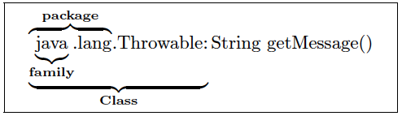
MaMaDroid
Call Graph Extraction
Sequence Extraction
Markov
Chain
Modeling
?
Classification
Abstract the API calls to one of three modes (family, package, or class)

Slide 27
MaMaDroid
Call Graph Extraction
Sequence Extraction
Markov
Chain
Modeling
?
Classification
Transform sequences of abstracted calls into Markov chains
Select as features vector, probability of transitioning from states

Slide 28
MaMaDroid
Call Graph Extraction
Sequence Extraction
Markov
Chain
Modeling
?
Classification
Perform classification with RF, 1-NN, and 3-NN

Slide 29
Results^{9, 10}
Mode | Family | Package | Class
Datasets | [Precision, Recall, F-Measure]
drebin, oldbenign | 0.82, 0.95, 0.88 | 0.95, 0.97, 0.96 | 0.95, 0.97, 0.96
2013, oldbenign | 0.91, 0.93, 0.92 | 0.98, 0.95, 0.97 | 0.98, 0.95, 0.97
2014, oldbenign | 0.88, 0.96, 0.92 | 0.93, 0.97, 0.95 | 0.93, 0.97, 0.95
2014, newbenign | 0.97, 0.99, 0.98 | 0.98, 1.00, 0.99 | 0.98, 1.00, 0.99
2015, newbenign | 0.89, 0.93, 0.91 | 0.93, 0.98, 0.95 | 0.93, 0.98, 0.95
2016, newbenign | 0.87, 0.91, 0.89 | 0.92, 0.92, 0.92 | 0.91, 0.92, 0.92
9. Mariconti et al. MaMaDroid: Detecting Android Malware by Building Markov Chains of Behavioral Models. In NDSS, 2017.
10. Onwuzurike et al. MaMaDroid: Detecting Android Malware by Building Markov Chains of Behavioral Models (Extended Version). Under Submission at ACM TOPS.

Slide 30
Detection over time

Slide 31
Comparative Analysis of Program Analysis Approach for Malware Detection
Select the technique proposed by MaMaDroid
Recruit users to stimulate apps
Implement MaMaDroid in dynamic (aka AuntieDroid – Integration of MaMaDroid into modified CHIMP¹¹) and hybrid analysis settings
Datasets
Benign: 2,723 apps downloaded from Play Store in 2017
Malware: 2,694 apps i.e., 2,692 from VirusShare and 2 recently reported in the media
11. Almeida et al. CHIMP: Crowdsourcing Human Inputs for Mobile Phones. In WWW, 2018

Slide 32

AuntieDroid
?
Virtual
Device
Trace
Parsing
Feature
Extraction
Classification
App Stimulation
Run app under analysis
Collect runtime method traces every 30s

Slide 33
AuntieDroid
?
Virtual
Device
Trace
Parsing
Feature
Extraction
Classification
App Stimulation
Parse traces and transform them into call graphs
Transform call graphs into sequences of calls and aggregate the sequences

Slide 34
AuntieDroid
?
Virtual
Device
Trace
Parsing
Feature
Extraction
Classification
App Stimulation
Abstract calls and transform sequences of calls into Markov chains
Select as features vector, probability of transitioning from states

Slide 35
AuntieDroid
?
Virtual
Device
Trace
Parsing
Feature
Extraction
Classification
App Stimulation
Perform classification using Random Forests

Slide 36
Hybrid System
Trace 1
1
java.lang.Class.getMethod
air.com.eni.ChefJudy030.AppEntry.onNewIntent
1
android.app.Activity.onNewIntent
+
Trace 2
7
java.lang.Class.getMethod
air.com.eni.ChefJudy030.AppEntry.onNewIntent
3
android.app.Activity.onNewIntent
=
8
java.lang.Class.getMethod
air.com.eni.ChefJudy030.AppEntry.onNewIntent
4
android.app.Activity.onNewIntent
Aggregated Trace

Slide 37
Results¹²
Analysis | Stimulator | Mode | F-Measure | Precision | Recall
Static (MaMaDroid) |  | Family | 0.86 | 0.84 | 0.88
 |  | Package | 0.91 | 0.89 | 0.93
Dynamic (AuntieDroid) | Human | Family | 0.85 | 0.80 | 0.90
 |  | Package | 0.88 | 0.84 | 0.92
 | Monkey | Family | 0.86 | 0.84 | 0.89
 |  | Package | 0.92 | 0.91 | 0.93
Hybrid | Static + Human | Family | 0.87 | 0.86 | 0.88
 |  | Package | 0.90 | 0.88 | 0.91
 | Static + Monkey | Family | 0.88 | 0.88 | 0.89
 |  | Package | 0.92 | 0.92 | 0.93
12. Onwuzurike et al. A Family of Droids: Analyzing Behavioral Model based Android Malware Detection via Static and Dynamic Analysis. In PST, 2018.

Slide 38
Summary of Contributions

Slide 39
Summary of Contributions
Show that many popular apps still leak users' private information due to SSL vulnerabilities
Provide code sample for safe use of self-signed certificate
Show that ephemeral messaging apps are not always ephemeral
Anonymous apps can identify users

Slide 40
Summary of Contributions
Design and implement a novel approach for Android malware detection
Perform a comparative analysis of the different program analysis types w.r.t malware detection
Show that humans do not improve Android malware detection in a dynamic setting

Slide 41
Limitations

Slide 42
Limitations
Limited sample size of apps analyzed
Inherent limitations of program analysis approach employed in the analysis of apps
Code obfuscation
App decompilation failure
App instantiation method during dynamic analysis

Slide 43
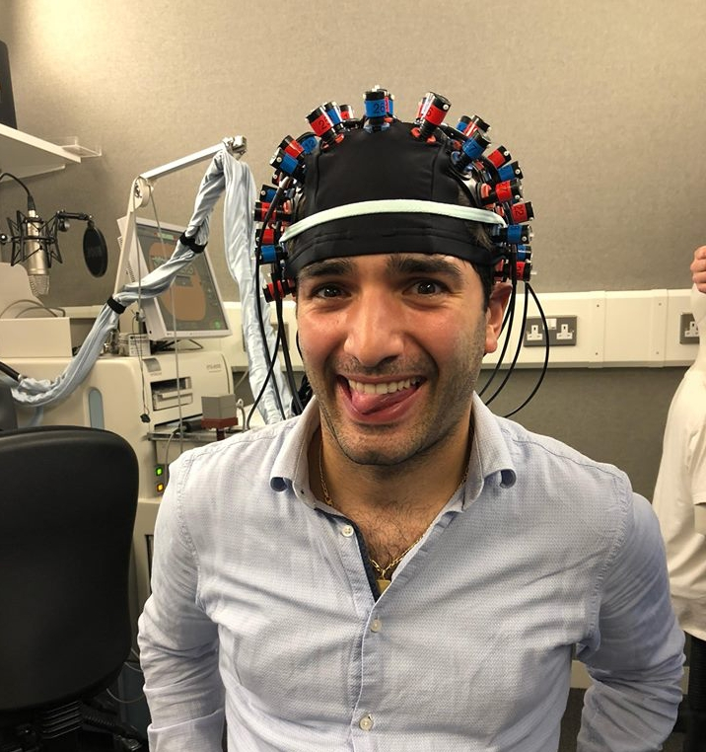


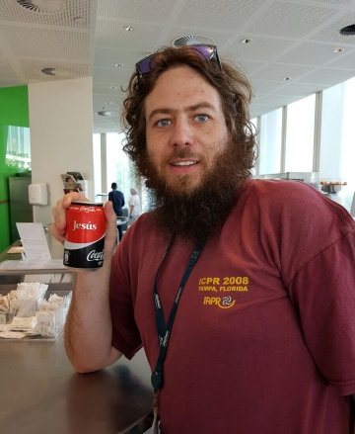

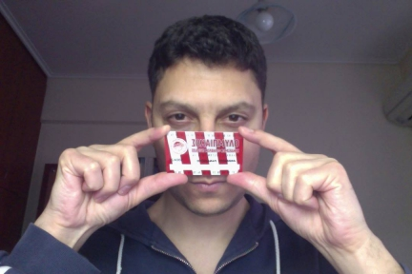
Acknowledgements

