Slide 1
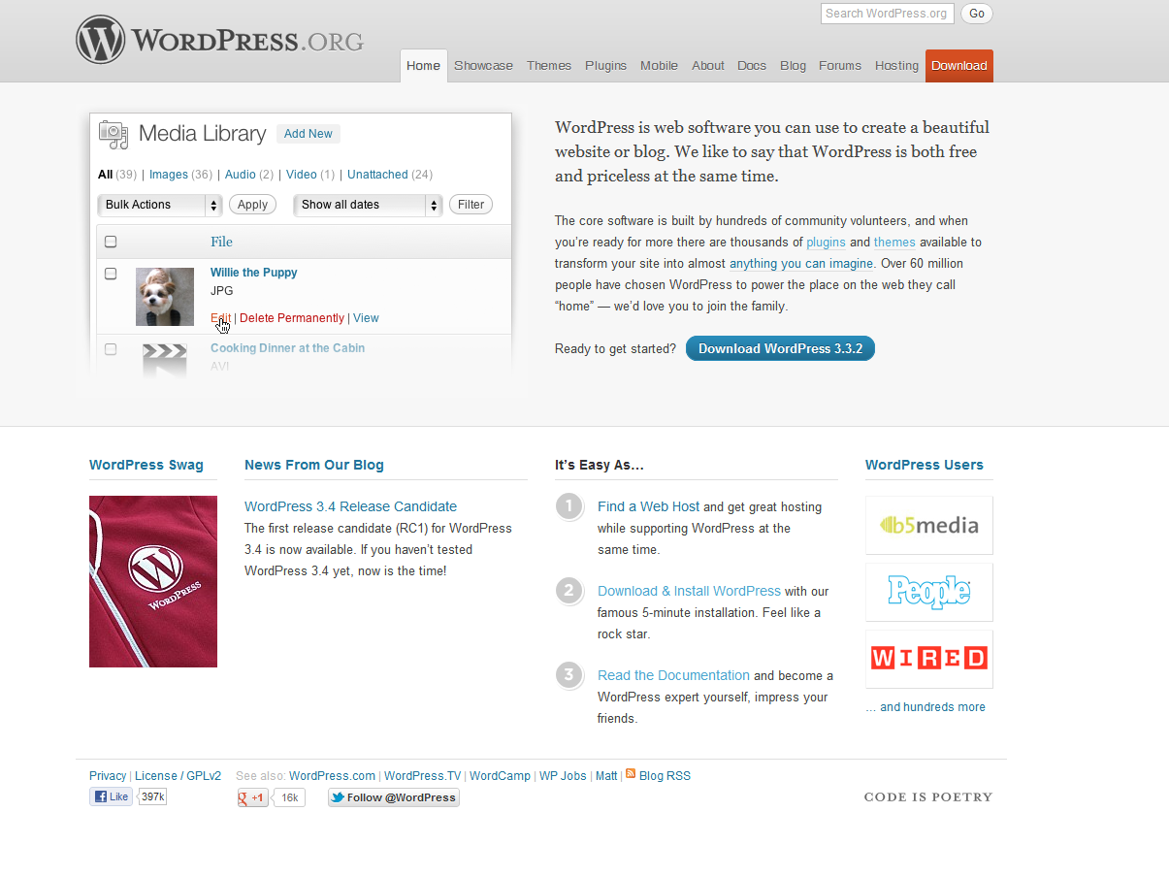

Slide 2
Using Wordpress
Readers
Similar to any basic website design, just load the page (http://gsunet/taskforce/)
Comment system that allows ANY reader, no account necessary, to make comments on the page (if allowed by admin).
Additional plug-ins for polls, feedback forms, slide shows & photo gallery, and other reader interaction
Admins/Editors
User roles (Admins, Editors, Authors, Contributors) with different levels of access and ability to make changes/add content
Log-in to dashboard and add content/make changes to the site through a simple to use (like microsoft word) interface, with ability to upload documents, photos, etc…

Slide 3
Wordpress Access
Note: Login issues regarding anonymmous for off-campus are being worked on/addressed.
All Commmittee members have a basic (contributor) account on Task Force Wordpress Website *account types can be changes upon request.
Username: Same as email account name (ex: “morganb”)
Default Password: “Gram123” (Passwords are case sensitive, and can be changed once you log-in)
You do not need to be logged in to make comments, participate in polls, etc…
Contributors can add content to the database/website, but it will not appear on the site until approved by an admin/editor.
Admins/Editors can also make changes to the look (themes, etc…) of the site and download/enable plug-ins to enhance the site.

Slide 4
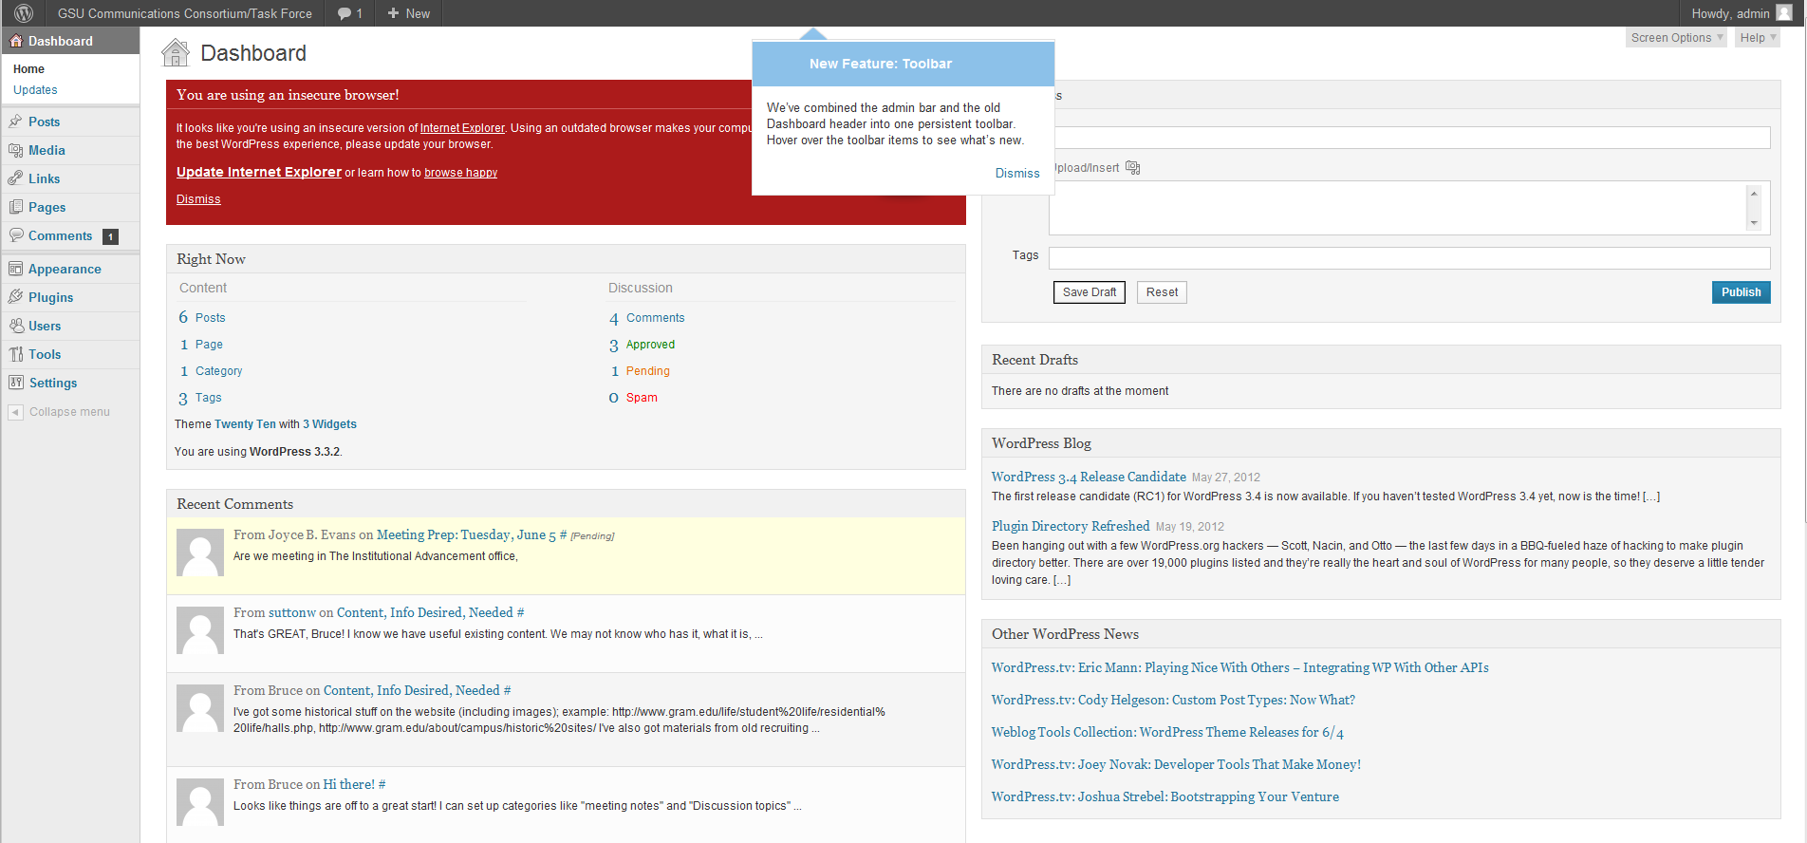
Wordpress Dashboard
Quick Post Panel
Site “At-a-Glance”
Navigation Panel
Recent Comments

Slide 5
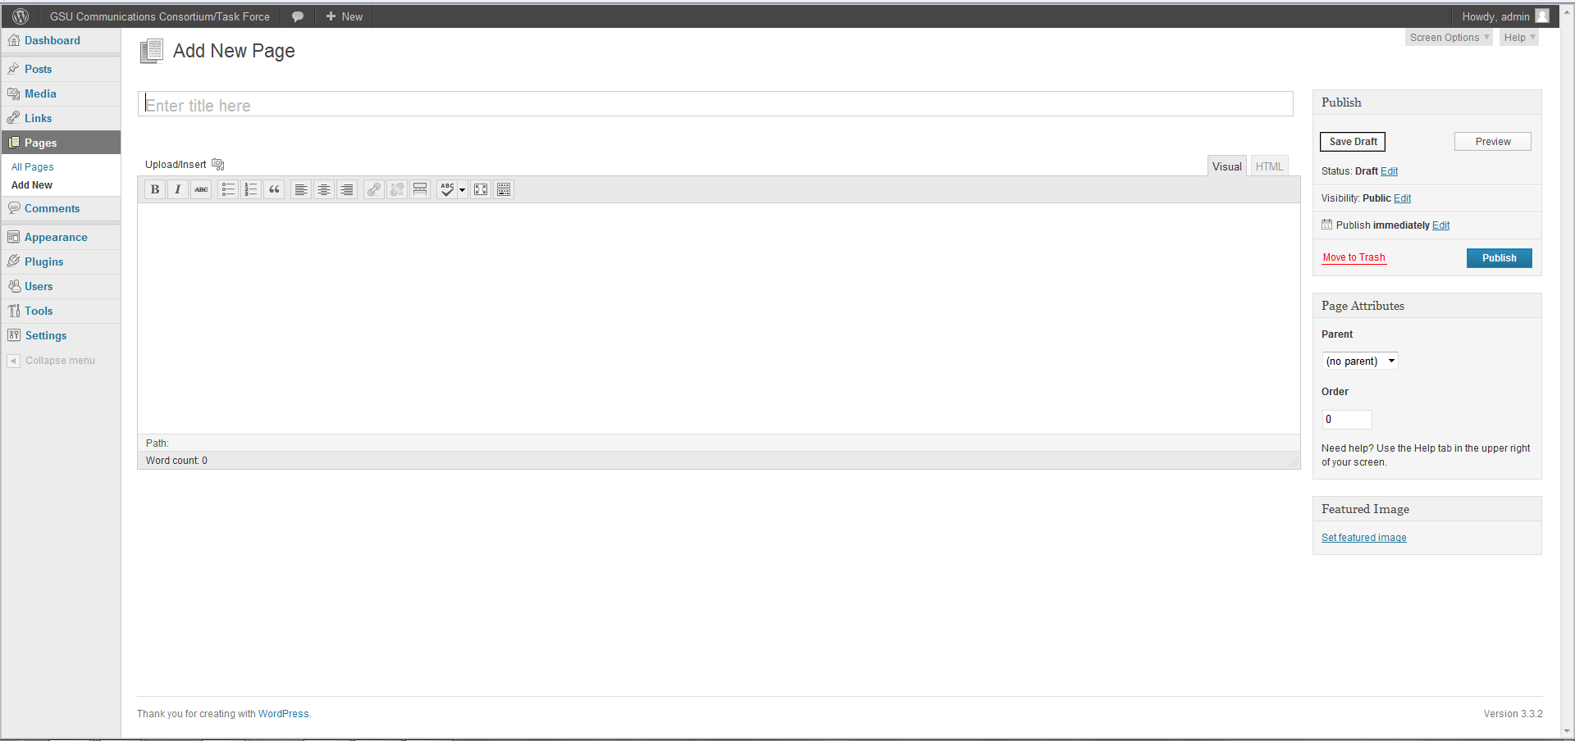
New Page/Post
Page/Post Title
Publish Panel
Upload button – add documents/photos to page/post
Rich Text/Code View Tabs
Edit menu bar – Bold, arrange text, add hyperlink
Main Edit Area - add content here
Page/Post Attributes Panel – Categories, etc…
Pages are not Categorized and added to the front page like posts, but they do appear on the navigation bar. Posts are generally for news, Pages are for static content (about us, contact, documents, etc…)

