Slide 1
CS211 Project (Internet of Things) Device-to-device communication
Week 4
October 27, 2020

Slide 2
What is IoT?
Secure connection of billions of ‘things’.
These devices, or things, connect to the network to:
Provide information they gather from the environment through sensors.
Allow other systems to reach out and act on the world through actuators.
Examples:
Wide range (Autonomous machinery in industrial sector to fitness tracker on the wrist)
Smart Home

Slide 3
Key features of a good IoT platform
Protocol Support
Scalability
Security
Data Integration and Analytics
SDKs and Tools

Slide 4
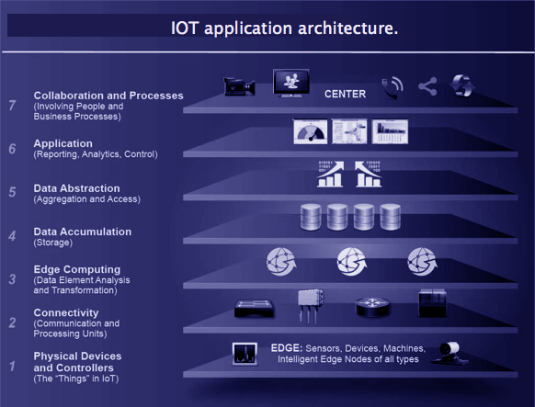
IoT Architecture
*Picture credits: https://data-flair.training/blogs/iot-protocols

Slide 5
Connectivity Solutions
Wi-Fi
Bluetooth
Zigbee
Cellular
NFC

Slide 6
IoT Protocols
Constrained Application Protocol (CoAP):
Designed by IETF (RFC 7252)
Constrained nodes and networks (like lossy, low-power, etc.)
M2M application (smart energy, building automation)
Uses UDP for message delivery
Can easily translate to HTTP
Advantages:
Multicast
Low overhead
Simple
Requires less memory and power

Slide 7
Message Queue Telemetry Transport Protocol (MQTT):
A lightweight publish/subscribe protocol
Uses TCP for its operation
Has 2 entities (MQTT broker, and MQTT clients)
Can support lossless, bidirectional transmission
Supports 3 QoS measures:
At most once (fire and forget)
At least once (acknowledged delivery)
Exactly once (assured delivery)

