Slide 1
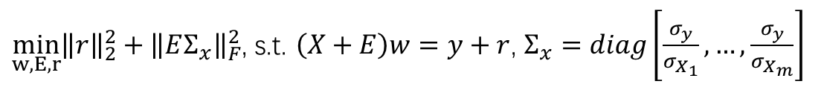
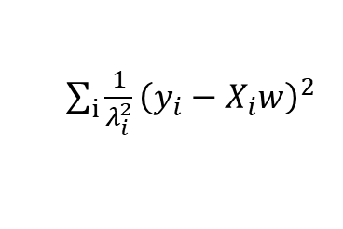
行列结合
$\min_{w,E,r}{{\left\|r\right\|}_{2}^{2}}+{\left\|EΣ_{x}\right\|}_{F}^{2}$, s.t. $\left(X+E\right)w=y+r$, $Σ_{x}=diag\left[\frac{σ_{y}}{σ_{X_{1}}},…,\frac{σ_{y}}{σ_{X_{m}}}\right]$
$\sum_{i}{\frac{1}{λ_{i}^{2}}{\left(y_{i}−X_{i}w\right)}^{2}}$
$\min_{w,E,r}{\sum_{i}{\frac{1}{λ_{i}^{2}}({\left\|r\right\|}_{2}^{2}+{\left\|EΣ_{x}\right\|}_{F}^{2}})}$, s.t. $\left(X+E\right)w=y+r$, $Σ_{x}=diag\left[\frac{σ_{y}}{σ_{X_{1}}},…,\frac{σ_{y}}{σ_{X_{m}}}\right]$

Slide 2
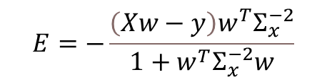
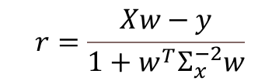
行列结合
关于噪声：？？？？不同列的噪声标准差不同但同一批次的噪声分布要一样
关于求解：先求实际值和预测值的误差，计算出不同批次的权值，对数据进行加权之后再根据求解列的方 法进行求解
$$r=\frac{Xw−y}{1+w^{T}Σ_{x}^{−2}w}$$
$$E=−\frac{\left(Xw−y\right)w^{T}Σ_{x}^{−2}}{1+w^{T}Σ_{x}^{−2}w}$$
$\min_{w,E,r}{\sum_{i}{\frac{1}{λ_{i}^{2}}({\left\|r\right\|}_{2}^{2}+{\left\|EΣ_{x}\right\|}_{F}^{2}})}$, s.t. $\left(X+E\right)w=y+r$, $Σ_{x}=diag\left[\frac{σ_{y}}{σ_{X_{1}}},…,\frac{σ_{y}}{σ_{X_{m}}}\right]$

Slide 3
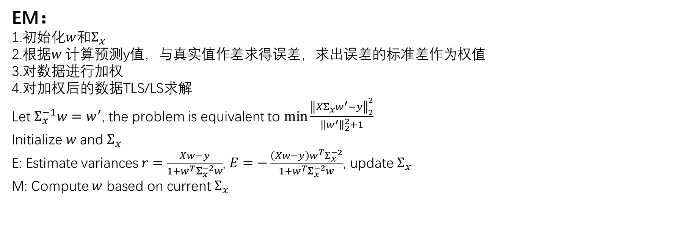
行列结合
EM：
1.初始化$w$和$Σ_{x}$
2.根据$w$ 计算预测y值，与真实值作差求得误差，求出误差的标准差作为权值
3.对数据进行加权
4.对加权后的数据TLS/LS求解
Let $Σ_{x}^{−1}w=w^{′}$, the problem is equivalent to $\min{\frac{{\left\|XΣ_{x}w^{′}−y\right\|}_{2}^{2}}{{\left\|w^{′}\right\|}_{2}^{2}+1}}$
Initialize $w$ and $Σ_{x}$
E: Estimate variances $r=\frac{Xw−y}{1+w^{T}Σ_{x}^{−2}w}$, $E=−\frac{\left(Xw−y\right)w^{T}Σ_{x}^{−2}}{1+w^{T}Σ_{x}^{−2}w}$, update $Σ_{x}$
M: Compute $w$ based on current $Σ_{x}$

