Slide 1

TOPIC NAME:
HealthPlus
Subject Name: IP Project (CS203)
Submitted By →
1. Luckshay : 2010991610
2. Liza : 2010991608
3. Puneet Jain : 2010991674
4. Reeya Bansal : 2010991682
Department of Computer Science and Engineering
Chitkara University, Punjab

Slide 2
HealthPlus Project
Welcome to the presentation on the HealthPlus project. We are excited to introduce you to our comprehensive healthcare management solution.

Slide 3
Background
The HealthPlus project aims to revolutionize healthcare services by providing a digital platform that simplifies appointment scheduling, digitizes medical records, enables seamless communication, and facilitates blood donation camps.

Slide 4
Objectives
Simplify appointment scheduling for patients, ensuring convenience and efficiency.
Digitize and centralize medical records to enhance accessibility and reduce paperwork.
Improve communication between healthcare providers and patients for timely and effective healthcare guidance.
Create and manage blood donation camps to encourage and streamline the process of blood donation.

Slide 5
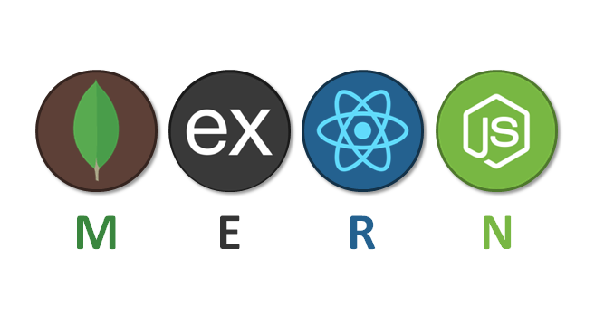

Methodology
The HealthPlus project is developed using the MERN stack, which combines MongoDB for data storage, Express.js and Node.js for server-side operations, and React for front-end development with Python for Data Analytics. This technology stack provides a scalable, flexible, and efficient foundation for the application.

Slide 6
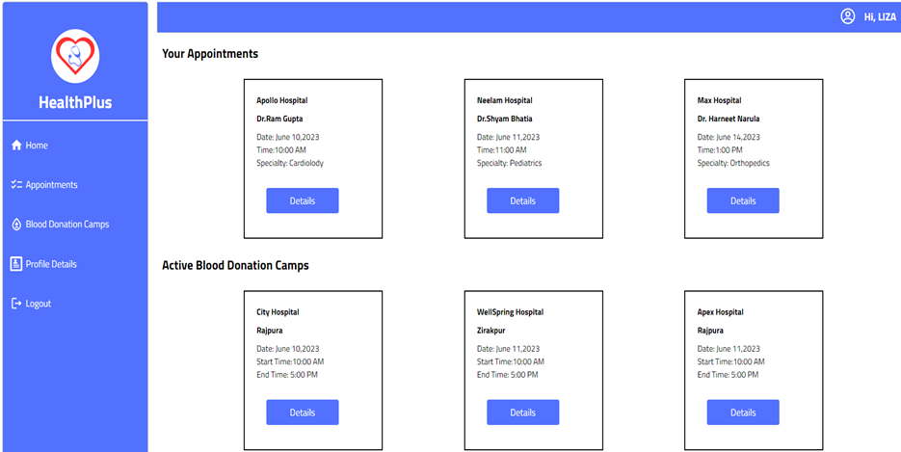
Features - Appointment Scheduling
Our appointment scheduling feature allows patients to easily book, reschedule, and manage their appointments with healthcare providers.
Real-time notifications and reminders ensure that patients never miss important appointments.

Slide 7
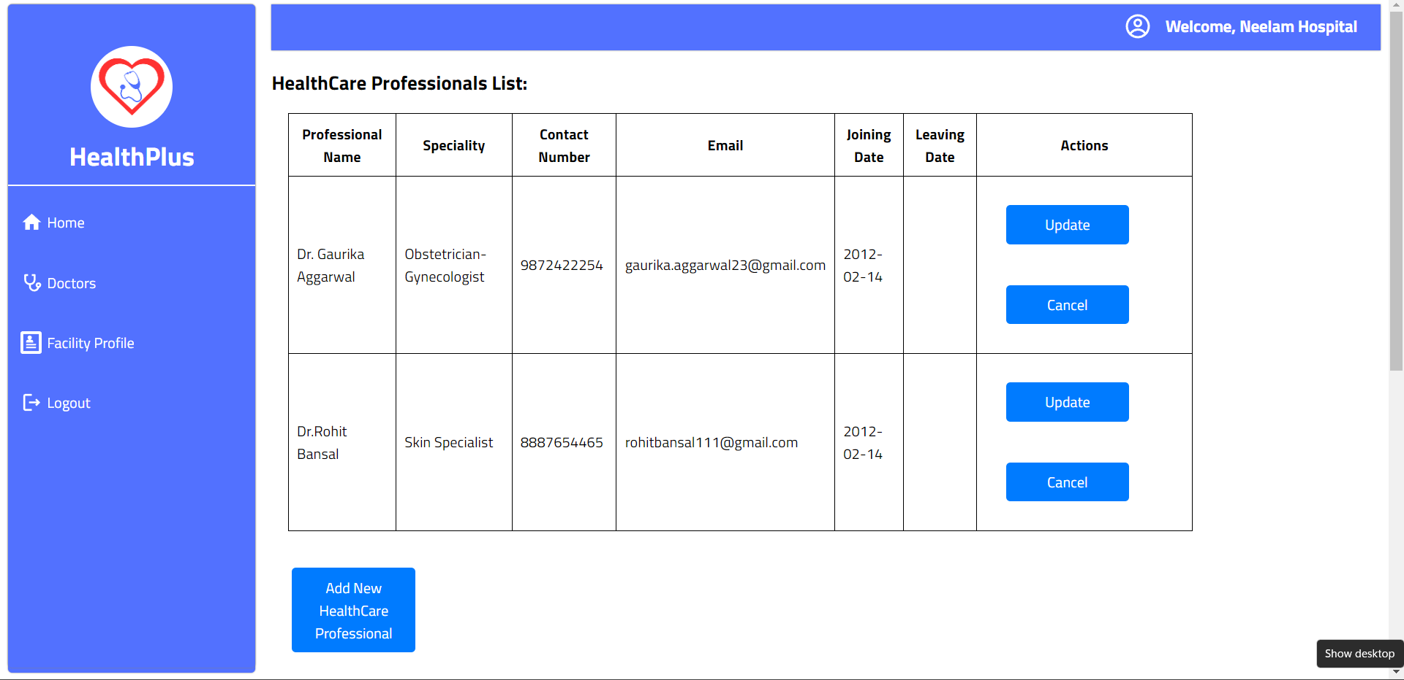
Features - Doctor Management
Our healthcare facility management system includes a robust feature for managing doctors effectively.
This feature streamlines the process of scheduling, assigning, and tracking doctors' availability and appointments.

Slide 8
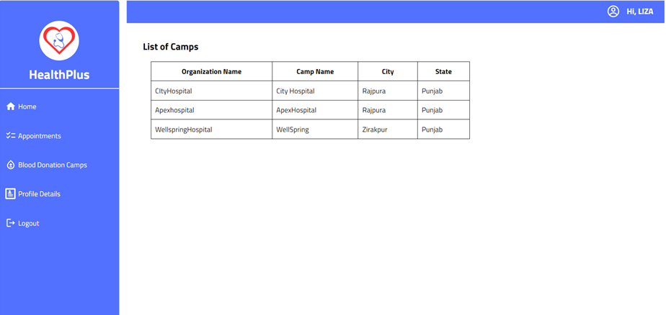
Features - Blood Donation Camps
HealthPlus also allows organizations and healthcare providers to create and manage blood donation camps. This feature includes scheduling, donor registration, coordination, and tracking, making it easier to organize and encourage blood donation campaigns.

Slide 9
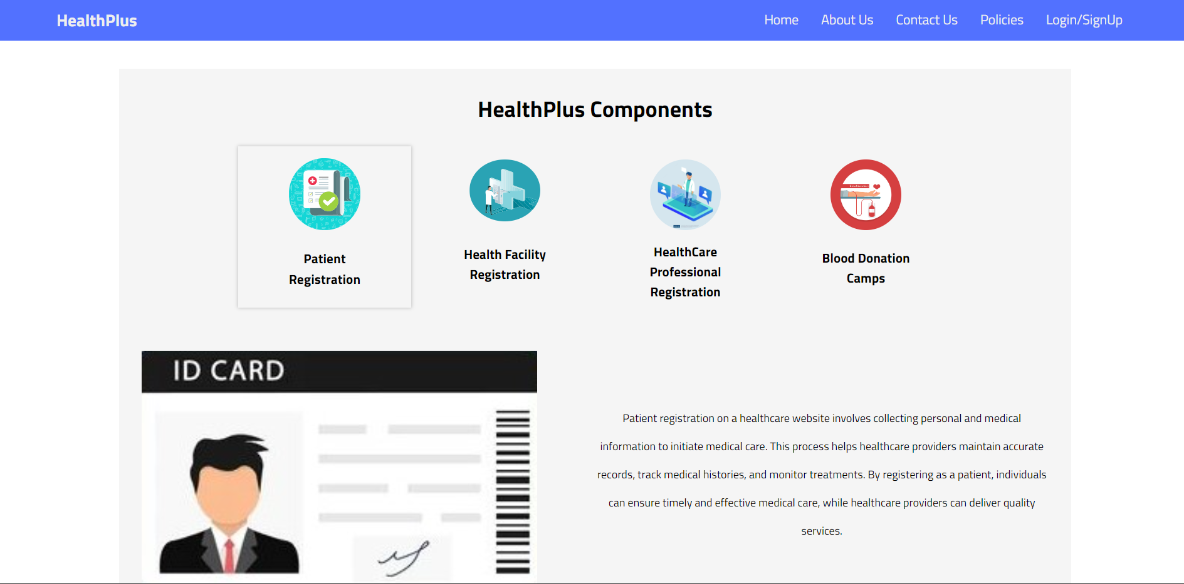
Sample Images

Slide 10
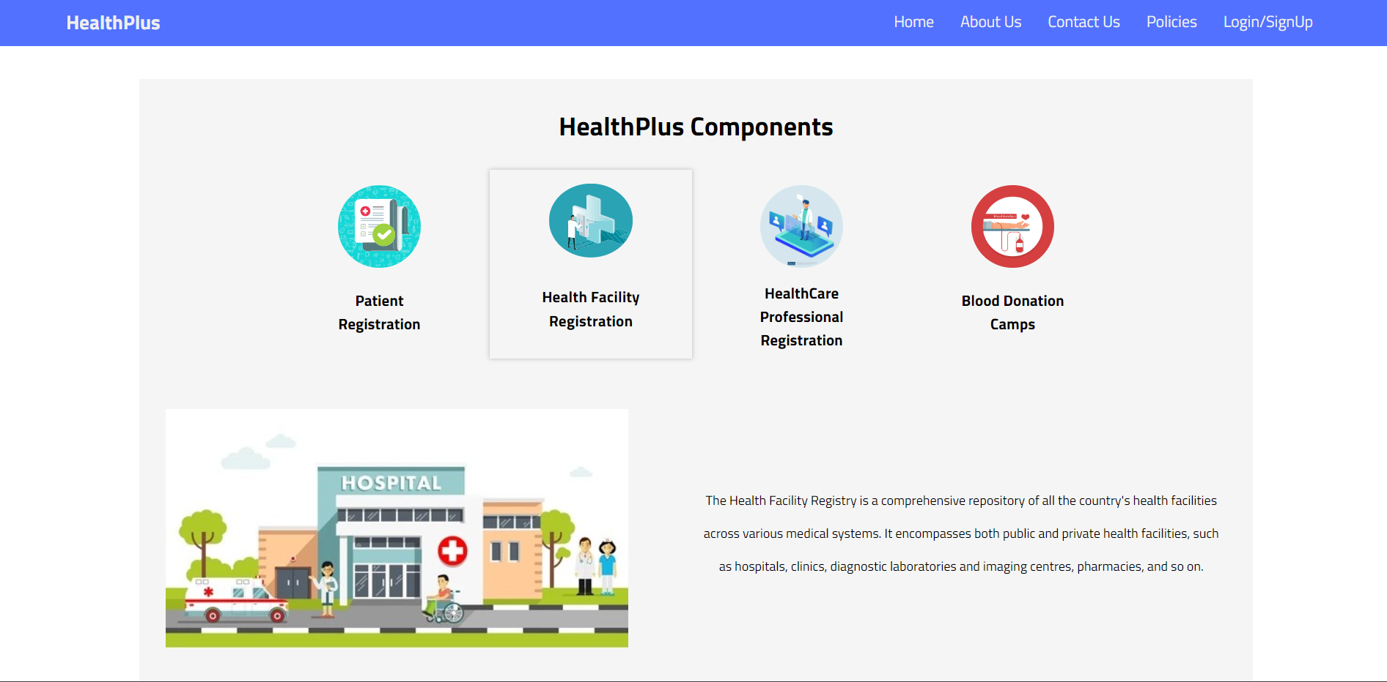
Sample Images

Slide 11
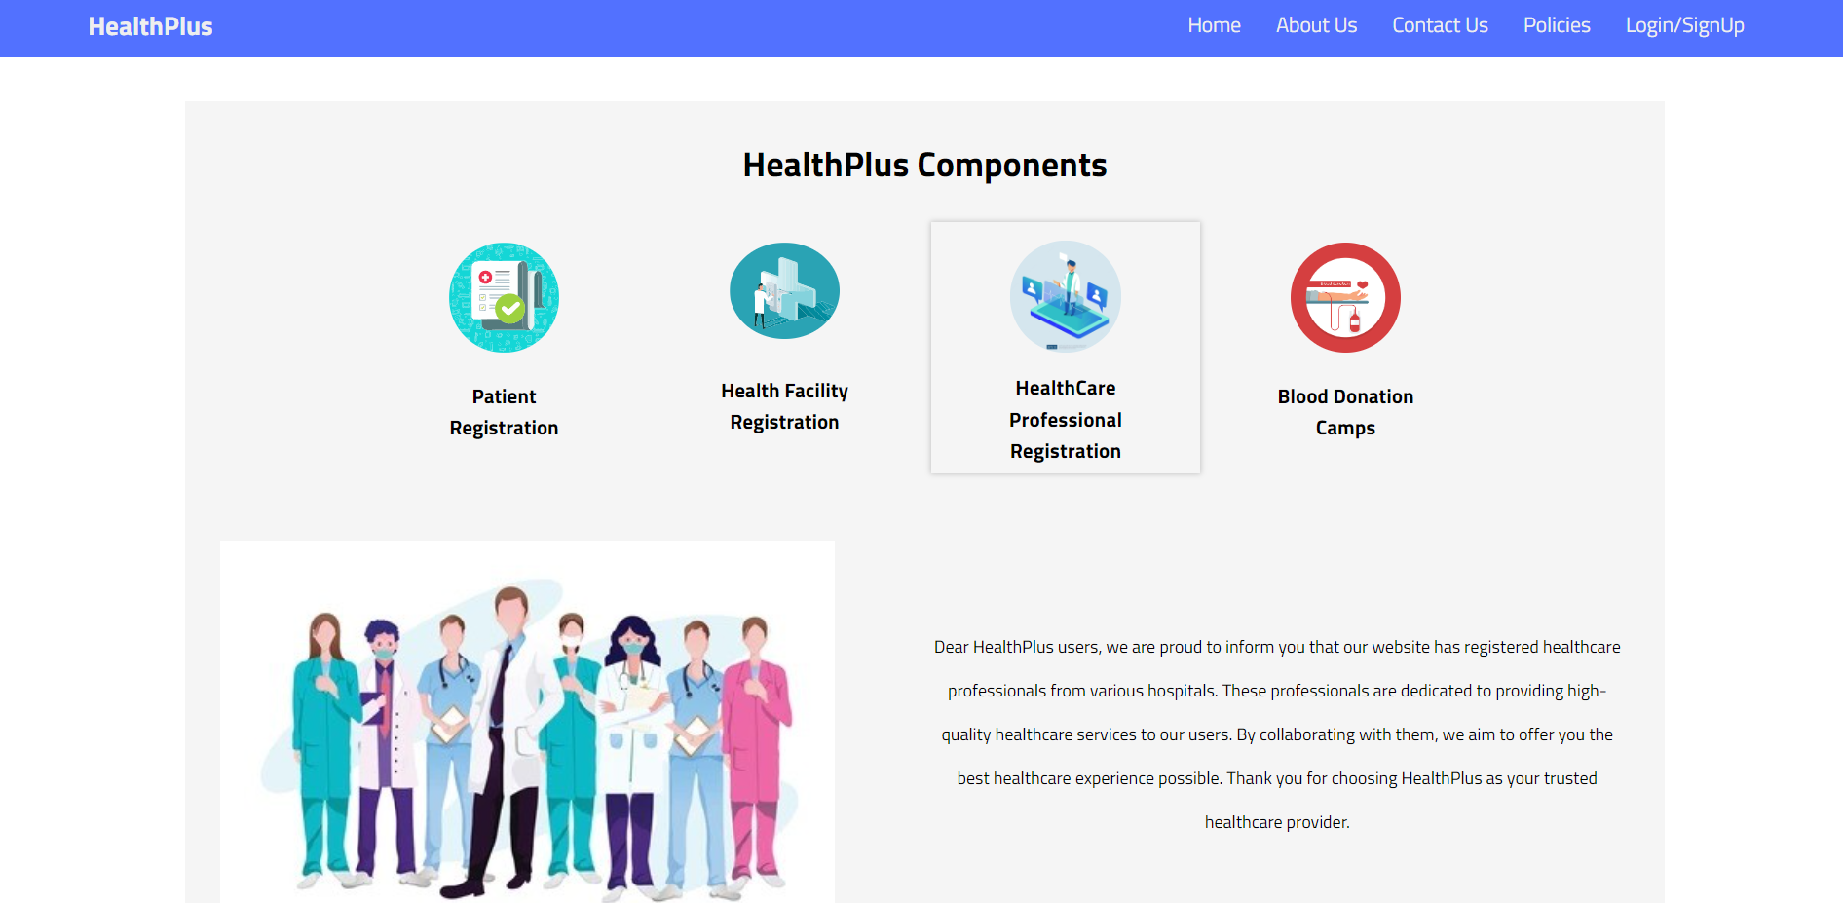
Sample Images

Slide 12
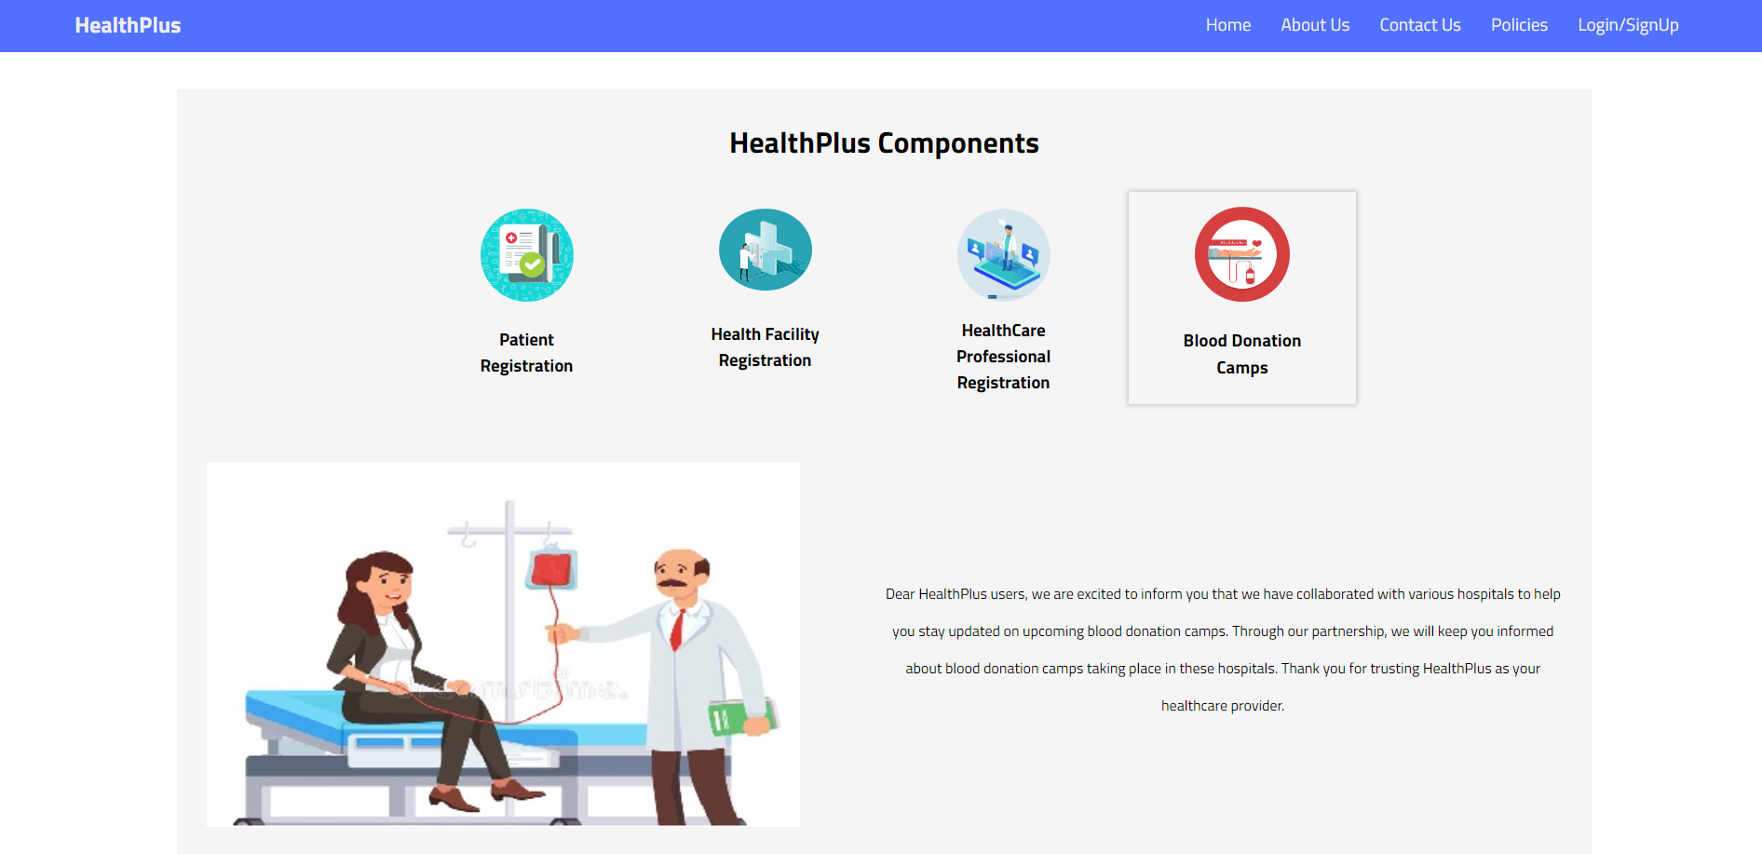
Sample Images

Slide 13
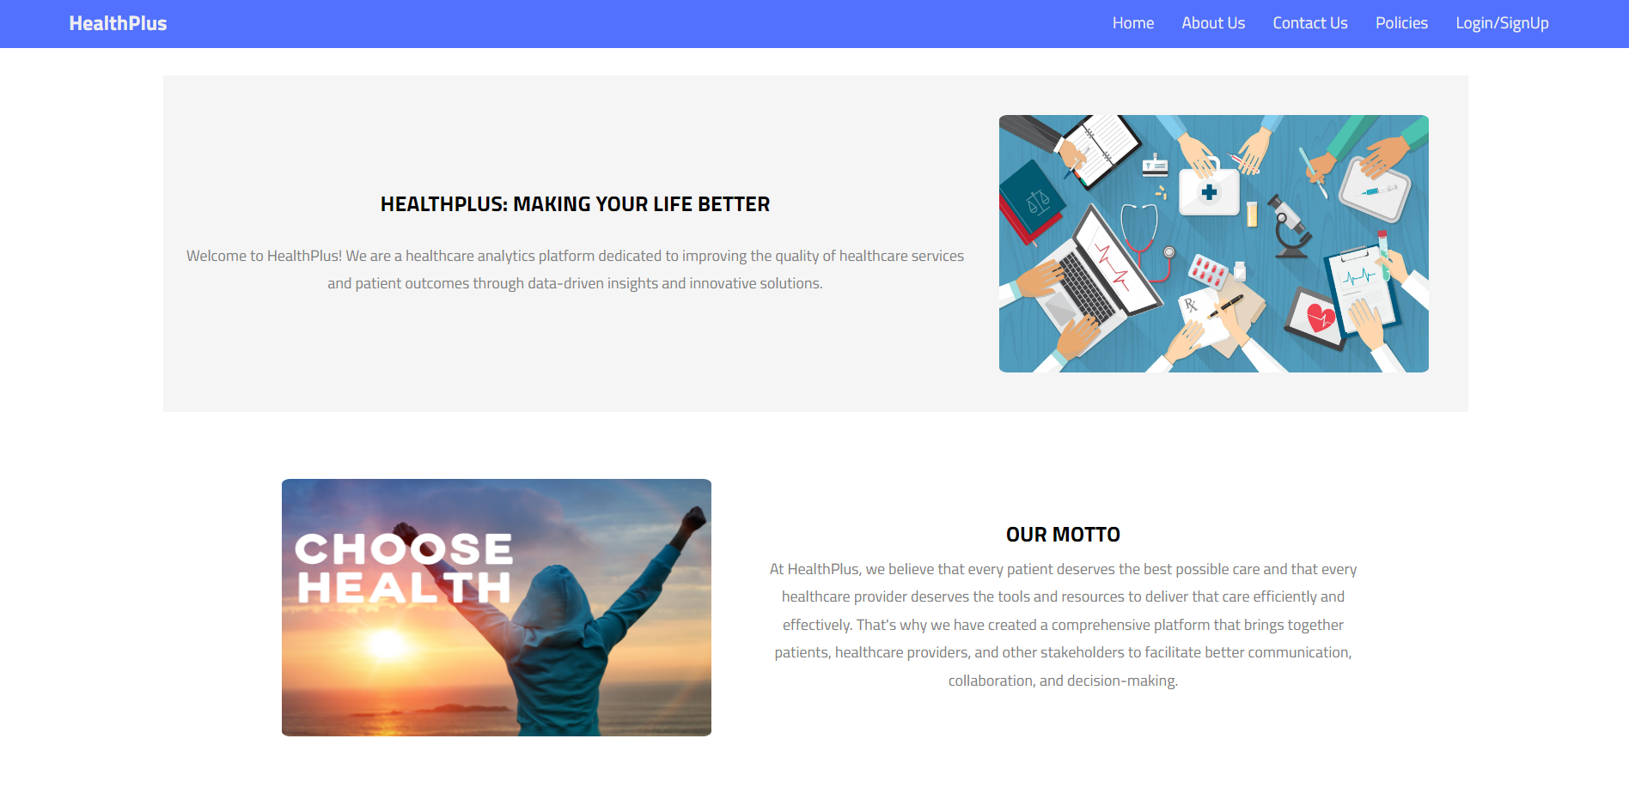
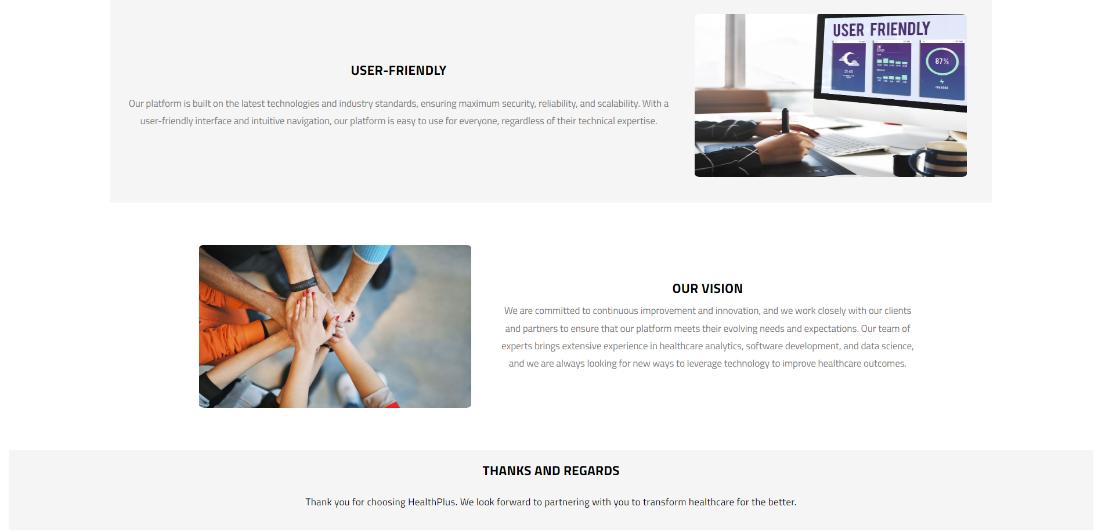
Sample Images

Slide 14
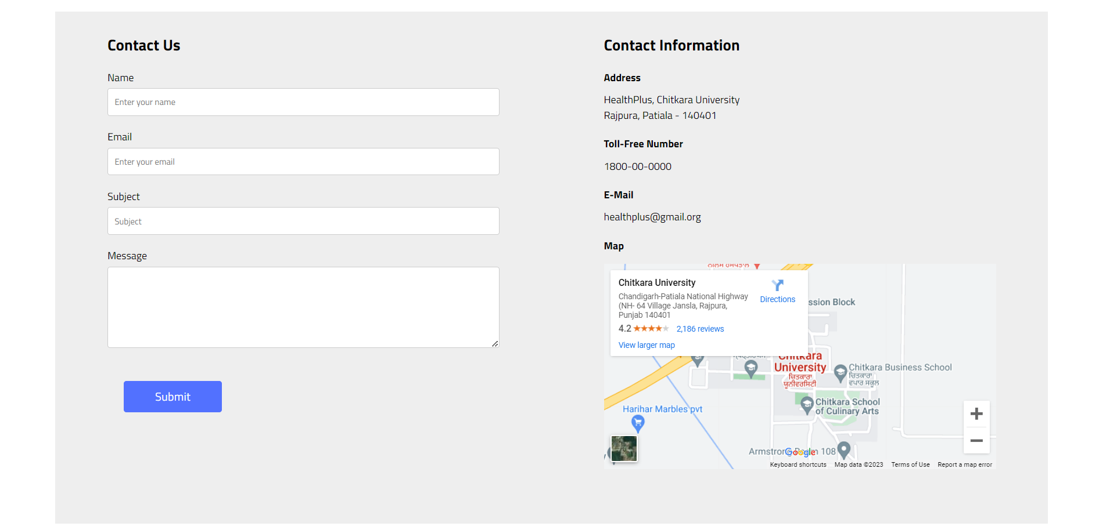
Sample Images

Slide 15
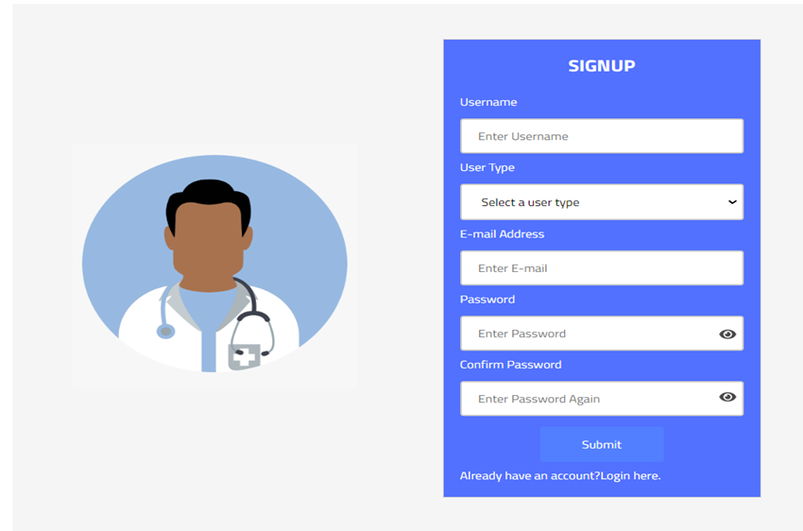
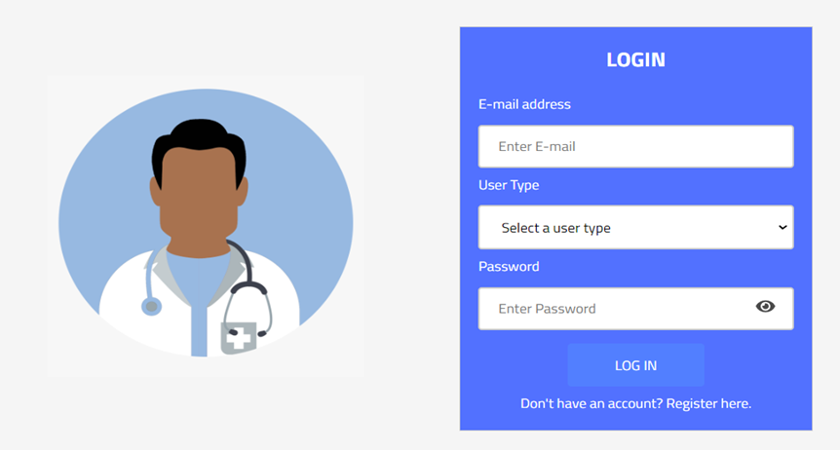
Sample Images

Slide 16
Limitations
While the HealthPlus project offers numerous advantages, it has certain limitations to consider:
Limited scalability for handling a large volume of users and data.
Integration challenges with third-party APIs for advanced features.

Slide 17
Challenges
Developing robust data privacy and security measures to ensure the protection of sensitive healthcare information.
Addressing regulatory and compliance requirements specific to the healthcare industry.
Ensuring seamless integration with existing healthcare systems and infrastructure.

Slide 18
Future Scope
The future of the HealthPlus project holds exciting possibilities:
Enhancements to the blood donation camp feature with advanced analytics and integration with blood banks and hospitals.
Implementing donor recognition programs to encourage more participation.
Expanding the platform to cover additional healthcare services and cater to a wider range of patient needs.
Implementing telemedicine features for virtual consultations and remote healthcare services, expanding access to healthcare for patients in remote areas.

Slide 19
Bibliography/References
MERN Documentation:
MongoDB. (n.d.). Retrieved from https://www.mongodb.com/
Express.js. (n.d.). Retrieved from https://expressjs.com/
React. (n.d.). Retrieved from https://reactjs.org/
Node.js. (n.d.). Retrieved from https://nodejs.org/
ChatGPT:
OpenAI. (n.d.). ChatGPT. Retrieved from https://chat.openai.com/
NDHM App:
National Digital Health Mission. (n.d.). Retrieved from https://ndhm.gov.in/

Slide 20
Conclusion
In conclusion, the HealthPlus project is poised to revolutionize the healthcare industry. With its advanced features, seamless user experience, and focus on improving access to quality healthcare services, HealthPlus has the potential to make a significant impact.
Link to website

