Slide 1
Battle of Neighbourhood
Toronto

Slide 2
Problem Description
The project tries to suggest people with good spots in Torronto to move into. The spots suggested have various spots, like hotels, parks, shopping complexes etc nearby. People moving into Torronto will be interested in such project, as it will provide them with suggestions of where to move into.

Slide 3
Data Description
The data used in this project is provided by Foursquare location data. The data are grouped by landscape area, and each area included the information about this area and all information about restaurants, cafes, and stores which in this area.

Slide 4
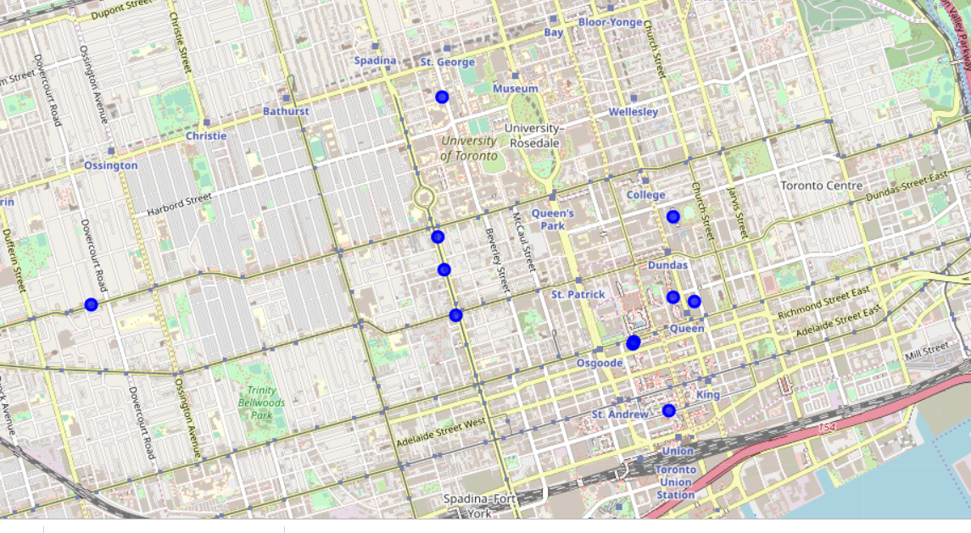
Finding-1: Hotel, Café Cluster

Slide 5
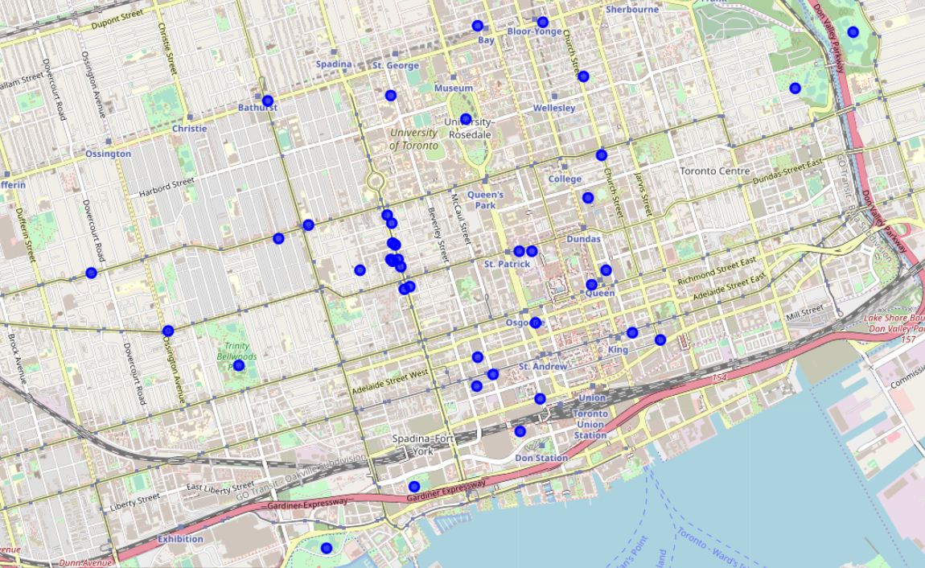
Finding-2: Park, Restaurant Cluster

Slide 6
Result
From the maps, we can see that locations near Queen and Sapdina avenue forms the biggest clusters. Thus, these places will be the best for a new comer to Toronto to move into. These locations are quite near to cafes, shopping complexes, parks and hotels.

