Slide 1
Amazon Sales Analysis
Amazon, a global e-commerce and technology giant, pioneers convenience and innovation. From retail to cloud computing, it transforms industries, prioritizing customer-centric solutions, and shaping the future of online commerce.
Sales management has gained importance to meet increasing competition and the need for improved methods of distribution to reduce cost and to increase profits. Sales management today is the most important function in a commercial and business enterprise

Slide 2
Objectives
To calculate total sales, total profit, net profit margin
To find which order priority gave highest sales
To find which is the bestseller Item type
To find which mode of channel generated maximum sales
To find yearly total sales
To find total sales and total profit by region
To find the number of units sold of a particular item type

Slide 3
The Process
Data Collection
Data Cleaning
Data Analysis
Insights
Summary

Slide 4
Data Collection
The Data has been collected in the form of a CSV file named “Amazon Sales Data.csv”.
The CSV file has the data of sales of products during the timespan of 2010 and 2017.

Slide 5
Data Cleaning
There were no Null values or blank fields
Some values in ‘Order Date’ and ‘Ship Date’ columns are in String datatype. So we converted them to datetime datatype using Python

Slide 6
Data Analysis
Data Visuals
(Dashboards)

Slide 7
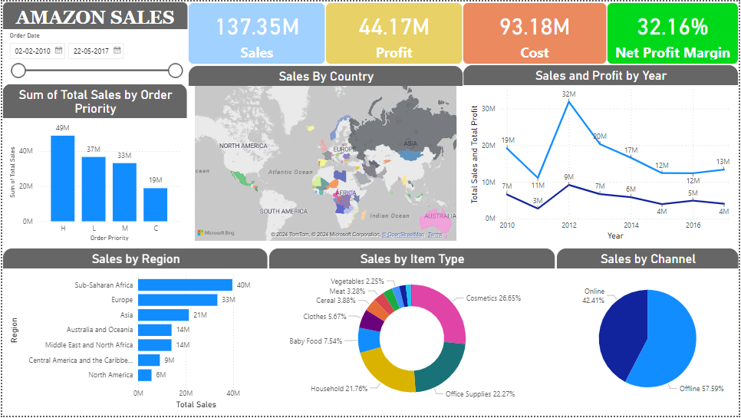

Slide 8
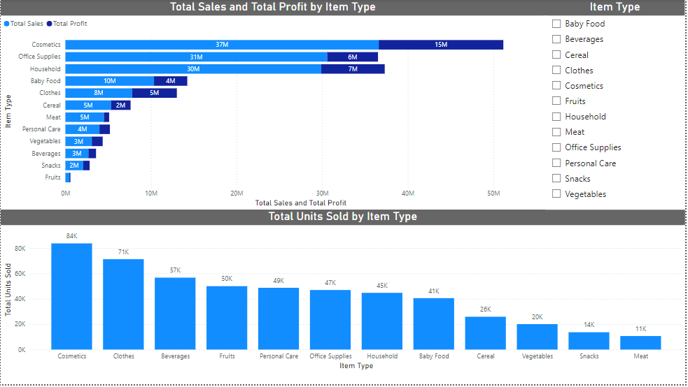






Slide 9
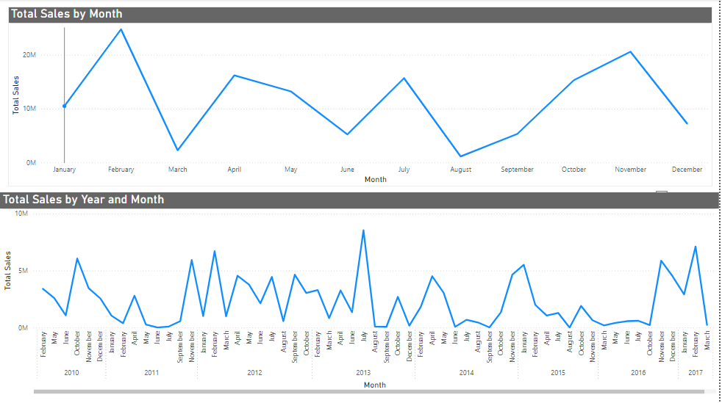

Slide 10
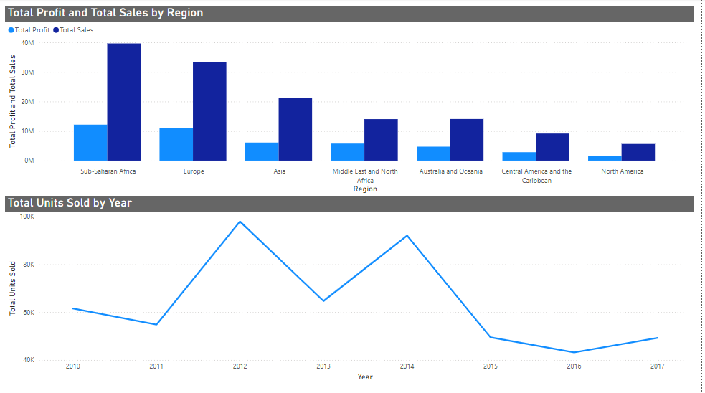

Slide 11
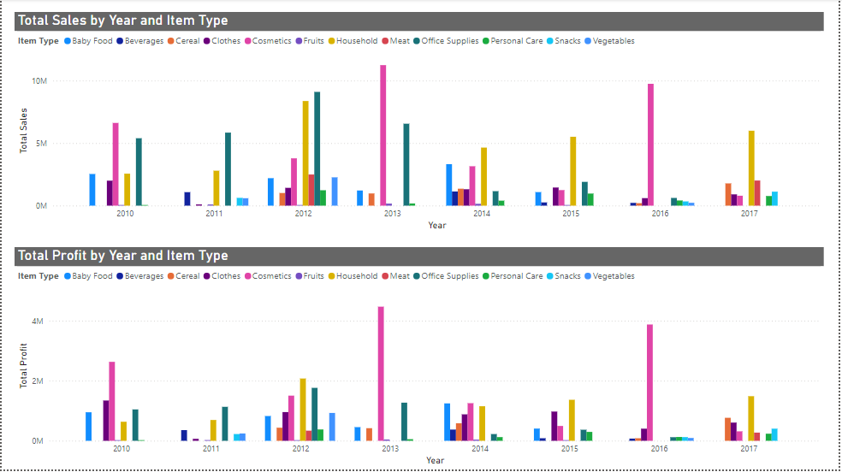

Slide 12
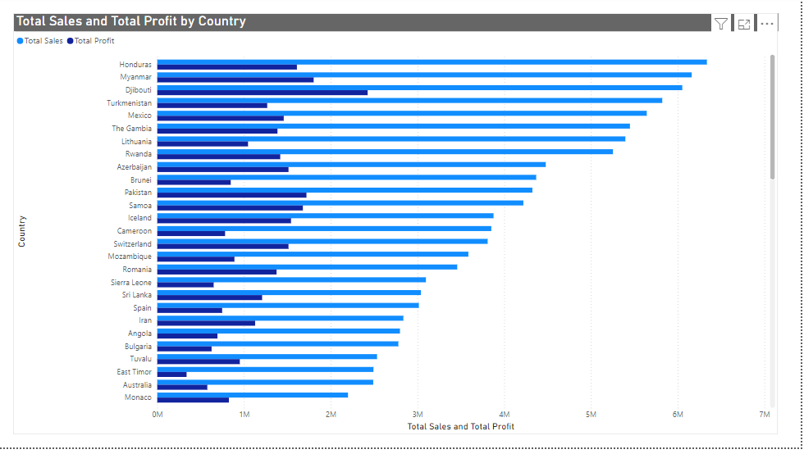

Slide 13
Insights
The total sales is $137.35 million out of which total profit is $44.17 million.
The Net Profit Margin is 32.16%.
The “H” order priority gave the highest sales, which means people need their products fast.
“Cosmetics” products gave the highest sales.
Majority of people still prefer “Offline Channel” for buying products.
The year 2012 has seen the highest sales and highest profit.
The Sub-Saharan Africa region has seen the highest sales.
The Honduras country has seen the highest sale.
The Djibouti country has seen the profit.

Slide 14
Summary
Cosmetic products are very popular among people of Europe and these products generated the highest profit ($14.56 million) of all items. So, it is advisable to create some marketing campaigns promoting Cosmetic products.
Total Population of North America prefer to shop offline as compared to people of Europe, who mostly prefer Online channel for shopping. But because high profits are coming from Online channel, it advisable to promote products online.
The Region Sub-Saharan Africa has generated the highest profit where people bought Fruits the most, with approx. 31 thousands unit sold. Highlight the health benefits of fruits during campaigns and align marketing with local preferences.
The second most purchased item, after Cosmetics in Europe is Baby Food. This insight tells us that majority of people of Europe are newlywed couples. Thus you can promote products related to new born babies to these people.

Slide 15
Summary
Fruits has generated the least profit of all item types which is only $120.50 thousands. It is advisable to understand the customer needs, adjust the price and analyse the local preference.
North America Region has generated the least profit by selling only Personal Care and Household Items through Offline Channel. Try to promote products other than both these item types through Online Channel by giving some discounts. Do some survey to find local people’s preferences.
Meat is the least sold item type with 11 thousands units sold in Australia and Oceania and Sub-Saharan Africa Region using only Online Channel. Consider selling different kinds of meat products and adjust the prices.
Household Items and Cosmetic Products are sold the most through Offline and Online Channels respectively. Enhance physical stores with attractive displays and promotions for Household Items. Run targeted ads and make the website more user friendly for Cosmetic products.

Slide 16
Thank you

