Slide 1
Minimum-Cost Bounded-Degree Spanning Tree
Girvar Patidar
Somya Bansal

Slide 2
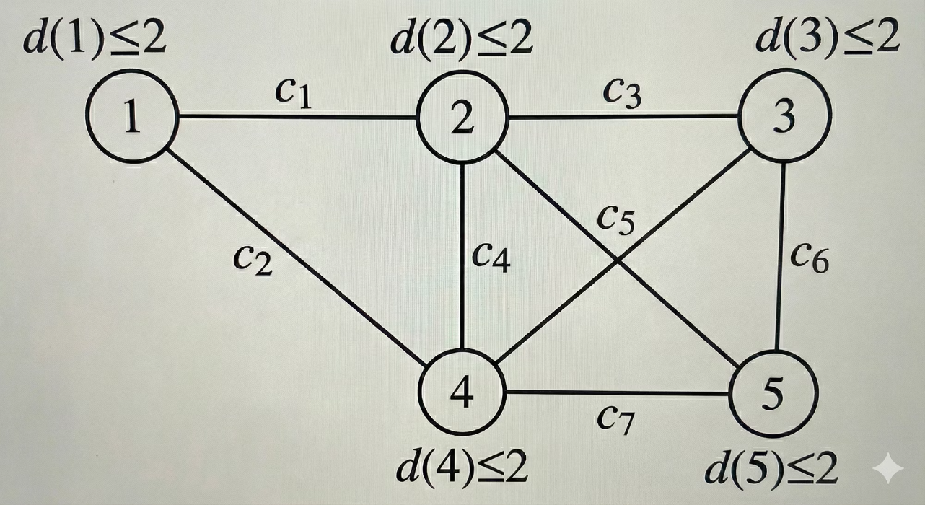
The Problem: Finding Optimal Spanning Trees
Objective
Research Goals
Given a weighted undirected connected graph, find a minimum-cost spanning tree where each node's degree is within a specified bound.
Remove reliance on time-consuming Linear Programming and adapt combinatorial local search techniques.

Slide 3
The Problem: Finding Optimal Spanning Trees
Objective
Research Goals
Given a weighted undirected connected graph, find a minimum-cost spanning tree where each node's degree is within a specified bound.
Remove reliance on time-consuming Linear Programming and adapt combinatorial local search techniques.

Slide 4
Local Search for Unweighted Graphs
Minimum-Degree Spanning Tree Problem
Find a spanning tree T that minimizes the maximum degree of any vertex v in T.
Computational Complexity
NP-hard: The problem is computationally intensive.
Hamiltonian Path: A spanning tree with max degree 2 is a Hamiltonian path, which is NP-complete to decide.
Exact solutions are infeasible, driving the need for approximation algorithms and heuristics.

Slide 5
Designing the Local Search Algorithm
A polynomial-time local search algorithm finds a tree T with a maximum degree at most 2 \cdot \text{OPT} + \lceil \log_2 n \rceil.
Local Move Definition
Identify edges not in T that create a cycle. Select an edge (v, w) where \max(d_T(v), d_T(w)) \le d_T(u) - 2.
Move Properties
After a move, d_{T'}(u) = d_T(u) - 1. The algorithm targets high-degree nodes and terminates when no further moves are possible.

Slide 6
OPT + 1 Local Search Framework
This framework operates in phases and subphases to reduce node degrees.
Phase-Based Execution
Algorithm runs in phases, each removing all degree-k nodes. Each phase has subphases targeting single degree-k nodes.
Subphase Actions
Identify reducible degree-(k-1) nodes, mark them, and update graph components. This enables local moves to reduce node degrees.

Slide 7
OPT + 1 Local Search Framework
This framework operates in phases and subphases to reduce node degrees.
Phase-Based Execution
Algorithm runs in phases, each removing all degree-k nodes. Each phase has subphases targeting single degree-k nodes.
Subphase Actions
Identify reducible degree-(k-1) nodes, mark them, and update graph components. This enables local moves to reduce node degrees.

Slide 8
Linear Programming Formulation
We use an LP formulation for a graph G = (V, E) with edge costs c_e \ge 0 and degree bounds b_v \ge 1 for constrained vertices W \subseteq V.
Subject to:
\sum_{e \in E} x_e = |V| - 1 (spanning tree)
\sum_{e \in E(S)} x_e \le |S| - 1, \forall S \subseteq V, |S| \ge 2 (acyclicity)
\sum_{e \in \delta(v)} x_e \le b_v, \forall v \in W (degree bounds)
x_e \ge 0, \forall e \in E (non-negativity)

Slide 9
LP-Based Deterministic Rounding
An iterative process to derive a spanning tree from the LP relaxation.
Solve LP Relaxation
Obtain a basic optimal solution x and identify its support E(x) = \{e : x_e > 0\}.
Iterative Reduction
Repeatedly remove zero-edges, add single incident edges to solution, and remove vertices from W under specific conditions.
This returns a spanning tree F with cost \le LP optimal value, and \deg_F(v) \le b_v + 2 for each v \in W.

Slide 10
Refinement to +1 Violation Bound
An improved algorithm guarantees a tighter bound on degree violations.
1
2
Improved Algorithm
Resulting Tree
Repeatedly solve LP relaxation and remove vertices v from W that are guaranteed to have \le b_v + 1 support edges.
When W is empty, compute an ordinary minimum-cost spanning tree. This yields \deg_F(v) \le b_v + 1.

Slide 11
Flow-Based Constraint Reduction
Motivation
Replace the exponential number of cycle constraints with a polynomial-sized flow formulation.
Extended Variable Set
Flow Constraints
Original edge variables: x_e
Capacity constraints: \forall \{u, v\} \in E, \forall a \in V \setminus \{r\}: f_{uv}^a \le x_{uv}, f_{vu}^a \le x_{uv}.
Flow variables: f_{uv}^a \ge 0 for each arc (u, v) and commodity a \in V \setminus \{r\}.
Per-commodity supply/demand ensures flow from source a to sink r.

Slide 12
Feedback Vertex Set (FVS)
A set F \subseteq V is an FVS if removing F makes the graph acyclic (every cycle intersects F).
Goal: find F of minimum total cost c(F) = \sum_{v \in F} c(v).
Problem is NP-hard, so we use approximation algorithms.

Slide 13
Local Ratio for FVS: How It Works
Compute \alpha: \alpha = \min_{v \in V} c(v)/(d(v)−1), where d(v) is the degree of v (assume d(v) \geq 2).
Reduce costs: For every vertex set: c'(v) = c(v) − \alpha(d(v)−1). (By choice of \alpha, at least one v has c'(v) = 0.)
Select & remove: Let F_0 = \{v \in V : c'(v) = 0\}. Add F_0 to the solution and remove them from the graph: G' \leftarrow G \setminus F_0.
Recurse: Run the same procedure on (G', c'|_{V(G')}) to get F'.
Combine: The final FVS is F = F_0 \cup F'.

Slide 14
Bounded-Degree Spanning Tree
Each vertex v has a degree bound b_v.
In any spanning tree T, define the exceedance: e_T(v) = d_T(v) − b_v. (How much the degree of v exceeds its allowed limit.)
The quality of a tree is measured by its maximum exceedance: \max_{v \in V} e_T(v).
Goal: Find a spanning tree T that minimizes this maximum exceedance: \min_T \max_v e_T(v).

Slide 15
Local Search Framework
For the current tree T, compute the current worst exceedance: k = \max_v e_T(v).
Define the critical vertex sets: D_k = \{v : e_T(v) = k\}, D_{k-1} = \{v : e_T(v) = k−1\}. These are the vertices closest to violating the bounds the most.
The algorithm searches for a local move (edge swap) that:
  reduces the degree of at least one vertex in D_k,
  while maintaining a valid spanning tree.

Slide 16
Lower Bound on the Optimal Exceedance
Suppose at level k no local improving move exists.
Then every spanning tree T' must have: \max_v e_{T'}(v) \ge k−1.
Meaning: Even the optimal spanning tree cannot reduce the worst exceedance below k−1.
Therefore: k \le \text{OPT}_{\text{exc}} + 1.
This gives the algorithm a +1 approximation guarantee.

