Slide 1
Embedded Software Course
Introduction
Renesas Technical Training – 25G SW Engineer
Software Department
Mar 15, 2017
Renesas Design Vietnam Co., Ltd.

Slide 2
Agenda
Training Plan
Knowledge of this course
Daily Practice/Daily Question
Final exercise
Instructors/Supporters
Requirements
Daily report
Weekly report
Final test
Pass/Fail Judgment

Slide 3
Agenda
Training Plan
Knowledge of this course
Daily Practice/Daily Question
Final exercise
Instructors/Supporters
Requirements
Daily report
Weekly report
Final test
Pass/Fail Judgment

Slide 4
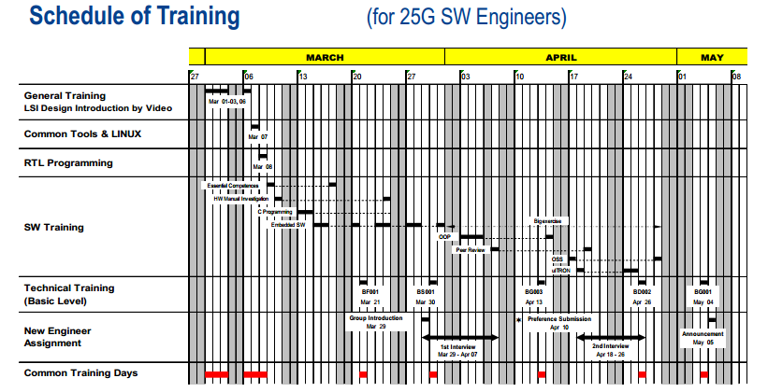
Training Plan
Final Practice & Weekly report
Daily report

Slide 5
Agenda
Training Plan
Knowledge of this course
Daily Practice/Daily Question
Final exercise
Instructors/Supporters
Requirements
Daily report
Weekly report
Final Test
Pass/Fail Judgment

Slide 6
Knowledge of this course
Theory
  Chapter 1: Introduction to Embedded C
  Chapter 2: Introduction to Microcomputer
  Chapter 3: Assembly Language
  Chapter 4: Embedded C Language
  Chapter 5: Linking C and Assembly Language
  Chapter 6: Time management
  Chapter 7: I/O control
  Chapter 8: Interrupt
  Chapter 9: MCU peripheral

Slide 7
Agenda
Training Plan
Knowledge of this course
Daily Practice/Daily Question
Final exercise
Instructors / Supporters
Requirements
Daily report
Weekly report
Final Test
Pass/Fail Judgment

Slide 8
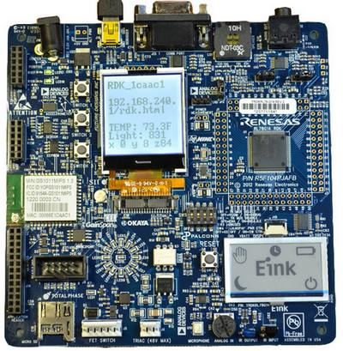
Daily Practice/Daily Question (1/2)
Max score: 100
YRDKRL78-G14 REV 2.1 board
Refer Embedded SW Exercise document for detail description
Daily practice must be submitted within training day.
Individual task

Slide 9
Daily Practice/Daily Question (2/2)
Max score: 100
Daily Question:
  Use electronic form
  Delivered Questions by Instructor of training day via email.
  Submit daily question and answer within training day to get 100% of your achievement.
  Attach your answer in daily report.
  Can Submit daily question and answer on next day BUT just get 50% of your achievement.
  Individual task

Slide 10
Agenda
Training Plan
Knowledge of this course
Daily Practice/Daily Question
Final exercise
Instructors / Supporters
Requirements
Daily report
Weekly report
Final Test
Pass/Fail Judgment

Slide 11
Final exercise
Max score: 100
4 Levels to achieve
25 scores for each level
Individual task
.
T.B.D

Slide 12
Agenda
Training Plan
Knowledge of this course
Daily Practice/Daily Question
Final big exercise
Instructors / Supporters
Requirements
Daily report
Weekly report
Final Test
Pass/Fail Judgment

Slide 13
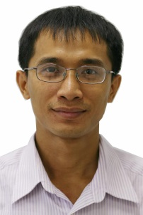

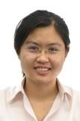


Instructors (1/2)
Quynh Tran
quynh.tran.jy@rvc.renesas.com
Chapter 1 & Chapter 2
Nguyen Nguyen
nguyen.nguyen.ym@rvc.renesas.com
Chapter 3
Thao Nguyen
thao.nguyen.yb@rvc.renesas.com
Chapter 4
Nguyen B.Nguyen
nguyen.nguyen.yj@renesas.com
Chapter 5
Quynh Tran
quynh.tran.jy@rvc.renesas.com
Chapter 6
Hung Tran
hung.tran.jy@renesas.com
Chapter 7

Slide 14

Instructors (2/2)
Khanh Do
khanh.do.te@renesas.com
Chapter 8,9

Slide 15
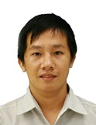
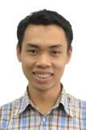
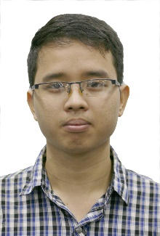
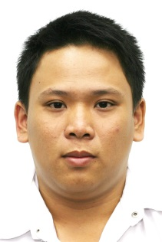
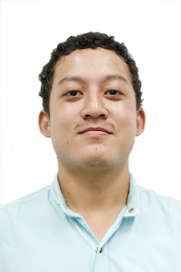
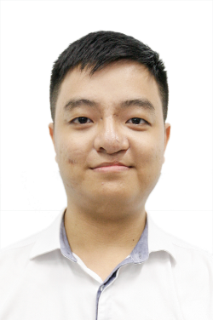
Supporters(1/2)
Tien Le
tien.le.px@renesas.com
Huan Thai
huan.thai.xw@rvc.renesas.com
Quan Le
quan.le.yb@rvc.renesas.com
Thanh Nguyen
thanh.nguyen.xh@rvc.renesas.com
Khoa Pham
khoa.pham.uj@rvc.renesas.com
Khoa Vo
khoa.vo.ry@rvc.renesas.com

Slide 16
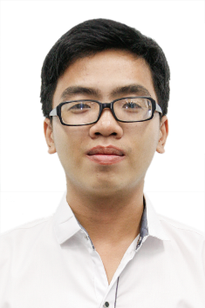
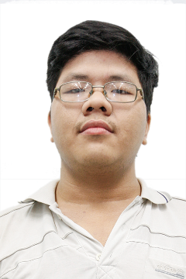
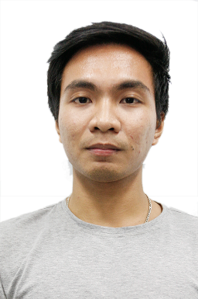
Supporters(12/2)
Loc Pham
loc.pham.xh@rvc.renesas.com
Dung Ly
dung.ly.zn@rvc.renesas.com
Dat Phan
dat.phan.yj@rvc.renesas.com
T.B.D

Slide 17
Agenda
Training Plan
Knowledge of this course
Daily Practice/Daily Question
Final big exercise
Instructors / Supporters
Requirements
Daily report
Weekly report
Final Test
Pass/Fail Judgment

Slide 18
Requirements
Keep the board safely during working
Rule of attending/taking break during lecture time
When send daily report, CC to tutors during time of this course for our follow-up purpose
Try to speak English during lecture time
Teamwork: ask others if you have any problem, try to share all knowledge with others.
-> Share a bit but gain a lot
Others:
  Be punctual
  Be honest
  Be positive
  Be systematic
  Be responsible
  Respect each other
PLEASE TRY YOURSELF 1st, your supporter also has his/her tasks.

Slide 19
Agenda
Training Plan
Knowledge of this course
Daily Practice/Daily Question
Final big exercise
Instructors / Supporters
Requirements
Daily report
Weekly report
Final Test
Pass/Fail Judgment

Slide 20
Daily Report(1/2)
Add more email address of all instructors on the days you have embedded lectures only
Answer additional question during the lecture
Follow additional request of instructor
Attach the source code of your daily practice
Some advices for making daily report:
1. What you have learned during a training day ?
=> It's common among all engineers.
So the information may not so useful.
Please focus on your actual feeling,
your personal recognition.
=> Refer to 2.

Slide 21
Daily Report(2/2)
2. Any questions about the content of training day ?
(Improvement ideas / Concerns / Difficulties / Etc)
=> Your thinking about the content of the lecture
e.g is it boring, un-useful ?
Your opinion how to improve it ?
Your difficulty during learning the course ?
Opinion about the lecturer, how they teach, how they transfer the knowledge, etc
What is your action items in order to test/experiment your knowledge ?

Slide 22
Agenda
Training Plan
Knowledge of this course
Daily Practice/Daily Question
Final exercise
Instructors / Supporters
Requirements
Daily report
Weekly report
Final Test
Pass/Fail Judgment

Slide 23
Weekly Report
Add more email address of all instructors and your supporter only
Some advices for making weekly report:
What you have done? Is there any comment from your supporter?
What shall be done in next week (action items)?
Attach your output : Sequence Diagram + Project are contained in [YourCode][YourName][LevelX].zip
Subject: [Embedded SW][25G][WeeklyReport][Week X][Your Code][Your Name]

Slide 24
Agenda
Training Plan
Knowledge of this course
Daily Practice/Daily Question
Final big exercise
Instructors / Supporters
Requirements
Daily report
Weekly report
Final Test
Pass/Fail Judgment

Slide 25
Final Test
Max score: 100
Date : T.B.D
Duration : 1 hour
Venue : T.B.D
Start Time : T.B.D
Individual task

Slide 26
Agenda
Training Plan
Knowledge of this course
Daily Practice/Daily Question
Final big exercise
Instructors / Supporters
Requirements
Daily report
Weekly report
Final Test
Pass/Fail Judgment

Slide 27
Pass/Fail Judgment
Lecture Score = Average (practice day1 + answer day 1 + …+ practice day7 + answer day 7+ …)
Final Practice Score = (LevelX x 25)
Final Score = Average(Lecture Score + Final Practice Score + Final Test)
PASS: Final Score >= 65

