Slide 1


Major Project
Autonomous AI Customer Support Agent Voice and Chat
Industry Mentor: Ms. Pooja Singh UPES Mentor:
Dr. Suresh Veesa
Presented by:
Suraj Kumar - 590016150
Lucky Patel - 590016745
Abhishek Kumar - 590018800

Slide 2
Content
Introduction
Problem Statement
Objective
Literature Review
Dataset Description
Methodology
Swot Analysis
Pert Chart
Conclusion
References
Introduction
Problem Statement & Objectives
Literature Review
Swot Analysis & Pert Chart
Conclusion & References
Dataset Description & Methodology

Slide 3
1. Introduction
In the digital era, e-commerce platforms require fast and efficient customer support. Traditional human-based support faces issues like high cost, slow response, and limited scalability. This project develops an Autonomous AI Customer Support Agent using NLP and speech recognition, enabling chat and voice interactions to provide real-time assistance and improve user experience on an online bookstore.
Background, Motivation & Problem Context
Traditional Support Issues:
Slow Response Time
Not Scalable During Peak Traffic
Growing Demand for Conversational Interfaces
Popularity of Voice-Based Interaction
Project Motivation:
Use NLP & Speech Recognition
Provide Real-Time Assistance
Improve User Experience

Slide 4
2. Problem Statement
Autonomous Ai customer support agent voice and chat.
This Project Builds an Ai powered virtual assistant capable of handling customer queries through both voice and chat. It uses natural language processing, speech recognition, and intent classification to understand customer request and generate customer requests and generate appropriate responses .
The model enable real time human responses, reducing dependence on human agents and improving overall customer support efficiency

Slide 5
3. Objective
The primary objective of this project is that supports both text and voice communication within an online bookstore platform.
It includes an NLP-based chatbot capable of understanding and responding to user queries. Voice interaction is enabled using speech recognition technology.
The project also focuses on integrating AI assistance with book browsing and purchasing functionalities.
By automating common queries, the system reduces dependency on human agents and improves efficiency.
Overall, the goal is to enhance user experience and demonstrate the integration of AI technologies in a practical and scalable application.

Slide 6
4. Dataset Description
Book Dataset Overview
Contains approximately 28,000 book records
Stored in MongoDB (NoSQL Database)
Supports book display and search functionality
Key Attributes in Dataset:
ISBN – Unique book identifier
Book Title
Author Name
Year of Publication
Publisher
Book Cover Image URLs (Small, Medium, Large)
Purpose of Dataset:
Enables book browsing & search (Title/Author)
Provides data to AI chatbot for answering queries
Supports cart and purchasing functionality

Slide 7
5.Methodology
The proposed AI-powered online bookstore system is divided into multiple functional modules, each responsible for handling specific tasks within the overall architecture. The implementation status of each module is described below:
1. User Interface Module The User Interface module is developed using HTML, CSS, and JavaScript. It provides an interactive web-based platform where users can browse books, search for titles or authors, manage their shopping cart, and interact with the AI chatbot through text or voice input. This module has been successfully completed.
2. Chatbot Interaction Module This module manages user queries submitted through text or voice. It integrates with AI APIs such as OpenAI/OpenRouter to generate intelligent and context-aware responses. The chatbot ensures real-time assistance to users. This module has been completed.
3. Speech Processing Module The Speech Processing module enables voice-based interaction. It uses a Speech Recognition API to convert spoken input into text and a Speech Synthesis API to convert chatbot responses into voice output. This module has been implemented successfully.
4. Backend Server Module The backend server is developed using the Flask framework in Python. It handles request routing, user authentication, database communication, AI API integration, and response management. This module has been completed.

Slide 8
5. Database Module The system uses MongoDB as the database management system. It stores over 28,000 book records, including ISBN, book title, author name, year of publication, publisher, and image URLs. The database module has been fully implemented.
6. AI Integration Module This module connects the backend server with AI services for natural language processing and response generation. It ensures intelligent interaction between the system and users. This module has been successfully integrated.
7. Search and Recommendation Module The search module enables users to search for books based on title or author and retrieves relevant results from the database efficiently. This module has been completed.
8. REST API Communication Module The REST API module ensures seamless communication between the frontend and backend components using RESTful architecture principles. This module has been completed.

Slide 9
6. Swot Analysis
Strengths
• Automated Customer Support: The system provides automated AI-based responses, reducing dependency on human support staff. • Voice and Chat Interaction: Supports both text and voice-based communication, improving accessibility and user experience. • Scalable Architecture: Built using a scalable client–server architecture capable of handling multiple concurrent users. • Large Book Dataset: Contains over 28,000 book records, enabling efficient search and information retrieval.
Weaknesses
• Dependence on External AI APIs: The chatbot relies on third-party AI services, creating external dependency. • Internet Dependency: Continuous internet connection is required for AI and database operations. • Limited Context Understanding: AI models may occasionally misinterpret complex or ambiguous queries.

Slide 10
Opportunities
• Personalized Recommendation System: Integration of machine learning algorithms for customized book suggestions. • Mobile Application Development: Expansion into Android/iOS platforms. • Multi-language Support: Future enhancement to support regional languages. • Expansion to Other E-commerce Domains: The system can be adapted for other industries such as electronics or retail platforms.
Threats
• Data Privacy and Security Risks: Handling user data requires strict security measures. • Third-party API Downtime: System performance may be affected if external AI services are unavailable. • Competition from Established Platforms: Competing with major e-commerce platforms may be challenging.

Slide 11
7. PERT Chart
Phase | Duration | Status
Problem Analysis | 1 Week | Completed
System Design | 1 Week | Completed
Dataset and Database Setup | 1 Week | Completed
Backend Development | 2 Weeks | Completed
Frontend Development | 2 Weeks | Completed
AI and Voice Integration | 1 Week | Active
Testing and Debugging | 1 Week | Pending
Documentation and Deployment | 1 Week | Pending

Slide 12
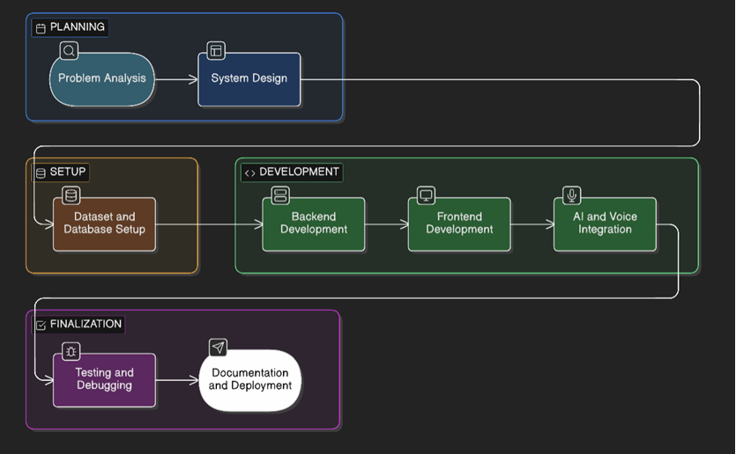

Slide 13
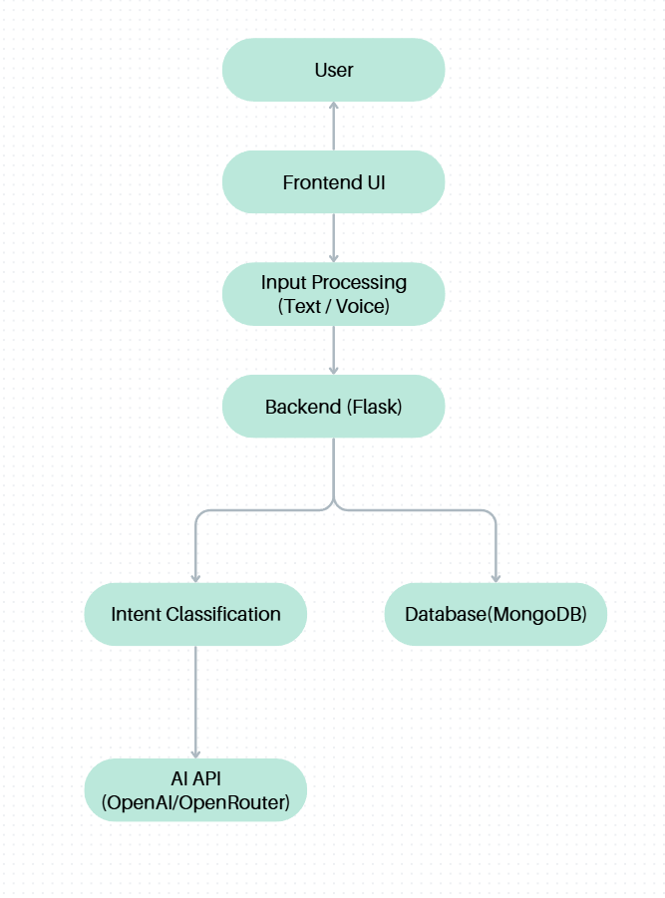
Block Diagram of Proposed System

Slide 14
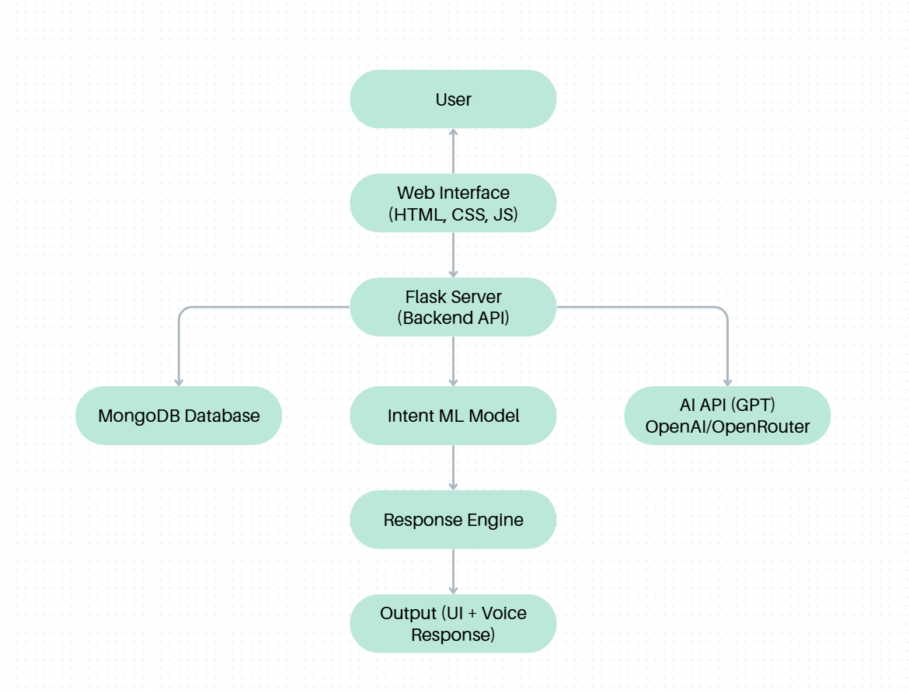
System Architecture of AI Chatbot

Slide 15
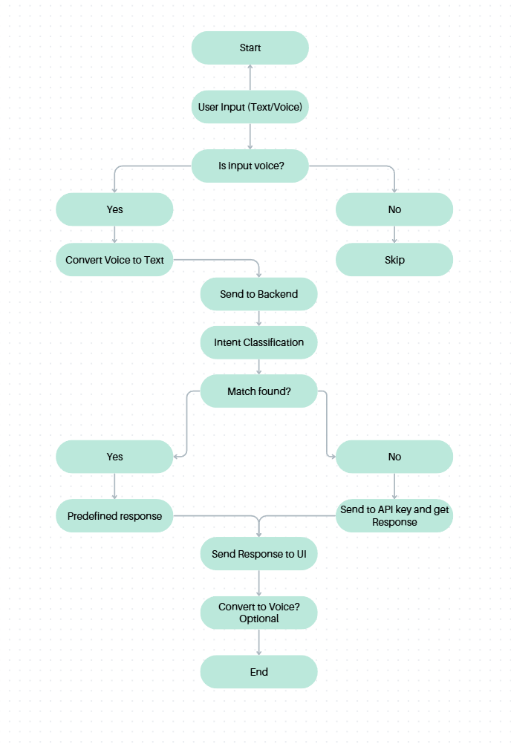
Diagram of System Working

Slide 16
8. Conclusion
In conclusion, the project demonstrates how AI, NLP, and voice technologies can be integrated into an online bookstore platform to automate customer support. The system provides real-time assistance through chat and voice, improves user experience, and reduces operational dependency on human agents. It highlights the practical implementation of intelligent digital support systems.

Slide 17
9. References
Bird, S., Klein, E., & Loper, E. (2009). Natural language processing with Python. O’Reilly Media.
2. Flask Documentation. (2024). Flask web framework documentation. Retrieved from https://flask.palletsprojects.com
3. Jurafsky, D., D., & Martin, J. H. (2021). Speech and language processing: An introduction to natural language processing, computational linguistics, and speech recognition (3rd ed.). Pearson.
4. MongoDB Inc. (2024). MongoDB documentation. Retrieved from https://www.mongodb.com
5. OpenAI. (2024). OpenAI API documentation. Retrieved from https://platform.openai.com
6. Russell, S., & Norvig, P. (2021). Artificial intelligence: A modern approach (4th ed.). Pearson.
7. Sutton, R. S., & Barto, A. G. (2018). Reinforcement learning: An introduction (2nd ed.). MIT Press.
8. Shawar, B. A., & Atwell, E. (2007). Chatbots: Are they really useful? Journal for Language Technology and Computational Linguistics, 22(1), 29–49.
9. Weizenbaum, J. (1966). ELIZA—A computer program for the study of natural language communication between man and machine. Communications of the ACM, 9(1), 36–45.
10. Devlin, J., Chang, M., Lee, K., & Toutanova, K. (2019). BERT: Pre-training of deep bidirectional transformers for language understanding. Proceedings of NAACL-HLT, 4171–4186.

Slide 18
Thank You

