Slide 1
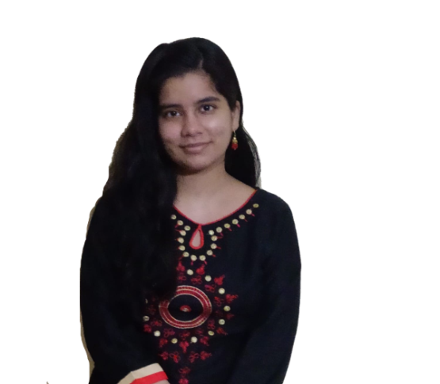

Scribbalm
Data Science
Competition 2021
A Guide for the
Professional Writers
Kanika Gupta
CSE Student - 2018 Batch
The Northcap University
Lakshay Goyal
CSE Student - 2018 Batch
The Northcap University

Slide 2
Introduction
We derived the name of project from 2 words – Scribbler + Balm. And this is our aim with this project, to provide a helping hand to the writers.
Writers often face a problem called “Writer’s Block”. Writer's block is a condition, primarily associated with writing, in which an author is unable to produce new work or experiences a creative slowdown.
We want to help or provide the insights to the writer as to how he can continue, not through words but music

Slide 3
What we want to achieve?
The project uses the emotion of the already written chapters of the book.
A model extracts the emotion from each paragraph and then convert them into a music.
Using these music sequences of different chapters, we predict what the music of next chapter might look like.

Slide 4
Stages of Project
Extract the emotion from the already written chapters of the book.
Generate a music sequence for each chapter using extracted emotion.
Train a model on these music sequences to predict what the next chapter might look like.

Slide 5
Step 1 – Extracting Emotion
Read Text File
Pre-processing
Data
Tokenization
Train NLP Bag-of-Words model
Convert tokens to vectors
Lemmatization
Convert chapters to emotions

Slide 6
Step 2 – Generate Music
Map Emotions to Piano keys
Combining keys of chapter to create music
Convert the file to MIDI format
Record the Music Generated

Slide 7
Step 3 – Predicting Next Sequence
Identify which is notes and which is chord
Midi files
Getting notes and pitch
Reshaping and passing through LSTM
Normalization through pitch
Mapping the notes to integer values
Saving weights and then predict
Convert back to notes and chords
Saving output in midi format

Slide 8
Thank You

