Slide 1
Autumn Data Analysis Hackathon
(2023)
TechJapan Inc.
-Lucky

Slide 2

Company “X”

Slide 3
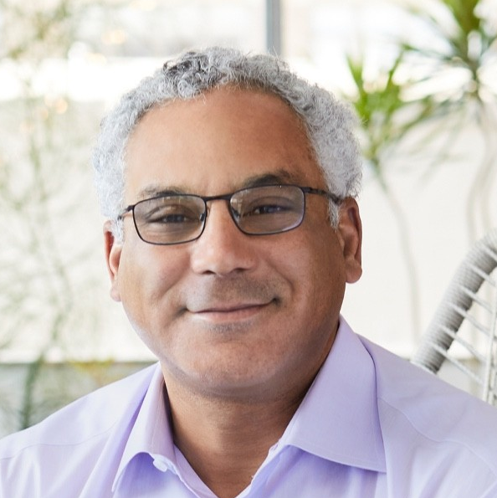
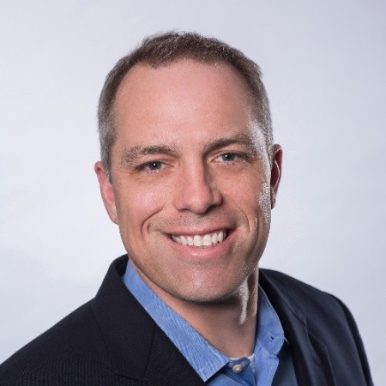
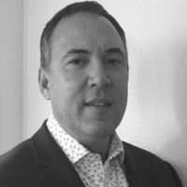
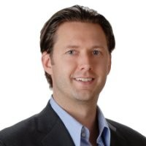
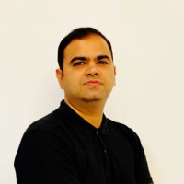
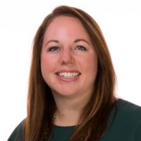
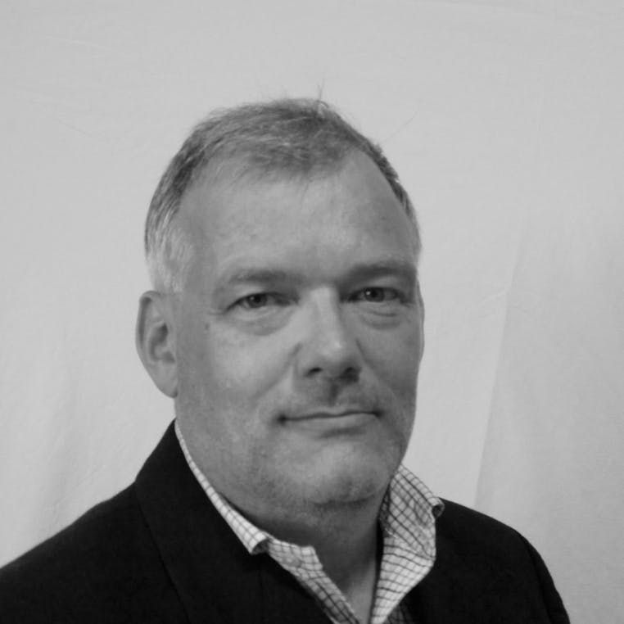
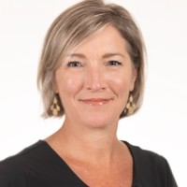
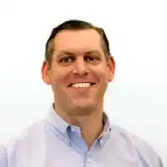
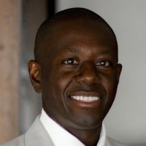
Team Leaders:
Yancey Spruill
Finance
CEO(2019-Present)
Strategy
Operations
HR
Revenue
Matt Steinfort
Jeffrey S. Guy
Matt Norman
Aaqib Gadit
Megan Wood
CFO(2023-Present)
C0O(2020-Present)
CPO(2020-Present)
CRO(2023-Present)
CSO(2022-Present)
Infrastructure
Communications
Legal
Architecture & Engineering
Nancy Coleman
Alan Shapiro
Chris Higgins
Senior VP Corporate Communications(2023-Present)
General Counsel(2017-Present)
Al Sene
VP, Infrastructure(2020-Present)
VP& GM of Architecture(2022-Present)

Slide 4
Recent Changes in company:
Jan 2023: Matt Steinfort appointed as the CFO of the company.
Jan 2023: Aaqib Gadit appointed as the CRO of the company.
April 2023: Nancy Coleman appointed as senior VP of the the corporate operations
your own text here
July 2023: DigitalOcean acquired Paperspace for $111 million.
Feb 2023: Premium Intel CPUs are now available for CPU-Optimized Droplets your own text here
May 2023: PostgreSQL is now available for database clusters

Slide 5




Evolution of DigitalOcean:
VPS Hosting (2012-2015)
Cloud InfraStructure(2015-2018)
Developer &
SMB cloud
(2018-)
> Droplets
>Volume
>Load Balancers
>Spaces
>Cloud Firewalls
>Managed Databases
>Marketplace
>Manage Kubernetes
>App Platform

Slide 6
Thankyou

