Slide 1
Autumn Data Analysis Hackathon
(2023)
TechJapan Inc.
-Lucky

Slide 2
Problem Statement :
Imagine you are Mr. Shah, and this assignment has been passed over to you by the boss. You need to find a better and more effective way of mapping these insights.
The following is a list of parameters you can use:
Mapping down the IT industry trends over the last few years for Company X.
Understanding which positions will be in demand in the future so that the talent procurement for those positions can be done beforehand.
Creating a generalised organisational structure chart for company X to understand the recent changes company X has undergone.
A writeup mentioning the process, data collection methods, insights and key findings.
Company X Characteristics :
Below are the characteristics or the parameters for choosing the Company X (the company can be chosen by the participants)
It needs to be a late series company, a post IPO company which has successfully grown over the past few years so that it can be taken as an example.
It should have an IT tech product and should be in a similar industry so that trends can be mapped down.

Slide 3
ROADMAP
Understanding the
Problem statement
Selecting Company
“X”
Collecting
reports & Resources
Visualising data using
Tableau
AnalyZing Data using
Excel
Understanding Digital ocean
Annual reports, Current reports & workflow
Explaining digital ocean using
Keynote
Writing document to
explain the process
Submitting the project using
GitHub

Slide 4

Company “X”

Slide 5




Evolution of DigitalOcean:
VPS Hosting (2012-2015)
Cloud InfraStructure(2015-2018)
Developer &
SMB cloud
(2018-)
> Droplets
>Volume
>Load Balancers
>Spaces
>Cloud Firewalls
>Managed Databases
>Marketplace
>Manage Kubernetes
>App Platform

Slide 6
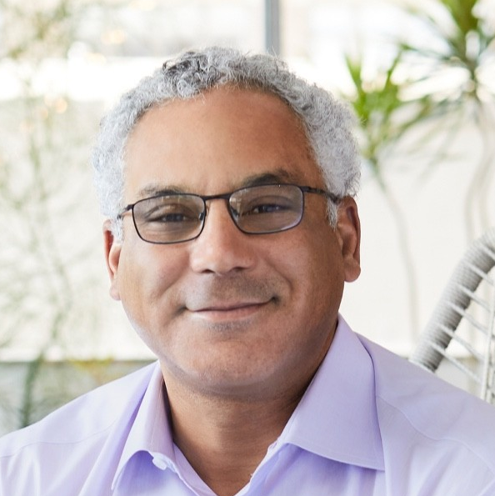
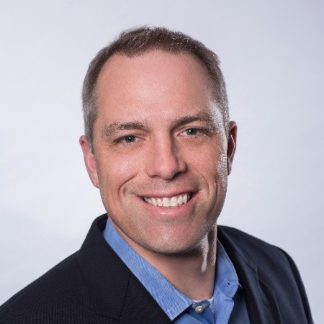
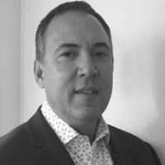
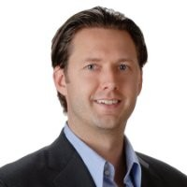
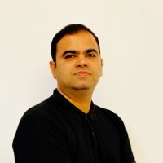
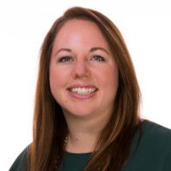
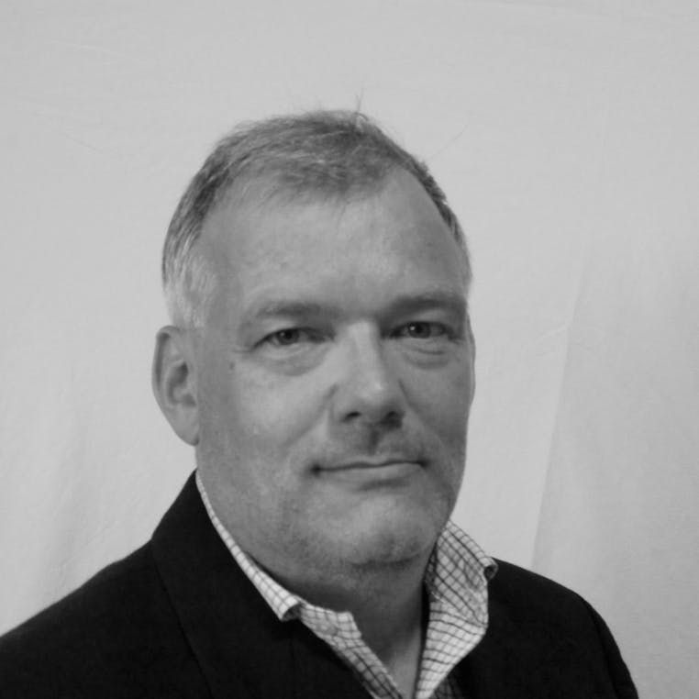
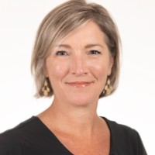
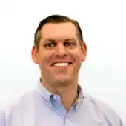
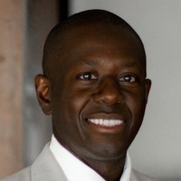
Team Leaders:
Yancey Spruill
Finance
CEO(2019-Present)
Strategy
Operations
HR
Revenue
Matt Steinfort
Jeffrey S. Guy
Matt Norman
Aaqib Gadit
Megan Wood
CFO(2023-Present)
C0O(2020-Present)
CPO(2020-Present)
CRO(2023-Present)
CSO(2022-Present)
Infrastructure
Communications
Legal
Architecture & Engineering
Nancy Coleman
Alan Shapiro
Chris Higgins
Senior VP Corporate Communications(2023-Present)
General Counsel(2017-Present)
Al Sene
VP, Infrastructure(2020-Present)
VP& GM of Architecture(2022-Present)

Slide 7
Recent Changes in company:
Jan 2023: Matt Steinfort appointed as the CFO of the company.
Jan 2023: Aaqib Gadit appointed as the CRO of the company.
April 2023: Nancy Coleman appointed as senior VP of the the corporate operations.
July 2023: DigitalOcean acquired Paperspace for $111 million.
Feb 2023: Premium Intel CPUs are now available for CPU-Optimized Droplets your own text here
May 2023: PostgreSQL is now available for database clusters

Slide 8
Thank you

